Slide 1
Fifteen Puzzle Game
By Keon Hee Park, Kenny Nguyen & Shittul Mona

Slide 2
Project Team
Keon Hee Park : Project Leader , designer and part of the coder .
Kenny Nguyen: Chief Programmer.
Shittul Mona : Tester

Slide 3
Description
The purpose of the game is to un-jumble all of the fifteen squares by moving couple squares. It is basically taking one square to the empty spot and move couple of the squares to different place .
The problem statement is after misplacing those squares how fast you can solve the game by putting those square back to the right place.

Slide 4
Functionality Of the project
Taking one of the puzzle sqaure to the blank square .
If you click shuffle, all the squares get suffled.
Click on random square to take them to right place to solve the game.
One you win the game , it gives you notification .

Slide 5
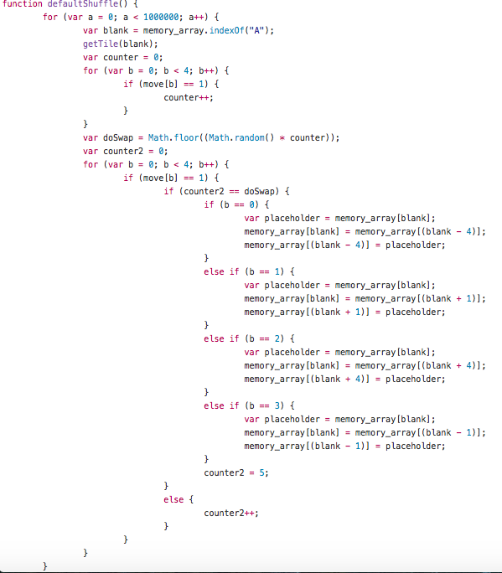
Code Snippet

Slide 6
Code Snippet

Slide 7
Demo

Slide 8
Q & A
Question ?

