Slide 1
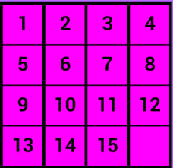
Fifteen Puzzle Game
Project members: Keon Hee Park, Kenny Nguyen & shittul Mona
Team leader: Keon Hee Park
Description: The purpose of the game is to un-jumble all of the fifteen squares by moving couple squares. It is basically taking one square to the empty spot and move couple of the squares to different places .
Course: Web Programming (CSC 4370)
Instructor: Louis Henry
Date: November 7th, 2016

Slide 2
Project Members
Programmers & Testers:
Keon Hee Park
Kenny Nguyen
Shittul Mona
Front-end Developer:
Kenny Nguyen
Keon Hee Park
Back-end Developer:
Kenny Nguyen
Keon Hee Park

Slide 3
User
Statement of Problem: The problem statement is after misplacing those squares how fast can you solve the game by putting those square back to the right place.
General Requirements
Inputs: User clicks the shuffle button to misplace the squares .
Outputs: The system displays misplaced squares and requires user to put those squares back to the right places.

Slide 4
Design
Overview of Solution:
Simple and Easy-to-Use interface
Key Design Features:
HTML, CSS, JAVASCRIPT and JQUERY
User Interface:
Web

Slide 5
Development
Programming Languages:
HTML, CSS, JVASCRIPT AND JQUERY
Database:
None. Text file.
Music:
? Soundtrack
Software Development Methodologies:
Extreme Programming (XP)
Development time: Tuesday to Saturday (November 1st^{th} to 5th)

Slide 6
Testing
Test Plan:
Make the board
Check if the swaps work
Check if the shuffle works
Data Used:
Tracking and Reporting Bugs:
refresh testing.

Slide 7
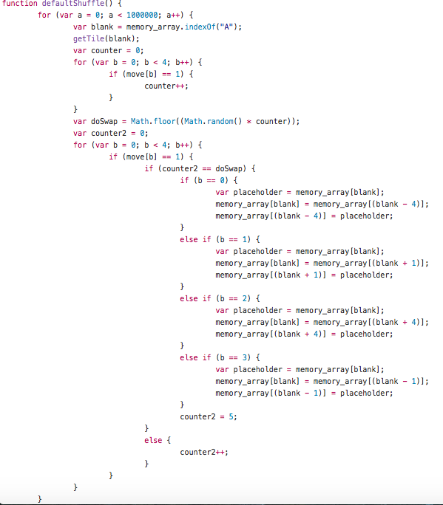
Code Display

Slide 8
Project Limitations and Future Possibilities
Better interactivity:
Ajax implementation
Other:

Slide 9
Questions?
We have the answers!

