Slide 1
Final Project Critical Design Review
Nguyen, Kevin

Slide 2
System Description
The system is a calculator that performs simple integer addition/subtraction and displays the result on an LCD display:
Inputs: The user shall provide keypad presses which are captured by the microcontroller's GPIO pins connected to the keypad
Function:
Each keypad input is decoded and identified as operator, operand, or command
Operators and operands are buffered and displayed on the LCD in real-time Operands are constructed from a series of digit keypresses.
An equal or operator command keypress instructs the ALU to perform the arithmetic operation.
Outputs: The LCD driver converts the ALU result into a binary format to be shown on the LCD display. GPIO functions are used to drive the pins connected to the LCD display.

Slide 3
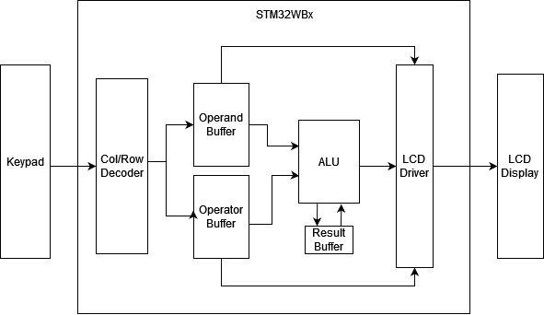
Overall System Block Diagram

Slide 4
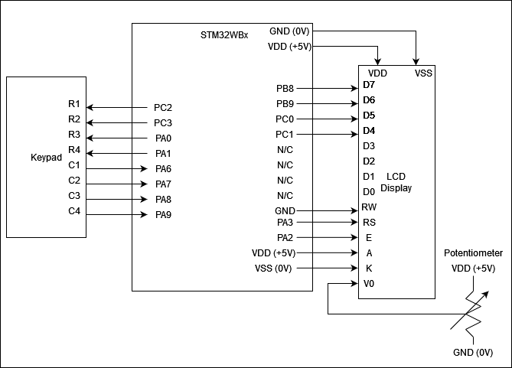
Overall System Schematic

Slide 5
Subsystems Overview
Keypad
4x4 array of keys which are connected to MCU
Decoder/Buffers
Decodes keypad inputs and stores into buffer
ALU
Performs integer addition/subtraction
LCD & GPIO Drivers
Converts strings into format that can be driven out on GPIO
LCD Display
Displays data on LCD screen and has a controller which can be configured into different modes of operation

Slide 6
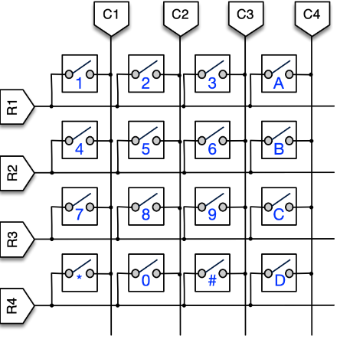
Keypad Subsystem
Description
A 4x4 array of switches where each row is connected to each column via a switch
Keypad has 4 row pins and 4 column pins
Inputs
User input, physical press of a key
Outputs
Row pins connected to MCU GPIO output pins
Column pins connected to GPIO input pins
GPIO input pins are configured as external interrupts
Keypad mapping: ​
"A": add ​
"B": subtract​
"C": clear​
"D": equate, perform operation​
"*": Shift display left
"#": Shift display right

Slide 7
Decoder & Buffers Subsystems
Decoder
Inputs:
Column pins generate an external interrupt in the program
Outputs:
Row pins are driven to known values
Decoded keypress string
Buffers
Inputs:
A series of digit keypresses
Outputs:
Operands are constructed by buffering a series of digit keypresses until an operator key is pressed

Slide 8
Arithmetic Logic Unit (ALU) Subsystem
Description
Performs specified addition or subtraction on integer operands
Provides result to LCD display driver
Inputs
Operand, Operator, and Result register
Function
First calculation require two operands
Result is stored in register
Subsequent calculations use current operand and result register
Outputs
Integer operation result converted into a string format
Sent to LCD driver block

Slide 9
LCD Driver Subsystem
Description
Displays operands, operators and operation result on LCD display in real-time
Inputs
String-formatted operands and operators
Operation result from ALU
Function
Initializes the LCD display microcontroller into 4-bit mode
Converts string inputs into an 8-bit binary value which is separated into two 4-bit commands sent to the LCD display
Outputs
Two 4-bit messages starting with the four MSBs
Sets RS pin high and data pins using the 4-bit input values
Pulses EN pin on LCD display to clock in each 4-bit message

Slide 10
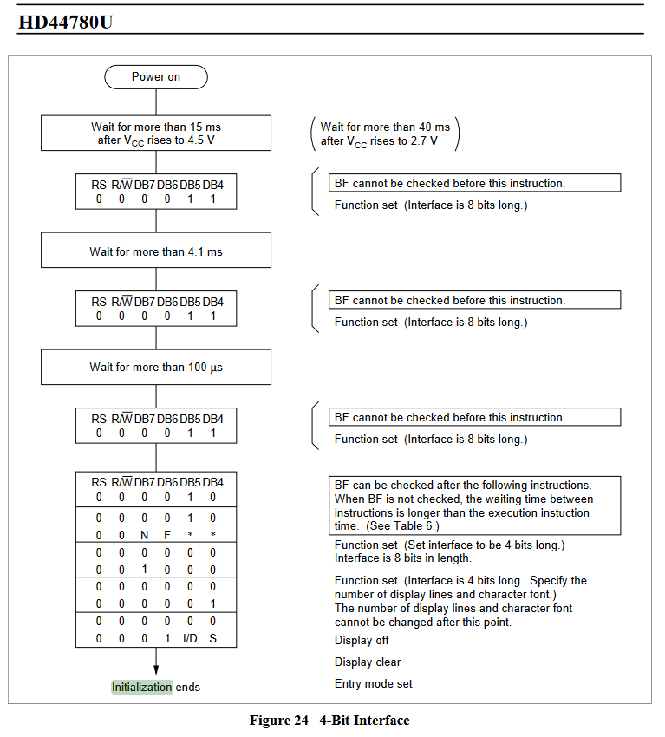
LCD Initialization
Had to insert delays between commands to LCD
Set cursor to blinking mode using entry mode set instruction
Set to 4-bit mode which only requires upper 4 data pins (DB7-DB4)

Slide 11
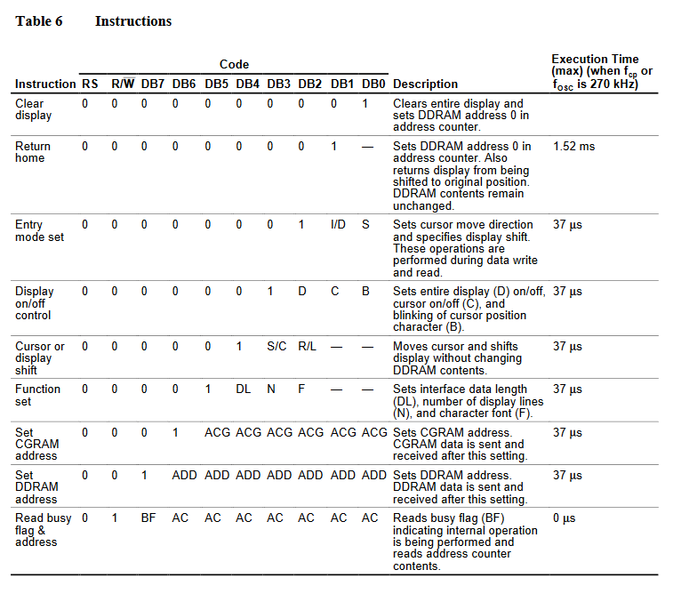
LCD Message Instructions
#ifndef LCD16X2_H_
#define LCD16X2_H_
#include "stm32wbxx_hal.h"
//-----[ Prototypes For All Functions ]-----
void LCD_Init(); // Initialize The LCD For 4-Bit Interface
void LCD_Clear(); // Clear The LCD Display
void LCD_SL(); // Shift The Entire Display To The Left
void LCD_SR(); // Shift The Entire Display To The Right
void LCD_CMD(unsigned char); // Send Command To LCD
void LCD_DATA(unsigned char); // Send 4-Bit Data To LCD
void LCD_Set_Cursor(unsigned char, unsigned char); // Set Cursor Position
void LCD_Write_Char(char); // Write Character To LCD At Current Position
void LCD_Write_String(char*); // Write A String To LCD
void LCD_Home(); // Returns display to original position
void LCD_Set_Auto_Shift(int); // Configures display to automatically shift with cursor.
#endif /* LCD16X2_H_ */

Slide 12
LCD Display
Description
Displays input operands/operators and results in real-time
Input Pins:
D0 – D7 : 8 data pins which will be applied to LCD internal registers
RS : selects whether the input data is sent to the command or data registers
E : enable pin is pulsed to shifts in values set on the data pins
V0 : controls the contrast level of LCD display when connected to potentiometer
A and K pins : provides power to the LCD backlight, A is connected +5V and K is grounded
VSS/VDD pins: power and ground for LCD internal controller connected to +5V and ground

Slide 13
Handling Consecutive Inputs
We perform additional calculations without the need for '=' key press. The following example demonstrates how the LCD would display multiple operand inputs after the first calculation:
No result displayed on Line 2 of LCD yet.
LCD Line 1: <operand_1><operator_1><operand_2>
LCD Line 2:
Pressing another operator on keypad <operator_2> triggers result from previous equation to be displayed
LCD Line 1: <operand_1> <operator_1> <operand_2> <operator_2>...
LCD Line 2: <result_1>
Same thing for each additional operator/operand added
LCD Line 1: ... <operand_2> <operator_2><operand_3><operator_3>
LCD Line 2: <result_2>

Slide 14
Integration Plan and Schedule
Keypad => Decoder Interface
Verify decoder captures/converts keypad inputs in ASCII and string formats
Decoder => Buffer Interface
Decoder shall fill buffer with keypresses to construct each operand
Decoder shall store the operator value to handle when # of operands > 2
Buffers => ALU Interface
Develop conditions for when buffer will provide ALU with inputs
Buffer => LCD Driver/Display
Buffers shall provide keypress inputs to the LCD driver in real-time for display
ALU => LCD Driver/Display
Verify ALU result correctly displayed on LCD
System-Level Integration
Test unique input combinations and corner cases

Slide 15
Prototyping Plan and Schedule
Keypad Input (~1 hour)
Read and buffer keypad inputs and identify operands/operators
Keypad mapping: "A": addition, "B": subtraction, "C": clear, "D": equals
Decoder & Buffers (~5 hours)
More difficult part was coming up with scheme to signal when an operand is "constructed" from individual keypress inputs
ALU (~2-3 hours)
Verify integer addition and subtraction operation
Check for overflow/underflow ALU result conditions
LCD Display/Driver (~10 hours)
Verify proper use of control signals (RS, R/W, and Enable)
Develop LCD driver block to handle conversion of input strings into GPIO commands

Slide 16
Parts List
Part Number | Quantity | Part Name | Subsystem
3647-LCD16022x16Blue-White-ND | 1 | LCD 1602 2x16 Blue-White | LCD Display
n/a | 1 | Solderless Breadboard | LCD Display
1993-1066-ND | 1 | Potentiometer | LCD Display
497-NUCLEO-WB55RG-ND | 1 | STM32 Nucleo-64 Development Board | Address Decoder ALU LCD Driver
2333119 | 1 | Membrane Switch Module | Keypad

Slide 17
Risks
Risk | Level | Mitigation
How will overflow/underflow ALU results be handled? | Medium | Limited by range of values that an integer type can represent in C (-32,768 to 32,767)
How will simultaneous keypad presses be handled? | Low | Software de-bouncing wait time can be increased in the main program to mitigate this issue.
'Clear' operator not identified as part of requirements. | Medium | Will likely implement and evaluate necessity of a 'clear' key to empty display and buffer.
Determine if 'V0' pin needs to be connected on LCD display. | High | Determined that this pin is used to control contrast of LCD display, which is required for visibility of characters. Requires connection to potentiometer to control input voltage.
Risk Levels:
Low: Little to no operational impact
Medium: Some loss of functionality
High: Catastrophic, no functionality or potential damage to design

Slide 18
Copyright The Johns Hopkins University 2022. All rights reserved.

