Slide 1
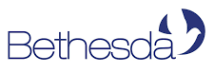

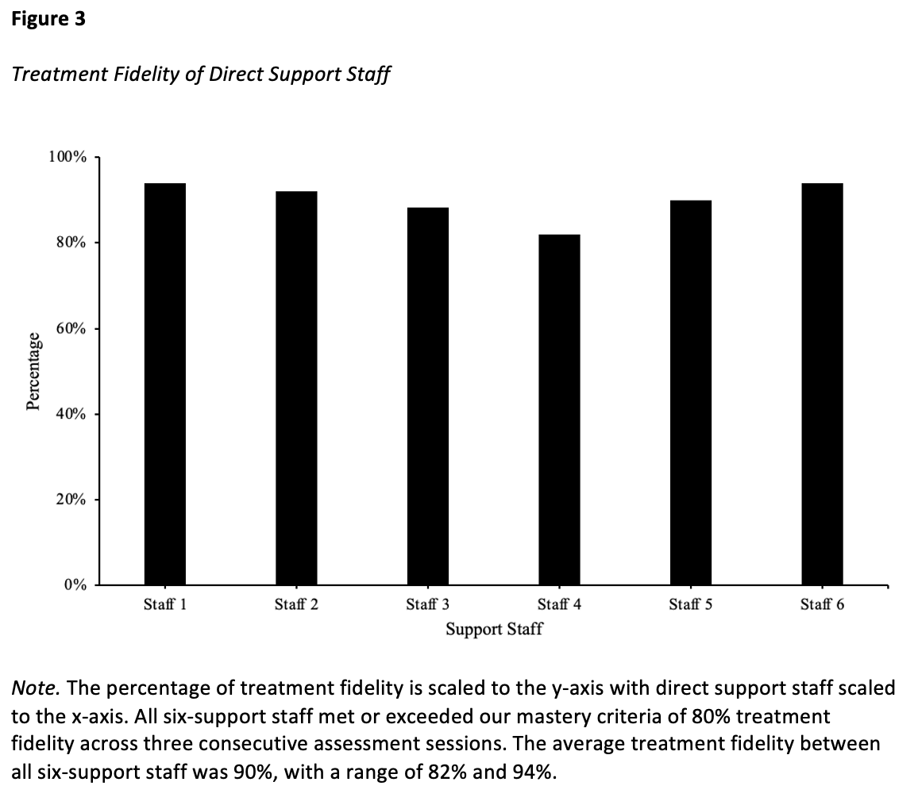
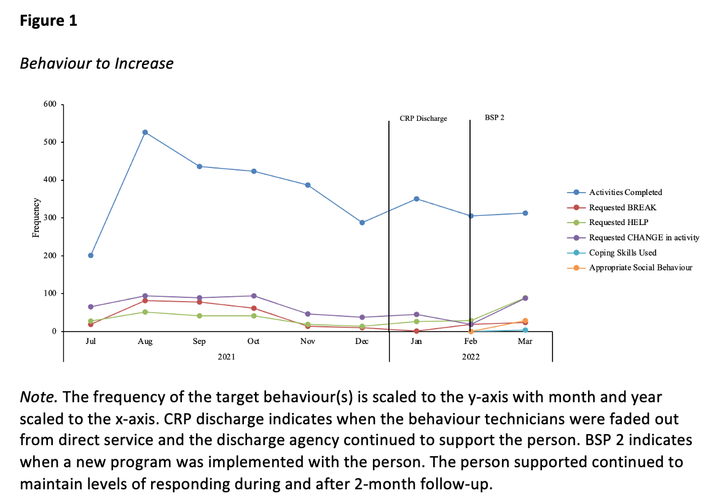
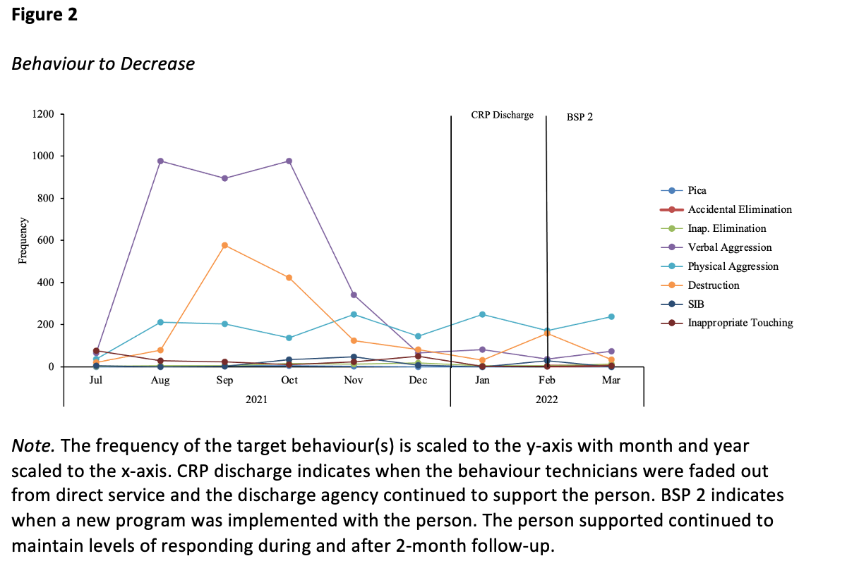
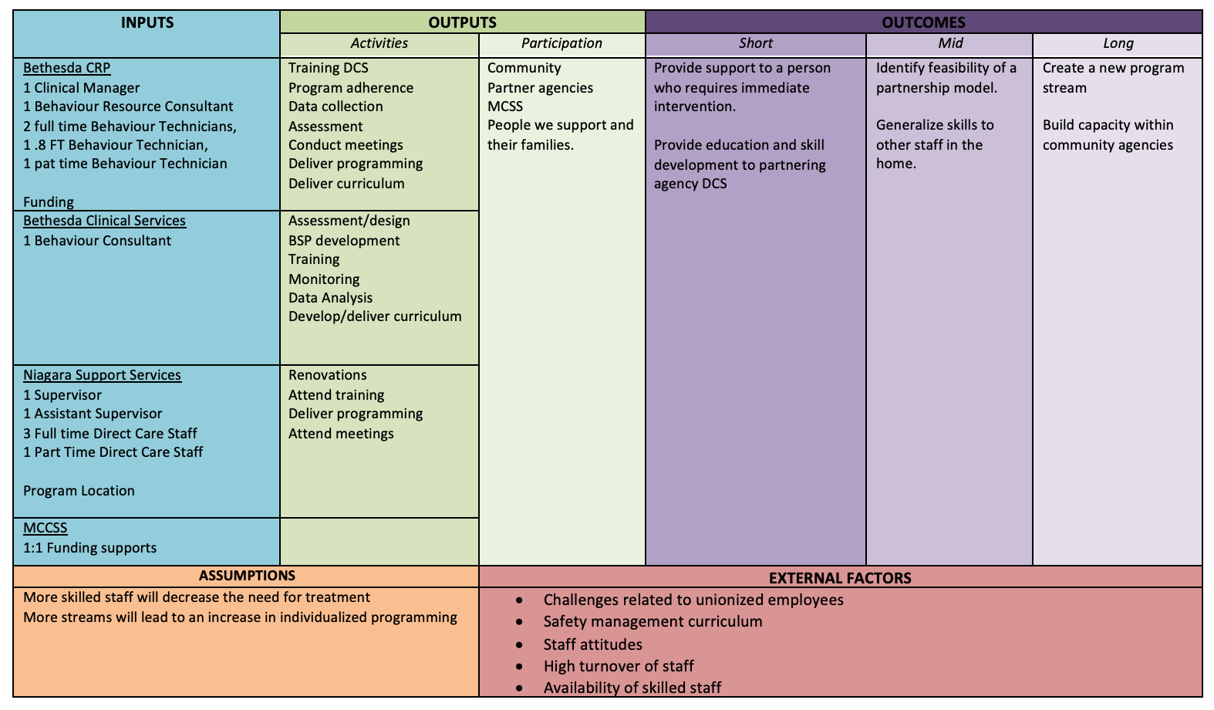
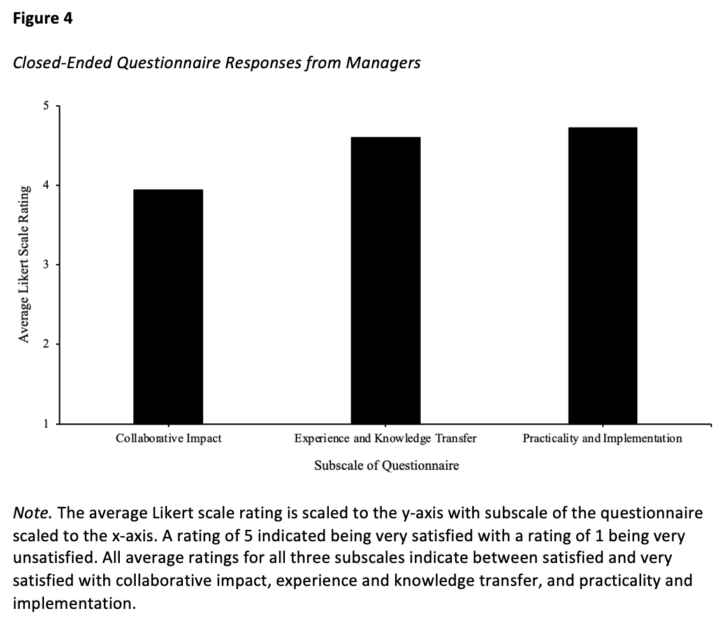
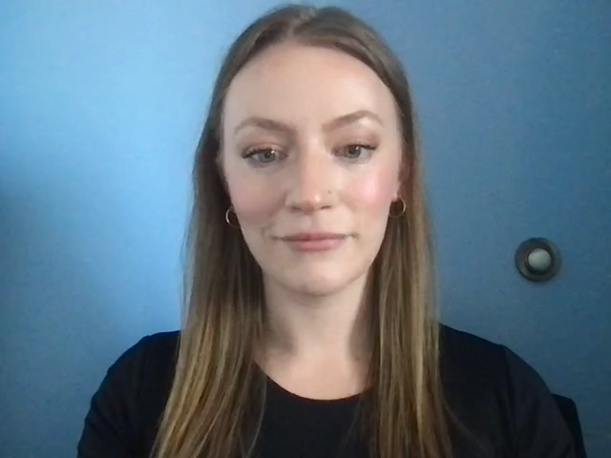
Evaluating the Efficacy of a Mobile Treatment Team: A Collaborative Effort
Autumn Kozluk*, Shawna Gain, and Jacqueline Colosimo
Bethesda Services, Ontario, Canada
Contact: akozluk@bethesdaservices.com
Introduction
Data Extraction
Support Staff Results
The residential treatment program (RTP) is designed for short term intensive behavioural and residential care for adults with developmental disabilities who engage in severe challenging behaviour.
After completion of the program persons’ are discharged to their permanent residence, however a common concern amongst caregivers, persons’, and agencies is the lack of generalization of both skill acquisition and behaviour reduction upon formal discharge, as well as the lack of support and adequate training in the discharge environment.
In order to combat this, the mobile treatment team was trialed with a person who engages in severe challenging behaviour and was experiencing residential breakdown. A collaborative effort between two agencies allowed the intensive behavioural supports from the RTP to be implemented in the person’s new residence, as opposed to transferring the person to the RTP and thereafter discharged to the agency.
The goals of this evaluation was to create a stable environment for the individual, provide intensive behavioural supports to reduce challenging behaviour and increase alternative appropriate behaviour, build capacity within the discharge agency to maintain results achieved, and generalize and maintain skills for the person as well as the discharge agency support staff.
After conducting the support staff interviews and administering managerial and caregiver questionnaires, key trends and themes were analyzed in order to create a fulsome analysis.
To assess individual gains, the persons’ graphs were visually inspected to discern reliable patterns, level, and trends.
Results indicated that the knowledge and competency of the direct care staff support the results of the managerial interviews in that five out of six staff scored 100% on their knowledge-based interviews, with all six staff scoring 80% or higher.
Treatment fidelity scores reflect competency in implementation of the program, with all support staff scoring 80% or higher.
Individual Results
Results indicated that the implementation of the intensive behavioural supports were effective in producing and maintaining low rates of challenging behaviour during the project and after a 2-month follow-up.
Discussion and Future Directions
The evaluation aimed to better understand the feasibility and effectiveness of a mobile treatment team collaborating with an outside agency and the impact of creating capacity within the discharge environment.
Results were supportive of the project and indicate that this type of model can be used to create capacity within community agencies.
The success of this type of program could reduce waitlist times, potentially reduce the likelihood of system involvement, promote cost efficiency in the long-term implementation of the program, and build interagency collaboration and person-centered care.
A limitation of the project was inter-agency communication. Managers and staff reported that often communication and what was shared to each team was not clear. Going forward, it would be advantageous to set up collaborative team meetings to share pertinent information to both teams at the same time.
Logic Model
Managerial Interview Results
Results from the managerial interviews from both agencies identified that staff knowledge, capacity, competency, and expertise was significantly increased throughout the implementation of the project.
All three manager respondents indicated that they were extremely satisfied with the program meeting expectations and that the goals of the program were met and completed in a timely manner.
The persons’ gains were evaluated by the success of the intensive behavioural support
The support staff’s knowledge and capacity was assessed throughout the implementation and 2 months post completion of the program.
Managers of both agencies were given a social validity questionnaire regarding their experience and their staff’s growth and experience
The person’s caregivers were administered a social validity questionnaire to assess their experience and the person’s growth throughout the process. Results are unavailable at this time.
All three manager respondents indicated that they were extremely satisfied with the overall experience working alongside the mobile treatment team and indicating that all staff on their agency team gained valuable skills and experiences as a result of the program and staff continued to maintain those skills as the behaviour technicians faded out.
In the open-ended questions, multiple managers indicated that the mentorship within the direct support staff but also across the entire team throughout the residential setting was a direct reflection of the program and the skills gained from the behaviour technicians.

