Slide 1
Participation Affects SAT Test Scores
Nicholas Nguyen

Slide 2
What is the problem?
Average state test scores are decreasing!

Slide 3
Why aim to increase test scores?
Progression within education (teachers, students, school system)
Better representation of schools
High test scores → better grades → merit scholarships

Slide 4
Procedure
Identify which states have a decreasing average test score by looking at the rate of change of total scores
The data provided will show how participation correlates to states with decreasing average test scores.
This presentation will show which states need to change their policies in order to increase average state test scores.

Slide 5
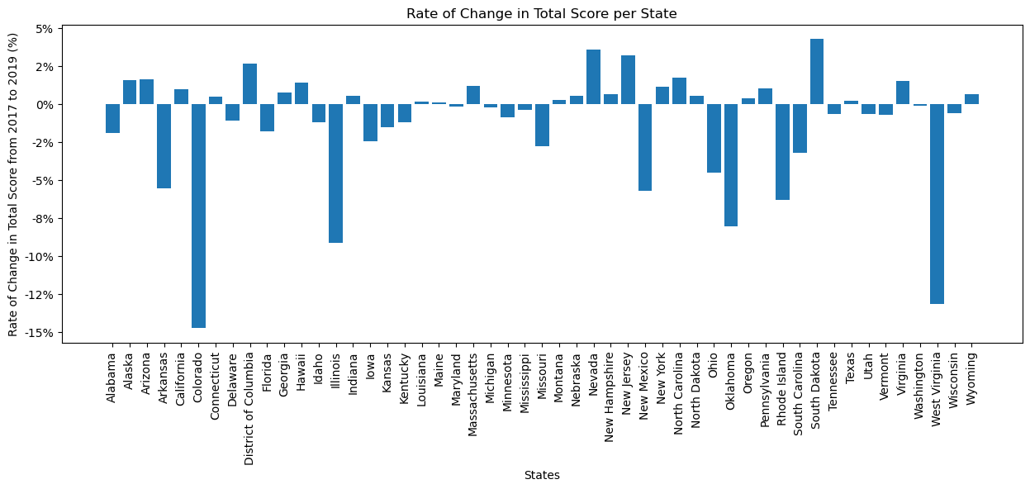
States With Decreasing Test Score Rates from 2017 to 2019
Colorado, Illinois, Oklahoma, Rhode Island, West Virginia

Slide 6
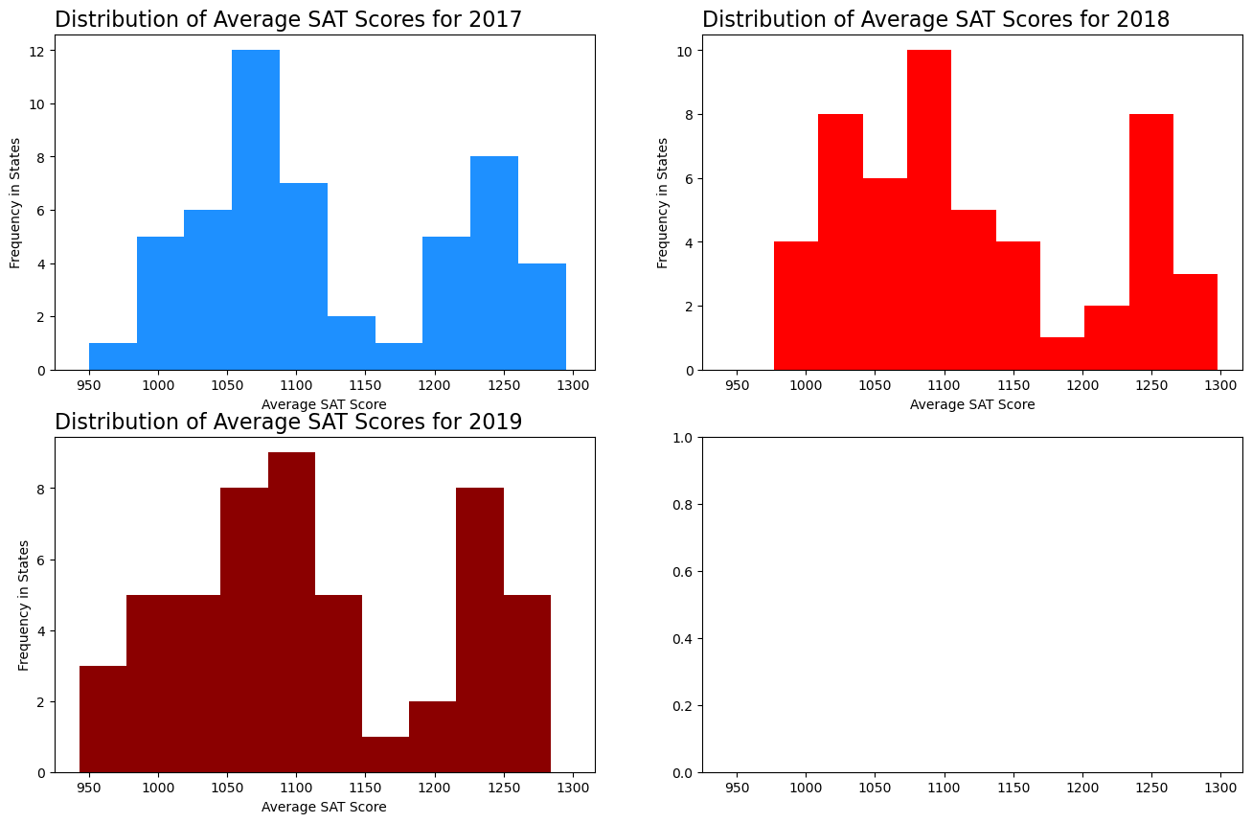
How do the test scores change over time?
Avg SAT Scores
2017 - 1126
2018 - 1120
2019 - 1113
An increase of frequency in lower avg SAT scores occurred

Slide 7
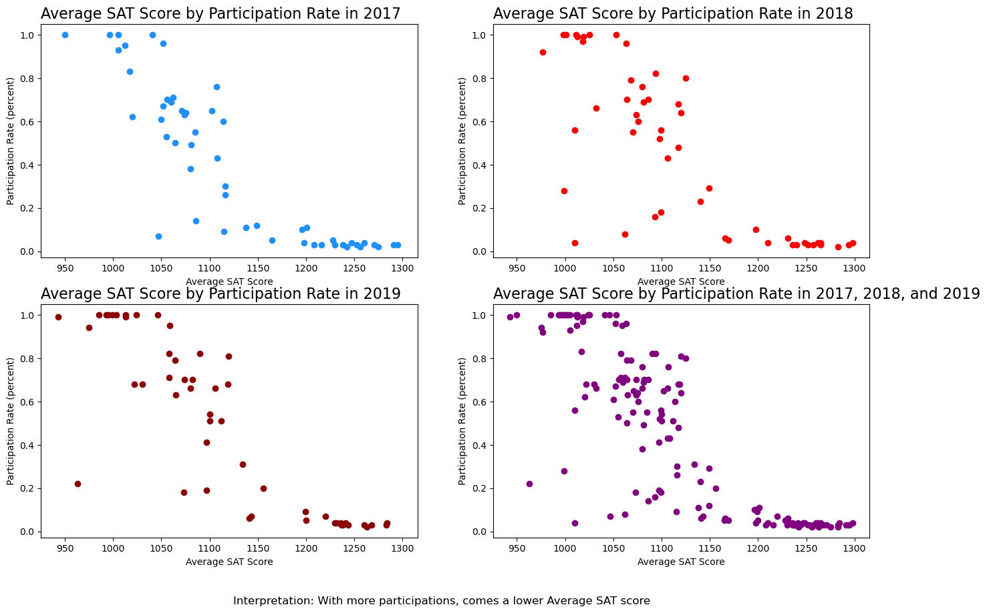
As participation increased for the SAT from 2017 to 2019, total average scores decreased

Slide 8
So what is the solution for these states?
Colorado, Illinois, Oklahoma, Rhode Island, West Virginia
Lower Participation =
Higher Test Scores

Slide 9
We can improve test scores in schools by…
Allowing optional SAT test taking
Upcharging the SAT test
Require students with higher GPA’s to take the SAT

Slide 10
Thank you for listening!
Sources: SAT Scores, Matplotlib, Python

