Slide 1

Amrutvahini college of engineering, Sangamner
By
Mr. Dattatraya Jankiram Katkhade
Miss. Rituja Yogesh Puranik
Mr. Owes Noormahemud Shaikh
Miss. Swapnali Raosaheb Jawale
Under Guidance of
Prof. A. D. Gawali

Slide 2
Simulation-Based Learning System for Data Structures and Algorithms

Slide 3
Abstract
Complex Algorithms
Visualization using Animation
Necessary of Visualization
Core Concepts
High thinking Capacity
Problem Solving Skill
Future Algorithms Growth

Slide 4
Objectives
To Design and Develop Online Browser-based Application which can be used by Students or Teachers for simulation-based visualization of Data Structures and Algorithms.
Each topic having separate MCQ test for the perfect understanding of Data Structures and Algorithms.

Slide 5

Registration Page

Slide 6

Login Page

Slide 7
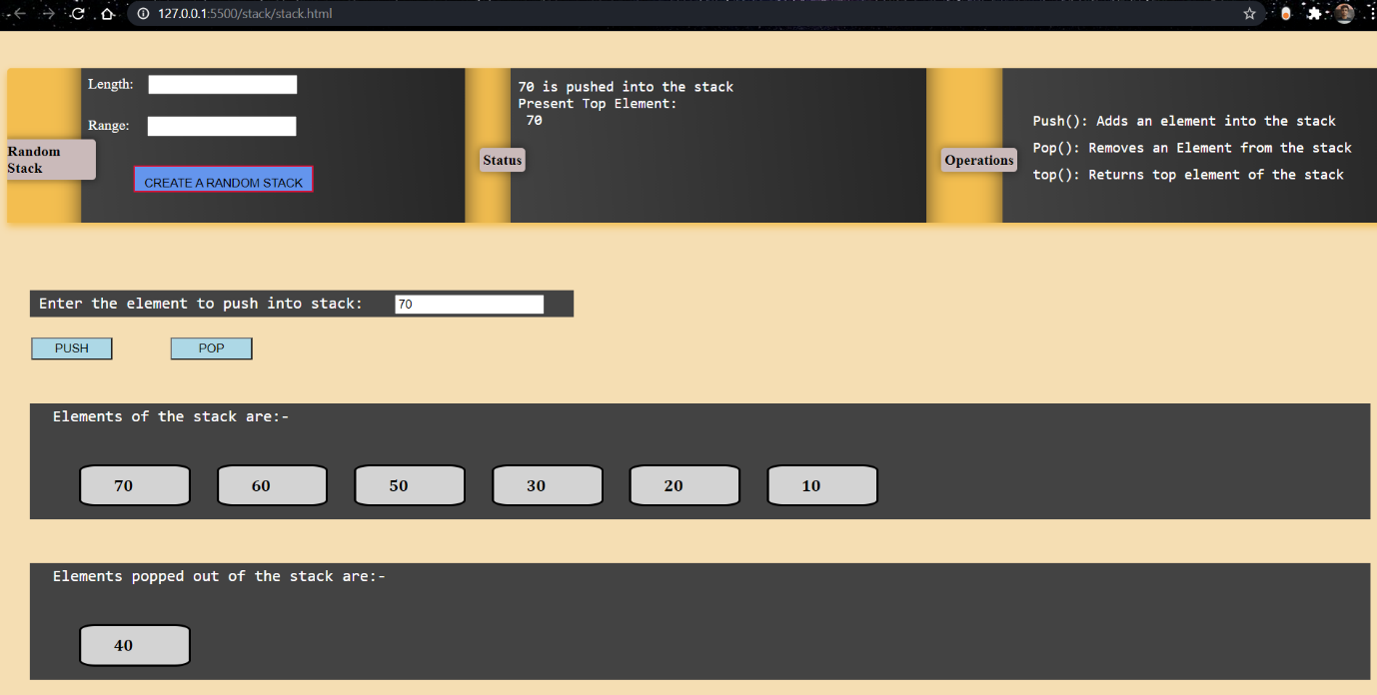
Stack Visualizer

Slide 8
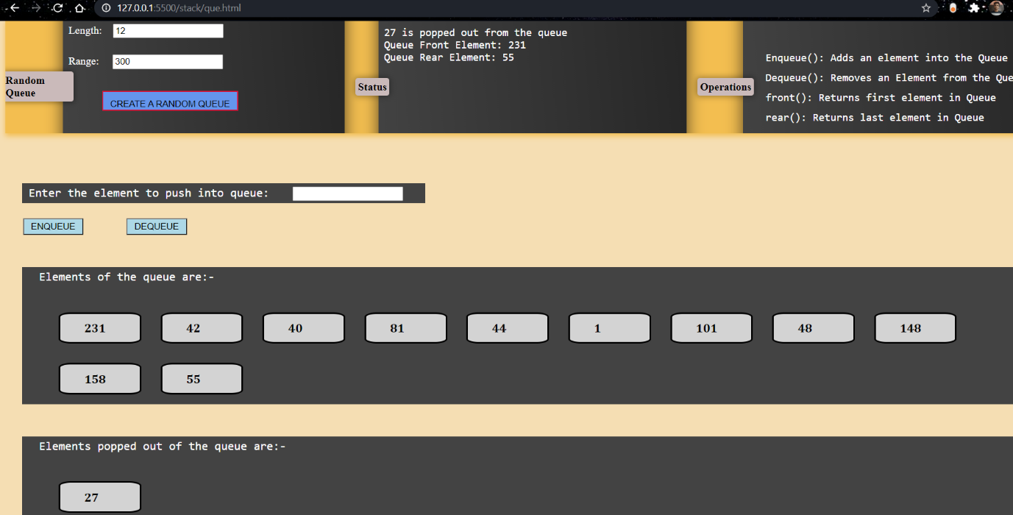
Queue Visualizer

Slide 9
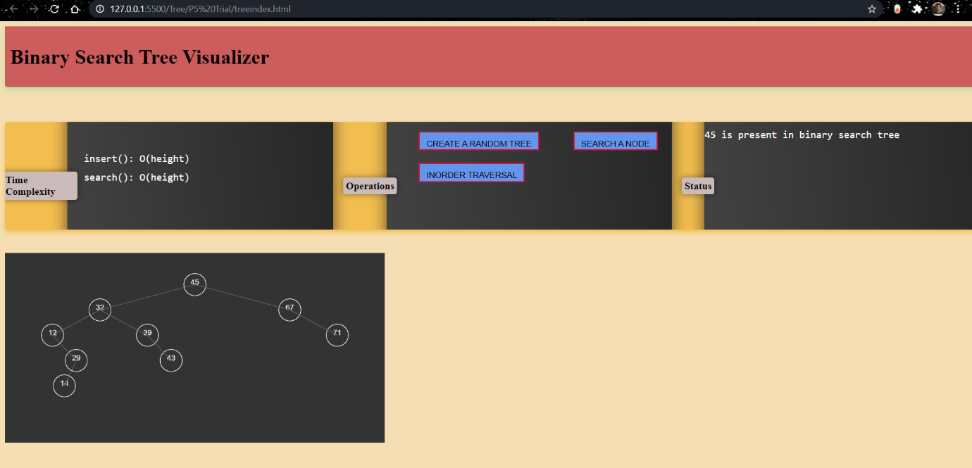
Binary Search Tree Visualizer

Slide 10
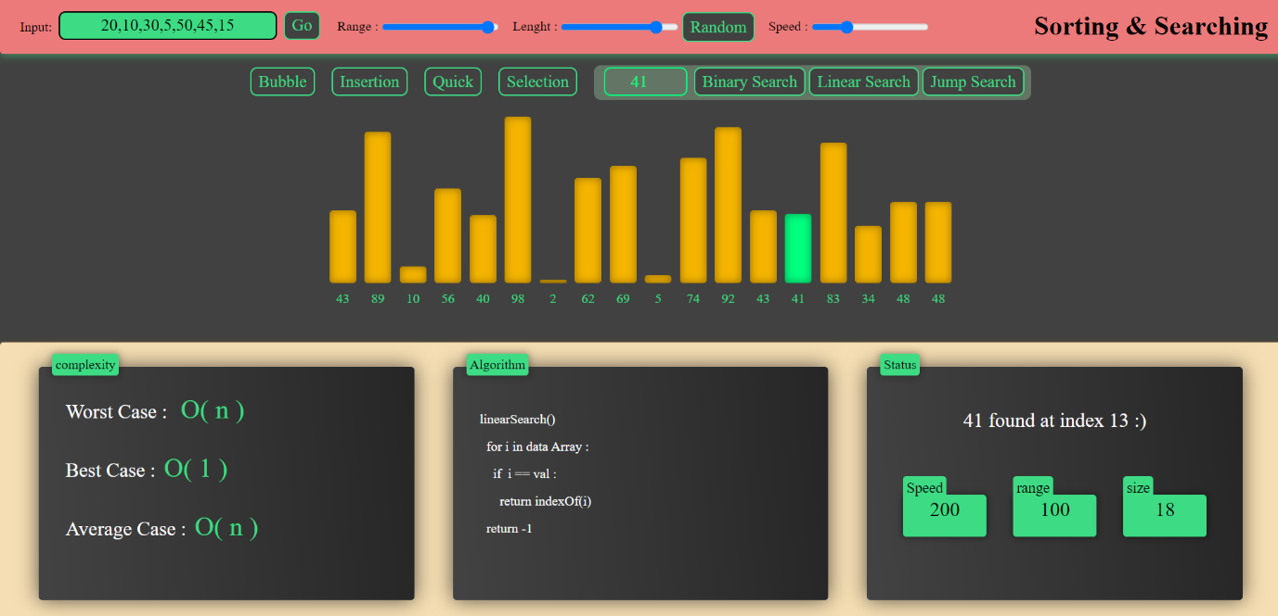
Searching & Sorting Visualizer

Slide 11
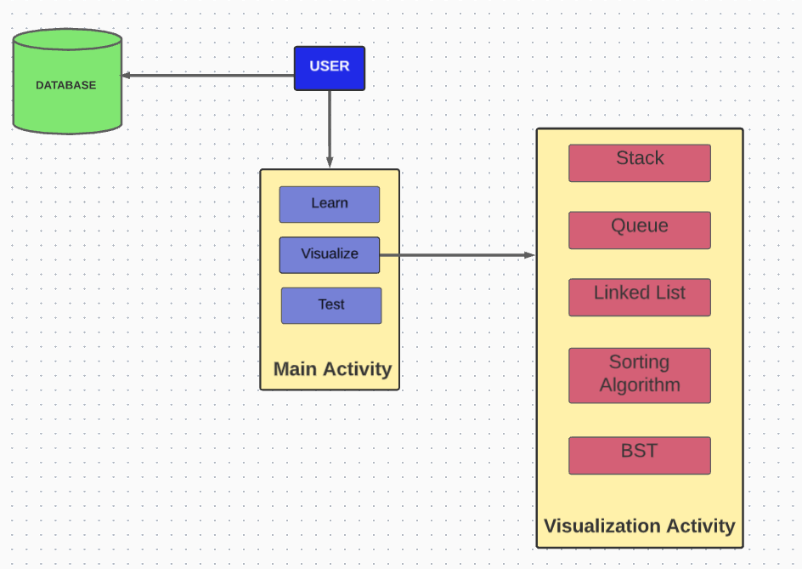
Design Architecture

Slide 12
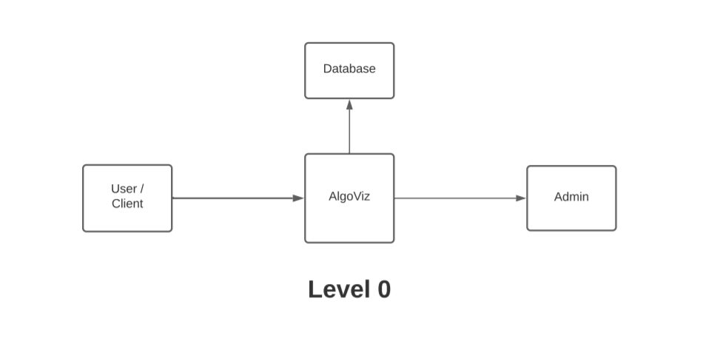
Level-0 Data Flow Diagram

Slide 13
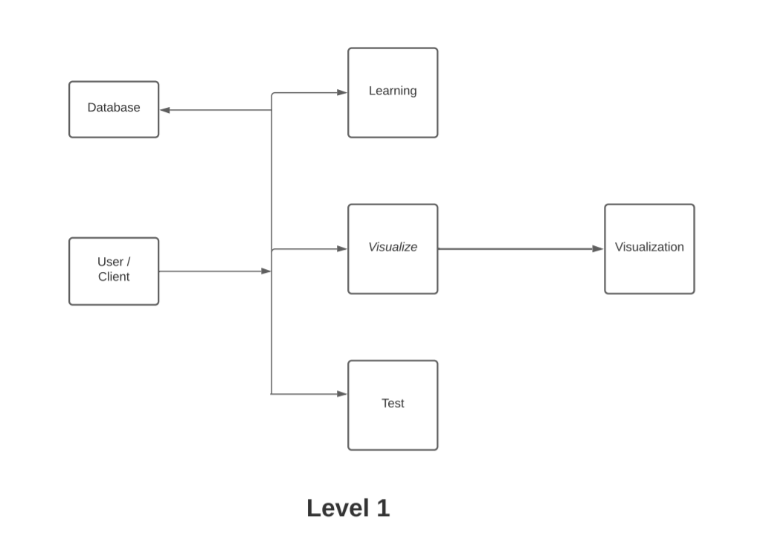
Level-1 Data Flow Diagram

Slide 14
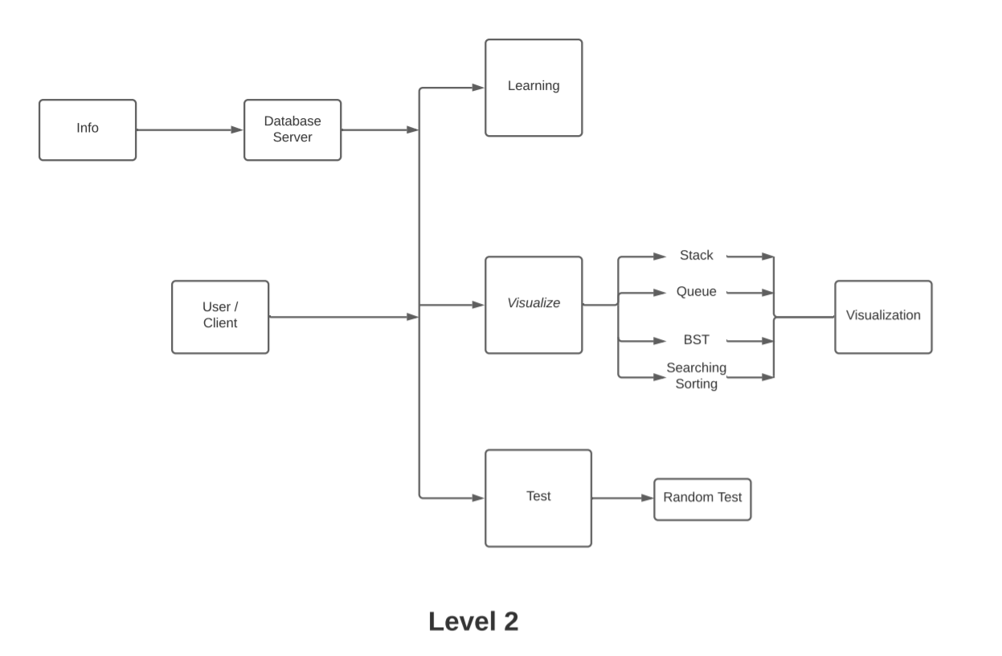
Level-2 Data Flow Diagram

Slide 15
Technical Specifications
Operating Systems:
Windows, RedHat Linux
Software Requirements:
Visual Studio Code, MongoDB Compass
Languages used for Front-end:
HTML, CSS, JavaScript, p5.js library
Back-end:
Node JS, Express Framework, MongoDB Server, Kubernetes

Slide 16
Conclusion
Algorithm visualization can be seen as a valuable supporting tool, used in addition to standard ways of education in the field of computer science.
This tool can be used as an effective supplement to the traditional classroom education and textbook for Data Structures and Algorithms course.

Slide 17
THANK YOU..!

