Slide 1

Unit-4
Synchronization
Distributed System (DS)
GTU #3170719
Prof. Umesh H. Thoriya
Computer Engineering Department
umesh.thoriya@darshan.ac.in
9714233355

Slide 2

Looping
Topics to be covered
  Clock Synchronization
  Logical Clocks
  Mutual Exclusion
  Global Positioning Of Nodes
  Election Algorithms

Slide 3
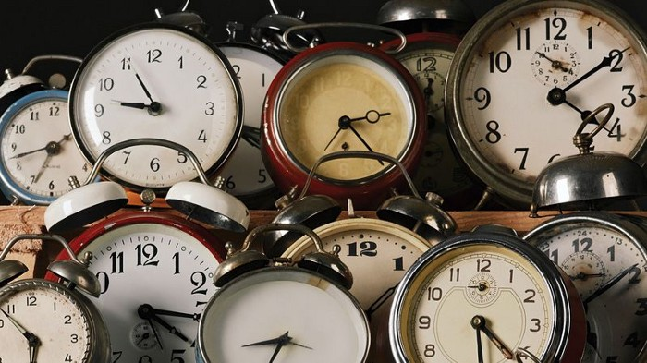
Synchronization

Slide 4
Synchronization
Until now, we have looked at:
    How entities communicate with each other
    How entities are named and identified
In addition to the above requirements, entities in DSs often have to cooperate and synchronize to solve a given problem correctly
    E.g., In a distributed file system, processes have to synchronize and cooperate such that two processes are not allowed to write to the same part of a file

Slide 5


Need for Synchronization – An Example
Vehicle tracking in a City Surveillance System using a Distributed Sensor Network of Cameras
    Objective: To keep track of suspicious vehicles
    Camera Sensor Nodes are deployed over the city
    Each Camera Sensor that detects a vehicle reports the time to a central server
    Server tracks the movement of the suspicious vehicle
1:12 PM:
Car spotted
1:08 PM:
Car spotted
1:05 PM:
Car spotted
1:16 PM:
Car spotted
If the sensor nodes do not have a consistent version of the time, the vehicle cannot be reliably tracked
1:15 PM:
Car spotted
1:25 PM:
Car spotted
3:00 PM:
Car spotted
1:00 PM:
Car spotted
1:17 PM:
Car spotted
1:18 PM:
Car spotted

Slide 6
Need for Synchronization – An Example
Writing a file in a Distributed File System
Write data1 to file abc.txt at offset 0
Client A
Server
Client C
Distributed
File
abc.txt
Write data3 to file abc.txt at offset 1
Client B
Write data2 to file abc.txt at offset 1
  If the distributed clients do not synchronize their write operations to the distributed file, then the data in the file can be corrupted

Slide 7
Clock Synchronization
Clock synchronization is a mechanism to synchronize the time of all the computers in a DS
It is often important to know when events occurred and in what order they occurred.
  Need to know when a transaction occurs.
  Online reservation system.
  E-mail sorting can be difficult if time stamps are incorrect.
In a non-distributed system dealing with time is trivial as there is a single shared clock, where all processes see the same time.
In a distributed system, on the other hand, each computer has its own clock.
Because no clock is perfect each of these clocks has its own skew which causes clocks on different computers to drift and eventually become out of sync.
  In centralized system, time is unambiguous
  In distributed system, time is not trivial

Slide 8
Coordinated Universal Time (UTC)
All the computers are generally synchronized to a standard time called Coordinated Universal Time (UTC)
    UTC is the primary time standard by which the world regulates clocks and time
UTC is broadcasted via the satellites
    UTC broadcasting service provides an accuracy of 0.5 msec
Computer servers and online services with UTC receivers can be synchronized by satellite broadcasts
    Many popular synchronization protocols in distributed systems use UTC as a reference time to synchronize clocks of computers

Slide 9
Tracking Time on a Computer
How does a computer keep track of its time?
    Each computer has a hardware timer
    The timer causes an interrupt ‘H’ times a second
    The interrupt handler adds 1 to its Software Clock (C)
    Issues with clocks on a computer
    In practice, the hardware timer is imprecise
It does not interrupt ‘H’ times a second due to material imperfections of the hardware and temperature variations
The computer counts the time slower or faster than actual time
    Loosely speaking, Clock Skew is the skew between:
The computer clock and the actual time (e.g., UTC)

Slide 10




Clock Skew
Clock Skew: Difference between two clocks at one point in time.
When the UTC time is t, let the clock on the computer have a time C(t)
Three types of clocks are possible
  Perfect clock:
    The timer ticks ‘H’ interrupts a second
    dC/dt = 1
  Fast clock:
    The timer ticks more than ‘H’ interrupts a second
    dC/dt > 1
  Slow clock:
    The timer ticks less than ‘H’ interrupts a second
    dC/dt < 1
$$\frac{dC}{dt}>1$$
$$\frac{dC}{dt}=1$$
15
Perfect clock
Fast Clock
10
Clock time, C_{p}(t)
Slow Clock
7
$$\frac{dC}{dt}<1$$
0
10
UTC, t
UTC= Coordinated Universal Time

Slide 11



Clock Skew
Frequency of the clock is defined as the ratio of the number of seconds counted by the software clock for every UTC second
Frequency = dC/dt
Skew of the clock is defined as the extent to which the frequency differs from that of a perfect clock
Skew = dC/dt – 1
Hence,
$$\frac{dC}{dt}>1$$
$$\frac{dC}{dt}=1$$
15
Perfect clock
Fast Clock
10
Clock time, C_{p}(t)
Slow Clock
7
$$\frac{dC}{dt}<1$$
0
10
UTC, t

Slide 12

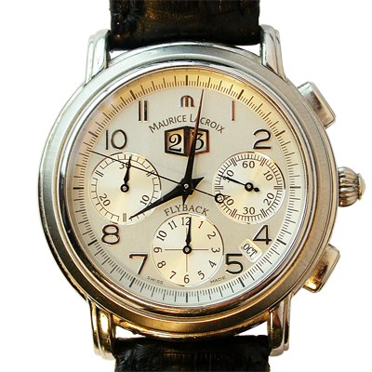
Drifting of Clock
Synchronization techniques
    External Synchronization : Synchronization with real time (external) clocks.
    Mutual (Internal) Synchronization : For consistent view of time across all nodes of the system
8:01:24
8:01:48
Skew = +84 seconds
+84 seconds/35 days
Drift = +2.4 sec/day
Oct 23, 2016
8:00:00
Skew = +108 seconds
+108 seconds/35 days
Drift = +3.1 sec/day

Slide 13
Dealing with Drift
Assume we set computer to true time. (It is not good idea to set clock back.)
    Illusion of time moving backwards can confuse message ordering and software development environments.
There should be go for gradual clock correction.
    If fast: Make clock run slower until it synchronizes.
    If slow: Make clock run faster until it synchronizes.
Operating System can change rate at which it requests interrupts.
    if system requests interrupts every 14 msec but clock is too slow: request interrupts at 12 msec.
Software correction: Redefine the interval.

Slide 14
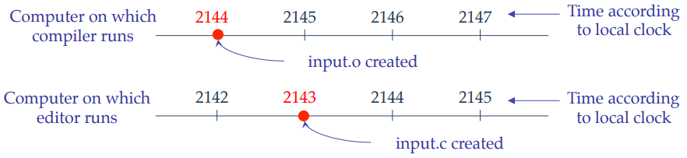
Dealing with Drift
In a distributed system, achieving agreement on time is not easy.
Assume no global agreement on time. Let’s see what happens:
Assume that the compiler and editor are on different machines
output.o has time 2144 msec
output.c is modified but is assigned time 2143 msec because the clock on its machine is slightly behind.
Make will not call the compiler.
The resulting executable will have a mixture of object files from old and new sources.

Slide 15
Physical Clocks
It is impossible to guarantee that crystals in different computers all run at exactly the same frequency. This difference in time values is clock skew.
“Exact” time was computed by astronomers
    The difference between two transits of the sun is termed a solar day.
    Divide a solar day by 24*60*60 yields a solar second.
However, the earth is slowing! (35 days less in a year over 300 million years)
There are also short-term variations caused by turbulence deep in the earth’s core.
    A large number of days (n) were used to the average day length, then dividing by 86,400 to determine the mean solar second.

Slide 16
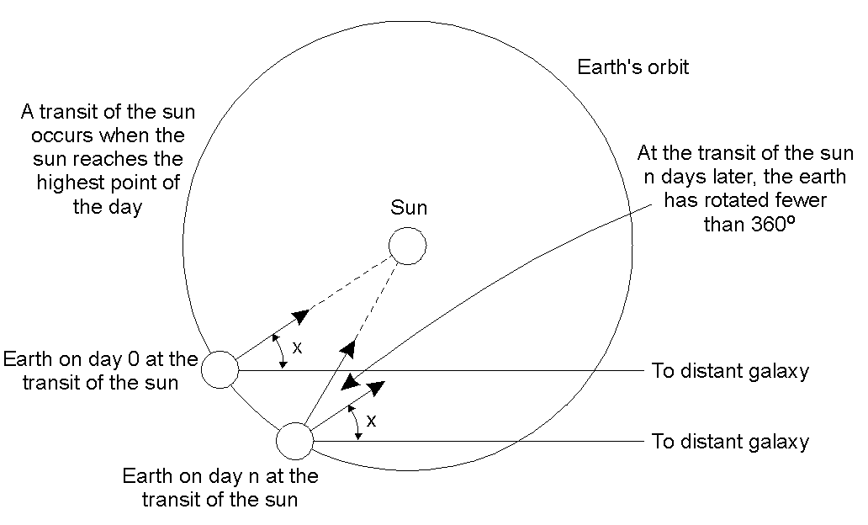
Physical Clocks
Computation of the mean solar day.

Slide 17
Physical Clocks
How Computer Clocks Are Implemented ?
A computer clock usually consists of three components
    A quartz crystal that oscillates at a well-defined frequency,
    A constant register - used to store a constant value that is decided based on the frequency of oscillation of the quartz
    A counter register - is used to keep track of the oscillations of the quartz crystal.
The value in the counter register is decremented by 1 for each Oscillation of the quartz crystal. When the value of the counter register becomes zero, an interrupt is generated and its value is reinitialized to the value in the constant register.
Each interrupt is called a clock tick.

Slide 18


Synchronization to a time server
Suppose a server with an accurate clock (e.g., GPS-receiver)
    Could simply issue an RPC to obtain the time:
But this doesn’t account for network latency
    Message delays will have outdated server’s answer
Client
Server
Time of day?
2:50 PM
Time ↓

Slide 19
Cristian’s Algorithm
Flaviu Cristian (in 1989) provided an algorithm to synchronize networked computers with a time server
The basic idea:
    Identify a network time server that has an accurate source for time (e.g., the time server has a UTC receiver)
    All the clients contact the network time server for synchronization
However, the network delays incurred when the client contacts the time server results in outdated time
    The algorithm estimates the network delays and compensates for it

Slide 20
Cristian’s Algorithm
Client Cli sends a request to Time Server Ser, time stamped its local clock time T1
Ser will record the time of receipt T2 according to its local clock
  dTreq is network delay for request transmission
Server
Time Server Ser
T2
T3
T1
T1, T2, T3
Client
Client Cli
T1
T4
dTreq
dTres
Ser replies to Cli at its local time T3, piggybacking T1 and T2
Cli receives the reply at its local time T4
    dTres is the network delay for response transmission
Now Cli has the information T1, T2, T3 and T4
Assuming that the transmission delay from Cli→Ser and Ser→Cli are the same
T2-T1 ≈ T4–T3

Slide 21
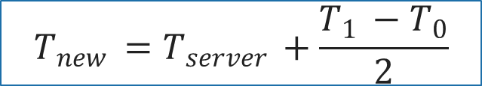

Cristian’s Algorithm
Note times:
    Request sent: T0
    Reply received: T1
Assume network delays are symmetric.
Client sets time to:
T_{server}
server
request
reply
client
T₀
T₁
time
$$\frac{T_{1 }−T_{0}}{2}$$
= estimated overhead
in each direction
$$T_{new }=T_{server }+\frac{T_{1 }−T_{0}}{2}$$

Slide 22
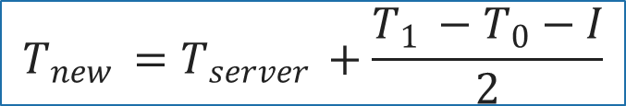
Cristian’s Algorithm
T_{server}
server
request
reply
client
T₀
T₁
time
I = server processing time
$$T_{new }=T_{server }+\frac{T_{1 }−T_{0}−I}{2}$$

Slide 23
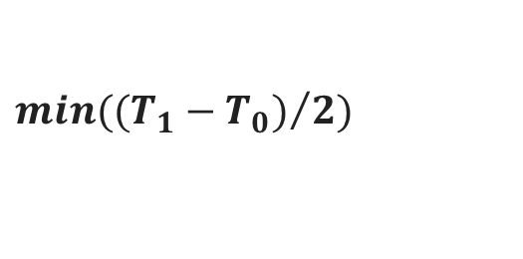
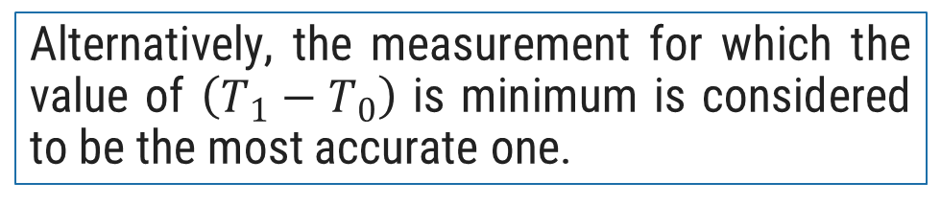
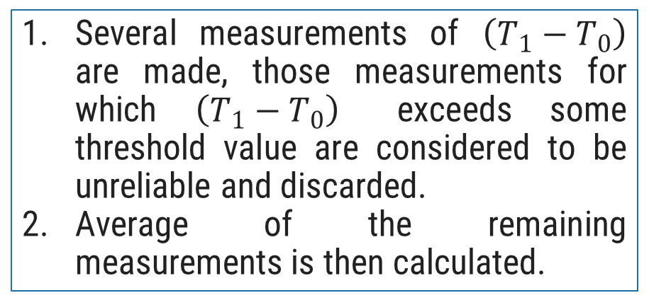

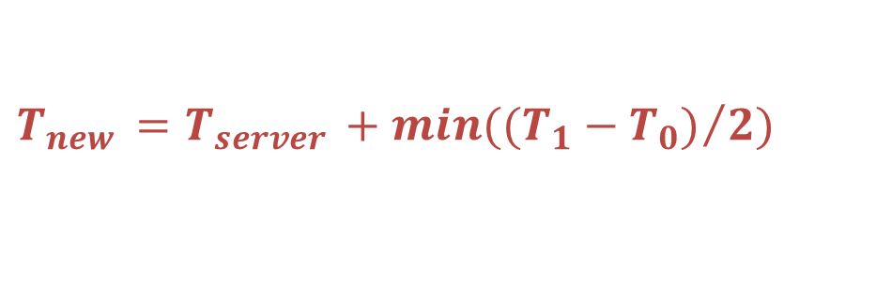
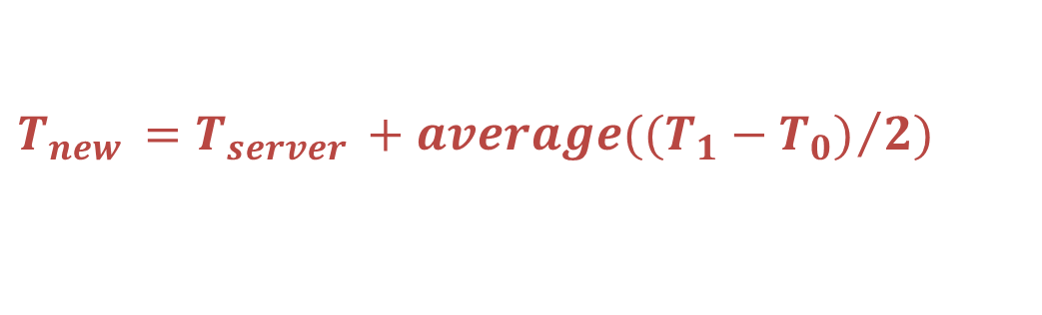
Cristian’s Algorithm
T_{server}
server
request
reply
client
T₀
T₁
time
Several measurements of $\left(T_{1}−T_{0}\right)$ are made, those measurements for which $\left(T_{1}−T_{0}\right)$ exceeds some threshold value are considered to be unreliable and discarded.
Average of the remaining measurements is then calculated.
Alternatively, the measurement for which the value of $\left(T_{1}−T_{0}\right)$ is minimum is considered to be the most accurate one.
$$min({(T_{1}−T_{0})}/2)$$
$$T_{new }=T_{server }+min({(T_{1}−T_{0})}/2)$$
$$average({(T_{1}−T_{0})}/2)$$
$$T_{new }=T_{server }+average({(T_{1}−T_{0})}/2)$$

Slide 24

Error Bounds in Cristian’s Algorithm
T_{server}
server
request
reply
client
T₀
T₁
time
T_{min}
T_{min}
Earliest time message arrives
Latest time message leaves
range = T₁-T₀-2T_{min}
Accuracy of Result =
$±\frac{T_{1 }−T_{0}}{2} −$ $T_{min }$

Slide 25
Cristian’s Algorithm
Assumption about packet transmission delays:
    Cristian’s algorithm assumes that the round-trip times for messages exchanged over the network are reasonably short
    The algorithm assumes that the delay for the request and response are equal
    Cristian’s algorithm is intended for synchronizing computers within intranets
A probabilistic approach for calculating delays:
    There is no tight bound on the maximum drift between clocks of computers
Time server failure or faulty server clock:
    Faulty clock on the time server leads to inaccurate clocks in the entire DS
    Failure of the time server will render synchronization impossible

Slide 26
Berkeley Algorithm
A single time server can fail, blocking timekeeping
The Berkeley algorithm is a distributed algorithm for timekeeping
Assumes all machines have equally-accurate local clocks
Obtains average from participating computers and synchronizes clocks to that average
Time server periodically sends a message (“time=?”) to all computers in the group.
Each computer in the group sends its clock value to the server.
Server has prior knowledge of propagation time from node to server.
Time server readjusts the clock values of the reply messages using propagation time & then takes fault tolerant average.
The time server readjusts its own time & sends the adjustment (positive or negative) to each node.

Slide 27

Berkeley Algorithm
Approach:
A time server periodically (approx. once in 4 minutes) sends its time to all the computers and polls them for the time difference
The computers compute the time difference and then reply
The server computes an average time difference for each computer
The server commands all the computers to update their time (by gradual time synchronization)
  At 3:00, the time daemon tells the other machines its time and asks for theirs.
  They respond with how far ahead or behind the time daemon they are.
  The time daemon computes the average and tells each machine how to adjust its clock
3:05
3:00
3:00
3:00
+0:00
+0:05
Time server
+0:15
-0:20
-0:10
+0:25
3:05
2:50
3:05
3:25

Slide 28
Network Time Protocol (NTP)
NTP is an Application layer porticol
    The NTP service is provided by a network of servers located across the Internet.
    Uses standard UDP Internet transport protocol
    Adjust system clock as close to UTC as possible over the Internet.
    Enable sufficiently frequently resynchronizations
    Primary servers are connected directly to a time source (e.g. a radio clock receiving UTC, GPS) of clients and servers.
    The servers are connected in a logical hierarchy called a synchronization subnet.
T₁
T₂
B
req
resp
A
T₀
T₃
Δ₁
Δ₂

Slide 29
Network Time Protocol (NTP)
NTP defines an architecture for a time service and a protocol to distribute time information over the Internet
In NTP, servers are connected in a logical hierarchy called synchronization subnet
The levels of synchronization subnet is called strata
    Stratum 1 servers have most accurate time information (connected to a UTC receiver)
    Servers in each stratum act as time servers to the servers in the lower stratum

Slide 30
Hierarchical organization of NTP Servers
Stratum 1
  This stratum contains the primary servers that are directly connected to the UTC receivers
Stratum 2
  Stratum 2 are secondary servers that are synchronized directly with primary servers
More accurate time
Stratum 3
  Stratum 3 synchronizes with Stratum 2 servers
Last stratum
  End user computers synchronize with the servers in the upper layer stratum

Slide 31
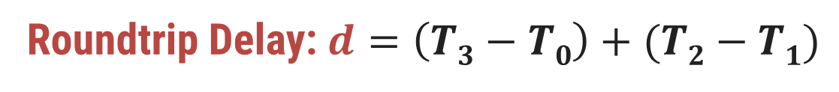
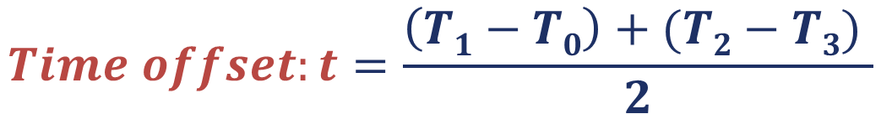
Network Time Protocol (NTP)
Let’s consider the following example with 2 machines A and B:
    First, A sends a request timestamped with value T₀ to B.
    B, as the message arrives, records the time of receipt T₁ from its own local clock and responses with a message timestamped with T₂, piggybacking the previously recorded value T₁.
    Lastly, A, upon receiving the response from B, records the arrival time T₃.
    To account for the time delay in delivering messages, we calculate Δ₁ = T₁-T₀, Δ₂ = T₃-T₂.
    Now, an estimated offset of A relative to B is:
    Based on t, we can either slow down the clock of A or fasten it so that the two machines can be synchronized with each other.
T₁
T₂
B
Roundtrip Delay: $d=\left(T3−T0\right)+(T2−T1)$
req
resp
$$Time offset:t=\frac{\left(T1−T0\right)+(T2−T3) }{2}$$
A
T₀
T₃
Δ₁
Δ₂

Slide 32
Logical Clocks
If two machines do not interact, there is no need to synchronize them.
    What usually matters is that processes agree on the order in which events occur rather than the time at which they occurred
Many times, it is sufficient if processes agree on the order in which the events have occurred in a DS
    For example, for a distributed make utility, it is sufficient to know if an input file was modified before or after its object file
    Logical clocks are used to define an order of events without measuring the physical time at which the events occurred
    Two types of logical clocks:
    Lamport’s Logical Clock (or simply, Lamport’s Clock)
    Vector Clock

Slide 33
Lamport’s Logical Clock
Lamport advocated maintaining logical clocks at the processes to keep track of the order of events
To synchronize logical clocks, Lamport defined a relation called “happened-before”
The expression a → b (reads as “a happened before b”) means that all entities in a DS agree that event a occurred before event b

Slide 34
The Happened-before Relation
The happened-before relation can be observed directly in two situations:
  If a and b are events in the same process, and a occurs before b, then a→b is true
  If a is an event of message m being sent by a process, and b is the event of m (i.e., the same message) being received by another process, then a→b is true
  The happened-before relation is transitive
    If a→b and b→c, then a→c

Slide 35
Properties of Logical Clock
From the happened-before relation, we can infer that:
    If two events a and b occur within the same process and a → b, then C(a) and C(b) are assigned time values such that C(a) < C(b)
    If a is the event of sending message m from one process (say P1), and b is the event of receiving m (i.e., the same message) at another process (say, P2), then:
    The time values C1(a) and C2(b) are assigned in a way such that the two processes agree that C1(a) < C2(b)
The clock time C must always go forward (increasing), and never backward (decreasing)

Slide 36

Synchronizing Logical Clocks
    Three processes P1, P2 and P3 running at different rates
    If the processes communicate between each other, there might be discrepancies in agreeing on the event ordering
    Ordering of sending and receiving messages m1 and m2 are correct
    However, m3 and m4 violate the happened-before relationship
P1
P2
P3
0
0
0
6
m1
8
10
12
16
20
18
24
m2
30
24
32
x
40
30
40
50
36
x
48
m3
60
42
56
70
48
m4
64
80
54
72
90
60
80
100

Slide 37
Lamport’s Clock Algorithm
    When a message is being sent:
    Each message carries a timestamp according to the sender’s logical clock
    When a message is received:
    If the receiver logical clock is less than the message sending time in the packet, then adjust the receiver’s clock such that:
    currentTime = timestamp + 1
P1
P2
P3
0
0
0
6
8
10
12
16
20
18
24
30
24
32
40
30
40
m3:60
50
36
48
60
42
56
m4:69
61
70
48
64
69
80
54
54
70
72
77
90
60
76
80
85
100

Slide 38
Implementation of Lamport’s Clock
Each process Pi maintains a local counter Ci and adjusts this counter according to the following rules:
For any two successive events that take place within Pi, Ci is incremented by 1
Each time a message m is sent by process Pi , m is assigned a timestamp ts(m) = Ci
Whenever a message m is received by a process Pj, Pj adjusts its local counter Cj to max(Cj, ts(m)) + 1

Slide 39
Implementation of Lamport’s Clock
Each process P_{i} maintains a local counter C_{i} and adjusts this counter according to the following rules:
  For any two successive events that take place within P_{i}, C_{i} is incremented by 1
  Each time a message m is sent by process P_{i} , m is assigned a timestamp ts(m) = C_{i}
  Whenever a message m is received by a process P_{j}, P_{j} adjusts its local counter C_{j} to max(C_{j}, ts(m)) + 1
C₀=0
C₀=1
C₀=2
P₀
m:2
C₁=0
C₁=3
P₁
C₂=0
P₂

Slide 40
Vector Clocks
  Vector clock was proposed to overcome the limitation of Lamport’s clock
    The property of inferring that a occurred before b is known as the causality property
A vector clock for a system of N processes is an array of N integers
Every process P_{i} stores its own vector clock VC_{i}
    Lamport’s time values for events are stored in VC_{i}
    VC_{i} (a) is assigned to an event a
If VC_{i}(a) < VC_{i}(b), then we can infer that a→b (or more precisely, that event a causally preceded event b)

Slide 41
Updating Vector Clocks
Vector clocks are constructed as follows:
  VC_{i}[i] is the number of events that have occurred at process P_{i} so far
      VC_{i}[i] is the local logical clock at process P_{i}
  If VC_{i}[j]= k, then P_{i} knows that k events have occurred at P_{j}
      VC_{i}[j] is P_{i}’s knowledge of the local time at P_{j}
Increment VC_{i} whenever a new event occurs
Pass VC_{j} along with the message

Slide 42
Vector Clock Update Algorithm
Whenever there is a new event at P_{i}, increment VC_{i}[i]
When a process P_{i} sends a message m to P_{j}:
  Increment VC_{i}[i]
  Set m’s timestamp ts(m) to the vector VC_{i}
When message m is received process P_{j} :
  VC_{j}[k] = max(VC_{j}[k], ts(m)[k]) ; (for all k)
  Increment VC_{j}[j]
VC₀=(0,0,0)
VC₀=(1,0,0)
VC₀=(2,0,0)
P₀
m:(2,0,0)
VC₁=(0,0,0)
VC₁=(2,1,0)
P₁
VC₂=(0,0,0)
P₂

Slide 43
Inferring Events with Vector Clocks
Let a process P_{i} send a message m to P_{j} with timestamp ts(m), then:
  Pj knows the number of events at the sender Pi that causally precede m
    (ts(m)[i] – 1) denotes the number of events at P_{i}
  Pj also knows the minimum number of events at other processes Pk that causally precede m
    (ts(m)[k] – 1) denotes the minimum number of events at P_{k}
VC₀=(0,0,0)
VC₀=(1,0,0)
VC₀=(2,0,0)
P₀
m:(2,0,0)
VC₁=(0,0,0)
VC₁=(0,1,0)
VC₁=(2,2,0)
VC₁=(2,3,0)
P₁
VC₂=(0,0,0)
m’:(2,3,0)
VC₂=(2,3,1)
P₂

Slide 44
Enforcing Causal Communication
Assume that messages are multicast within a group of processes, P₀, P₁ and P₂
To enforce causally-ordered multicasting, the delivery of a message m sent from P_{i} to P_{j} can be delayed until the following two conditions are met:
  ts(m)[i] = VCj[i] + 1 (Condition I)
  ts(m)[k] <= VCj[k] for all k != i (Condition II)
Assuming that P_{i} only increments VC_{i}[i] upon sending m and adjusts VC_{i}[k] to max{VC_{i}[k], ts(m)[k]} for each k upon receiving a message m’
P₀
VC₀=(0,0,0)
VC₀=(1,0,0)
VC₀=(1,1,0)
m:(1,0,0)
m:(1,1,0)
P₁
VC₁=(0,0,0)
VC₁=(1,0,0)
VC₁=(1,1,0)
P₂
VC₂=(0,0,0)
VC₂=(1,0,0)
VC₂=(1,1,0)
VC₂=(1,1,0)
Condition II does not hold ➔ Delay delivery

Slide 45
Mutual Exclusion
In single-processor systems, critical regions are protected using semaphores, monitors, and similar constructs.
In distributed systems, since there is no shared memory, these methods cannot be used.
Mutual exclusion: Concurrent access of processes to a shared resource or data is executed in mutually exclusive manner.
Only one process is allowed to execute the critical section (CS) at any given time.
In a distributed system, shared variables (semaphores) or a local kernel cannot be used to implement mutual exclusion.
Message passing is the sole means for implementing distributed mutual exclusion

Slide 46
Critical Section
The sections of a program that need exclusive access toshared resources are referred to as critical sections.
Mutual Exclusion : Prevent processes from executing concurrently with their associated critical section.
Requirement :
Mutual exclusion: At anytime only one process should access the resource.
  A process can get another resource first releasing its own.
No starvation: if every process that is granted the resource eventually release it, every request must be eventually granted.

Slide 47
Types of Distributed Mutual Exclusion
Mutual exclusion algorithms are classified into two categories
Request to access
  1. Permission-based Approaches
    A process, which wants to access a shared resource, requests the permission from one or more coordinators
  2. Token-based Approaches
    Each shared resource has a token
    Token is circulated among all the processes
    A process can access the resource if it has the token
Coordinator
C1
Client 1
Grant
Server
P1
Resource
Access
Server
Resource
Access
Access
Access
Client 1
Client 2
Client 3
P1
P2
P3
Token
Token
Token

Slide 48
Permission-based Approaches
There are two types of permission-based mutual exclusion algorithms
  Centralized Algorithms
  Decentralized Algorithms

Slide 49
Centralized Mutual Exclusion Algorithm
One process is elected as a coordinator (C) for a shared resource
Coordinator maintains a Queue of access requests
Whenever a process wants to access the resource, it sends a request message to the coordinator to access the resource
When the coordinator receives the request:
  If no other process is currently accessing the resource, it grants the permission to the process by sending a “grant” message
  If another process is accessing the resource, the coordinator queues the request, and does not reply to the request
The process in action releases the exclusive access after accessing the resource
Afterwards, the coordinator sends the “grant” message to the next process in the queue
P0
P1
P2
Rel
Grant
Access
Req
Grant
Access
Req
Resource
C
P2
P1
Queue

Slide 50
Centralized Mutual Exclusion Algorithm
Coordinator coordinates entry to critical section.
Allows only one process to enter critical section.
Ensures no starvation as uses first come, first served policy.
Simple implementation
Three messages per critical section
  Request
  Reply
  Release
Single point of failure & performance bottleneck.

Slide 51








Centralized Mutual Exclusion Algorithm
Process P₂ then asks permission to enter the same critical region. The coordinator does not reply.
$$P_{2}$$
P_{c} sends back a reply message granting permission to P₁ as critical section is free.
On receiving release message, P_{c} takes the first request from the queue and sends a reply message.
6 Reply
3 Request
7 Release
5 Release
9 Release
$$P_{1}$$
2 Reply
$$P_{C}$$
8 Reply
$$P_{3}$$
1 Request
4 Request
Process P₁ wants to enter a critical section for which it sends a request to P_{c}
When process P₁ exits the critical section sends a release message to P_{c}
Initial state
$$P_{2}$$
Status after 3
$$P_{3}$$
$$P_{2}$$
Status after 4
$$P_{3}$$
Status after 5
Status after 7

Slide 52
A Centralized Algorithm – Advantages and Disadvantages
Advantages
Flexibility : Blocking versus non-blocking requests
  The coordinator can block the requesting process until the resource is free
  Or, the coordinator can send a “permission-denied” message back to the process
  Simplicity : The algorithm guarantees mutual exclusion, and is simple to implement
Disadvantages
Fault-Tolerance Deficiency : Centralized algorithm is vulnerable to a single-point of failure (at coordinator)
  If processes normally block after making a request, they cannot distinguish a dead coordinator from ‘‘permission denied’’ since no message comes back.
  Performance Bottleneck : In a large-scale system, single coordinator can be overwhelmed with requests

Slide 53
Distributed Mutual Exclusion Algorithm
When a process wants to enter the CS (critical section) , it sends a request message to all other processes, and when it receives reply from all processes, then only it is allowed to enter the CS.
The request message contains following information:
  Process identifier
  Name of CS
  Unique time stamp generated by process for request message

Slide 54
Distributed Mutual Exclusion Algorithm
The decision whether receiving process replies immediately to a request message or defers its reply is based on three cases:
  If receiver process is in its critical section, then it defers its reply.
  If receiver process does not want to enter its critical section, then it immediately sends a reply.
  If receiver process itself is waiting to enter critical section, then it compares its own request timestamp with the timestamp in request message
      If its own request timestamp is greater than timestamp in request message, then it sends a reply immediately.
      Otherwise, the reply is deferred.

Slide 55




Distributed Mutual Exclusion Algorithm
TS=6
OK
P₁
P₂
P₁
P₂
$$P_{1}$$
TS=4
Defers sending a reply to P₁
TS=6
TS=4
OK
OK
TS=4
TS=6
P₄
P₃
$$P_{2}$$
$$P_{1}$$
P₄
P₃
Already in CS
Defers sending a reply to P₁ and P₂
(a)
(b)
P₁
P₁
OK
Exits CS
P₂
$$P_{1}$$
P₂
Enters CS
Enters CS
OK
OK
P₄
P₃
P₄
P₃
Exits CS
(c)
(d)

Slide 56
A Token Ring Algorithm
With a token ring algorithm:
  Each resource is associated with a token
  The token is circulated among the processes
  The process with the token can access the resource
How is the token circulated among processes?
  All processes form a logical ring where each process
  knows its next process
  One process is given the token to access the resource
  The process with the token has the right to access
  the resource
  If the process has finished accessing the resource
  OR does not want to access the resource:
  It passes the token to the next process in the ring
Access
T
Resource
P0
P1
P2
P3
P4
P5
P6
P7
T
T
T
T
T
T
T

Slide 57
Failure in Token Ring Algorithm
Two types of failure can occur:
Process failure
Lost token

Slide 58
Failure in Token Ring Algorithm
Process failure: A process failure in the system causes the logical ring to break.
  Requires detection of failed process & dynamic reconfiguration of logical ring.
  Process receiving token sends back acknowledgement to neighbor.
  When a process detects failure of neighbor, it removes failed process by skipping it & passing token to process after it.
  When a process becomes alive after recovery, It informs the neighbour previous to it so that it gets the token during the next round of circulation.
Lost token: If the token is lost, a new token must be generated.
  Must have mechanism to detect & regenerate token.
  Designate process as monitor. Monitor periodically circulates “who has token”.
  Owner of token writes its process identifier in message & passes on.
  On receipt of message, monitor checks process identifier field. If empty generate new token & passes it.
  Multiple monitors can be used.

Slide 59
Comparison of Mutual Exclusion Algorithms
Number of messages
Delay before a process
required for a process
Algorithm
can access the resource
Problems
to access and release
(in message times)
the shared resource
3
2
•
Coordinator crashes
Centralized
•
Crash of any process
-
2(n
1)
2(n
1)
Decentralized
-
•
Large
number of messages
•
Token may be lost
1 to ∞
(n
Token
Ring
0
to
-
1)
•
Ring can cease to exist since
processes crash

Slide 60
Need for a Coordinator
Many algorithms used in distributed systems require a coordinator
  For example, see the centralized mutual exclusion algorithm.
In general, all processes in the distributed system are equally suitable for the role
Election algorithms are designed to choose a coordinator.

Slide 61



Election in Distributed Systems
Many distributed algorithms require one process to act as a coordinator
Typically, it does not matter which process is elected as the coordinator
Coordinator
Time server
C1
Client 1
P1
Server
Resource
Home Node Selection in Naming
Berkeley Clock Synchronization Algorithm
A Centralized Mutual Exclusion Algorithm

Slide 62

Election Algorithms
What is Election?
In a group of processes, elect a leader to undertake special tasks.
What happens when a leader fails (crashes)
  Some process detects this (how?)
  Then what?
Any process can serve as coordinator
Any process can “call an election” (initiate the algorithm to choose a new coordinator).
  There is no harm (other than extra message traffic) in having multiple concurrent elections.
Elections may be needed when the system is initialized, or if the coordinator crashes or retires.
An algorithm for choosing a unique process to play a particular role.

Slide 63
Assumptions
Any process can call for an election.
A process can call for at most one election at a time.
Every process/site has a unique ID; e.g.
  The network address
  A process number
Every process in the system should know the values in the set of ID numbers, although not which processors are up or down.
The process with the highest ID number will be the new coordinator.
Multiple processes can call an election simultaneously.
  All of them together must yield a single leader only
  The result of an election should not depend on which process calls for it.
Messages are eventually delivered.
Process groups (as with ISIS toolkit or MPI) satisfy these requirements.

Slide 64
Election Algorithms
Bully Algorithm
Ring Algorithm

Slide 65
Bully Algorithm
Bully algorithm specifies the process with the highest identifier will be the coordinator of the group. It works as follows:
When a process p detects that the coordinator is not responding to requests, it initiates an election:
  p sends an election message to all processes with higher numbers.
  If nobody responds, then p wins and takes over.
  If one of the processes answers, then p’s job is done.
If a process receives an election message from a lower-numbered process at any time, it:
  sends an OK message back.
  holds an election (unless its already holding one).
A process announces its victory by sending all processes a message telling them that it is the new coordinator.
If a process that has been down recovers, it holds an election.

Slide 66
Bully Algorithm
A process (say, P_{i}) initiates the election algorithm when it notices that the existing coordinator is not responding
Process P_{i} calls for an election as follows:
Coordinator
1
5
6
3
7
0
4
2
P_{i} sends an “Election” message to all processes with higher process IDs
When process P_{j} with j>i receives the message, it responds with a “Take-over” message. P_{i} no more contests in the election
  Process P_{j} re-initiates another call for election. Steps 1 and 2 continue
If no one responds, P_{i} wins the election. P_{i} sends “Coordinator” message to every process
Election
Take-Over
Take-Over
Election
Election
Take-over
Election
Election
Election
X

Slide 67
Ring Algorithm
The ring algorithm assumes that the processes are arranged in a logical ring and each process is knowing the order of the ring of processes.
If any process detects failure, it constructs an election message with its process ID and sends it to its neighbor.
If the neighbor is down, the process skips over it and sends the message to the next process in the ring.
This process is repeated until a running process is located.
At each step, the process adds its own process ID to the list in the message and sends the message to its living neighbor.
Eventually, the election message comes back to the process that started it.
The process then picks either the highest or lowest process ID in the list and sends out a message to the group informing them of the new coordinator.

Slide 68
Ring Algorithm
This algorithm is generally used in a ring topology
When a process P_{i} detects that the coordinator has crashed, it initiates the election algorithm
1
2
3
4
5
6
7
0
E: 5,6,0
E: 5,6,0,1
P_{i} builds an “Election” message (E), and sends it to its next node. It inserts its ID into the Election message
When process P_{j} receives the message, it appends its ID and forwards the message
  If the next node has crashed, P_{j} finds the next alive node
When the message gets back to P_{i}:
  P_{i} elects the process with the highest ID as coordinator
  P_{i} changes the message type to a “Coordination” message (C) and triggers its circulation in the ring
C: 6
C: 6
E: 5,6,0,1,2
C: 6
X
E: 5,6
C: 6
E: 5,6,0,1,2,3
C: 6
E: 5,6,0,1,2,3,4
C: 6
E: 5
C: 6

Slide 69
Comparison of Election Algorithms
Algorithm | Number of Messages for Electing a Coordinator | Problems
Bully Algorithm
Ring Algorithm
O(n²)
Large message overhead
An overlay ring topology is necessary
2n
Assume that: n = Number of processes in the distributed system

Slide 70
Summary of Election Algorithms
Election algorithms are used for choosing a unique process that will coordinate certain activities
At the end of an election algorithm, all nodes should uniquely identify the coordinator
We studied two algorithms for performing elections:
  Bully algorithm
    Processes communicate in a distributed manner to elect a coordinator
  Ring algorithm
    Processes in a ring topology circulate election messages to choose a coordinator

Slide 71
Decentralized Algorithm
To avoid the drawbacks of the centralized algorithm, Lin et al. (2005) advocated a decentralized mutual exclusion algorithm
Assumptions:
Distributed processes are in a Distributed Hash Table (DHT) based system
Each resource is replicated n times
    The i^{th} replica of a resource rname is named as rname-i
Every replica has its own coordinator for controlling access
    The coordinator for rname-i is determined by using a hash function
Approach:
Whenever a process wants to access the resource, it will have to get a majority vote from m > n/2 coordinators
If a coordinator does not want to vote for a process
    It will send a “permission-denied” message to the process

Slide 72
Decentralized Algorithm
If n=10 and m=7, then a process needs at-least 7 votes to access the resource
C1
rname-1
Req
Access
C2
rname-2
0
P0
OK
2
6
1
4
5
3
7
C3
rname-3
C4
rname-4
Req
P1
C5
rname-5
0
OK
1
2
3
rname-6
Deny
C6
Deny
C7
rname-7
C8
rname-8
C9
rname-9
C10
rname-10
rname-x
= xth replica of a resource rname
Cj
= Coordinator j
Pi
= Process i
n
= Number of votes gained

Slide 73
Decentralized Algorithm
Now every replica has a coordinator that controls access
Coordinators respond to requests at once: Yes or No
For a process to use the resource it must receive permission from m > n/2 coordinators.
    If the requester gets fewer than m votes it will wait for a random time and then ask again.
If a request is denied, or when the CS is completed, notify the coordinators who have sent OK messages, so they can respond again to another request. (Why is this important?)
More robust than the central coordinator approach. If one coordinator goes down others are available.
    If a coordinator fails and resets then it will not remember having granted access to one requestor, and may then give access to another. According to the authors, it is highly unlikely that this will lead to a violation of mutual exclusion.

Slide 74
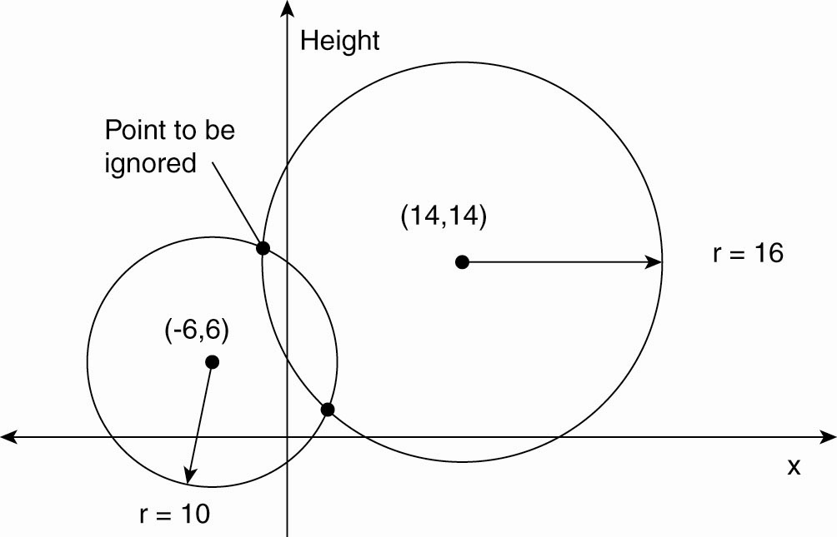
Global Positioning System
Basic idea: You can get an accurate account of time as a side-effect of GPS.
Real world facts that complicate GPS
    It takes a while before data on a satellite’s position reaches the receiver.
    The receiver’s clock is generally not in synch with that of a satellite.
Computing a position in a two-dimensional space

Slide 75
Global Positioning of Nodes
When the number of nodes in a distributed system grows, it becomes increasingly difficult for any node to keep track of the others.
Such knowledge may be important for executing distributed algorithms such as routing, multicasting, data placement, searching, and so on.
There are many applications of geometric overlay networks.
Consider the situation where a Web site at server O has been replicated to multiple servers on the Internet.
    When a client C requests a page from O, the latter may decide to redirect that request to the server closest to C, give the best response time.
    If the geometric location of C is known, as well as those of each replica server, O can then simply pick that server ( i.e. ) S, for which d(C,S) is minimal.
    There is no need to sample all the latencies between C and each of the replica servers

Slide 76
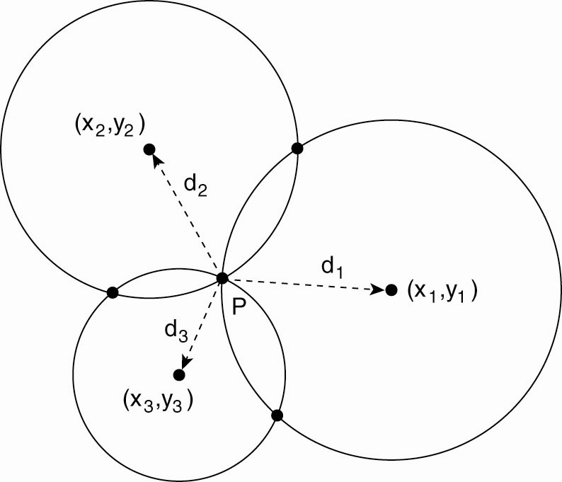
Global Positioning of Nodes
Observation:
    A node P needs k+1 landmarks to compute its own position in a d-dimensional space. Consider two-dimensional case.
Computing a node’s position in a two-dimensional space.

Slide 77
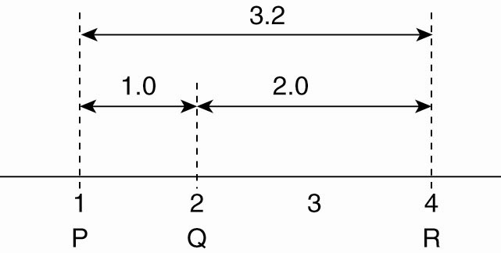
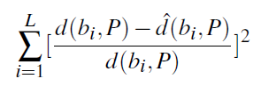

Global Positioning of Nodes
Solution
P needs to solve three equations in two unknowns (x_{P},y_{P}):
Computing position
Problems :
    Measured latencies to landmarks fluctuate
    Computed distances will not even be consistent:
    Let the L landmarks measure their pairwise latencies d(b_{i},b_{j}) and let each node P minimize
$$d=\sqrt{{\left(xi−xp\right)}^{2}+{\left(yi−yp\right)}^{2}}$$
Inconsistent distance measurements in a one-dimensional space.

Slide 78
Elections in Wireless Environments
Traditional algorithms aren’t appropriate.
  Can’t assume reliable message passing or stable network configuration
This discussion focuses on ad hoc wireless networks but ignores node mobility.
  Nodes connect directly, no common access point, connection is short term
  Often used in multiplayer gaming, on-the-fly file transfers, etc.
  Assumptions
  Wireless algorithms try to find the best node to be coordinator; traditional algorithms are satisfied with any node.
  Any node (the source) can initiate an election by sending an ELECTION message to its neighbors – nodes within range.
  When a node receives its first ELECTION message the sender becomes its parent node.

Slide 79
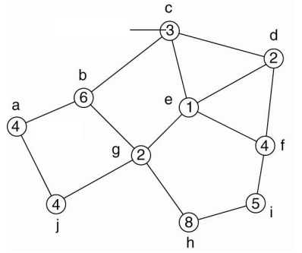
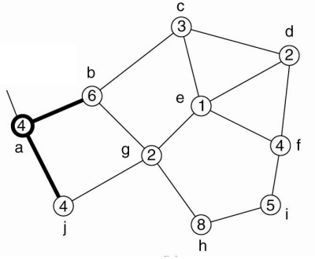
Elections in Wireless Environments
Node a initiates an ELECTION message by broadcasting to nodes b and j
Capacity
Broadcasting node
Source
Election algorithm in a wireless network, with node a as the source: Initial network
Election algorithm in a wireless network, with node a as the source: The build-tree phase

Slide 80
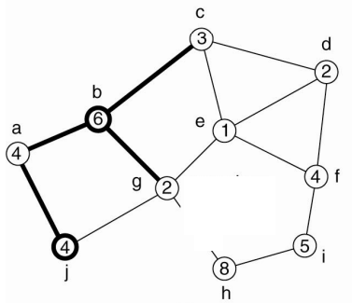
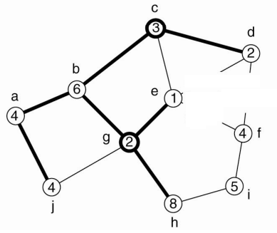
Elections in Wireless Environments
The Node b marks a as parent and passes the ELECTION message to node g
Election message it transmitted till the leaf nodes
Each nodes then transmit back the best available option to its parent node
e receives broadcast from g first
G receives broadcast from b first

Slide 81
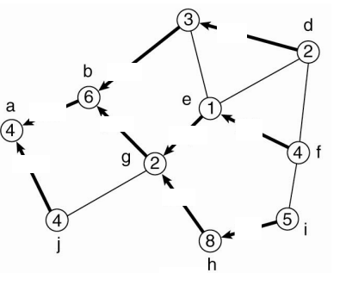
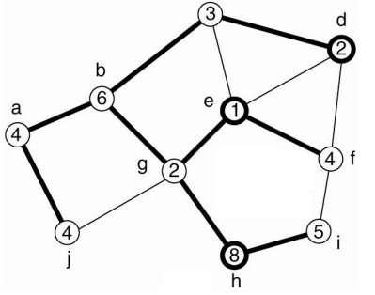
Elections in Wireless Environments
Node g has node e and h as child nodes but it will propagate only the best node i.e [h,8] back to its own parent.
When multiple elections are initiated, nodes tend to join the ones having highest identifier in the source tag
[d,2]
[c,3]
[h,8]
[h,8]
[f,4]
[f,4]
f receives broadcast from e first
[j,4]
[h,8]
[i,5]

Slide 82
Elections in Large-Scale Systems
Above discussed situations deal with selecting one coordinator as they are small distributed systems
For a larger network, a situation arises where we need to select super peers in a peer- to-peer network.
Requirements for superpeer selection:
  Normal nodes should have low-latency access to superpeers.
  Superpeers should be evenly distributed across the overlay network.
  There should be a predefined portion of superpeers relative to the total number of nodes in the overlay network.
  Each superpeer should not need to serve more than a fixed number of normal nodes.

Slide 83
Elections in Large-Scale Systems
Requirements are relatively easy to meet in most peer-to-peer systems as the over lay network is either DHT based or randomly unstructured.
In DHT networks,
  Idea is to reserve a fraction of the identifier space for Superpeers
  Each node receives a m-bit identifier and first k bits are reserved to identify the Superpeers
  For N superpeers, first log₂(N) bits of any key can be used to identify the Superpeers

Slide 84
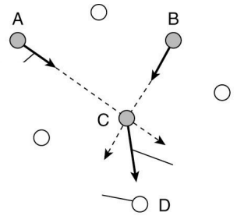
Elections in Large-Scale Systems
Total of N tokens are spread across N randomly-chosen nodes
Each token represents a repelling force by which another token is inclined to move away If all tokens exert the same repulsion force, they will move away and spread evenly in the geometric space
Token-holding node
Repulsion
force of A on C
Normal node
Resulting movement by which the token at C is passed to another node
Node D will become token holder

