Slide 1

Unit-2
Basics of Architectures, Processes and Communication
Distributed System (DS)
GTU #3170719
Prof. Umesh H. Thoriya
Computer Engineering Department
umesh.thoriya@darshan.ac.in
9714233355

Slide 2

Looping
Topics to be covered
  Architectures - Types of System Architectures
  Self Management in Distributed Systems
  Processes - Basics of Threads
  Virtualization
  Roles of Client and Server
  Code Migration
  Communication - Types of Communications
  Remote Procedure Calls
  Message-Oriented Communication
  Stream-Oriented Communication
  Multicasting

Slide 3
Architectural Styles
Distributed systems are often complex pieces of software of which the components are by definition dispersed across multiple machines.
To master their complexity, it is crucial that these systems are properly organized.
There are different ways on how to view the organization of a distributed system, but an obvious one is to make a distinction between the logical organization of the collection of software components and on the other hand the actual physical realization.
Important styles of architecture for distributed systems:
  Layered architectures
  Object-based architectures
  Data-centered architectures
  Event-based architectures

Slide 4
Layered architectures
The Components are organized in a layered fashion where a component at layer Li is allowed to call components at the underlying layer Li-1, but not the other way around,
This model has been widely adopted by the networking community
An key observation is that control generally flows from layer to layer; requests go down the hierarchy whereas the results flow upward.
Layer N
Layer N-1
Request flow
Response flow
Layer 2
Layer 1

Slide 5
Object-based architectures
Each object corresponds a component
Components are connected through a (remote) procedure call mechanism.
The layered and object-based architectures still form the most important styles for large software systems
Object
Object
Object
Method call
Object
Object

Slide 6
Data-centered architectures
It evolve around the idea that processes communicate through a common (passive or active) repository.
It can be argued that for distributed systems these architectures are as important as the layered and object-based architectures
For example,
  A wealth of networked applications have been developed that rely on a shared distributed file system in which virtually all communication takes place through files.
  Web-based distributed systems are largely data-centric: processes communicate through the use of shared Web-based data services.
Component
Component
Data delivery
Publish
Shared (persistent) data space

Slide 7
Event-based architectures
Processes communicate through the propagation of events.
For distributed systems, event propagation has generally been associated with what are known as publish/subscribe systems.
Advantage - processes are loosely coupled. In principle, they need not explicitly refer to each other. This is also referred to as being decoupled in space, or referentially decoupled.
Component
Component
Event delivery
Event bus
Publish
Component

Slide 8
System Architecture
There are three views toward system architectures:
Centralized Architectures
Decentralized architectures
Distributed Architectures

Slide 9
Centralized Architectures
Manage distributed system complexity – think in terms of clients that request services from servers.
Processes are divided into two groups:
  A server is a process implementing a specific service, for example, a file system service or a database service.
  A client is a process that requests a service from a server by sending it a request and subsequently waiting for the server's reply.
wait for result
Client
Request
Reply
Server
Provide service
Time

Slide 10
Centralized Architectures
Communication - implemented using a connectionless protocol when the network is reliable e.g. local-area networks.
  Client requests a service – packages and sends a message for the server, identifying the service it wants, along with the necessary input data.
  The Server will always wait for an incoming request, process it, and package the results in a reply message that is then sent to the client.

Slide 11
Connectionless protocol
Describes communication between two network end points in which a message can be sent from one end point to another without prior arrangement.
Device at one end of the communication transmits data to the other, without first ensuring that the recipient is available and ready to receive the data.
The device sending a message sends it addressed to the intended recipient.

Slide 12
Application Layering
Traditional three-layered view:
The user-interface level
    It contains units for an application’s user interface
    Clients typically implement the user-interface level
Simplest user-interface program - character-based screen
Simple GUI
The processing level
    It contains the functions of an application, i.e. without specific data
    Middle part of hierarchy -> logically placed at the processing level
The data level
    It contains the data that a client wants to manipulate through the application components
    manages the actual data that is being acted on

Slide 13
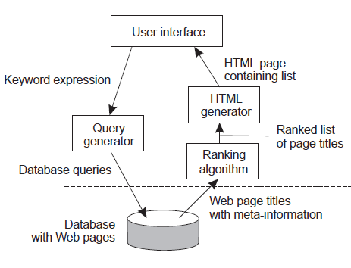
Internet search engine- An example of Application Layering
Traditional three-layered view:
User-interface level: a user types in a string of keywords and is subsequently presented with a list of titles of Web pages.
Data Level: huge database of Web pages that have been prefetched and indexed.
Processing level: search engine that transforms the user's string of keywords into one or more database queries.
    Ranks the results into a list
    Transforms that list into a series of HTML pages
User-interface level
Processing level
Data level

Slide 14
Multi-Tiered Architectures
Simplest organization - two types of machines:
    A client machine containing only the programs implementing (part of) the user-interface level
    A server machine containing the rest, that is the programs implementing the processing and data level
Single-tiered: dumb terminal/mainframe configuration
Two-tiered: client/single server configuration
Three-tiered: each layer on separate machine

Slide 15
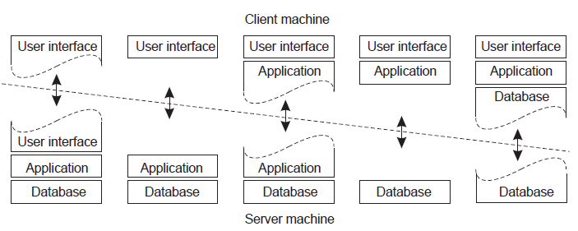
Two-tiered Architectures - Thin-client model and fat-client model
A
B
C
D
E
Case-A: Only the terminal-dependent part of the user interface
Case- B: Place the entire user-interface software on the client side
Case- C: Move part of the application to the front end

Slide 16
Two-tiered Architectures - Thin-client model and fat-client model
Thin
Client
Fat
Client
A
B
C
D
E
Case-D: Used where the client machine is a PC or workstation, connected through a network to a distributed file system or database
Case- E: Used where the client machine is a PC or workstation, connected through a network to a distributed file system or database

Slide 17





Multitiered Architectures (3-Tier Architecture)
Data Tier
(Back-End)
Middle Tier
(Business Tier)
Client Tier (Front-End)
Client
Machine
network
network
Mobile
Client
network
Database
Business
Logic
Desktop
Client
17

Slide 18
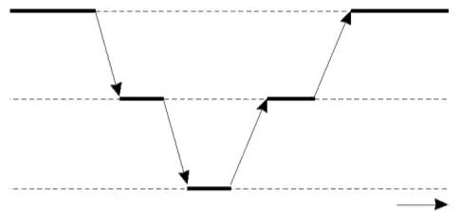
Multitiered Architectures (3-Tier Architecture)
The server tier in two-tiered architecture becomes more and more distributed
Distributed transaction processing
    A single server is no longer adequate for modern information systems
This leads to three-tiered architecture
    Server may acting as a client
Waiting for result
An example of a
server acting as client
User interface
(presentation)
Request
operation
Return result
Application
server
Request data
Return data
Database
server
Time

Slide 19
An example of a server acting as client
Programs that form part of the processing level reside on a separate server, but may additionally be partly distributed across the client and server machines.
Example: Three-tiered architecture - organization of Web sites.
    Web server acts as an entry point to a site, passing requests to an application server where the actual processing takes place.
    Application server interacts with a database server.

Slide 20
Decentralized Architectures
Multi-tiered architectures can be considered as vertical distribution
    Placing logically different components on different machines
An alternative is horizontal distribution (peer-to-peer systems)
    A collection of logically equivalent parts
    Each part operates on its own share of the complete data set, balancing the load
    Peer-to-peer architectures - how to organize the processes in an overlay network in which the nodes are formed by the processes and the links represent the possible communication channels (which are usually realized as TCP connections).
    Decentralized Architectures Types
    Structured P2P
    Unstructured P2P
    Hybrid P2P

Slide 21
Structured P2P Architectures
There are links between any two nodes that know each other
Structured: the overlay network is constructed in a deterministic procedure
    Most popular: distributed hash table (DHT)
    DHT-based system
    Data items are assigned a random key from a large identifier space, such as a 128-bit or 160-bit identifier.
    Nodes are assigned a random number from the same identifier space.
    Some well known structured P2P networks are Chord, Pastry, Tapestry, CAN, and Tulip.

Slide 22

Chord
Each node in the network knows the location of some fraction of other nodes.
  If the desired key is stored at one of these nodes, ask for it directly
  Otherwise, ask one of the nodes you know to look in its set of known nodes.
  The request will propagate through the overlay network until the desired key is located
  Lookup time is O(log(N))
Actual node
00
01
02
03
04
05
06
07
08
09
10
11
12
13
14
15
{13, 14, 15}
{0, 1}
{8, 9, 10, 11, 12}
{2, 3, 4}
Associated data keys
{5, 6, 7}
n
= Active node with id=n
p
= No node assigned to key p

Slide 23
Chord
Join
  Generate the node’s random identifier, id, using the distributed hash function
  Use the lookup function to locate succ(id)
  Contact succ(id) and its predecessor to insert self into ring.
  Assume data items from succ(id)
Leave (normally)
  Notify predecessor & successor;
  Shift data to succ(id)
Leave (due to failure)
  Periodically, nodes can run “self-healing” algorithms
Actual node
00
01
02
03
04
05
06
07
08
09
10
11
12
13
14
15
{13, 14, 15}
{0, 1}
{8, 9, 10, 11, 12}
{2, 3, 4}
Associated data keys
{5, 6, 7}
n
= Active node with id=n
p
= No node assigned to key p

Slide 24
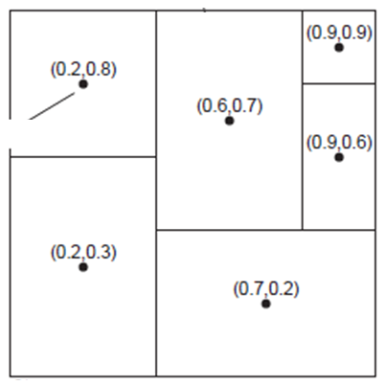
Content Addressable Network (CAN)
CAN deploys a d-dimensional Cartesian coordinate space, which is completely partitioned among all the nodes that participate in the system.
Example: 2-dimensional case
  Two-dimensional space [0,1]x[0,1] is divided among six nodes
  Each node has an associated region
  Every data item in CAN will be assigned a unique point in this space, after which it is also clear which node is responsible for that data
Keys associated with node at (0.6,0.7)
(0, 1)
(1, 1)
Actual node
(0, 0)
(1, 0)

Slide 25
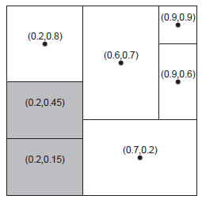
Content Addressable Network (CAN)
Joining CAN
When a node P wants to join a CAN system, it picks an arbitrary point from the coordinate space and subsequently looks up the node Q in whose region that point falls.
Node Q then splits its region into two halves and one half
is assigned to the node P.
Nodes keep track of their neighbors, that is, nodes responsible for adjacent region.
When splitting a region, the joining node P can easily come to know who its new neighbors are by asking node P.
As in Chord, the data items for which node P is now responsible are transferred from node Q.

Slide 26
Content Addressable Network (CAN)
Leaving CAN
Assume that the node with coordinate (0.6,0.7) leaves.
Its region will be assigned to one of its neighbors, say the node at (0.9,0.9), but it is clear that simply merging it and obtaining a rectangle cannot be done.
In this case, the node at (0.9,0.9) will simply take care of that region and inform the old neighbors of this fact

Slide 27
Overlay Networks
Nodes act as both client and server; interaction is symmetric
Each node acts as a server for part of the total system data
Overlay networks connect nodes in the P2P system.
An overlay network can be thought of as a computer network on top of another network. All nodes in an overlay network are connected with one another by means of logical or virtual links and each of these links correspond to a path in the underlying network.
A link between two nodes in the overlay may consist of several physical links.
Messages in the overlay are sent to logical addresses, not physical (IP) addresses
Various approaches used to resolve logical addresses to physical.

Slide 28
Unstructured P2P Architectures
Largely relying on randomized algorithm to construct the overlay network
    Each node has a list of neighbors, which is more or less
    Many systems try to construct an overly network that resembles a random graph
    Each node maintains a partial view, i.e., a set of live nodes randomly chosen from the current set of nodes constructed in a random way
An unstructured P2P network is formed when the overlay links are established arbitrarily.
Data items are randomly mapped to some node in the system & lookup is random, unlike the structured lookup in Chord.
Such networks can be easily constructed as a new peer that wants to join the network can copy existing links of another node and then form its own links over time.
In an unstructured P2P network, if a peer wants to find a desired piece of data in the network, the query has to be flooded through the network in order to find as many peers as possible that share the data..

Slide 29
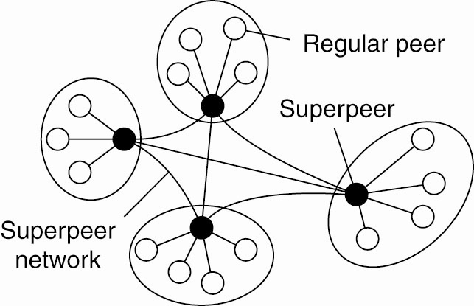
Superpeers
Used to address the following question
    How to find data items in unstructured P2P systems
    Flood the network with a search query?
    An alternative is using superpeers
    Nodes such as those maintaining an index or acting as a broker are generally referred to as superpeers
    They hold index of info. from its associated peers (i.e. selected representative of some of the peers)
A hierarchical organization of nodes into a superpeer network

Slide 30
Finding Data Items
This is quite challenging in unstructured P2P systems
    Assume a data item is randomly placed
Solution 1: Flood the network with a search query
Solution 2: A randomized algorithm
    Let us first assume that
Each node knows the IDs of k other randomly selected nodes
The ID of the hosting node is kept at m randomly picked nodes
    The search is done as follows
Contact k direct neighbors for data items
Ask your neighbors to help if none of them knows
    What is the probability of finding the answer directly?

Slide 31
Hybrid Architectures
Many real distributed systems combine architectural features
    E.g., the superpeer networks – combine client-server architecture (centralized) with peer-to-peer architecture (decentralized)
Two examples of hybrid architectures
    Edge-server systems
    Collaborative distributed systems
    Superpeer networks

Slide 32
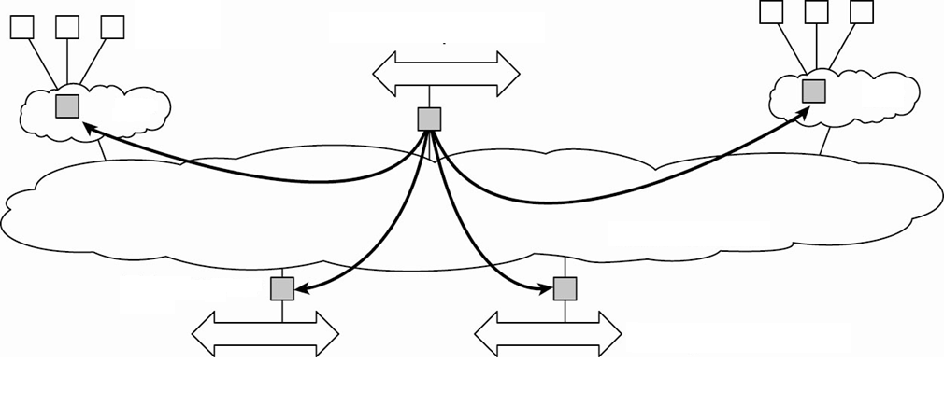
Edge-Server Systems
Deployed on the Internet where servers are “at the edge” of the network (i.e. first entry to network)
Each client connects to the Internet by means of an edge server.
Client
Content provider
ISP
ISP
Core Internet
Edge server
Enterprise network

Slide 33
Collaborative Distributed Systems
A hybrid distributed model that is based on mutual collaboration of various systems
    Client-server scheme is deployed at the beginning
    Fully decentralized scheme is used for collaboration after joining the system
Examples of Collaborative Distributed System:
    BitTorrent: is a P2P File downloading system. It allows download of various chunks of a file from other users until the entire file is downloaded
    Globule: A Collaborative content distribution network. It allows replication of web pages by various web servers

Slide 34
BitTorrent
Information needed to download a specific file
Many trackers, one per file, tracker holds which node holds which chunk of the file
The principal working of BitTorrent (Pouwelse et al. 2004).

Slide 35
Globule
Collaborative content distribution network:
    Similar to edge-server systems
    Enhanced web servers from various users that replicates web pages
Components
    A component that can redirect client requests to other servers.
    A component for analyzing access patterns.
    A component for managing the replication of Web pages.
It Has a centralized component for registering the servers and make these servers known to others

Slide 36
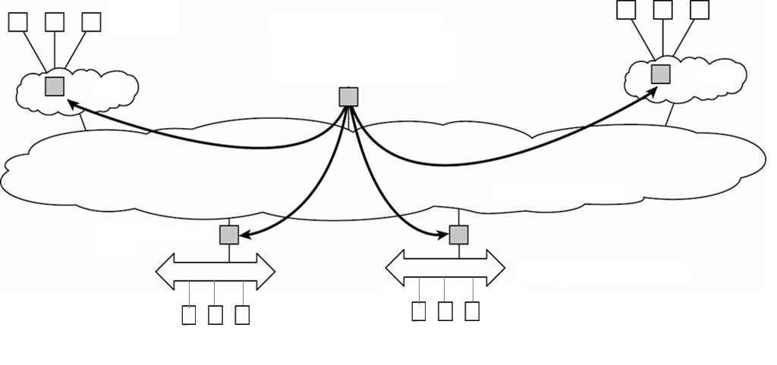
Globule
Client
Origin server
ISP
ISP
Core Internet
Replica Server
Enterprise network
Client
Client

Slide 37
Architectures Versus Middleware
Middleware forms a layer between applications and distributed platforms
Provide a degree of distribution transparency, hiding the distribution of data, processing, and control from applications.
Many middleware follows a specific architecture style
    Object-based style, event-based style
    Benefits: simpler to design application
    Limitations: the solution may not be optimal
In many cases, distributed systems/applications are developed according to a specific architectural style .
Middleware systems follow a specific architectural style
    Object-based architectural style - CORBA
    Event-based architectural style - TIB/Rendezvous
    Interceptors : Intercept the usual flow of control when invoking a remote object

Slide 38
Supporting Technology: Interceptors
An Interceptor is a software that Breaks the usual flow of control and Allows other (application specific) code to be executed
It makes middleware more adaptable to application requirements and changing environment
Interceptors are good for
    Providing transparent replication and
    Improving performance

Slide 39
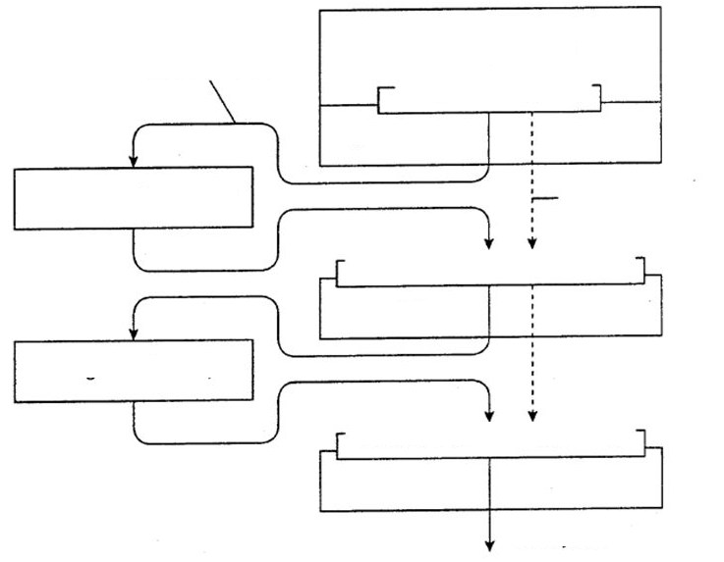
Interceptors
May want to send to many other B’s (i.e. replicated)
Intercepted Call
Client Application
B.do_something(value)
Application stub
Request-level interceptor
Nonintercepted Call
Invoke(B, &do_something, value)
Object middleware
Message-level interceptor
May want to break a large message for better performance
send([B, “do_something”, value])
Local OS
To Object B

Slide 40
General Approaches for Adaptability (Adaptive Middleware)
Separation of concerns
    Modularizing the system and separate security from functionality
    However, the problem is that a lot of things you cannot easily separate, e.g., security
Computational reflection
    Ability to inspect itself, and if necessary, adapt its behavior
    Reflective middleware has yet to proof itself as a powerful tool to manage the complexity of distribute systems
    Component-based design (stand-alone)
    However, components are less independent than one may think
    Replacement of one component may have huge impact on others

Slide 41
Self-Management in Distributed Systems
    Distributed systems are often required to adapt to environmental changes by
    Switching policies for allocation resources
    The algorithms to make the changes are often already in the components
    But the challenge is how to make such change without human intervention
    A strong interplay between software architectures and system architectures
    Organize components in a way that monitoring and adjustment can be done easily
    Decide where the processes to be executed to do the adaption

Slide 42
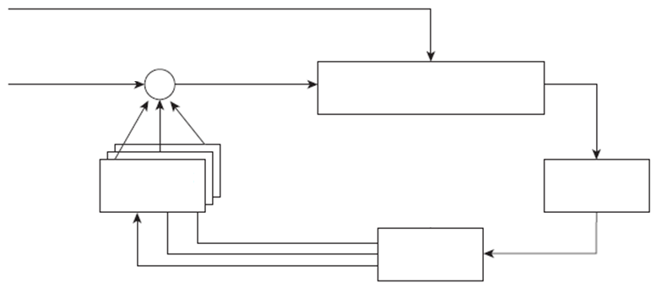
The Feedback Control Model
    Allow automatic adaption to changes by means of one or more feedback control loops
    self-managing
    self-healing
    self-configuration
    self-optimization, etc
Uncontrollable parameters (disturbance/ noise)
Initial configuration
Corrections
Observed output
Core of distributed system
+/-
+/-
+/-
Adjustment measures
Reference input
Metric
estimation
Analysis
Adjustment triggers
Measured output

Slide 43
Introduction to Threads
    Processor: Provides a set of instructions along with the capability of automatically executing a series of those instructions.
    Thread: A minimal software processor in whose context a series of instructions can be executed. Saving a thread context implies stopping the current execution and saving all the data needed to continue the execution at a later stage.
    Process: A software processor in whose context one or more threads may be executed. Executing a thread, means executing a series of instructions in the context of that thread.

Slide 44
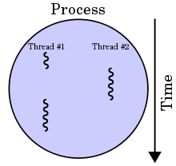
What is Threads?
Thread is a light weight process created by a process.
Thread is a single sequence of execution within a process.
Thread has it own.
  Program counter that keeps track of which instruction to execute next.
  System registers which hold its current working variables.
  Stack which contains the execution history.
Processes are generally used to execute large, ‘heavyweight’ jobs such as working in word, while threads are used to carry out smaller or ‘lightweight’ jobs such as auto saving a word document.
A thread shares few information with its peer threads (having same input) like code segment, data segment and open files.

Slide 45
Process & Thread
Similarities between Process & Thread
  Like processes threads share CPU and only one thread is running at a time.
  Like processes threads within a process execute sequentially.
  Like processes thread can create children.
  Like a traditional process, a thread can be in any one of several states: running, blocked, ready or terminated.
  Like process threads have Program Counter, Stack, Registers and State.

Slide 46
Process Vs. Thread
Process | Thread
Process means a program is in execution. | Thread means a segment of a process.
The process is not Lightweight. | Threads are Lightweight.
The process takes more time to terminate. | The thread takes less time to terminate.
It takes more time for creation. | It takes less time for creation.
Individual processes are independent of each other. | Threads are parts of a process and so are dependent.
All the different processes are treated separately by the operating system. | All user level peer threads are treated as a single task by the operating system.
Communication between processes requires more time than between threads. | Communication between threads requires less time than between processes

Slide 47
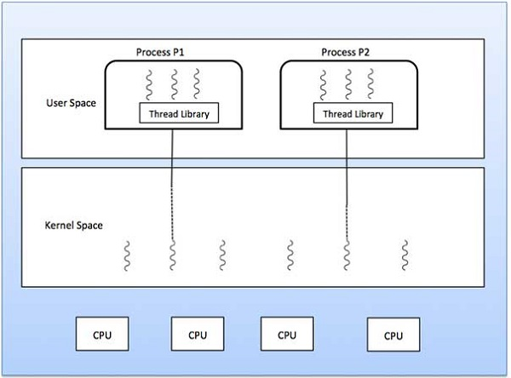
Types of Threads
Kernel Level Thread
User Level Thread
User
Level
Threads
Kernel
Level
Threads

Slide 48
User Level Thread Vs. Kernel Level Thread
$$\text{USER} \text{LEVEL} \text{THREAD}$$ | $$\text{KERNEL} \text{LEVEL} \text{THREAD}$$
User thread are implemented by users. | Kernel threads are implemented by OS.
OS doesn’t recognized user level threads. | Kernel threads are recognized by OS.
Implementation of User threads is easy. | Implementation of Kernel thread is complex.
Context switch time is less. | Context switch time is more.
Context switch requires no hardware support. | Context switch requires hardware support.
If one user level thread perform blocking operation then entire process will be blocked. | If one kernel thread perform blocking operation then another thread with in same process can continue execution.
Example : Java thread | Example : Window Solaris

Slide 49
Models for Organizing Threads
Depending on the application’s needs the threads of a process of the application can be organized in different ways.
Threads can be organized by three different models.
  Dispatcher/Worker model
  Team model
  Pipeline model

Slide 50

Dispatcher/Worker Model
In this model, the process consists of a single dispatcher thread and multiple worker threads.
The dispatcher thread:
  Accepts requests from clients.
  Examine the request.
  Dispatches the request to one of the free worker threads for further processing of the request.
Each worker thread works on a different client request.
Therefore, multiple client requests can be processed in parallel.
Requests
Port
Dispatcher Thread
Worker Thread
Worker Thread
Worker Thread
Server process for processing incoming requests

Slide 51
Team Model
In this model, all threads behave as equal.
Each thread gets and processes clients requests on its own.
This model is often used for implementing specialized threads within a process.
Each thread of the process is specialized in servicing a specific type of requests like copy, save, autocorrect.
Requests
Port
Type 1
Type 2
Type 3
Thread
Thread
Thread

Slide 52
Pipeline Model
This model is useful for applications based on the producer-consumer model.
The output data generated by one part of the application is used as input for another part of the application.
The threads of a process are organized as a pipeline.
The output data generated by the first thread is used for processing by the second thread, the output of the second thread is used for third thread, and so on.
The output of the last thread in the pipeline is the final output of the process to which the threads belong.
Requests
Port
Thread
Thread
Thread

Slide 53
Virtualization
Multiprogrammed operating systems provide the illusion of simultaneous execution through resource virtualization
  Use software to make it look like concurrent processes are executing simultaneously
Virtual machine technology creates separate virtual machines, capable of supporting multiple instances of different operating systems.
Virtualization is a broad term that refers to the abstraction of computer resources.
Virtualization creates an external interface that hides an underlying implementation
Benefits:
  Hardware changes faster than software
  Compromised systems (internal failure or external attack) are isolated.
  Run multiple different operating systems at the same time

Slide 54
Virtualization
Common uses of the term, divided into two main categories:
  Platform virtualization
  Resource virtualization
Platform virtualization:
  It involves the simulation of virtual machines.
  Platform virtualization is performed on a given hardware platform by "host" software (a control program), which creates a simulated computer environment (a virtual machine) for its "guest" software.
  The "guest" software, which is often itself a complete operating system, runs just as if it were installed on a stand-alone hardware platform.
Resource virtualization:
  It involves the simulation of combined, fragmented, or simplified resources.
  Virtualization of specific system resources, such as storage volumes, name spaces, and network resources.

Slide 55
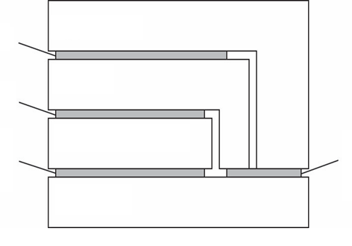
Architectures of Virtual Machines
Four distinct levels of interfaces to computers the behavior of which that virtualization can mimic
  Unprivileged machine instructions: available to any program
  Privileged instructions: hardware interface for the OS/other privileged software
  System calls: interface to the operating system for applications & library functions
  API: An OS interface through library function calls from applications.
Library Functions
Application
Library
System Calls
Privileged Instructions
Operating System
General
Instructions
Hardware

Slide 56
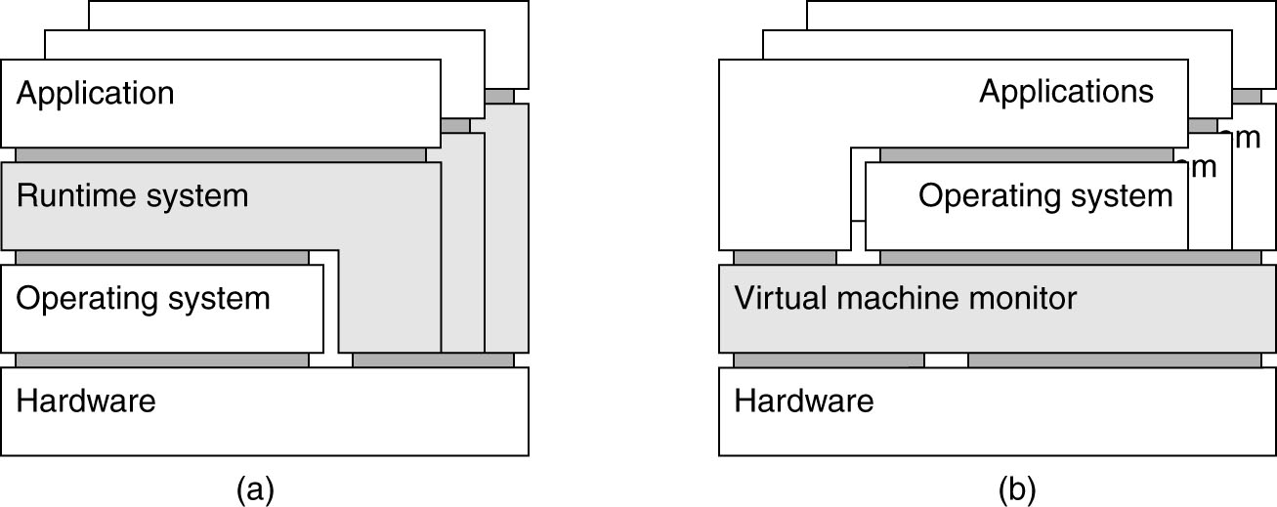
Two Ways to Virtualize
Process Virtual Machine
Virtual Machine Monitor
  program is compiled to intermediate code, executed by a runtime system
  software layer mimics the instruction set; supports an OS and its applications

Slide 57
Clients
A Program, Which interact with a human user or a remote servers
Typically, the users interact with the client via a GUI
The client is the machine (workstation or PC) running the front-end applications.
It interacts with a user through the keyboard, display, and pointing device such as a mouse.
The client has no direct data access responsibilities. It simply requests processes from the server and displays data managed by the server.

Slide 58
Networked User Interfaces
Two ways to support client-server interaction:
For each remote service - the client machine will have a separate counterpart that can contact the service over the network.
  Example: an agenda running on a user's PDA that needs to synchronize with a remote, possibly shared agenda.
  In this case, an application-level protocol will handle the synchronization
Provide direct access to remote services by only offering a convenient user interface.
  The client machine is used only as a terminal with no need for local storage, leading to an application neutral solution as shown in

Slide 59
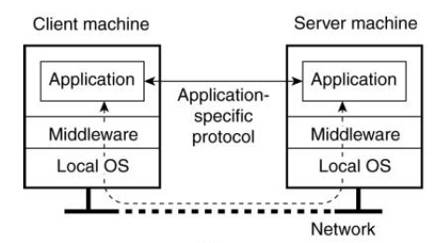
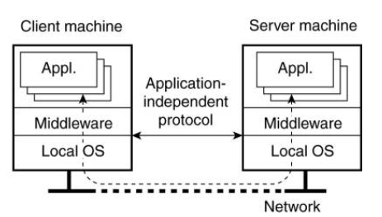
Networked User Interfaces
Networked application with its own protocol
General solution to allow access to remote applications.

Slide 60
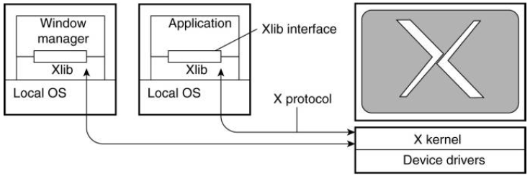
The X Window System
Used to control bit-mapped terminals, which include a monitor, keyboard, and a pointing device such as a mouse.
X kernel is heart of the system.
  Contains all the terminal-specific device drivers - highly hardware dependent
  X kernel offers a low-level interface for controlling the screen and for capturing events from the keyboard and mouse
  This interface is made available to applications as a library called Xlib.
Application Server
Application Server
User's Terminal
Terminal (includes display, keyboard, mouse, etc.)

Slide 61
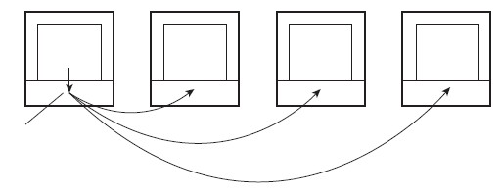
Client-Side Software for Distribution Transparency
Access transparency
  Handled through client-side stubs for RPCs: provides
  Same interface as at the server, hides different machine architectures
Location/migration transparency
  let client-side software keep track of actual location (if server changes location: client rebinds to the server if necessary).
  Hide server locations from user.
Replication transparency
  multiple invocations handled by client stub
Client machine
Server 1
Server 2
Server 3
Client
appl.
Server
appl.
Server
appl.
Server
appl.
Client side handles
Request replication
Replicated request

Slide 62
Client-Side Software for Distribution Transparency
Failure transparency
  Mask server and communication failures: done through client middleware,
  e.g. connect to another machine.
Concurrency transparency
  Handled through special intermediate servers, notably transaction monitors, and requires less support from client software
Persistence transparency
  Completely handled at the server.

Slide 63
Servers
A server is a process implementing a specific service on behalf of a collection of clients.
  Each server is organized in the same way:
  It waits for an incoming request from a client ensures that the request is fulfilled
  It waits for the next incoming request.
  Types of server
  Iterative server
  Concurrent server

Slide 64
Iterative server and Concurrent server
Iterative server
  Process one request at a time
  When an iterative server is handling a request, other connections to that port are blocked.
  The incoming connections must be handled one after another.
  Iterative servers support a single client at a time.
  Much easier to build, but usually much less efficient
Concurrent server
  Process multiple requests simultaneously.
  Concurrent servers support multiple clients concurrently (may or may not use concurrent processes)
  Clients queue for connection, then are served concurrently. The concurrency reduces latency significantly.

Slide 65
Stateless server
  A stateless server is a server that treats each request as an independent transaction that is unrelated to any previous request.
  Example: A Web server is stateless.
  It merely responds to incoming HTTP requests, which can be either for uploading a file to the server or (most often) for fetching a file.
  When the request has been processed, the Web server forgets the client completely.
  The collection of files that a Web server manages (possibly in cooperation with a file server), can be changed without clients having to be informed.

Slide 66
Stateful server
  A stateful server remembers client data (state) from one request to the next.
  Information needs to be explicitly deleted by the server.
  Example:
  A file server that allows a client to keep a local copy of a file, even for performing update operations.
  The server maintains a table containing (client, file) entries.
  This table allows the server to keep track of which client currently has the update permissions on which file and the most recent version of that file
  Improves performance of read and write operations as perceived by the client

Slide 67
Server Clusters
  A server cluster is a collection of machines connected through a network, where each machine runs one or more servers.
  A server cluster is logically organized into three tiers
  First tier
  Second tier
  Third tier

Slide 68
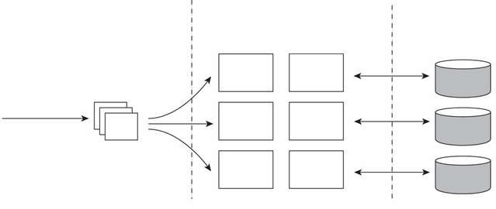
Server Clusters
  First tier - consists of a (logical) switch through which client requests are routed
  The switch (access/replication transparency)
  Second tier - application processing
  Cluster computing
  Enterprise server clusters
  Third tier - data-processing servers - notably file and database servers
  For other applications, the major part of the workload may be here
Logical switch
(possibly multiple)
Application/Compute
Servers
Distributed File/Database
system
Dispatched request
Client request
First tier
Second tier
Third tier

Slide 69
Code Migration
  Traditionally, communication in distributed systems is concerned with exchanging data between processes.
  Code migration in the broadest sense deals with moving programs between machines, with the intention to have those programs be executed at the target
  process migration in which an entire process is moved from one machine to another
  Code migration is often used for load distribution, reducing network bandwidth, dynamic customization, and mobile agents.
  Code migration increases scalability, improves performance, and provides flexibility.
  Reasons for Code Migration:
  Performance
  Flexibility

Slide 70
Performance in Code Migration
  Overall system performance can be improved if processes are moved from heavily-loaded to lightly loaded machines.
  How system performance is improved by code migration?
  Using load distribution algorithms
  Using qualitative reasoning
  Migrating parts of the client to the server
  Migrating parts of the server to the client

Slide 71
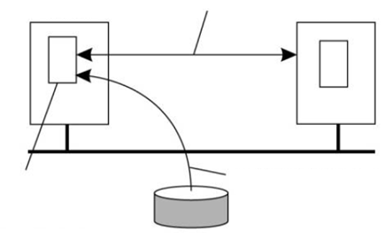
Flexibility in Code Migration
  The traditional approach to building distributed applications is to partition the application into different parts, and decide in advance where each part should be executed.
  For example,
  Suppose a client program uses some proprietary APIs for doing some tasks that are rarely needed, and because of the huge size of the necessary API files, they are kept in a server.
  If the client ever needs to use those APIs, then it can first dynamically download the APIs and then use them.
2. Client and Server
Communicate
  Advantage of this model: Clients need not have all the software preinstalled to do common tasks.
  Disadvantage of this model : Security - blindly trusting that the downloaded code implements only the advertised APIs while accessing your unprotected hard disk
Client
Server
Service-specific
Client-side code
1. Client fetches code
Code repository

Slide 72
Models for Code Migration
  To get a better understanding of the different models for code migration, we use a framework described in Fuggetta et al. (1998).
  In this framework, a process consists of three segments.
  The code segment: It is the part that contains the set of instructions that make up the program that is being executed.
  The resource segment: It contains references to external resources needed by the process, such as files, printers, devices, other processes, and so on.
  The execution segment: It is used to store the current execution state of a process, consisting of private data, the stack, and, of course, the program counter.

Slide 73
Weak Mobility Vs. Strong Mobility
Parameters
Weak Mobility
Strong Mobility
Definition
In
this
model,
it
is
possible
to
transfer
In
contrast
to
weak
mobility,
in
systems
that
support
only
the
code
segment,
along
with
strong
mobility
the
execution
segment
can
be
perhaps
some
initialization
data
.
transferred
as
well
.
Characteristic
A
transferred
program
is
always
started
A
running
process
can
be
stopped,
subsequently
Feature
from
its
initial
state
moved
to
another
machine,
and
then
resume
execution
where
it
left
off
.
Java
applets
–
which
always
start
D’Agents
Example
.
execution
from
the
beginning
Benefit
Simplicity
Much
more
general
than
weak
mobility

Slide 74
Migration Initiation
  Sender-Initiated Migration
  It is initiated at the machine where the code currently resides or is being executed
  Examples:
  Uploading programs to a compute server.
  Sending a search program across the Internet to a web database server to perform the queries at that server.
  Receiver-Initiated Migration
  The initiative for code migration is taken by the target machine
  Example: Java applets.

Slide 75
Alternatives for code migration
Execute at target process
Sender-Initiated mobility
Execute in separate process
Weak mobility
Execute at target process
Receiver-Initiated mobility
Mobility mechanism
Execute in separate process
Migrate process
Sender-Initiated mobility
Strong mobility
Clone process
Migrate process
Receiver-Initiated mobility
Clone process

Slide 76
Execute Migrated Code for weak mobility
  In the case of weak mobility, it also makes a difference if the migrated code is executed by the target process, or whether a separate process is started.
  For example, Java applets are simply downloaded by a web browser and are executed in the browser's address space.
  Benefit for executing code at target process: There is no need to start a separate process, thereby avoiding communication at the target machine.
  Drawback for executing code at target process: The target process needs to be protected against malicious or inadvertent code executions.

Slide 77
Migrate or Clone Process (for strong mobility)
  Instead of moving a running process, also referred to as process migration, strong mobility can also be supported by remote cloning.
  In contrast to process migration, cloning yields an exact copy of the original process, but now running on a different machine.
  The cloned process is executed in parallel to the original process.
  Benefit of cloning process: The model closely resembles the one that is already used in many applications. The only difference is that the cloned process is executed on a different machine.
  In this sense, migration by cloning is a simple way to improve distribution transparency.

Slide 78
Migration and Local Resources
  What often makes code migration so difficult is that the resource segment cannot always be simply transferred along with the other segments without being changed.
  When the process moves to another location, it will have to give up the port and request a new one at the destination.
  Process-to-Resource Bindings
  Binding by Identifier
  Binding by Value
  Binding by Type

Slide 79
Process-to-Resource Bindings
  Binding by Identifier
  A process refers to a resource by its identifier. In that case, the process requires precisely the referenced resource, and nothing else.
  Examples:
  A URL to refer to a specific web site.
  Local communication endpoints (IP, port etc.)
  Binding by Value
  Only the value of a resource is needed. In that case, the execution of the process would not be affected if another resource would provide the same value.
  Example: Standard libraries for programming languages.
  Binding by Type
  A process indicates it needs only a resource of a specific type.
  Example: References to local devices, such as monitors, printers and so on.

Slide 80
Resource Types
  When migrating code, we often need to change the references to resources, but cannot affect the kind of process-to-resource binding.
  Resource Types:
  Unattached resources :
  They can be easily moved between different machines.
  Example: Typically (data) files associated only with the program that is to be migrated.
  Fastened resources:
  They may be copied or moved, but only at relatively high costs.
  Example: Local databases and complete web sites.
  Although such resources are, in theory, not dependent on their current machine, it is often infeasible to move them to another environment.
  Fixed resources:
  They are intimately bound to a specific machine or environment and cannot be moved.
  Example: Local devices, local communication end points

Slide 81
Managing Local Resources
  Combining three types of process-to-resource bindings, and three types of resource-to-machine bindings, leads to nine combinations that we need to consider when migrating code
Resource-to-machine Binding
 | Unattached | Fastened | Fixed
By Identifier | MV (or GR) | GR (or MV) | GR
By Value | CP (or MV, GR) | GR (or CP) | GR
By Type | RB (or MV, CP) | RB (or GR, CP) | RB (or GR)
Process-to-resource Binding
GR Establish global system wide reference
MV Move the resource
CP Copy the value of the resource
RB Re-bind to a locally available resource

Slide 82
Migration in Heterogeneous Systems
  Heterogeneous System: different OS and machine architecture
  If week mobility
  No runtime information (execution segment) needed to be transferred
  Just compiler the source code to generate different code segments, one for each potenital target machine
  But how execution segment is migrated at strong mobility?
  Execution segment: data private to the process, stack, PC
  Idea: avoid having execution depend on platform-specific data (like register values in the stack)

Slide 83
Migration in Heterogeneous Systems
  Solutions:
  First, code migration is restricted to specific points
  Only when a next subroutine is called
  Then, running system maintains its own copy of the stack, called migration stack, in a machine-independent way
  Updated when call a subroutine or return from a subroutine
  Finally, when migrate
  The global program-specific data are marshaled along with the migration stack are sent
  The dest. load the code segment fit for its arch. and OS.
  It only works if compiler supports such as stack and a suitable runtime system

Slide 84
Communication in a Distributed System
  In a distributed system, processes run on different machines.
  Processes can only exchange information through message passing.
  Harder to program than shared memory communication
  Successful distributed systems depend on communication models that hide or simplify message passing
  Communication in distributed systems is always based on low-level message passing as offered by the underlying network.

Slide 85
Layered Network Communication Protocols
  Physical layer:
Transmitting bits between sender and receiver
Functions of a Physical layer: Line Configuration, Data Transmission, Topology, Signals
Data link layer:
transmitting frames over a link, error detection and correction
Functions of a Datalink layer: Framing, Flow Control, Error Control, Access Control
  Network layer:
Routing of packets between source host and destination host
  IP – Internet’s network layer protocol
Application protocol
Application
7
Presentation
Presentation protocol
6
Session
Session protocol
5
Transport protocol
Transport
4
Network
Network protocol
3
Data link protocol
Data link
2
Physical protocol
Physical
1
Network

Slide 86
Layered Network Communication Protocols
  Transport layer:
  Process‐to‐process communication
  TCP and UDP ‐ Internet’s transport layer protocols
  TCP: Connection‐oriented, Reliable communication
  UDP: Connectionless, Unreliable communication
  Session layer:
It establishes, manages, and terminates the connections between the local and remote application.
Functions of Session layer: Dialog control, Synchronization
Application protocol
Application
7
Presentation
Presentation protocol
6
Session
Session protocol
5
Transport protocol
Transport
4
Network
Network protocol
3
Data link protocol
Data link
2
Physical protocol
Physical
1
Network

Slide 87
Layered Network Communication Protocols
  Presentation layer:
  Transforms data to provide a standard interface for the Application layer.
  Functions of Presentation layer:
  MIME encoding
  Data compression
  Data encryption
  Application layer:
Provides means for the user to access information on the network through an application
It serves as a window for users and application processes to access network service.
Application protocol
Application
7
Presentation
Presentation protocol
6
Session
Session protocol
5
Transport protocol
Transport
4
Network
Network protocol
3
Data link protocol
Data link
2
Physical protocol
Physical
1
Network

Slide 88
Middleware Layer
  Middleware provides common services and protocols that can be used by many different applications
  High‐level communication services, e.g., RPC, multicasting
  Security protocols, e.g., authentication protocols, authorization protocols
  Distributed locking protocols for mutual exclusion
  Distributed commit protocols
Application protocol
Application
6
Middleware
Middleware protocol
5
Transport
Transport protocol
4
Network
Network protocol
3
Data link protocol
Data link
2
Physical protocol
Physical
1
Network

Slide 89
OSI Model
Application Layer
Application layer is used by Network applications.
Example: browsers
Data
Compression
Translation
Encryption
Presentation Layer
EDB12345AB
1010110010
10110100
01010101
Session Management – Securing multiple requests to a service from the same user.
Authentication - Who you are?
Authorization - Rules that determine who is allowed to do what.
Decryption
Session Layer
Segmentation: Received data divided into small data units called segments.
Flow control: It controls amount of data being transmitted.
Error Control: It is the process of detecting and correcting corrupted segments.
Transport Layer
Logical addressing
Routing
Path determination
Network Layer
Physical addressing
Media access control
Error correction
Data Link Layer
Physical Layer

Slide 90
OSI Model (Layers & Activities)
OSI Layers
Activities
Application
To allow access to network resources.
Presentation
To translate, compress, and encrypt/decrypt data.
Session
To establish, manage, and terminate session.
Transport
To provide reliable process-to-process
message delivery and error recovery.
Network
To move packets from source to destination;
To provide internetworking.
Data Link
To organize bits into frames;
To provide hop-to-hop delivery.
Physical
To transmit bits over a medium;
To provide mechanical and electrical specifications.

Slide 91
Types of Communication
  Transient Vs. Persistent communication
  Synchronous Vs. Asynchronous communication

Slide 92
Transient Vs. Persistent communication
  Transient Communication
  Here, Sender and receiver run at the same time based on request/response protocol, the message is expected otherwise it will be discarded.
  Middleware discards a message if it cannot be delivered to receiver immediately
  Messages exist only while the sender and receiver are running.
  Communication errors or inactive receiver cause the message to be discarded.
  Transport-level communication is transient
  Persistent Communication
  Messages are stored by middleware until receiver can accept it
  Receiving application need not be executing when the message is submitted.
  Example: Email

Slide 93
Synchronous Vs Asynchronous Communication
  Synchronous Communication
  Sender blocks until its request is known to be accepted
  Sender and receiver must be active at the same time
  Sender execution is continued only if the previous message is received and processed.
  Asynchronous Communication
  Sender continues execution immediately after sending a message
  Message stored by middleware upon submission
  Message may be processed later at receiver’s convenience

Slide 94
Distributed Communications Classifications
  Persistent asynchronous communication.
  Persistent synchronous communication.
  Transient asynchronous communication.
  Transient synchronous communication.
  Receipt-based transient synchronous communication.
  Delivery-based transient synchronous communication at message delivery.
  Response-based transient synchronous communication.

Slide 95

Distributed Communications Classifications
A sends message and continues.
A stopped running.
A sends message and waits until accepted.
A stopped running.
A
A
Message is stored at B’s location for later delivery.
Accepted
Time
→
Time
→
B
B
B is not running
B starts and receives message.
B is not running
B starts and receives message.
Persistent synchronous communication
Persistent asynchronous communication

Slide 96
Distributed Communications Classifications
A sends message and continues.
A sends message and waits until received.
A
A
Message can be sent only if B is running.
Request is received.
ACK
Time
→
Time
→
B
B
B receives message.
B is running but doing something else.
B processes request.
Transient asynchronous communication
Receipt-based synchronous communication

Slide 97
Distributed Communications Classifications
A sends request and waits until accepted.
A sends request and waits for reply.
A
A
Request is received.
Accepted
Accepted
Time
→
Request is received.
Time
→
B
B
B is running but doing something else.
Process request
B is running but doing something else.
Process request
Delivery-based synchronous communication
Response-based synchronous communication

Slide 98
Message Passing
It refers to means of communication between
  Different thread with in a process .
  Different processes running on same node.
  Different processes running on different node.
In this a sender or a source process send a message to a non receiver or destination process.
Message has a predefined structure and message passing uses two system call: Send and Receive
  send(name of destination process, message)
  receive(name of source process, message)
Mode of communication between two process can take place through two methods
  Direct Addressing
  Indirect Addressing
P1
Send
P2
Receive
Sender
Receiver

Slide 99
Client Server Model
Following are different types of packets transmitted across the network.
  REQ: Request packet is used to send the request from the client to the server.
  Reply: This message is used to carry the result from the server to the client.
  ACK: Acknowledgement packet is used to send the correct receipt of the packet to the sender.
  Are You Alive (AYA)?: This packet is sent in case the server takes a long time to complete the client's request.
  I am Alive (IAA): The server, if active, replies with this packet.

Slide 100
Client Server Model Interaction
Two processes in client-server model can interact in various ways:
  Sockets
  Remote Procedure Calls (RPC)
Socket
The process acting as server opens a socket using a well-known port and waits until some client request comes.
The second process acting as a client also opens a socket but instead of waiting for an incoming request, the client processes ‘requests first’.
Server Program
Client Program
Socket
Socket
Transport
Transport
Network
Network
Data link
Data link
Physical
Physical

Slide 101
Remote Procedure Call (RPC)
Low level message passing is based on send and receive primitives.
Remote Procedure Call (RPC) is a protocol that one program can use to request a service from a program located in another computer on a network without having to understand the network's details.
A procedure call is also sometimes known as a function call or a subroutine call.
More sophisticated is allowing programs to call procedures located on other machines.
RPC is a request–response protocol, i.e., it follows the client-server model
wait for result
Client
call remote procedure
return from call
Request
Reply
Server
call local procedure and return results
time

Slide 102
RPC Model
It is similar to commonly used procedure call model. It works in the following manner:
  For making a procedure call, the caller places arguments to the procedure in some well specified location.
  Control is then transferred to the sequence of instructions that constitutes the body of the procedure.
  The procedure body is executed in a newly created execution environment that includes copies of the arguments given in the calling instruction.
  After the procedure execution is over, control returns to the calling point, returning a result.

Slide 103
Conventional Procedure Call
Consider a call in C like
where
  fd is an integer indicating a file
  buf is an array of characters into which data are read
  nbytes is another integer telling how many bytes to read
Stack pointer
count = read(fd, buf, nbytes);
Main programs’s
Local variables
Main programs’s
Local variables
nbytes
buf
fd
return address
read’s local
variables
The stack while the called procedure is active
The stack before the call

Slide 104
Functions of RPC Elements
  The Client
  It is user process which initiates a remote procedure call
  The client makes a perfectly normal call that invokes a corresponding procedure in the client stub.
  The Client stub
  On receipt of a request it packs a requirements into a message and asks the local RPCRuntime to send it to the server stub.
  On receipt of a result it unpacks the result and passes it to client.

Slide 105
Functions of RPC Elements
  RPCRuntime
  It handles transmission of messages between client and server.
  It is responsible for
  Retransmission
  Acknowledgement
  Routing and Encryption
  The Server stub
  It unpacks a call request and make a perfectly normal call to invoke the appropriate procedure in the server.
  On receipt of a result of procedure execution it packs the result and asks to RPCRuntime to send.
  The Server
  It executes a appropriate procedure and returns the result from a server stub.

Slide 106
RPC Mechanism
Client Machine
Server Machine
Client
Server
Return
Call
Call
Execute
Return
Client Stub
Server Stub
Unpack
Pack
Unpack
Pack
RPCRuntime
RPCRuntime
Receive
Send
Receive
Send
Call Packet
Request Packet

Slide 107
RPC Mechanism
Client Machine
Client Machine
The client process call the server procedure.
Just like local procedure call, the client process sends the arguments required for the execution of the program.
As it happened the client system, the server stub packs the return value into a message, and sends it to the RPC runtime system.
The underlying layers of the communication system will then send the message back to the client system.
During the execution of a program, the client feels the need to call the server procedure.
The client process has passed the parameter for the server process, but server can only understand message, not parameters.
The client stub packs the arguments in the form of message.
It sends the message to the server system.
Sockets are used in the communication between the client and server.
It passes the message to the underlying communication layers.
The server stub unpack the parameters.
It calls the desired server routine using the regular procedure call mechanism.
The server stub and the client stub must share the same standards of encoding the parameters, else the parameters could be misread at the server end.
The client system captures the packets, parses and sends the message to the client stub.
Client stub unpacks the parameters and sends the return value to the client process.
The client process which was blocked till now, is activated and the process continues its execution.
The process running on the server recognizes the parameters and performs the required operations, and sends the return value to the server stub.
The server procedure feels that the caller process is the server stub, and has no idea about the client process.
Client
The receiver socket at the server end receives the packets from the client and recognized that it is a procedure call.
The message is then redirected to the server stub.
Server
Return
Call
Call
Execute
Return
Return
Client Stub
Server Stub
Unpack
Pack
Unpack
Pack
RPCRuntime
RPCRuntime
Receive
Wait
Send
Receive
Send
Call Packet
Request Packet

Slide 108
RPC Mechanism
Client procedure calls client stub.
Remote OS gives message to server stub.
Client stub builds message, and calls local OS.
Client’s OS sends message to remote OS.
Server stub unpacks parameters, calls server.
Client Machine
Server Machine
Client process
Server process
8 ← add(3, 5)
K=add(3, 5)
Implementation of add
Client stub (RPC library)
Server stub (RPC library)
proc: add | int: 3 | int: 5
proc: add | int: 3 | int: 5
Client OS
Server OS
proc: add | int: 3 | int: 5
proc: add | int: 3 | int: 5

Slide 109
RPC Mechanism
Server’s OS sends message to the client’s OS.
Server does work, returns result to the stub.
Stub unpacks result, returns to client.
Server stub packs it in message, calls local OS.
Client’s OS gives message to client stub.
Client Machine
Server Machine
Client process
Server process
8 ← add(3, 5)
K = 8
Implementation of add
K=add(3, 5)
Client stub (RPC library)
Server stub (RPC library)
Result | int: 8
Result | int: 8
Client OS
Server OS
Result | int: 8
Result | int: 8

Slide 110
Steps in a Remote Procedure Call
The client calls a local procedure, called the client stub.
Network messages are sent by the client stub to the remote system (via a system call to the local kernel using sockets interfaces).
Network messages are transferred by the kernel to the remote system via some protocol (either connectionless or connection-oriented).
A server stub, sometimes called the skeleton, receives the messages on the server. It unmarshals the arguments from the messages.
The server stub calls the server function, passing it the arguments that it received from the client.
When server function is finished, it returns to the server stub with its return values.
The server stub converts the return values, if necessary, and marshals them into one or more network messages to send to the client stub.

Slide 111
Steps in a Remote Procedure Call
Messages get sent back across the network to the client stub.
The client stub reads the messages from the local kernel.
The client stub then returns the results to the client function, converting them from the network representation to a local one if necessary.

Slide 112
Server Management
  Stateful File Servers
A stateful server maintains client’s state information from one remote procedure call to the next.
These clients state information is subsequently used at the time of executing the second call.
To illustrate how a stateful file server works, let us consider a file server for byte-stream files that allows the following operations on files:
  Open(filename, mode)
  Read(fid, n, buffer)
  Write(fid, n, buffer)
  Seek(fid, position)
  Close(fid)

Slide 113
Stateful File Server
After opening a file, if a client makes two subsequent Read (fid, 100, buf) requests, for the first request the first 100 bytes (bytes 0 to 99) will be read and for the second request the next 100 bytes (bytes 100 to 199) will be read.
Client Process
Open(filename, mode)
Server Process
File Table
Return(fid)
Fid | Mode | R/w Pointer
Read(fid, 100, buf)
Return (bytes 0 to 99)
Read(fid, 100, buf)
Return (bytes 100 to 199)

Slide 114
Stateless File Server
A stateless file server does not maintain any client state information.
Therefore every request from a client must be accompanied with all the necessary parameters to successfully carry out the desired operation.
Each request identifies the file and the position in the file for the read/write access.
Operations on files in Stateless File server:
  Read(filename, position, n, buffer): On execution, the server returns n bytes of data of the file identified by filename.
  Write(filename, position, n, buffer): On execution, it takes n bytes of data from the specified buffer and writes it into the file identified by filename.

Slide 115
Stateless File Server
Client Process
This file server does not keep track of any file state information resulting from a previous operation.
Therefore, if a client wishes to have similar effect as previous figure, the following two read operations must be carried out:
  Read(filename, 0, 100, buffer)
  Read(filename, 100, 100, buffer)
Server Process
File Table
Read(filename,0, 100, buf)
Fid | Mode | R/w Pointer
Return (bytes 0 to 99)
Read(filename,100, 100, buf)
Return (bytes 100 to 199)

Slide 116
Difference between Stateful & Stateless
Parameters | Stateful | Stateless
State | A Stateful server remember client data (state) from one request to the next. | A Stateless server does not remember state information.
Programming | Stateful server is harder to code. | Stateless server is straightforward to code.
Efficiency | More because clients do not have to provide full file information every time they perform an operation. | Less because information needs to be provided.
Crash recovery | Difficult due to loss of information. | Can easily recover from failure because there is no state that must be restored.
Information transfer | The client can send less data with each request. | The client must specify complete file names in each request.
Operations | Open, Read, Write, Seek, Close | Read, Write

Slide 117
Passing Value Parameters
Packing parameters into a message is called parameter marshaling.
Client and server machines may have different data representations (think of byte ordering)
Wrapping a parameter means transforming a value into a sequence of bytes
Client and server have to agree on the same encoding:
  How are basic data values represented (integers, floats, characters)
  How are complex data values represented (arrays, unions)
Client and server need to properly interpret messages, transforming them into machine-dependent representations.
Possible problems:
  IBM mainframes use EBCDIC char code and IBM PC uses ASCII code
  Integer: one’s complement and 2’s complement
  Little endian and big endian

Slide 118
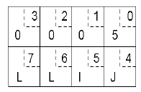
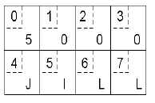
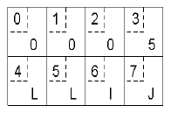
Passing Value Parameters
Original message on the Pentium
The message after receipt on the SPARC
The message after being inverted

Slide 119
Asynchronous RPC
A shortcoming of the original model: no need of blocking for the client in some cases.
There are two cases
  If there is no result to be returned
  If the result can be collected later

Slide 120
Asynchronous RPC
1. If there is no result to be returned
  e.g., inserting records in a database, ...
  The server immediately sends an ack promising that it will carryout the request
Client
wait for result
wait for acceptance
client
call remote procedure
return from call
call remote procedure
return from call
request
reply
request
accept request
Server
server
call local procedure and return results
call local procedure
time
time
The interconnection between client and server in a traditional RPC
The interaction using asynchronous RPC

Slide 121
Asynchronous RPC
1. If the result can be collected later
  Example: prefetching network addresses of a set of hosts, ...
  The server immediately sends an ACK promising that it will carryout the request
  The client can now proceed without blocking
  The server later sends the result
Wait for acceptance
Interrupt client
Client
Call remote procedure
Return from call
Return results
Acknowledge
Accept request
Request
Server
Call local procedure
Time
Call client with asynchronous RPC
A client and server interacting through two asynchronous RPCs

Slide 122
Message-oriented Transient Communication
Messages are sent through a channel abstraction
The channel connects two running processes
Time coupling between sender and receiver
Transmission time is measured in terms of milliseconds, typically
Examples
  Berkeley Sockets — typical in TCP/IP-based networks
  MPI (Message-Passing Interface) — typical in high-speed
  interconnection networks among parallel processes
  Socket - communication end point to which an application can write data that are to be sent out over the underlying network, and from which incoming data can be read.

Slide 123
Berkeley Sockets
Primitive | Meaning
Primitive | Meaning
Socket | Create a new communication end point
Connect | Actively attempt to establish a connection
Send | Send some data over the connection
Bind | Attach a local address to a socket
Receive | Receive some data over the connection
Listen | Announce willingness to accept connections
Close | Release the connection
Write | Send data on the connection
Accept | Block caller until a connection request arrives
Read | Get data that was sent on the connection
Server
socket
bind
listen
accept
read
write
close
Synchronization point
Communication
Socket
connect
write
read
close
Client

Slide 124
The Message-Passing Interface (MPI)
The Message Passing Interface (MPI) is a library specification for message passing.
It is a standard API that can be used to create applications for high-performance multicomputers.
Specific network protocols (not TCP/IP)
Message-based communication
Primitives for all 4 forms of transient communication (+ variations)
Vendors + Open Source
  IBM, Intel, TMC, Meiko, Cray, Convex, Ncube, OpenMPI

Slide 125
Message-passing primitives of MPI
Primitive | Meaning
MPI_bsend | Append outgoing message to a local send buffer
MPI_send | Send a message and wait until copied to local or remote buffer
MPI_ssend | Send a message and wait until receipt starts
MPI_sendrecv | Send a message and wait for reply
MPI_isend | Pass reference to outgoing message, and continue
MPI_issend | Pass reference to outgoing message, and wait until receipt starts
MPI_recv | Receive a message; block if there is none
MPI_irecv | Check if there is an incoming message, but do not block

Slide 126
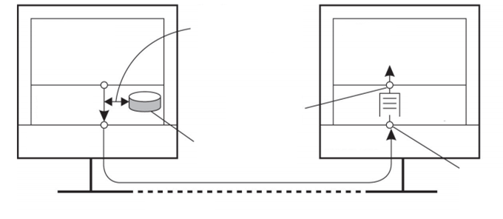
Message-Oriented Persistent Communication
Message-queuing systems –Message-Oriented Middleware (MOM)
  Basic idea: MOM provides message storage service.
  A message is put in a queue by the sender, and delivered to a destination queue
  The target(s) can retrieve their messages from the queue
  Time uncoupling between sender and receiver
  Example: email
Sender
Receiver
Queuing layer
Queue-level
address
Queuing layer
Local OS
Address look-up database
Local OS
Transport-level address
Network

Slide 127
Message-Queuing Model
  The persistency is fulfilled by the various queues in the system
  Each application has a private queue to which other applications can send messages
  Message-queuing systems guarantee that the message eventually will be inserted in recipient’s queue
  No guarantee about when it is delivered
  No guarantee whether the message will ever be read at all
  Loosely-coupled communication
  Systemwide unique name of the destination queue is used for addressing

Slide 128
Loosely-Coupled Communication
Sender
running
Sender
running
Sender
passive
Sender
passive
Receiver
running
Receiver
passive
Receiver
running
Receiver
passive

Slide 129
Message-Oriented Persistent Communication
Four Commands:
Primitive | Meaning
Put | Append a message to a specified queue.
Get | Block until the specified queue is nonempty, and remove the first message.
Poll | Check a specified queue for messages, and remove the first. Never block.
Notify | Install a handler to be called when a message is put into the specified queue.

Slide 130
General Architecture of a Message-Queuing System
  Messages can be put only into queues that are local to the sender (same machine or on a nearby machine on a LAN)
  Such a queue is called the source queue
  Messages can also be read only from local queues
  A message put into a local queue must contain the specification of the destination queue; hence a messagequeuing system must maintain a mapping of queues to network locations; like in DNS
Look-up
Transport-level
Address of Queue
Sender
Receiver
Queuing layer
Queue-level
address
Queuing layer
Local OS
Address look-up database
Local OS
Transport-level address
Network

Slide 131
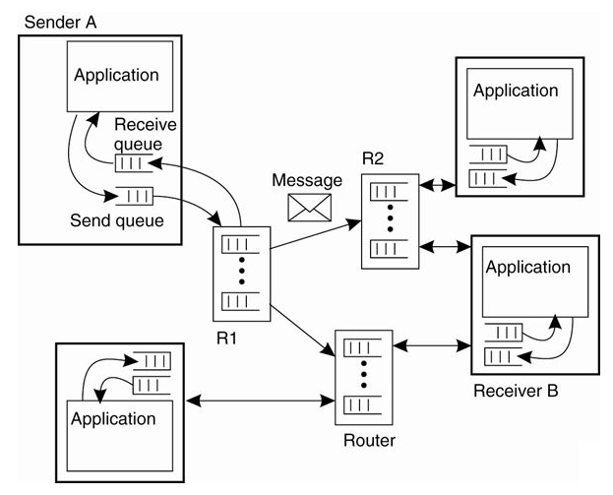
General organization of a message-queuing system with routers
  Messages are managed by queue managers
  They generally interact with the application that sends and receives messages
  Some also serve as routers or relays, i.e., they forward incoming messages to other queue managers
  However, each queue manager needs a copy of the queueto-location mapping, leading to network management problems for large-scale queuing systems
  The solution is to use a few routers that know about the network topology

Slide 132
Stream-Oriented Communication
RPC, RMI, message-oriented communication are based on the exchange of discrete messages
  Timing might affect performance, but not correctness
In stream-oriented communication the message content must be delivered at a certain rate, as well as correctly.
  e.g., music or video
Audio and video are time-dependent data streams – if the timing is off, the resulting “output” from the system will be incorrect.
Time-dependent information – known as “continuous media” communications.
Example:
  Voice: PCM: 1/44100 sec intervals on playback.
  Video: 30 frames per second (30-40 msec per image).

Slide 133
Transmission Modes in Stream-Oriented Communication
Asynchronous transmission mode – the data stream is transmitted in order, but there’s no timing constraints placed on the actual delivery (e.g., File Transfer).
Synchronous transmission mode – the maximum end-to-end delay is defined (but data can travel faster).
Isochronous transmission mode – data transferred “on time” – there’s a maximum and minimum end-to-end delay (known as “bounded jitter”).
  Known as “streams” – isochronous transmission mode is very useful for multimedia systems.
  e.g., audio & video

Slide 134
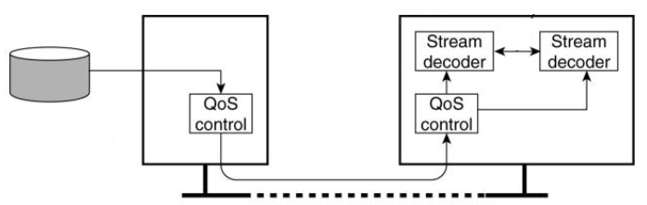
Types of Streams in Stream-Oriented Communication
Simple Streams – one single sequence of data, for example: voice
Complex Streams – several sequences of data (substreams) that are “related” by time.
  Think of a lip synchronized movie, with sound and pictures, together with sub-titles
  This leads to data synchronization problems … which are not at all easy to deal with
Stream synchronization
Multimedia server
Client
Compressed multimedia data
Network
A general architecture for streaming stored multimedia data over a network

Slide 135
Quality of Service
  Ensuring that the temporal relationships in the stream can be preserved
  Streams are all about timely delivery of data.
  How do you specify this Quality of Service (QoS)?
  Basics:
  The required bit rate at which data should be transported
  The maximum delay until a session has been set up (i.e., when an application can start sending data)
  The maximum end-to-end delay (i.e., how long it will take until a data unit makes it to a recipient)
  The maximum delay variance, or jitter
  The maximum round-trip delay

Slide 136
Multicast Communication
  Application-level multicasting
  Gossip-based data dissemination

Slide 137
Application-level multicasting
  Basic idea: organize nodes of a distributed system into an overlay network and use that network to disseminate data
  Multicast tree construction in Chord
  Initiator generates a multicast identifier mid.
  Lookup succ(mid), the node responsible for mid.
  Request is routed to succ(mid), which will become the root.
  If P wants to join, it sends a join request to the root
  When request arrives at Q
  Q has not seen a join request for mid before ➔ it becomes forwarder; P becomes child of Q. Join request continues to be forwarded.
  Q is already a forwarder for mid ➔ P becomes child of Q. No need to forward join request anymore.

Slide 138
Gossip‐Based Data Dissemination
  Use epidemic algorithm to rapidly propagate information among a large collection of nodes with no central coordinator
  Assume all updates for a specific data item are initiated at a single node
  Upon an update, try to “infect” other nodes as quickly as possible
  Pair‐wise exchange of updates (like pair‐wise spreading of a disease)
  Eventually, each update should reach every node
  Terminology:
  Infected node: node with an update it is willing to spread
  Susceptible node: node that is not yet updated

