Slide 1

Unit-3
Naming
Distributed System (DS)
GTU #3170719
Prof. Umesh H. Thoriya
Computer Engineering Department
umesh.thoriya@darshan.ac.in
9714233355

Slide 2

Looping
Topics to be covered
  Names
  Identifiers
  Addresses
  Flat Naming
  Structured Naming
  Attribute-Based Naming

Slide 3
Names, identifiers, and addresses
Name: set of bits/characters used to identify/refer to an entity, a collective of entities, etc. in a context
    Simply comparing two names, we might not be able to know if they refer to the same entity
Identifier: a name that uniquely identifies an entity
    The identifier is unique and refers to only one entity
Address: the name of an access point, the location of an entity
    e.g. phone number, or IP-address + port for a service

Slide 4
Naming
Names (character or bit strings) are used to denote entities in a distributed system.
Entity: resources, processes, users, mailboxes, newsgroups, queues, web pages, etc.
To operate on an entity, we need an access point.
An access points is a special kind of entity whose name is called address
    The address of an access point of an entity is also called an address of that entity
    An entity may offer more than one access point
    Access point of an entity may change
    Can be human-friendly(or not) and location dependent(or not)
    Naming systems are classified into three classes based on the type of names used:
  Flat naming
  Structured naming
  Attribute-based naming

Slide 5
Identifiers
A true identifier is a name with the following properties:
  P1: An identifier refers to at most one entity
  P2: Each entity is referred to by at most one identifier
  P3: An identifier always refers to the same entity
Addresses and identifiers are two important types of names that are each used for different purposes
Human-friendly names - UNIX file names

Slide 6
True identifier
The purpose of a name is to identify an entity and act as an access point to it.
To fulfil the role of true identifier,
    Name refers to only one entity
    Different names refer to different entities
    Name always refers to the same entity (i.e. it is not reused)

Slide 7
Name Resolution
Given a path name, it is easy to lookup information stored in the node for the entity in name space
The process of looking up a name is called name resolution.
Example:
    N:<label-1, label-2, …, label-n>
    Resolution starts at N, looking up the directory table returns the identifier for the node that label-1 refers to, N1
    Second, looking up the label-2 in directory table of the node N1, and so on
    Resolution stops at node referred to by label-n by returning the content of that node

Slide 8
Flat Naming
Flat names are fixed size bit strings
    Can be efficiently handled by machines
    Identifiers are flat names
In flat naming, identifiers are simply random bits of strings (known as unstructured or flat names)
Flat name does not contain any information on how to locate an entity
How to resolve flat names?
    Broadcasting
    Forwarding pointers
    Home-based approaches: Mobile IP
    Distributed Hash Tables: Chord

Slide 9


Broadcasting
Approach: Broadcast the identifier to the complete network. The entity associated with the identifier responds with its current address
Example: Address Resolution Protocol (ARP)
    Resolve an IP address to a MAC address.
    In this application
    IP address is the identifier of the entity
    MAC address is the address of the access point
Challenges:
    Not scalable in large networks
    This technique leads to flooding the network with broadcast messages
    Requires all entities to listen to all requests
Who has the address 192.168.0.1?
x
x
I am 192.168.0.1. My identifier is 02:AB:4A:3C:59:85

Slide 10
Forwarding Pointers
Forwarding Pointers enables locating mobile entities
    Mobile entities move from one access point to another
    When an entity moves from location A to location B, it leaves behind (in A) a reference to its new location at B
Name resolution mechanism
    Follow the chain of pointers to reach the entity
    Update the entity’s reference when the present location is found
Challenges:
    Long chains lead to longer resolution delays
    Long chains are prone to failure due to broken links

Slide 11

Forwarding Pointers – An Example
Stub-Scion Pair (SSP) chains implement remote invocations for mobile entities using forwarding pointers
    Server stub is referred to as Scion in the original paper
Each forwarding pointer is implemented as a pair: (client stub, server stub)
    The server stub contains a local reference to the actual object or a local reference to another client stub
When object moves from A (e.g., P2) to B (e.g., P3),
    It leaves a client stub at A (i.e., P2)
    It installs a server stub at B (i.e., P3)
Process P1
Process P2
Process P3
Process P4
= Process n;
= Remote Object;
= Caller Object;
= Server stub;
= Client stub
n

Slide 12
Home-Based Approaches
Each mobile entity has a fixed IP address (home address)
    Entity’s home address is registered at a naming service
    Home node keeps track of current address of the entity (care‐of address)
    Entity updates the home about its current address (care‐of address) whenever it moves
    Name resolution
    Client contacts the home to obtain the current address
    Client then contacts the entity at the current location
    Challenges:
    Home address is permanent for an entity’s lifetime
    If the entity permanently moves, then a simple home-based approach incurs higher communication overhead
    Poor geographical scalability
    Consider the scenario where the clients are nearer to the mobile entity than the home entity

Slide 13
Home-Based Approaches
Single-tiered scheme:
Let a home keep track of where the entity is
    An entity’s home address is registered at a naming service
    The home registers the foreign address of the entity
    Clients always contact the home first, and then continues with the foreign location
    Two-tiered scheme:
    Keep track of visiting entities:
    Check local visitor register first
    Fall back to home location if local lookup fails

Slide 14



Home-based approaches – An example
1. Update home node about the foreign address
Mobile entity
Home node
2. Client sends the packet to the mobile entity at its home node
3a. Home node forwards the message to the foreign address of the mobile entity
3b. Home node replies the client with the current IP address of the mobile entity
4. Client directly sends all subsequent packets directly to the foreign address of the mobile entity

Slide 15
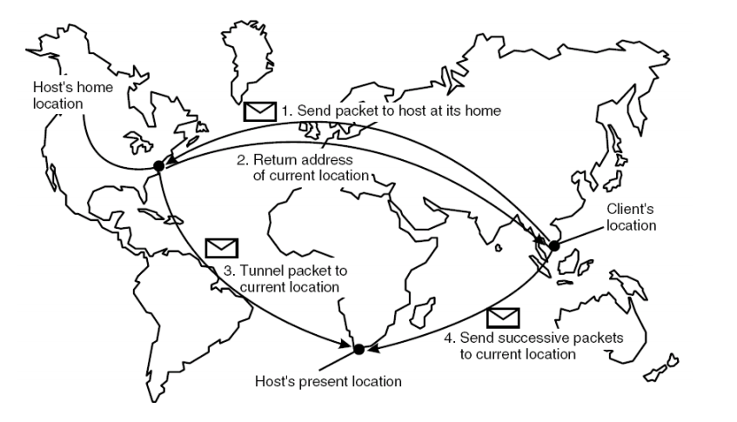
Home-based approaches – An example

Slide 16
Distributed Hash Tables/Chord
Chord is representative of other DHT approaches
It is based on an m-bit identifier space: both host node and entities are assigned identifiers from the name space.
    Entity identifiers are also called keys.
    Entities can be anything at all
    An m-bit identifier space = 2^{m} identifiers.
    m is usually 128 or 160 bits, depending on hash function used.
    Each node has an m-bit id, obtained by hashing some node identifier (IP address?)
    Each entity has a key value, determined by the application (not Chord) which is hashed to get its m-bit identifier k
    Nodes are ordered in a virtual circle based on their identifiers.
    An entity with key k is assigned to the node with the smallest identifier id such that id ≥ k. (the successor of k)

Slide 17
Chord
Each node p knows its immediate neighbors, its immediate successor, succ(p + 1) and its predecessor, denoted pred(p).
When given a request for key k, a node checks to see if it has the object whose id is k. If so, return the entity; if not, forward request to one of its two neighbors.
Requests hop through the network one node at a time.

Slide 18
Chord
DHT is a distributed system that provides a lookup service similar to a hash table
    (key, value) pair is stored in the nodes participating in the DHT
    The responsibility for maintaining the mapping from keys to values is distributed among the nodes
    Any participating node can serve in retrieving the value for a given key
DATA
KEY
DISTRIBUTED NETWORK
Pink Panther
Hash function
ASDFADFAD
Participating Nodes
cs.qatar.cmu.edu
Hash function
DGRAFEWRH
86.56.87.93
Hash function
4PINL3LK4DF

Slide 19
Chord
Chord assigns an m-bit identifier (randomly chosen) to each node
    A node can be contacted through its network address
Alongside, it maps each entity to a node
    Entities can be processes, files, etc.,
Mapping of entities to nodes
    Each node is responsible for a set of entities
    An entity with key k falls under the jurisdiction of the node with the smallest identifier id >= k. This node is known as the successor of k, and is denoted by succ(k)
Entity with k
Node n (node with id=n)
000
003
Node 000
004
008
Node 005
040
079
Node 010
Node 301
Map each entity with key k to node succ(k)

Slide 20
A Naive Key Resolution Algorithm
The main issue in DHT is to efficiently resolve a key k to the network location of succ(k)
Given an entity with key k, how to find the node succ(k)?
19
00
01
02
03
04
05
06
07
08
09
10
11
12
13
14
15
16
17
18
19
20
21
22
23
24
25
26
27
28
29
30
31
All nodes are arranged in a logical ring according to their IDs
Each node ‘p’ keeps track of its immediate neighbors: succ(p) and pred(p)
If ‘p’ receives a request to resolve key ‘k’:
  If pred(p) < k <=p, node p will handle it
  Else it will forward it to succ(n) or pred(n)
Solution is not scalable:
As the network grows, forwarding delays increase
  Key resolution has a time complexity of O(n)
n
= Active node with id=n
p
= No node assigned to key p

Slide 21
Key Resolution in Chord
1 | 04
2 | 04
3 | 09
4 | 09
5 | 18
Chord improves key resolution by reducing the time complexity to O(log n)
All nodes are arranged in a logical ring according to their IDs
Each node ‘p’ keeps a table FT_{p} of at-most m entries. This table is called Finger Table
  FT_{p}[i] = succ(p + 2^{(i-1)})
  NOTE: FT_{p}[i] increases exponentially
If node ‘p’ receives a request to resolve key ‘k’:
  Node p will forward it to node q with index j in F_{p} where
  q = FT_{p}[j] <= k < FT_{p}[j+1]
    If k > FT_{p}[m], then node p will forward it to FT_{p}[m]
    If k < FT_{p}[1], then node p will forward it to FT_{p}[1]
  succ(p + 2^{(i-1)})
i
1 | 01
2 | 01
3 | 01
4 | 04
5 | 14
1 | 09
2 | 09
3 | 09
4 | 14
5 | 20
00
01
02
03
04
05
06
07
08
09
10
11
12
13
14
15
16
17
18
19
20
21
22
23
24
25
26
27
28
29
30
31
26
1 | 11
2 | 11
3 | 14
4 | 18
5 | 28
1 | 28
2 | 28
3 | 28
4 | 01
5 | 09
1 | 14
2 | 14
3 | 18
4 | 20
5 | 28
1 | 21
2 | 28
3 | 28
4 | 28
5 | 04
1 | 20
2 | 20
3 | 28
4 | 28
5 | 04
1 | 18
2 | 18
3 | 18
4 | 28
5 | 01

Slide 22
Chord – Join and Leave Protocol
In large-scale distributed Systems, nodes dynamically join and leave (voluntarily or due to failures)
If a node p wants to join:
    It contacts arbitrary node, looks up for succ(p+1), and inserts itself into the ring
If node p wants to leave:
    It contacts pred(p) and succ(p+1) and updates them
00
01
02
03
04
05
06
07
08
09
10
11
12
13
14
15
16
17
18
19
20
21
22
23
24
25
26
27
28
29
30
31
Node 4 is succ(2+1)
Who is succ(2+1) ?
02

Slide 23
Finger Tables – A Better Way
Each node maintains a finger table containing at most m entries.
For a given node p, the ith entry is
Finger table entries are short-cuts to other nodes in the network.
As the index in the finger table increases, the distance between nodes increases exponentially.
To locate an entity with key value = k, beginning at node p
    If p stores the entity, return to requestor
    Else, forward the request to a node q in p’s finger table
    Node q has index j in p’s finger table; j satisfies the relation
FT_{p}[i]= succ(p + 2^{i-1}), the 1st node succeeding p by at least 2^{i-1}.
q = FT_{p}[j] ≤ k < FT_{p}[j + 1]

Slide 24
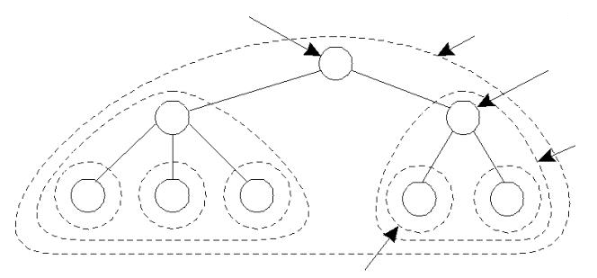
Hierarchical Approaches
A flat name space with hierarchical administration
Top level domain knows (or can find) all names
Each sub-domain knows subset of names
Local names resolved within own subset
Other names cached as needed
The root directory
node dir(T)
Top-level
domain T
Directory node
dir(S) of domain S
A subdomain S
Of top-level domain T
(S is contained in T)
A leaf domain, contained in S

Slide 25
Structured Naming
Flat names are difficult for humans to remember
Structured names are composed of simple human-readable names
    Names are arranged in a specific structure
Examples:
    File-systems utilize structured names to identify files
    /home/userid/work/dist-systems/naming.txt
    Websites can be accessed through structured names
    www.diet.engg.cse.ce

Slide 26
Name Spaces
Structured names are organized into name spaces
A name space is a directed graph consisting of:
  Leaf nodes
  Directory nodes
Leaf nodes:
    Each leaf node represents an entity
    A leaf node generally stores the address of an entity (e.g., in DNS), or the state of (or the path to) an entity (e.g., in file systems)
Directory nodes
    Directory node refers to other leaf or directory nodes
    Each outgoing edge is represented by (edge label, node identifier)
    Each node can store any type of data
    I.e., State and/or address (e.g., to a different machine) and/or path

Slide 27
Name Spaces - An Example
A path name is used to refer to a node in the graph
A path name is a sequence of edge labels leading from one node to another
    An absolute path name starts from the root node (e.g., /home/steen/mbox)
    A relative path name does not start at the root node (e.g., steen/mbox)
Looking up for the entity with name “/home/steen/mbox”
Data stored in n1
n0
keys
n2: “elke”
n3: “max”
n4: “steen”
home
n1
n5
elke
steen
max
n2
n3
n4
Leaf node
twmrc
mbox
Directory node

Slide 28
Name Resolution
The process of looking up a name is called name resolution
Closure mechanism:
    Name resolution cannot be accomplished without an initial directory node
    The closure mechanism selects the implicit context from which to start name resolution
    Examples:
  www.qatar.cmu.edu: start at the DNS Server
  /home/steen/mbox: start at the root of the file-system

Slide 29
Name Linking
The name space can be effectively used to link two different entities
Two types of links can exist between the nodes:
  Hard Links
  Symbolic Links

Slide 30
Hard Links
There is a directed link from the hard link to the actual node
Name resolution: Similar to the general name resolution
Constraint: There should be no cycles in the graph
“/home/steen/keys” is a hard link to “/keys”
n0
home
keys
n1
n5
“/keys”
elke
steen
max
keys
n2
n3
n4
twmrc
mbox

Slide 31
Symbolic Links
Symbolic link stores the name of the original node as data
Name resolution for a symbolic link SL
    First resolve SL’s name
    Read the content of SL
    Name resolution continues with content of SL
Constraint: No cyclic references should be present
“/home/steen/keys” is a symbolic link to “/keys”
n0
home
keys
n1
n5
“/keys”
elke
steen
max
n2
n3
n4
keys
twmrc
mbox
n6
Data stored in n6
“/keys”

Slide 32
Mounting of Name Spaces
Two or more name spaces can be merged transparently by a technique known as mounting
With mounting, a directory node in one name space will store the identifier of the directory node of another name space
Network File System (NFS) is an example where different name spaces are mounted
    NFS enables transparent access to remote files

Slide 33
Example of Mounting Name Spaces in NFS
Machine A
Machine B
Name Server for
foreign name space
Name Space 1
Name Space 2
remote
home
vu
steen
“nfs://flits.cs.vu.nl/home/steen”
mbox
OS
OS
Name resolution for “/remote/vu/home/steen/mbox” in a distributed file system

Slide 34
Distributed Name Spaces
In large-scale distributed systems, it is essential to distribute name spaces over multiple name servers
  Distribute the nodes of the naming graph
  Distribute the name space management
  Distribute the name resolution mechanisms

Slide 35
Layers in Distributed Name Spaces
Distributed name spaces can be divided into three layers
Global
Layer
  Consists of high-level directory nodes
  Directory nodes are jointly managed by different administrations
Administrat-ional Layer
  Contains mid-level directory nodes
  Directory nodes grouped together in such a way that each group is managed by an administration
Managerial Layer
  Contains low-level directory nodes within a single administration
  The main issue is to efficiently map directory nodes to local name servers

Slide 36
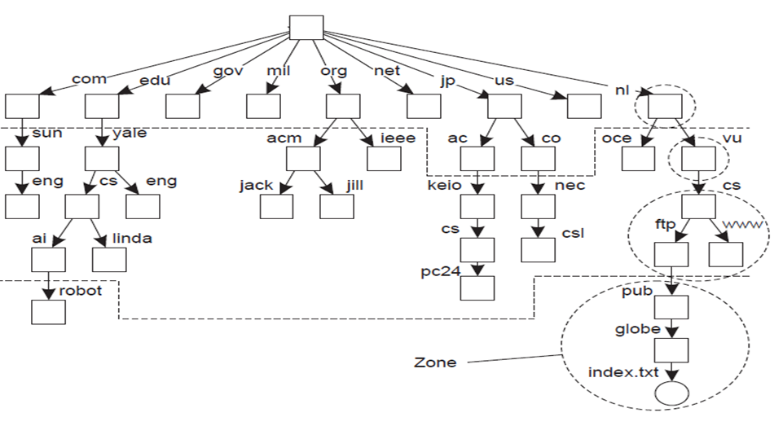
Distributed Name Spaces – An Example
Global Layer
Administrational Layer
Managerial Layer

Slide 37
Comparison of Name Servers at Different Layers
Global
Administrational
Managerial
Geographical scale of the network
Worldwide
Organization
Department
Total number
of nodes
Few
Many
Vast numbers
Number of
replicas
Many
None or few
None
Update propagation
Lazy
Immediate
Immediate
Is
client side caching applied?
Yes
Yes
Sometimes
Responsiveness to lookups
Seconds
Milliseconds
Immediate

Slide 38
DNS name space.
The most important types of resource records forming the contents of nodes in the DNS name space.
Type of record | Associated entity | Description
SOA (start of authority) | Zone | Holds information on the represented zone, such as an e-mail address of the system administrator
A (address) | Host | Contains an IP address of the host this node represents
MX (mail exchange) | Domain | Refers to a mail server to handle mail addressed to this node; it is a symbolic link; e.g. name of a mail server
SRV | Domain | Refers to a server handling a specific service
NS (name server) | Zone | Refers to a name server that implements the represented zone
CNAME | Node | Contains the canonical name of a host
PTR (pointer) | Host | Symbolic link with the primary name of the represented node
HINFO (host info) | Host | Holds information on the host this node represents; such as machine type and OS
TXT | Any kind | Contains any entity-specific information considered useful

Slide 39
Distributed Name Resolution
Distributed name resolution is responsible for mapping names to addresses in a system where:
    Name servers are distributed among participating nodes
    Each name server has a local name resolver
Two distributed name resolution algorithms:
  Iterative Name Resolution
  Recursive Name Resolution

Slide 40
Iterative Name Resolution
Client hands over the complete name to root name server
Root name server resolves the name as far as it can, and returns the result to the client
The root name server returns the address of the next-level name server (say, NLNS) if address is not completely resolved
Client passes the unresolved part of the name to the NLNS
NLNS resolves the name as far as it can, and returns the result to the client (and probably its next-level name server)
The process continues untill the full name is resolved

Slide 41
Iterative Name Resolution – An Example
1. <nl,vu,cs,ftp>
Client’s
Name
resolver
Root
name server
2. #<nl>, <vu,cs,ftp>
nl
3. <vu,cs,ftp>
Name server
nl node
4. #<vu>, <cs,ftp>
vu
5. <cs,ftp>
Name server
vu node
6 . #<cs>, <ftp>
cs
7. <ftp>
Name server
cs node
8 . #<ftp>
ftp
<nl,vu,cs,ftp>
#<nl,vu,cs,ftp>
Nodes are managed
by the same server
Resolving the name “ftp.cs.vu.nl”
<a,b,c> = structured name in a sequence
#<a> = address of node with name “a”

Slide 42


Iterated DNS query
www.google.com
Where is www.google.com?
Contact server replies with the name of the next authority in the hierarchy
“I don’t know this name, but this other server might”
asgard.ccs.neu.edu
ns1.google.com
com
Root

Slide 43
Recursive Name Resolution
Approach:
Client provides the name to the root name server
The root name server passes the result to the next name server it finds
The process continues till the name is fully resolved
Drawback:
Large overhead at name servers (especially, at the high-level name servers)

Slide 44
Recursive Name Resolution
Server for node | Should resolve | Looks up | Passes to child | Receives and caches | Returns to requester
cs | <ftp> | #<ftp> | -- | -- | #<ftp>
vu | <cs,ftp> | #<cs> | <ftp> | #<ftp> | #<cs> #<cs, ftp>
nl | <vu,cs,ftp> | #<vu> | <cs,ftp> | #<cs> #<cs,ftp> | #<vu> #<vu,cs> #<vu,cs,ftp>
root | <nl,vu,cs,ftp> | #<nl> | <vu,cs,ftp> | #<vu> #<vu,cs> #<vu,cs,ftp> | #<nl> #<nl,vu> #<nl,vu,cs> #<nl,vu,cs,ftp>

Slide 45
Recursive Name Resolution – An example
Passes to
Receives and
Returns to
Server for node
Should resolve
Looks up
child
caches
requester
cs
<ftp>
#<ftp>
--
--
#<ftp>
vu
<
cs,ftp
>
#<cs>
<ftp>
#<ftp>
#<cs>
#<cs, ftp>
nl
<vu,cs,ftp>
#<vu>
<cs,ftp>
#<cs>
#<vu>
#<cs,ftp>
#<vu,cs>
#<vu,cs,ftp>
root
<nl,vu,cs,ftp>
#<nl>
<vu,cs,ftp>
#<vu>
#<
nl
>
#<vu,cs>
#<
nl,vu
>
#<vu,cs,ftp>
#<
nl,vu,cs
>
#<
nl,vu,cs,ftp
>
Recursive name resolution of <nl, vu, cs, ftp>
name servers cache intermediate results for subsequent lookups

Slide 46
Recursive Name Resolution - An Example
1. <nl,vu,cs,ftp>
Client’s
Name
resolver
Root
name server
8. #< nl,vu,cs,ftp>
2. <vu,cs,ftp>
7. #<vu,cs,ftp>
Name server
nl node
6. #<cs,ftp>
3. <cs,ftp>
Name server
vu node
5. #<ftp>
4. <ftp>
Name server
cs node
<a,b,c> = structured name in a sequence
#<a> = address of node with name “a”
<nl,vu,cs,ftp>
#<nl,vu,cs,ftp>
Resolving the name “ftp.cs.vu.nl”

Slide 47
Recursive DNS Query
www.google.com
Where is www.google.com?
asgard.ccs.neu.edu
ns1.google.com
com
Root

Slide 48
Recursive Name Resolution - Advantages and drawbacks
Recursive name resolution puts a higher performance demand on each name server; hence name servers in the global layer support only iterative name resolution
Caching is more effective with recursive name resolution; each name server gradually learns the address of each name server responsible for implementing lower-level nodes; eventually lookup operations can be handled efficiently
The comparison between recursive and iterative name resolution:
Method | Advantage(s)
Recursive | Less Communication cost; Caching is more effective
Iterative | Less performance demand on name servers

Slide 49
Attribute-based Naming
In many cases, it is much more convenient to name, and look up entities by means of their attributes
    Similar to traditional directory services (e.g., yellow pages)
However, the lookup operations can be extremely expensive
    They require to match requested attribute values, against actual attribute values, which might require inspecting all entities
Solution: Implement basic directory service as a database, and combine it with traditional structured naming system
Example: Light-weight Directory Access Protocol (LDAP)

Slide 50
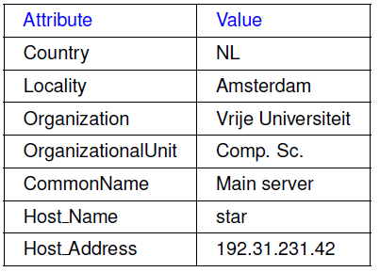
Light-weight Directory Access Protocol (LDAP)
LDAP directory service consists of a number of records called “directory entries”
  Each record is made of (attribute, value) pairs
  LDAP standard specifies five attributes for each record
Directory Information Base (DIB) is a collection of all directory entries
  Each record in a DIB is unique
  Each record is represented by a distinguished name
  E.g., /C=NL/O=Vrije Universiteit/OU=Comp. Sc.

Slide 51
Directory Information Tree in LDAP
All the records in the DIB can be organized into a hierarchical tree called Directory Information Tree (DIT)
LDAP provides advanced search mechanisms based on attributes by traversing the DIT

Slide 52
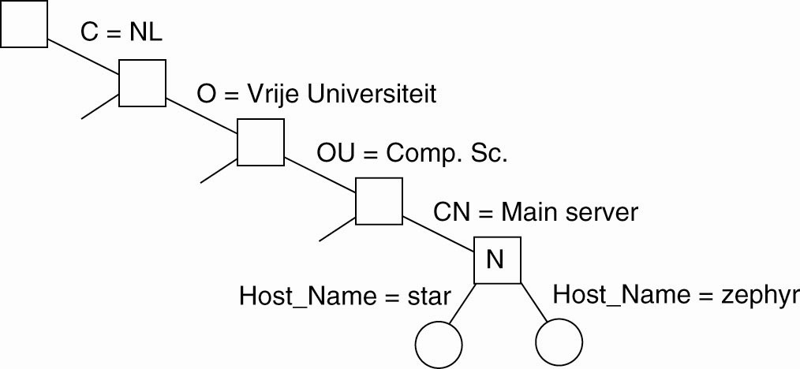
Directory Information Tree in LDAP – An Example
search("&(C = NL) (O = Vrije Universiteit) (OU = *) (CN = Main server)")
Attribute | Value
Country | NL
Locality | Amsterdam
Organization | Vrije Universiteit
OrganizationalUnit | Comp. Sc.
CommonName | Main server
Host_Name | zephyr
Host_Address | 137.37.20.10
Attribute | Value
Country | NL
Locality | Amsterdam
Organization | Vrije Universiteit
OrganizationalUnit | Comp. Sc.
CommonName | Main server
Host_Name | star
Host_Address | 192.31.231.42

Slide 53
Summary
Naming and name resolutions enable accessing entities in a distributed system
Three types of naming:
  Flat Naming
    Broadcasting, forward pointers, home-based approaches, Distributed Hash Tables (DHTs)
  Structured Naming
    Organizes names into Name Spaces
    Distributed Name Spaces
  Attribute-based Naming
    Entities are looked up using their attributes

