Slide 1

Unit-6
Security
Distributed System (DS)
GTU #3170719
Prof. Umesh H. Thoriya
Computer Engineering Department
umesh.thoriya@darshan.ac.in
9714233355

Slide 2

Topics to be covered
  Introduction to Security- Security Threats, Policies, and Mechanisms
  Design Issues
  Basics of Cryptography
  Secure Channels- Authentication, Message Integrity and Confidentiality
  Secure Group Communication
  Access Control- General Issues in Access Control,
  Firewalls
  Secure Mobile Code
  Denial of Service;
  Security Management
  Key Management
  Secure Group Management
  Authorization Management
Looping

Slide 3
Introduction to Security
Computer security is about keeping systems, programs, and data secure
What services do you expect from secure Distributed Systems?
Secure DS should provide
    Confidentiality of Information : Information is disclosed only to authorized parties
    Integrity of Information : Alterations to system’s assets is made only in an authorized way
    Secure DS are immune against possible security threats that compromise confidentiality and integrity

Slide 4
Introduction to Security
    Security in distributed systems can be divided into two parts.
    One part concerns the communication between users or processes, possibly residing on different machines.
    The principal mechanism for ensuring secure communication is:
  Secure channels
  Authentication
  Message integrity
  Confidentiality
    The other part concerns authorization, which deals with ensuring that a process gets only those access rights to the resources in a distributed system it is entitled to.

Slide 5
Goals of Security
Secrecy: Information within the system must be accessible only to authorized users.
Privacy: Information given to the users must be used only for the purpose for which it was given.
Authenticity: The user must be able to verify that the data obtained is from expected sender only.
Integrity: Information must be protected from unauthorized access.

Slide 6
Types of Security Threats
  Types of security threats to consider:
    Interception
    Interruption
    Modification
    Fabrication

Slide 7
Types of Security Threats
  Interception
    Unauthorized party has gained access to a service or data
    Example: Illegal copying of files, Eavesdropping over network
  Interruption
    Services or data become unavailable, unusable or destroyed
    Example: Denial-of-Service (DoS) Attacks
Eve
Alice: Let us meet at 10 AM
Alice
Bob
Eve
Alice: Let us meet at 12 PM
(*##SWF * KF !34#*
Alice
Bob

Slide 8
Types of Security Threats
  Modification
    Unauthorized changing of data or tampering with services
    Example: Changing a program to secretly log the activities
  Fabrication
    Additional data or activity is generated that would normally not exist
    Example: Replay attacks
Eve
Alice: Let us meet at 12 PM
Alice: Let us meet at 12 PM
Alice
Bob
Eve
Alice: Let us meet at 06 PM
Alice
Bob

Slide 9
Security Policy and Mechanisms
Security policy describes what actions the entities in a system are allowed to take and which ones are prohibited.
Security mechanisms implement security policies.
The following techniques are used:
    Encryption: Provides a means to implement confidentiality, since it transforms the data into cypher text which attacker cannot understand.
    Authentication: To verify weather the user, client, server etc. are authentic or not. User are authenticated by password.
    Authorization: To check as a weather the client is authorized to perform specific task.
    Auditing: Tools are used to trace which clients accessed what information and when they did so.

Slide 10
Cryptography
Cryptography is defined as a means of protecting private information against unauthorized access in cases where physical security is difficult to achieve.
Cryptography is carried out using two basic operations:
Encryption: The process of transforming intelligible information (plaintext) into unintelligible form (cipher text).
Decryption: The process of transforming the information from cipher text to plaintext.

Slide 11
Cryptography
The encryption algorithm has the following form: C = E(P, K_{e})
Where
    P = plaintext to be encrypted
    K_{e} = encryption key
    C = resulting cipher text
The decryption algorithm is performed by the same matching function which has the following form: P = D(C, K_{d})
Where,
    C = cipher text to be decrypted
    K_{d} = decryption key
    P = resulting plaintext
Side
information
Z
Plaintext
M
Break
X
Y
Plaintext M
Plaintext M
Encrypt
Decrypt
Ciphertext C
Encryption
Key
Decryption
Key

Slide 12
Cryptographic systems
Cryptography is the study of techniques for secure communication in the presence of third parties
Active Intruder can listen and modify C, and insert messages
Passive Intruder can listen to C
Intruder
Passive Intruder
_{C}
_{C}
Intruder
Active Intruder
_{C’}
Plain text message
C=E_{K}(P)
Sender
Receiver
Encryption Algorithm
Decryption Algorithm
P=D_{K}(C)
P
Communication Channel
Cipher text
K
K
Encryption key
Decryption key
C=E_{K}(P) ➔ C is obtained by encrypting the plain text P with key K
P=D_{K}(C) ➔ P is obtained by decrypting the cipher text P with key K

Slide 13
Types of Cryptographic Systems
Two types
    Symmetric Cryptosystem (Shared-key system)
    Asymmetric Cryptosystem (Public-key system)

Slide 14
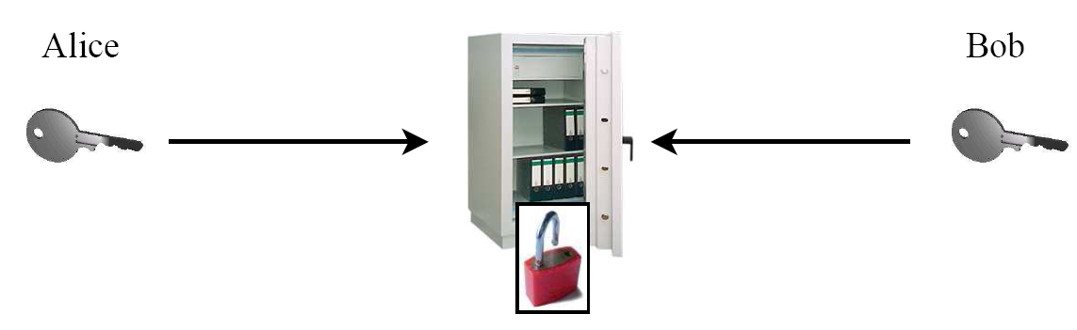
Symmetric Cryptosystem
Safe with a strong lock, only Alice and Bob have a copy of the key
    Alice encrypts: locks message in the safe with her key
    Bob decrypts: uses his copy of the key to open the safe

Slide 15




Symmetric Cryptosystem
A symmetric cryptosystem uses the same key for both encryption and decryption.
The shared key K_{A,B} between Alice A and Bob B should be kept secret
It is necessary that the key should be easily alterable if required and is always kept secret.
This implies that the key is known only to authorized users.
Symmetric cryptosystems are also called as shared key or private key cryptosystems since both sender and receiver share the same key.
$$P=D_{K}\left(EK\left(P\right)\right)$$
$$C$$
Alice
Bob
$$C=EK\left(P\right)$$
$$P=D_{K}\left(C\right)$$

Slide 16
Symmetric Cryptosystem
Plaintext, P
Encryption
method
Decryption method
Plaintext, P
Encryption
Key, K
Ciphertext
Decryption
Key, K
Symmetric
Key generator
Secure channels with
Confidentiality and authentication
Secret key Distribution

Slide 17


Asymmetric Cryptography
New Idea:
Use the good old mailbox principle.
Everyone can drop a letter.
But Only the owner has the
correct key to open the box.
Public Key
Private Key

Slide 18
Asymmetric Cryptography
In asymmetric cryptosystem, the keys used for encryption and decryption are different but they form a unique pair.
There are separate keys for encryption (K_{e}) and decryption (K_{d}).
P = DK_{d}(EK_{e}(P))
One key in the asymmetric cryptosystem is kept private while the other one is made public.
Hence these types of cryptosystems are referred to as public key systems.

Slide 19
Type of Attacks
Passive Attacks
Active Attacks
Browsing
Virus
Inferencing
Worm
Masquerading
Logic bomb
Integrity attack
Authenticity attack
Delay attack
Replay attack
Denial attack

Slide 20
Passive Attack
Intruder access unauthorized information from a computer system but cannot cause harm to the system.
Browsing: Intruders here attempt to read stored files, traverse message packet on the network, access other process memory, etc.
Inferencing: The intruder records and analyzes past activities and access methods and uses this information to draw inferences.
Masquerading: An intruder Masquerades as an authorized user or a program to gain access to unauthorized data or resource.

Slide 21
Active Attack
Virus: is a small computer program that needs to be executed by either running it or having it loaded from boot sector of a disk.
Worm: is a small piece of software the uses computer network and security holes to replicate itself.
Logic bomb: is a piece of code intentionally inserted into a software system that will set off a malicious function when specified conditions are met.

Slide 22

Active Attack
Integrity Attack:
    An intruder can change the message while it is traveling in the communication channel and the receiver may interpret it as original message.
Hi
Hello
Hello
Hi
A
B
Intruder

Slide 23
Active Attack
Denial Attack
    An intruder might partly or completely block communication path between two processes.
Blocks Communication
Hello B
A
B
C

Slide 24
Active Attack
Replay Attack
    An intruder retransmit an old message that is accepted as new message by the receiver.
Hello B Meet me at 6 PM – A
On 16 June 2021
Repeat same message on 20 June 2021
Hello B Meet me at 6 PM – A
On 16 June 2021
A
Repeat message
on 20th June
B
C

Slide 25
Design issues when considering security
Three design issues when considering security
Focus of Control.
Layering of Security Mechanisms.
Simplicity.

Slide 26
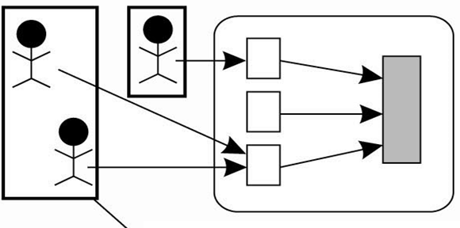
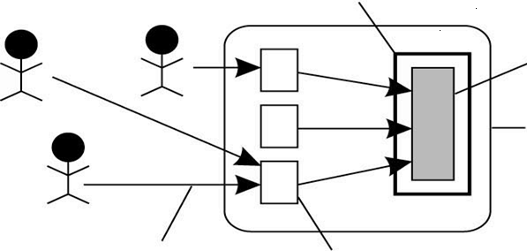
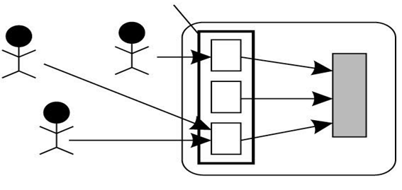
Design Issue: Focus of Control
The are three approaches that can be followed to protect a distributed application:
1. Protection against invalid operations on secure data
2. Protection against unauthorized invocations
3. Protection against unauthorized users
Data is protected against wrong or invalid operation
Data is protected against unauthorized invocations
State
Object
Data is protected by checking the role of invoker
Invocation
Method

Slide 27
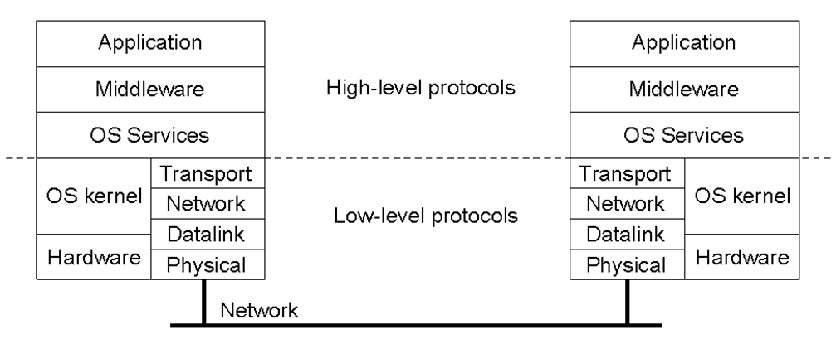
Design Issue: Layering of Security Mechanisms
The logical organization of a distributed system into several layers.
A decision is required as to where in the model security the mechanism is to be placed.

Slide 28
Trust and Security
A system is either secure or it is not.
Whether a client considers a systems to be secure is a matter of trust.
In which layer security mechanisms are placed depends on the trust a client has in how secure the services are in any particular layer.

Slide 29
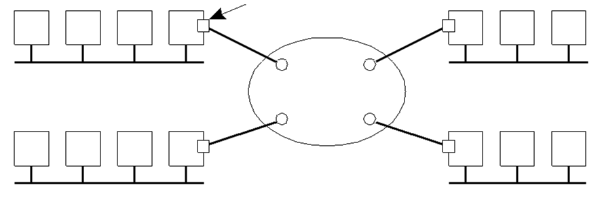
Trust and Security
Several sites connected through a wide-area backbone service.
Switched Multi-megabit Data Service (SMDS)
If the encryption mechanisms cannot be trusted, additional mechanisms can be employed by clients to provide the level of trust required (e.g., using SSL at the Application Layer).
Encryption device
SMDS

Slide 30
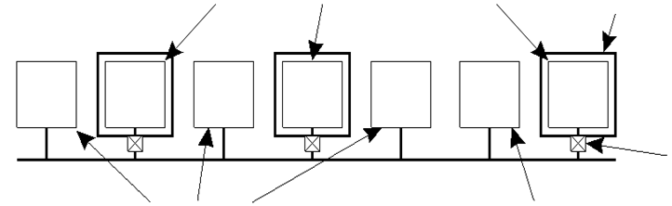
Distribution of Security Mechanisms
The Trusted Computing Base (TCB) is the set of services/mechanisms within a distributed system required to support a security policy.
Reduced Interfaces for Secure System Components (RISSC)
    Prevents clients and their applications from direct access to critical services.
    Any security-critical server is placed on a separate machine isolated from end-user systems using low-level secure network interfaces.
    Clients and their applications run on different machines and can access the secured server only through these network interface
Servers running secured services
No direct access from other machines
Access control device
Clients
Unsecured server

Slide 31
Design Issue: Simplicity
Designing a secure computer system is considered a difficult task, regardless of whether it is also a DS.
The use of a few simple mechanisms that are easily understood and trusted to work would be the ideal situation.
Unfortunately, the real world is not this clear cut, as introducing security mechanisms to an already complex system can often matters worse.

Slide 32
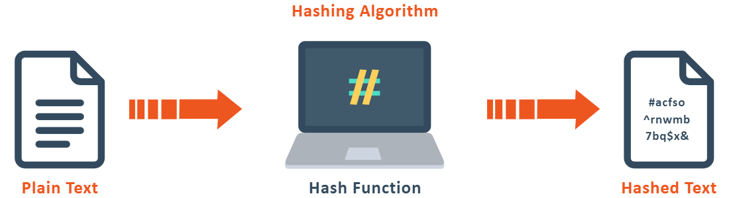
Cryptographic Hash Functions
A hash function is a unique identifier for any given piece of content. It’s also a process that takes plaintext data of any size and converts it into a unique ciphertext of a specific length.
A hash function 𝐻(𝑚) maps an input message 𝑚 to a hash value ℎ
Message 𝑚 is of any arbitrary length
Hash ℎ is fixed length
Often, ℎ is called as the “message digest” of 𝑚
How does a cryptographic hash function differ from a regular hash function?
ℎ=𝐻(𝑚)

Slide 33
Properties of Cryptographic Hash Functions
One-Way Function
    Finding hash ℎ from 𝑚 is easy, but not vice-versa
    Computationally infeasible to find 𝑚 that corresponds to a given hash ℎ
Weak-collision resistance
    Given a message, it is hard to find another message that has the same hash value
    Given 𝑚 and ℎ=𝐻(𝑚), it is computationally infeasible to find 𝑚′≠𝑚 such that 𝐻(𝑚)=𝐻(𝑚^′)
Strong-collision resistance
    Given a hash function, it is hard to find two messages with the same hash value
    Given 𝐻(.), it is computationally infeasible to find two messages 𝑚 and 𝑚′ such that 𝐻(𝑚)=𝐻(𝑚^′)

Slide 34
Encryption/Decryption Functions
Recall: An encryption function 𝐸_𝐾 (𝑚_𝑝) encrypts a plain-text message 𝑚_𝑝 to an cipher-text message 𝑚_𝑐 using a key 𝐾
𝑚_𝑐=𝐸_𝐾 (𝑚_𝑝 )
Similarly, decryption function 𝐷_𝐾 (𝑚_𝑐 ):
𝑚_𝑝=𝐷_𝐾 (𝑚_𝑐 )
Encryption/Decryption Functions have the same properties as Cryptographic Hash Functions
    One-way functions
    Weak and Strong collision resistance

Slide 35
Protocols in Cryptosystems
Data Encryption Standard (DES) : Encryption/Decryption in Symmetric Cryptosystems
RSA protocol : Encryption/Decryption in Public-Key cryptosystems
Hybrid Cryptographic protocol : A combination of Symmetric and Public-Key based system

Slide 36
DES Protocol
Purpose: Used for Encryption/Decryption in Symmetric Cryptosystems
DES is designed to operate on 64-bit blocks of data.
A block is transformed into an encrypted (64 bit) block of output in 16 rounds, where each round uses a different 48-bit key for encryption.
Each of these 16 keys is derived from a 56-bit master key
Before an input block starts its 16 rounds of encryption, it is first subject to an initial permutation, of which the inverse is later applied to the encrypted output leading to the final output block.
64-bit plain-text
...
DES
Encryption
Algorithm
64-bit Cipher-text
...
K_{M}
56-bit key
64-bit Cipher-text
...
DES
Decryption
Algorithm
64-bit plain-text
...
K_{M}
56-bit key

Slide 37
DES Encryption Algorithm
Permute a 64-bit block
16 rounds of identical operations
In each round i
  Divide the block into 2 halves L_{i} and R_{i}
  Extract 48-bit key K_{i} from K_{M}
  Mangle the bits in L_{i} and R_{i} using K_{i} to produce R_{i+1}
  Extract R_{i} as L_{i+1}
Perform an inverse permutation on the block L₁₆-R₁₆ to produce the encrypted output block
Input block
Master Key
...
K_{M}
L1
...
R1
Round 1
K₁
f(L1,R1,K1)
L2
R2
L15
R15
Round 16
f(L16,R16,K16)
K₁₆
L16
R16
...
Encrypted output block

Slide 38
RSA protocol
Sender uses a public key : Advertised to everyone
Receiver uses a private key
Plaintext
Plaintext
Internet
Encrypt with
public key
Decrypt with
private key
Ciphertext

Slide 39
RSA encryption algorithm
Select two large prime numbers, p and q.
Multiply these numbers to find n = p x q, where n is called the modulus for encryption and decryption.
Choose a number e less than n, such that n is relatively prime to (p - 1) x (q -1).
It means that e and (p - 1) x (q - 1) have no common factor except 1.
Choose "e" such that 1<e < φ (n), e is prime to φ (n)
gcd (e,d(n)) =1
If n = p x q, then the public key is <e, n>.
A plaintext message m is encrypted using public key <e, n>.
To find ciphertext from the plain text following formula is used to get ciphertext C.
C=m^{e} mod n Here, m must be less than n.
A larger message (>n) is treated as a concatenation of messages, each of which is encrypted separately.

Slide 40
RSA encryption algorithm
To determine the private key, we use the following formula to calculate the d such that:
D_{e} mod {(p - 1) x (q - 1)} = 1 Or
D_{e} mod φ (n) = 1
The private key is <d, n>. A ciphertext message c is decrypted using private key <d, n>.
To calculate plain text m from the ciphertext c following formula is used to get plain text m.
m = c^{d} mod n

Slide 41
RSA encryption algorithm- An Example
Step 1: Select two large prime numbers, p, and q.
p = 7
q = 11
Step 2: Multiply these numbers to find n = p x q, where n is called the modulus for encryption and decryption.
First, we calculate
n = p x q
n = 7 x 11
n = 77

Slide 42
RSA encryption algorithm- An Example
Step 3: Choose a number e less that n, such that n is relatively prime to (p - 1) x (q -1). It means that e and (p - 1) x (q - 1) have no common factor except 1. Choose "e" such that 1<e < φ (n), e is prime to φ (n), gcd (e, d (n)) =1.
Second, we calculate
φ (n) = (p - 1) x (q-1)
φ (n) = (7 - 1) x (11 - 1)
φ (n) = 6 x 10
φ (n) = 60
Let us now choose relative prime e of 60 as 7.
Thus the public key is <e, n> = (7, 77)

Slide 43
RSA encryption algorithm- An Example
Step 4: A plaintext message m is encrypted using public key <e, n>. To find ciphertext from the plain text following formula is used to get ciphertext C.
To find ciphertext from the plain text following formula is used to get ciphertext C.
C = m^{e} mod n
C = 9⁷ mod 77
C = 37
Step 5: The private key is <d, n>. To determine the private key, we use the following formula d such that:
D_{e} mod {(p - 1) x (q - 1)} = 1
7^{d} mod 60 = 1, which gives d = 43
The private key is <d, n> = (43, 77)

Slide 44
RSA encryption algorithm- An Example
Step 6: A ciphertext message c is decrypted using private key <d, n>. To calculate plain text m from the ciphertext c following formula is used to get plain text m.
m = c^{d} mod n
m = 37⁴³ mod 77
m = 9
In this example, Plain text = 9 and the ciphertext = 37

Slide 45
RSA encryption algorithm- Overview
Choose two large prime numbers p & q
Compute n=pq and z=(p-1)(q-1)
Choose number e, less than n, which has no common factor (other than 1) with z
Find number d, such that ed – 1 is exactly divisible by z
Keys are generated using n, d, e
    Public key is (n,e)
    Private key is (n, d)
Encryption: c = m^{e} mod n
    m is plain text
    c is cipher text
Decryption: m = c^{d} mod n
Public key is shared and the private key is hidden

Slide 46
RSA protocol
Invented by Rivest, Shamir and Adleman (RSA) as a protocol for Public-key systems
Approach:
  Choose two very large prime numbers, p and q
  Compute n = pq
  Compute z = (p-1)(q-1)
  Choose a number e that is relatively prime to z
    e is co-prime to z
  Compute the number d such that de % z = 1
    This is equivalent to finding de = 1 + kz for some
    integer k
Depending on the requirement, d and e can be used as public and private keys
  d is used for decryption; e is used for encryption
Example
p=7; q=19
n = 7*19 = 133
z = 6*18 = 108
e=5
d=65 for m=325

Slide 47


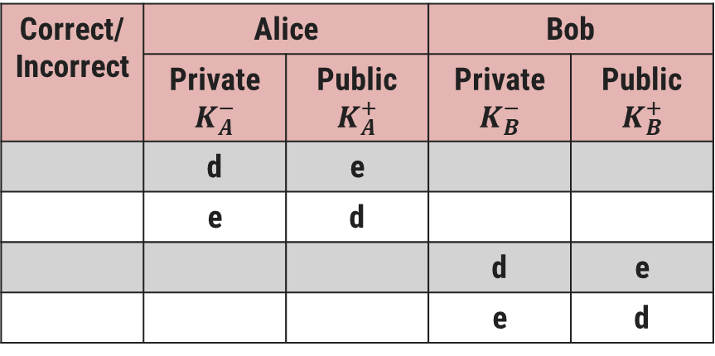

RSA protocol for encryption- An Example
Scenario: Alice (A) wants to send to Bob (B)
Problem: Only Bob should be able to decrypt the message
Given d and e are the two keys computed by RSA, which row indicates correct choice of keys?
Correct/ Incorrect | Alice |  | Bob
 | Private $$K_{A}^{−}$$ | Public $$K_{A}^{+}$$ | Private $$K_{B}^{−}$$ | Public $$K_{B}^{+}$$
 | d | e
 | e | d
 |  |  | d | e
 |  |  | e | d
$$m′$$
A
B
x
$$m′=E_{K_{B}^{+}}\left(m\right)$$
$$m=D_{K_{B}^{−}}\left(m′\right)$$
x
Correct
x

Slide 48
RSA protocol for encryption- An Example
At the sender:
Split the message into fixed-length blocks of size s (0 <= s < n)
For each block m_{i}
  Sender calculates the encrypted message c_{i} such that c_{i} =m_{i}^{e} (mod n)
  Send c_{i} to the receiver
At the receiver:
Receive c_{i} from sender
For each block c_{i}
  Compute actual message m_{i} = c_{i}^{d} (mod n)
Merge all c_{i}’s to obtain the complete message
Calculated Values
p=7; q=19; n=133; d=65; e=5
Example
s = 132
m_{i =} 6
  c_{i} = 6⁵ (mod 133)
  = 62
  m_{i} = 62⁶⁵ (mod 133)
  = 6

Slide 49
Secure Channels
A Secure Channel is an abstraction of secure communication between communication parties in a DS
A Secure Channel protects senders and receivers against:
    Interception : By ensuring confidentiality of the sender and receiver
    Modification and Fabrication of messages : By providing mutual authentication and message integrity protocols

Slide 50
Authentication
Consider a scenario where Alice wants to set up a secure channel with Bob
  Alice sends a message to Bob (or trusted third party) for mutual authentication
  Message integrity should be ensured for all communication between Alice and Bob
    Generate a “session key” to be used between Alice and Bob
    Session-keys ensure integrity and confidentiality
  When the channel is closed, the session key is destroyed

Slide 51
Mutual Authentication Protocols
Three types of Mutual Authentication Protocols:
Shared Secret Key based Authentication
Authentication using a Key Distribution Center
Authentication using Public-key Cryptography

Slide 52
Shared Secret Key based Authentication
Ensure data message integrity exchanged after authentication use secret-key cryptography with session keys.
The scheme is also known as “Challenge-Response protocol”
Let K_{A,B} be the shared secret key between Alice and Bob
The Challenge-Response Protocol
‘A’ sends her identity to ‘B’
‘B’ sends a challenge R_{B} back to ‘A’
‘A’ responds to the challenge by encrypting R_{B} with K_{A,B} (denoted by K_{A,B} (R_{B})), and sending it back to ‘B’
‘A’ challenges ‘B’ by sending R_{A}
‘B’ responds to the challenge by sending the encrypted message K_{A,B}(R_{A})
Alice
Bob
A
R_{B}
K_{A,B} (R_{B})
R_{A}
K_{A,B} (R_{A})
A and B are mutually authenticated

Slide 53
Optimization of the Authentication based on a shared secret key
Session key - is a shared (secret) key that is used to encrypt messages for integrity
Generally used only for as long as the channel exists
Chuck
(pretending to be Alice)
A, R_{C}
Bob
Session 1
Alice
Bob
R_{B},K_{A,B} (R_{C})
A, R_{A}
A, R_{B}
Session 2
R_{B},K_{A,B} (R_{A})
R_{B2},K_{A,B} (R_{B})
K_{A,B} (R_{B})
K_{A,B} (R_{B})
Session 1
Bob and Alice – Taking Shortcuts
Reflection Attack
Optimization of the Authentication based on a shared secret key, but using three instead of five messages

Slide 54
Authentication Using a Key Distribution Center (KDC)
Shared secret key based authentication is not scalable
    Each host has exchange keys with every other host
    Complexity: O(N²)
The complexity is reduced by electing one node as “Key Distribution Center” (KDC)
    KDC shares a secret-key with every host
    No pair of hosts need to share a key
    Complexity: O(N)

Slide 55
Authentication Using a Key Distribution Center
If Alice wants to set up a secure channel with Bob, she can do so with the help of a (trusted) KDC.
The KDC hands out a key to both Alice and Bob that they can use for communication
Alice sends a message to the KDC, telling it that she wants to talk to Bob.
The KDC returns a message containing a shared secret key KA,B that she can use.
    The message is encrypted with the secret key KA,KDC that Alice shares with the KDC
The KDC sends KA,B to Bob, but now encrypted with the secret key KB,KDC it shares with Bob
Alice
1
KDC
Bob
A, B
2
2
K_{A,KDC}(K_{A,B})
K_{B,KDC}(K_{A,B})

Slide 56
Authentication Using a Key Distribution Center using Ticket
Ticket
Alice
A, B
KDC
Bob
K_{A,KDC}(K_{A,B}) , K_{B,KDC}(K_{A,B})
A, K_{B,KDC}(K_{A,B})

Slide 57
Needham-Schroeder Authentication Protocol
A multi-way challenge response protocol
Protocol is a variant of a well-known example of an authentication protocol using a KDC, known as the Needham-Schroeder authentication protocol.
Nonce: A random number that is used only once
Response to Nonce R_{A1}
Ticket
Alice
R_{A1} , A, B
M1
KDC
Bob
M2
K_{A,KDC}(R_{A1} , B, K_{A,B} , K_{B,KDC}(A, K_{A,B}) )
M3
K_{A,B}(R_{A2}), K_{B,KDC}(A,K_{A,B})
M4
K_{A,B}(R_{A2} -1, R_{B})
M5
K_{A,B}(R_{B} -1)

Slide 58
Authentication Using Public-Key Cryptography
Mutual authentication in a public-key cryptosystem.
Note that the KDC is missing
But, this assumes that some mechanism exists to verify everyone’s public key.
Recall:
  K⁺_{N}: Public key of user N
  K⁻_{N}: Private key of user N
Alice
K⁺_{B}(A, R_{A})
Bob
K⁺_{A}(R_{A}, R_{B,} K_{A,B} )
K_{A,B} (R_{B})

Slide 59
Session Keys
During the establishment of a secure channel, after the authentication phase has completed, the communicating parties generally use a unique shared session key for confidentiality.
The session key is safely discarded when the channel is no longer used.
Why not using the same keys for confidentiality as those that are used for setting up the secure channel?
  Cryptographic keys are subject to “wear and tear” just like ordinary keys.
  Protection against replay attacks
  If a key is compromised, only a single session is affected

Slide 60
Message Integrity and Confidentiality
Encryption is used for providing Confidentiality
But, how to provide Message Integrity?
  Encryption protects message modification by third party adversaries
  How to protect modification at senders or receivers?
What if Alice denies that she sent M1?
What if Bob says that he had asked for $500 in M2?
Both parties have to keep SIGNED versions of the messages
M1
I will buy your horse for $200
Alice
Bob
M2
OK. Deal. $200

Slide 61
Message Integrity and Confidentiality
Besides authentication, a secure channel should also provide guarantees for message integrity and confidentiality
Confidentiality is easily established by simply encrypting a message before sending it.
Protecting a message against modifications is somewhat more complicated
Digital Signatures:
  Digitally sign a message in such a way that the signature is uniquely tied to its content
  Several ways to place digital signatures:
  Use a public-key cryptosystem such as RSA
  Use a message digest

Slide 62
Digital Signatures: Basic Idea
Given:
  Everybody knows Bob’s public key
  Only Bob knows the corresponding private key
Goal: Bob sends a “digitally signed” message
  To compute a signature, must know the private key
  To verify a signature, only the public key is needed
public key
?
public key
private key
Alice
Bob

Slide 63
Digital Signatures
Digital signatures are the public-key primitives of message authentication.
In the physical world, it is common to use handwritten signatures on handwritten or typed messages.
They are used to bind signatory to the message.
Digital signature is a technique that binds a person/entity to the digital data.
This binding can be independently verified by receiver as well as any third party.
Digital signature is a cryptographic value that is calculated from the data and a secret key known only by the signer.

Slide 64

Digital Signatures
The sender and the receiver will keep digitally signed copies of the messages
One way of creating digital signatures is by using RSA
Alice’s Computer
Bob’s Computer
m
m
K⁻_{A}
m
K⁺_{B}
K⁻_{B}
m
K⁻_{A}(m)
K⁻_{A}(m)
K⁺_{B}(m, K⁻_{A}(m))
Dig. Signed message of A
Bob saves the digitally signed message from A

Slide 65
Issues with Naïve Digital Signatures
The validity of the digitally signed message holds as long as A’s private key remains a secret
  ‘A’ can claim that her private key was stolen
If ‘A’ changes her private key, the signed message becomes invalid
  A centralized authority can keep track of when keys are changed
Encrypting the entire message with private key is costly
  RSA is slower, and encryption of long data is not preferred
  Any ideas on how to improve?

Slide 66

Digital Signature with Message Digest
Instead of attaching the encrypted message, attach the message digest
Alice’s Computer
Bob’s Computer
m
m
m
K⁺_{B}
K⁻_{B}
m
Hash
H(m)
K⁻_{A}
K⁻_{A}(H(m))
K⁻_{A}(H(m))
K⁺_{B}(m, K⁻_{A}(H(m)))
Bob saves the digitally signed message from A
Bob can verify the signature by comparing the hash of received message, and the hash attached in the digitally signed message

Slide 67
Secure Group Communication
Scenario: Client has to communicate with a group of replicated servers
    Replication can be for fault-tolerance or performance improvement
Client expects that the response is secure
Naïve Solution:
    Client collects the response from each server
    Client authenticates every response
    Client takes a majority vote
    Drawback of naïve approach
    Replicated of servers should be transparent to the client
    Reiter et al. proposed a transparent and secure group authentication protocol (Secure Group Authentication Protocol)

Slide 68
Secure Group Authentication Protocol
Problem: Authenticate a group of replicated servers at the client in a transparent way
Main Idea:
    Multiple servers share a secret
    None of them know the entire secret
    Secret can be revealed only if all/most of them cooperate
The approach is similar to k-fault tolerant systems
    Tolerate intrusion (faults) of c servers out of N servers if c <= N

Slide 69
Secure Replicated Servers
Secure and Transparent Replicated Servers
Example:
    Given a securely replicated group of servers
    Each server accompanies its response with a digital signature.
    If ri is the response from server Si, let md (ri) denote the message digest computed by server Si.
    This digest is signed with server Si's private key k_{i}⁻
    Want to protect the client against at most c corrupted servers => the server group should be able to tolerate corruption by at most c servers, and still be capable of producing a response that the client can put its trust in

Slide 70
Secure Replicated Servers
For each client call:
  Each server S_{i} returns the response (r_{i})
  In addition, it sends a signed message
  digest: sig(S_{i},r_{i}) = K⁻_{si}( md(r_{i}) )
For each response, client computes md_{c} (r_{i}) = H(r_{i})
Hence, client has N triplets R_{i} = < r_{i,} md_{c} (r_{i}), sig(S_{i},r_{i})>
Client takes c+1 combinations of triplets
For each combination vector [R, R’ and R’’]
  Computes a create a single digest using
  a special decryption function D(V)
d = D(V) = D(sig(S,r), sig(S’,r’),sig(S’’,r’’))
NOTE: d is a vector of responses
  If d[x] = respective md_{c} (r_{i}), then r_{i} is correct
Parameters: N=5; c=2
S₁
S₂
S₃
S₄
S₅
Client
sig(S₁,r₁)
r₁
sig(S₂,r₂)
Select another combination
r₂
sig(S₃,r₃)
Hash
r₃
sig(S₄,r₄)
r₄
sig(S₅,r₅)
No
r₅
d
D(V)
d=md(r)
md_{c} (r₁)
md_{c} (r₂)
Yes
md_{c} (r₃)
md_{c} (r₄)
r is OK
md_{c} (r₅)

Slide 71
Authentication in Kerberos
Network authentication protocol.
Developed at MIT in the mid 1980s.
A secret key based service for providing authentication in open networks.
Provides strong authentication for client-server applications.
There are four parties involved in the Kerberos protocol:
    User – Alice who uses the client workstation
    Real Server - The server (Bob) provides services for the user (Alice).
    Authentication Server (AS) – It is he KDC in the Kerberos protocol. Each user registers with the AS and is granted a user identity and a password. The AS verifies the user, issues a session key to be used between Alice and TGS and sends a ticket to TGS.
    Ticket Granting Server (TGS) – Issues a ticket for the real server. It provides the session key(KAB) between Alice and Bob.

Slide 72
Authentication in Kerberos
Step-1: User logon and request services on host. Thus user request for ticket-granting-service.
Step-2: Authentication Server verifies user’s access right using database and then gives ticket-granting-ticket and session key. Results are encrypted using Password of user.
Step-3: Decryption of message is done using the password then send the ticket to Ticket Granting Server. The Ticket contain authenticators like user name and network address.
Kerberos
Client
1
Database
AS
2
3
TGS

Slide 73
Authentication in Kerberos
Step-4: Ticket Granting Server decrypts the ticket send by User and authenticator verifies the request then creates the ticket for requesting services from the Server.
Step-5: User send the Ticket and Authenticator to the Server.
Step-6: Server verifies the Ticket and authenticators then generate the access to the service. After this User can access the services.
Kerberos
Client
1
Database
AS
2
3
6
5
4
TGS
Server

Slide 74
Authentication in Kerberos
1
2
Message 1 - Alice types in her login name at a workstation.
Message 2 - contains login name and is sent to the AS.
Message 3 - contains the session key K_{A,TGS} and the ticket K_{AS,TGS}(A,K_{A,TGS}).
    To ensure privacy, message 3 is encrypted with the secret key K_{A,AS} shared between Alice and the AS.
Message 4 - workstation prompts Alice for her password
Alice
login
Alice’s Workstation
AS
A
3
K_{A,AS} (K_{A,TGS}, K_{AS,TGS} (A, K_{A, TGS}))
4
Password?

Slide 75
Authentication in Kerberos
1
2
Message 5 – PWD returned to workstation which generates shared key K_{A,AS} and find session key K_{A,TGS}.
Message 6 –to talk to Bob, she requests the TGS to generate a session key for Bob.
    The fact that Alice has the ticket K_{AS,TGS}(A,K_{A,TGS}) proves that she is Alice.
    Message also contains a timestamp, t, encrypted with the secret key shared between Alice and the TGS.
Alice
login
Alice’s Workstation
AS
A
3
K_{A,AS} (K_{A,TGS}, K_{AS,TGS} (A, K_{A, TGS}))
4
Password?
5
6
TGS
PWD
K_{AS,TGS} (A, K_{A,TGS}), B, K_{A, TGS}(t)
7
K_{A,TGS} (B, K_{A,B}), K_{B,TGS}(A,K_{A,B})

Slide 76
Setting up a secure channel in Kerberos
Alice sends to Bob a message containing the ticket she got from the TGS, along with an encrypted timestamp.
When Bob decrypts the ticket, he notices that Alice is talking to him, because only the TGS could have constructed the ticket
    He also finds the secret key K^{A,B}, allowing him to verify the timestamp.
    At that point, Bob knows he is talking to Alice and not someone maliciously replaying message 1.
    By responding with K^{A,B}(t + 1), Bob proves to Alice that he is indeed Bob.
Alice
1
bob
K_{B,TGS} (A, K_{A,B}), K_{A,B}(t)
2
K_{A,B} (t + 1)

Slide 77
Access Control
When a secure channel is set up between a client and a server, the client can issue requests to the server.
A request can be carried out only if the client has sufficient access rights for that invocation.
Access Control (AC) verifies the access rights of a subject requesting an access to an object
A General model for Access Control
How is Access Control different from Authorization?
    Authorization = granting access rights
    Access Control = verifying access rights
Request an operation
Subject
Object
Request an
operation
Authorized request
Subject
Reference Monitor
Object

Slide 78
Access Control
Many access control models:
    Access Control Matrix
    Access Control List (Capability List)
    Firewalls

Slide 79
Access Control Matrix
A matrix M that keeps track of which operations can a subject invoke on an object
M [s,o] lists which operations subject s can perform on object o
The reference monitor will look up AC Matrix before authorizing the request
Scalability of AC Matrix
For a large DS with many users, most of the entries are empty
Two implementations of AC Matrix:
    Access Control Lists
    Capabilities
Objects
O1
Om
S1
Subjects
S2
Sn
R | W | X
√ | x | x

Slide 80
Access Control List and Capabilities
Access Control List
AC Matrix is stored as a list
    Similar to how a graph of nodes and edges are stored as an adjacency list
Capabilities
    AC Matrix can also be decomposed row-wise
    Capability for a user is a list of objects and the associated permissions for a given user
    The ‘capability’ object can be issued by Reference Monitor to a user, and can reside at the user side
    It should be protected (digital signature)
Obj 1
Sub 1
Sub 5
Sub x
Obj 2
Sub 3
Sub 5
Obj m
Sub 5
Sub n
R | W | X
√ | x | x
Sub 1
Obj 1
Obj 5
Obj y
R | W | X
√ | x | x

Slide 81
Comparison of ACL and Capabilities
Using an ACL (Access Control List )
Using Capabilities (CL- Capability List)
Create Access Request to Object r as Subject-s
Create Access Request to Object r as Subject-s. Pass capability C
(s,r)
ACL
Obj-r
(s,r)
C
Obj-r
if (s in ACL && r in ACL) grant access;
if (r in C)
grant access;
Client
Server
Client
Server
    The server stores the ACL
    The server is not interested in whether it knows the client
    Server should check Capability

Slide 82
Protection Domains
Access Control using ACL and Capabilities is still not scalable in very large DS
Reduce information by means of protection domains
Organizing Permissions:
    Object permission is given to a protection domain (PD)
    Each PD row consists of (object, permission) pair
User Management:
    Group uses into a “protection domain”
    Users belong to one or more protection domain
    E.g., employees, admin, guests
    Before granting the access, check permissions from user’s PDs
Objects
O1
Om
Protection Domains
PD1
PD2
PDn
PD: Admin
R | W | X
√ | √ | √
PD: Employees
R | W | X
√ | x | √
PD: Guests
R | W | X
x | x | x

Slide 83
Controlling Outsider Attacks
Above discussed schemes are good for preventing against small number of users who belong to a DS
But, what if any user on the Internet can access the resources of DS
    Search engines, Sending mails, …
Above approaches are complicated, inefficient and time-consuming when a DS is exposed to the rest-of-the-world
Two coarse grained Access Control schemes
    Firewall
    Controlling Denial of Service (DoS) attacks

Slide 84
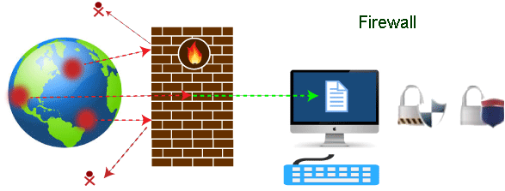
Firewall
A firewall can be defined as a special type of network security device or a software program that monitors and filters incoming and outgoing network traffic based on a defined set of security rules.
It acts as a barrier between internal private networks and external sources (such as the public Internet).
The primary purpose of a firewall is to allow non-threatening traffic and prevent malicious or unwanted data traffic for protecting the computer from viruses and attacks.

Slide 85
Firewall
A Firewall is a special kind reference monitor to control external access to any part of a distributed system.
Firewall provides access control by regulating the flow of network traffic to/from a LAN
Firewall disconnects any part of the DS from outside world
    The internal LANs route packets through Packet Filtering Routers (PFR) and Application Gateway (AG)
    Incoming/outgoing packet contents (e.g., src/dest IP) are examined by PFRs
    PFRs selectively forward the incoming/outgoing packets to/from AG
Connections to the internal network
Packet Filtering Router
Application Gateway
Packet Filtering Router
Connections to the external network
Internal LAN
External LAN

Slide 86
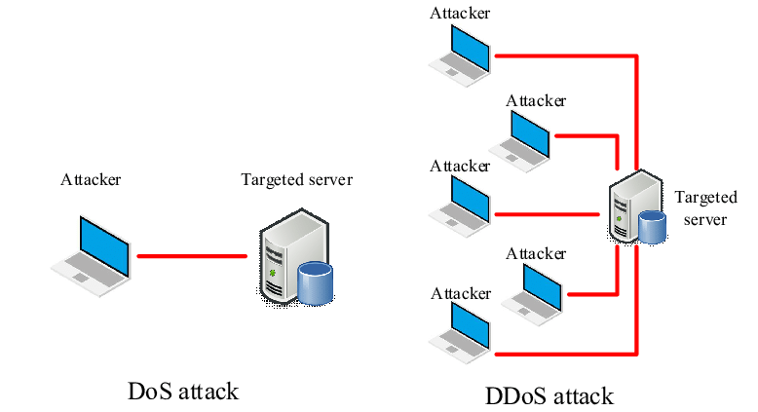
Denial of Service Attacks
Denial of service (DoS) usually refers to an attack that attempts to make a computer resource unavailable to its intended users by flooding a network or server with requests and data.
It can also simply refer to a resource, such as e-mail or a Web site, that is not functioning as usual.

Slide 87
Denial of Service Attacks
Denial of Service (DoS) attacks maliciously prevents authorized processes from accessing the resources
    Example: Flood a search server with TCP requests
DoS attacks from a single source can be easily prevented
Triggering DoS attacks from multiple sources (Distributed DoS or DDoS) is hard to detect
    Attackers hijack a large group of machines
    DDoS is hard to detect
    Two Types of DoS Attacks

Slide 88
Denial of Service Attacks
Bandwidth Depletion: Send many messages to a server
    Normal messages cannot reach the server
Resource Depletion : Trick the server to allocate large amount of resources
    Example: TCP SYN flooding
    Initiate a lot of TCP connections on server (by sending TCP SYN packets)
    Do not close the connections
    Each connection request blocks some memory for some time

Slide 89
Preventing DoS Attacks
Monitor at ingress routers:
    Monitor incoming traffic for large flow towards a destination
    Drawback: Too late to detect since regular traffic is already blocked
Monitor at egress routers:
    Monitor traffic when packets leave organization’s network
    e.g., Drop packets whose source IP does not belong to the org’s network
Monitor at core internet routers:
    Monitor at routers at the core of the Internet Service Providers (ISPs)
    e.g., Drop packets when rate of traffic to a specific node is disproportionately larger than the rate of traffic from that node

Slide 90
Key Distribution
Two types
    Secret-key distribution
    Public-key distribution

Slide 91
Securing Mobile Code
Two main issues:
    Securing against malicious agents that attempt to damage a mobile agent environment.
    Securing a mobile agent from a malicious environment that attempts to interfere with the working of the mobile agent.
    It has proved impossible to protect an agent against all types of attack.
    The emphasis is on being able to detect modifications (or tampering) to an agent.
    The Ajanta System uses public-key technologies to implement this idea:
    Read-only state.
    Append-only logs.
    Selective Revealing

Slide 92
Security Management
Security is implemented using symmetric and asymmetric keys.
There are three main issues:
    How to manage cryptographic keys.
    How to manage securely a group of servers such that a malicious process is not added to the group.
    Authorization management by capabilities and attribute certificates.

Slide 93
Key Management
Examples of key-generation that we studied:
    Session key : Generated and distributed by public-private key pair
    Public-Private Key : Generated by algorithms. How is it securely distributed?
How to boot-strap secure key generation and distribution in a DS?
There are two main approaches in key management:
    Diffie-Hellman Algorithm (For key generation over insecure channels)
    Key distribution

Slide 94
Diffie-Hellman Algorithm for Key Establishment
Alice
Bob
select random a
compute gª mod p
gª mod p
select random b
compute g^{b} mod p
g^{b} mod p
compute k = (g^{b})ª mod p
compute k = (gª)^{b} mod p

Slide 95
Diffie-Hellman Algorithm for Key Establishment
Suppose Alice and Bob want to agree on a shared symmetric key.
Alice and Bob, and everyone else, already know the values of p and g.
    Alice generates a random private value a and Bob generates a random private value b.
    Both a and b are drawn from the set of integers {1, ..., p−1}.
    Alice and Bob derive their corresponding public values—the values they will send to each other unencrypted—as follows.
    Alice’s public value is gª mod p and Bob’s public value is g^{b} mod p
    They then exchange their public values.
    Finally, Alice computes g^{ab} mod p = (g^{b} mod p)ª mod p
    Bob computes g^{ba} mod p = (gª mod p)^{b} mod p.

Slide 96
Diffie-Hellman Algorithm- An example
Step 1 –Publicly shared information
    Alice & Bob publicly agree to a number called the generator, or g, which has a primitive root relationship with p.
    In our example we’ll assume
    p = 17
    g = 3
Step 2 – Select a secret key
    Alice selects a secret key, which we will call a.
    Bob selects a secret key, which we will call b.
    For our example assume: a = 54 and b = 24

Slide 97
Diffie-Hellman Algorithm- An example
Step 3 – Combine secret keys with public information
    Alice combines her secret key of a with the public information to compute A.
    A = gª mod p
    A = 354 mod 17
    A = 15
    Bob combines his secret key of b with the public information to compute B.
    B = g^{b} mod p
    B = 354 mod 17
    B = 16
Step 4 – Share combined values
    Alice shares her combined value, A, with Bob. Bob shares his combined value, B, with Alice.
    Sent to Bob => A = 15
    Sent to Alice => B = 16

Slide 98
Diffie-Hellman Algorithm- An example
Step 5 – Compute Shared Key
    Alice computes the shared key.
    s = (B mod p)ª mod p
    s = g^{b*a} mod p
    s = 3^{54*24} mod 17
    s = 1
    Bob computes the shared key.
    s = (A mod p)ª mod p
    s = g^{a*b} mod p
    s = 3^{24*54} mod 17
    s = 1

Slide 99
Diffie-Hellman Algorithm for Key Establishment
Alice picks a
Bob
picks b
Alice
bob
1
N, g, gª mod n
2
Alice computes
(g^{b} mod n)ª
= g^{ab} mod n
g^{b} mod n
Bob computes
(gª mod n)^{b}
= g^{ab} mod n

