Slide 1

Unit-7
Categories of Distributed System
Distributed System (DS)
GTU #3170719
Prof. Umesh H. Thoriya
Computer Engineering Department
umesh.thoriya@darshan.ac.in
9714233355

Slide 2

Topics to be covered
  Distributed Object-based System
  Distributed File System
  Distributed Web-based System
  Distributed Coordination based System
Looping

Slide 3
Categories of Distributed System
Distributed Object-based System

Slide 4
Distributed Object-based System
In distributed object-based systems, the notion of an object plays a key role in establishing distribution transparency.
In principle, everything is treated as an object and clients are offered services and resources in the form of objects that they can invoke.
Few examples of Object based systems are CORBA, Java-based systems, and Globe

Slide 5
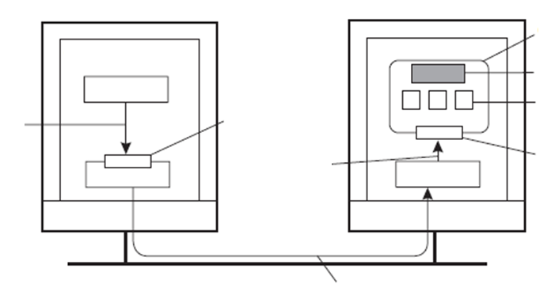
Distributed Objects
Client machine
Server machine
Object
Client
Server
State
Same interface as object
Method
Client invokes a method
Skeleton invokes same method at object
Interface
Proxy
Skeleton
Client OS
Server OS
Network
Marshalled invocation is passed across network
Common organization of a remote object with client-side proxy.

Slide 6
Distributed Objects
Data and operations encapsulated in an object
Operations implemented as methods grouped into interfaces
Object offers only its interface to clients
Object server is responsible for a collection of objects
Client stub (proxy) implements interface
Server skeleton handles (un)marshaling and object invocation

Slide 7
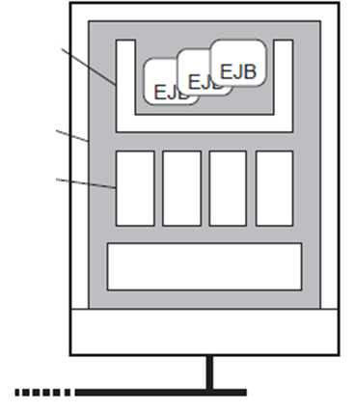
Example: Enterprise Java Beans
An EJB is essentially a Java object that is hosted by a special server offering different ways for remote clients to invoke that object
The important issue is that an EJB is embedded inside a container which effectively provides interfaces to underlying services that are implemented by the application server.
The container can more or less automatically bind the EJB to these services, meaning that the correct references are readily available to a programmer
Typical services include those for remote method invocation (RMI), database access (JDBC), naming (JNDI), and messaging (JMS).
Container
EJB
EJB
EJB
Server
Services
Network
General architecture of an Enterprise Java Beans server

Slide 8
Types of EJBs(Enterprise Java Beans)
Stateless session beans
Stateful session beans
Entity beans
Message-driven beans

Slide 9
Types of EJBs(Enterprise Java Beans)
Stateless session bean: Transient object, called once, does its work and is done.
    Example: execute an SQL query and return result to caller.
Stateful session bean: Transient object, but maintains client-related state until the end of a session.
    Example: shopping cart.
Entity bean: Persistent, state-ful object, can be invoked during different sessions.
    Example: object maintaining client info on last number of sessions.
Message-driven bean: Reactive objects, often triggered by message types.
    Used to implement publish/subscribe forms of communication.

Slide 10
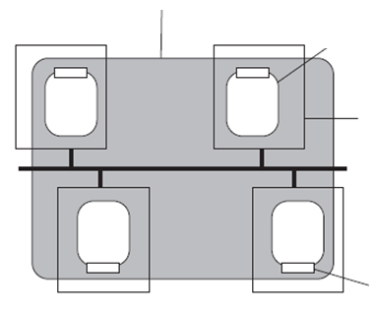
Globe Distributed Shared Objects
A Globe object is a physically distributed shared object: the object’s state may be physically distributed across several machines
Local object: A non-distributed object residing a single address space, often representing a distributed shared object
Contact point: A point where clients can contact the distributed object; each contact point is described through a contact address
Distributed shared object
Local object
Process
Network
Interface
The organization of a Globe distributed shared object

Slide 11
Globe Distributed Shared Objects
Same interface as implemented
by semantics subobject
Globe attempts to separate functionality from distribution by distinguishing different local sub-objects
Semantics sub-object: Contains the methods that implement the functionality of the distributed shared object
Communication sub-object: Provides a (relatively simple), network-independent interface for communication between local objects
Replication sub-object: Contains the implementation of an object-specific consistency protocol that controls exactly when a method on the semantics sub-object may be invoked
Control sub-object: Connects the user-defined interfaces of the semantics sub-object to the generic, predefined interfaces of the replication sub-object
Control
subobject
Replication
subobject
Semantics
subobject
Communication
subobject
Communication
with other local
objects
The general organization of a local object for distributed shared objects in Globe

Slide 12
Processes: Object servers
Servant The actual implementation of an object, sometimes containing only method implementations:
Skeleton: Server-side stub for handling network I/O:
    Un-marshalls incoming requests, and calls the appropriate servant code
    Marshalls results and sends reply message
    Generated from interface specifications
The “manager” of a set of objects:
    Inspects (as first) incoming requests
    Ensures referenced object is activated (requires identification of servant)
    Passes request to appropriate skeleton, following specific activation policy
    Responsible for generating object references

Slide 13
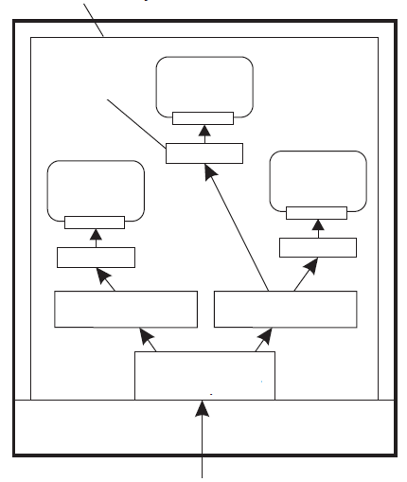
Object Adapter
Server with three objects
Server machine
The role of the object adapter is to bridge the gap between CORBA objects with IDL interfaces and the programming language interfaces of the corresponding servant classes.
An object adapter has the following tasks
    It creates remote object references for CORBA objects
    It dispatches each RMI via skeleton to the appropriate servant
    It activates and deactivates servants
Object's stub (skeleton)
Object adapter
Object adapter
Request
demultiplexer
Local OS
Organization of an object server supporting different activation policies

Slide 14
Communication: Client-to-object binding
Object reference: Having an object reference allows a client to bind to an object
    Reference denotes server, object, and communication protocol
    Client loads associated stub code
    Stub is instantiated and initialized for specific object
    Two ways of binding
    Implicit: Invoke methods directly on the referenced object
    Explicit: Client must first explicitly bind to object before invoking it

Slide 15
Java Remote Method Invocation (RMI)
The Java Remote Method Invocation (RMI) system allows an object running in one Java Virtual Machine (VM) to invoke methods on an object running in another Java VM.
Java RMI provides applications with transparent and lightweight access to remote objects. RMI defines a high-level protocol and API.
Programming distributed applications in Java RMI is simple.
    It is a single-language system.
    The programmer of a remote object must consider its behavior in a concurrent environment.

Slide 16
Remote Method Invocation (RMI)
RMI Architecture
Stub: lives on the client; pretends to be the remote object
Skeleton: lives on the server; talks to the true remote object
Reference Layer: determines if referenced object is local or remote
Transport Layer: packages remote invocations; dispatches messages between stub and skeleton
Client
Server
Stub
Skeleton
RMI Reference Layer
RMI Transport Layer
TCP/IP

Slide 17
Remote Method Invocation (RMI)
Client invokes method at stub
Stub marshals request and sends it to server
Server ensures referenced object is active:
    Create separate process to hold object
    Load the object into server process
Request is unmarshaled by object’s skeleton, and referenced method is invoked
If request contained an object reference, invocation is applied recursively (i.e., server acts as client)
Result is marshaled and passed back to client
Client stub unmarshals reply and passes result to client application

Slide 18
RMI: Parameter passing
Object reference: Much easier than in the case of RPC
    Server can simply bind to referenced object, and invoke methods
    Unbind when referenced object is no longer needed
Object-by-value: A client may also pass a complete object as parameter value
    An object has to be marshaled:
    Marshall its state
    Marshall its methods, or give a reference to where an implementation can be found
    Server un-marshals object. Note that we have now created a copy of the original object.
    Object-by-value passing tends to introduce nasty problems

Slide 19
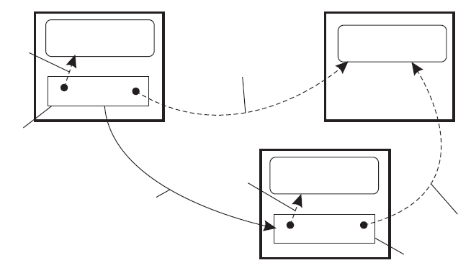
RMI: Parameter passing
Machine A
Machine B
Local
reference L1
Local object O1
Remote object O2
Remote
reference R1
Client code with
RMI to server at C
(proxy)
New local
reference
Copy of O1
Remote invocation with L1 and R1 as parameters
Copy of R1 to O2
Server code
(method implementation)
Machine C
The situation when passing an object by reference or by value

Slide 20
CORBA: Overview
OMG : The Object Management Group (OMG) was formed in 1989 and now has over 800 members.
Its aims were:
    To make better use of distributed systems
    To use object-oriented programming
    To allow objects in different programming languages to communicate with one another
    The object request broker (ORB) enables clients to invoke methods in a remote object
    CORBA (Common Object Request Broker Architecture) is a specification of an architecture supporting this (rather than an implementation such as RMI).

Slide 21
CORBA: Overview
CORBA (Common Object Request Broker Architecture) is a specification of an architecture supporting this (rather than an implementation such as RMI).
ORB(Object Request Broker) : the runtime system responsible for communication between objects and their clients
CORBA facilities: collections of classes and objects that provide general-purpose capabilities that are useful in many applications.
    Horizontal facilities: user interfaces, information management, system management, task management
    Vertical facilities: e.g., electronic commerce, banking, manufacturing, healthcare, telecommunications

Slide 22
CORBA: Overview
Application Objects
Vertical facilities (domain specific)
Horizontal facilities
(general purpose)
ORB: the runtime system responsible for communication between objects and their clients
CORBA facilities: collections of classes and objects that provide general-purpose capabilities that are useful in many applications.
    Horizontal facilities: user interfaces, information management, system management, task management
    Vertical facilities: e.g., electronic commerce, banking, manufacturing, healthcare, telecommunications
Common object services
Object Request Broker

Slide 23
CORBA: Components (Main CORBA Components)
An Interface Definition Language (IDL) and its mapping onto the implementation language (C, C ++, Java, Smalltalk, Ada, COBOL)
    specifies the syntax of objects and services
    cannot be used to describe semantics
    object can be implemented by a language without classes
An Interface Repository (IR) representing the interfaces of all objects available in the distributed system.
A fully dynamic calling mechanism allowing:
    run-time discovery of objects
    discovery of available interfaces from an IR
    construction of message requests
    sending of message requests
Object Adapters: an abstraction mechanism for removing implementation details from the message substrate.

Slide 24
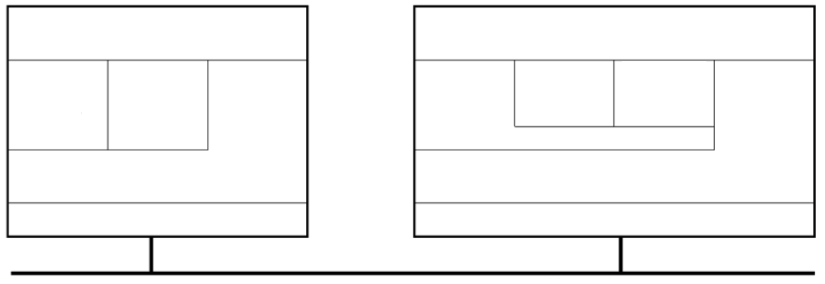
CORBA: Organisation
Client machine
Server machine
Client application
Object implementation
Static
IDL
proxy
Static
IDL
proxy
Static
IDL
proxy
Static
IDL
proxy
Dynamic
Skeleton
Interface
ORB
Interface
Skeleton
Client ORB
Server ORB
Local OS
Local OS
Network
ORB offers:
– Basic communication
– Object references
– Initial finding of services
Interfaces:
– Static (described in IDL)
– Run-time creation (Dynamic Invocation Interface)

Slide 25
CORBA: Communication
Request type
Failure semantics
Description
Synchronous
At
-
most
-
once
Caller
blocks
until
a
response
is
returned
or
an
exception
is
raised
One
-
way
Best
effort
delivery
Caller
continues
immediately
without
waiting
for
any
response
from
the
server
Deferred
At
-
most
-
once
Caller
continues
immediately
and
can
later
Synchronous
block
until
response
is
delivered

Slide 26
CORBA: Event and Notification Services
Push events to consumers
Supplier
Consumer
Push-style model
Event channel
Supplier
Consumer
Supplier
Ask suppliers for new event
Supplier
Consumer
Pull-style model
Event channel
Supplier
Consumer
Supplier

Slide 27
CORBA: Persistent Communication
CORBA messaging service:
    Object-oriented approach to communication
    All communication takes place by invoking an object
    May not be possible to get an immediate reply
    Callback model: A client features two interfaces: method and callback
    Polling model: A client is offered a collection of operations to poll its ORB for incoming results
    Messages sent are stored by the underlying system in case the client or server is not yet running

Slide 28
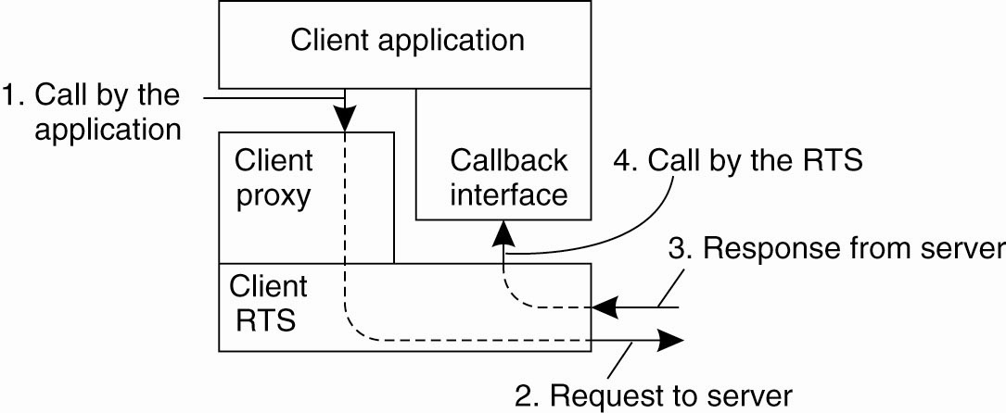
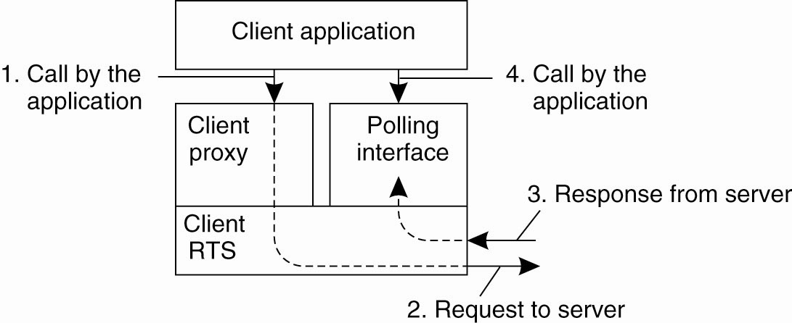
CORBA: Messaging
CORBA’s callback model for
asynchronous method invocation
CORBA’s polling model for
asynchronous method invocation

Slide 29
CORBA: Object references
In order to invoke remote objects, we need a means to uniquely refer to them.
Tagged Profile
Interoperable Object Reference (IOR)
Repository
identifier
Profile
ID
Profile
IIOP
version
Host
Port
Object key
Components
Adapter
identifier
Object
identifier
Other server- specific information

Slide 30
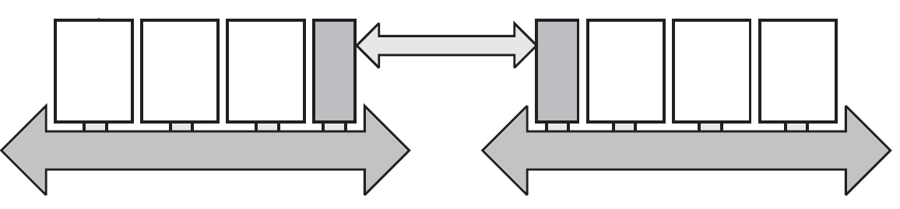
CORBA: Object references
It is not important how object references are implemented per object-based system, as long as there is a standard to exchange them between systems.
Object server
(Half) gateway
Interoperable references
Object system A
Object system B

Slide 31
CORBA: Interoperability
Interoperability is achieved by the introduction of a standard inter-ORB protocol (General Inter-ORB Protocol GIOP) which:
    Defines an external data representation, called the Common Data Representation (CDR)
    Specifies formats for the messages in a request-reply protocol including messages for enquiring about the location of an object, for canceling requests and for reporting errors.
The Internet Inter-ORB protocol (IIOP) defines a standard form for remote object references.
    IIOP is GIOP implemented in TCP/IP

Slide 32
CORBA: Clients and Servers
Clients:
    The IDL specification is compiled into a proxy
    Proxy connects a client application to the underlying ORB
Servers:
    The Portable Object Adapter (POA) makes code appear as CORBA objects to clients
    Creates remote object references for CORBA objects
    Activates objects
    Implements a specific activation policy (e.g., thread-per-request, threadper- connection, thread-per-object policy,...)
    Methods are implemented by means of servants.

Slide 33
CORBA: Clients and Servers
Mapping of CORBA object identifiers to servants.
Active Object Map
Servant
Active Object Map
OID1
Servant
OID1
OID2
OID2
Servant
OID3
OID3
Servant
OID4
Servant
OID4
OID5
OID5
Servant
OID6
OID6
Servant
The POA supports a single servant
The POA supports multiple servants

Slide 34
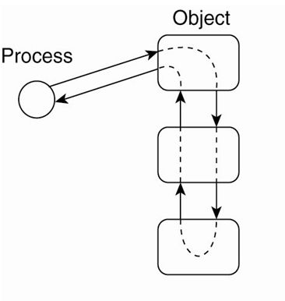
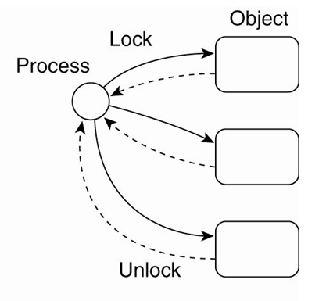
Synchronization and Locking
Problem: Implementation details are hidden behind interfaces
    When a process invokes a remote object, it has no knowledge whether that invocation will lead to invoking other objects.
    If an object is protected against concurrent access, we may have cascading set of locks the invoking process is unaware of
    When dealing with data resources such as files or database tables that are protected by locks, the pattern for the control flow is visible to the process.

Slide 35
Consistency and Replication
General approach to replicated objects:
    Traditional approaches treating them as containers of data with their own operations
Consistency: Data-centric consistency comes in the form of entry consistency
    No multiple invocations on the same object allowed
    Ensure that all the changes to a replicated object are the same.

Slide 36
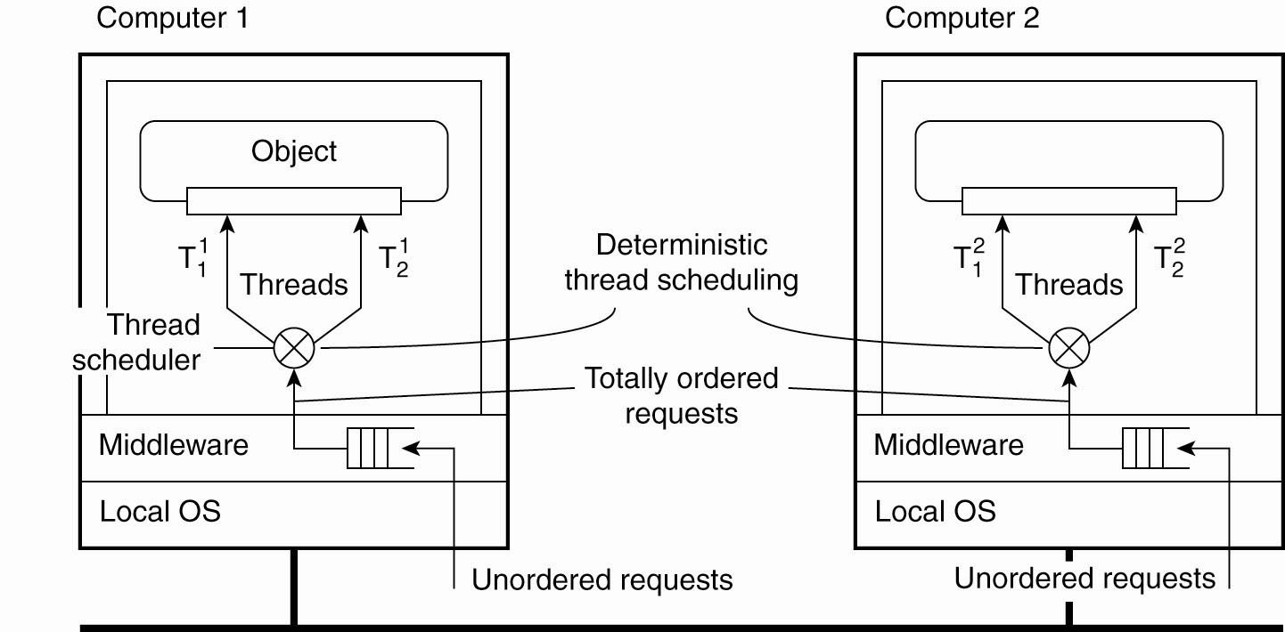
Entry Consistency
Deterministic thread scheduling for replicated object servers

Slide 37
Replication Frameworks
Invocations to objects are intercepted at three different points:
    At the client side just before the invocation is passed to the stub.
    Inside the client’s stub, where the interception forms part of the replication algorithm.
    At the server side, just before the object is about to be invoked.

Slide 38
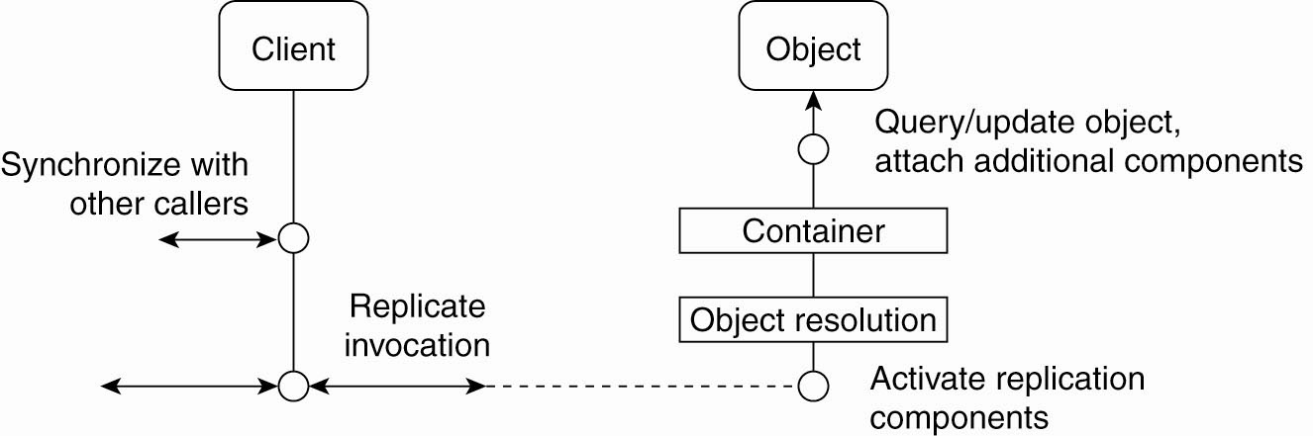
Replication Frameworks
A general framework for separating replication algorithms from objects in an EJB environment

Slide 39
Fault-Tolerant CORBA
Interoperable Object Group Reference (IOGR)
Repository
identifier
Profile
ID
Profile-1
Profile
ID
Profile-N
IIOP
version
Host-1
Port-1
Object key-1
Components
IIOP
version
Host-N
Port-N
Object key-N
Components
TAG
PRIMARY
Other server- specific information
TAG
BACKUP
Other server- specific information
A possible organization of an IOGR for an object group having a primary and backups

Slide 40
CORBA- An Example Architecture
Object group manager
Object
Replication manager
Client or
Object server
Property
manager
ORB
Interceptor
Logging &
Recovery
Replication
Reliable multicasting
To other replicas
LOG
An example architecture of a fault-tolerant CORBA system.

Slide 41
CORBA- An Example Architecture
There are several components that play an important role in this architecture.
By far the most important one is the replication manager, which is responsible for creating and managing a group of replicated objects.
A client there is no fundamental difference between an object group and any other type of CORBA object.
To create an object group, a client simply invokes the normal create_object operation as offered, in this case, by the replication manager, specifying the type of object to create. The client remains unaware of the fact that it is implicitly creating an object group.
The number of replicas that are created when starting a new object group is normally determined by the system-dependent default value.
The replica manager is also responsible for replacing a replica in the case of a failure, thereby ensuring that the number of replicas does not drop below a specified minimum.
The architecture also shows the use of message-level interceptors.

Slide 42
Example: Fault-Tolerant Java
Causes for nondeterministic behavior:
    JVM can execute native code, that is, code that is external to the JVM and provided to the latter through an interface.
    Input data may be subject to non-determinism.
    In the presence of failures, different JVMs will produce different output revealing that the machines have been replicated.

Slide 43
Overview of Globe Security
User certificate
Replica certificate
Administrative certificate
K⁺_{Alice}
K⁺_{Repl}
K⁺_{Adm}
U: 0010011100
R: 1100011100
R: 1101111100
sig(O, {U, K⁺_{Alice}})
sig(O, {R, K⁺_{Repl}})
U: 011001111
D:1
sig(O, {R,U,D, K⁺_{Adm}})

Slide 44
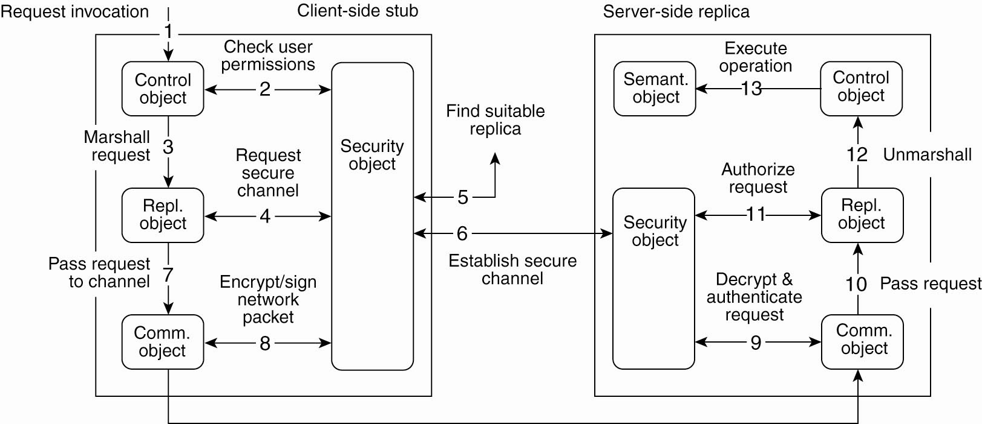
Secure Method Invocation
2. Control sub-object checks the user permissions with the information stored in the local security object.
9. After its receipt, the request is decrypted and authenticated
1. Application issues a invocation request by locally calling the associated method
6. Once a suitable replica has been found, security sub-object can set up a secure channel with its peer, after which control is returned to the replication sub-object.
3. Request is marshaled and passed on
12. Request is then un-marshaled
8. Subobject encrypts and signs the request so that it can pass through the channel
10. Request then passed on to the server-side replication sub-object.
13. Finally, the operation can be executed
5. Security object first initiates a replica lookup
7. Request is now passed on to the communication sub-object.
11. Authorization takes place
4. Replication sub-object requests the middleware to set up a secure channel to a suitable replica

Slide 45
Categories of Distributed System
Distributed File System

Slide 46
What is Distributed File System?
A distributed file system (DFS) is a file system with data stored on a server.
The data is accessed and processed as if it was stored on the local client machine.
The DFS makes it convenient to share information and files among users on a network in a controlled and authorized way.
Server allows the client users to share files and store data just like they are storing the information locally.
Servers have full control over the data and give access control to the clients.

Slide 47
Distributed File System
Clients
Local Disk
cache
cache
cache
Network
Distributed file system is a part of distributed system that provides a user with a unified view of the files on the network.
Servers
cache
cache
Server Disk
Server Disk
Server Disk

Slide 48
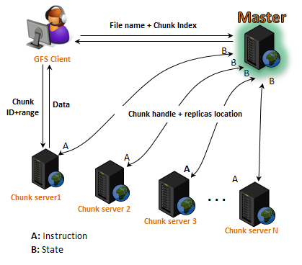

Distributed File System- Example
Google File System (GFS or GoogleFS) is a distributed file system developed by Google to provide efficient, reliable access to data using large clusters of hardware.

Slide 49
Benefits of DFSs
File sharing over a network: without a DFS, we would have to exchange files by e-mail or use applications such as the Internet’s FTP
Transparent files accesses: A user’s programs can access remote files as if they are local. The remote files have no special APIs; they are accessed just like local ones
Easy file management: managing a DFS is easier than managing multiple local file systems

Slide 50
DFS Component Placement
Access speed: Caching information on clients improves performance considerably
Consistency: If clients cache information, do all parties share the same view of it?
Recovery: If one or more computers crash, to what extent are the others affected? How much information is lost?

Slide 51
DFS Aspects
Aspect | Description
Architecture | How are DFSs generally organized?
Processes | Who are the cooperating processes? Are processes stateful or stateless?
Communication | What is the typical communication paradigm followed by DFSs? How do processes in DFSs communicate?
Naming | How is naming often handled in DFSs?
Synchronization | What are the file sharing semantics adopted by DFSs?
Consistency and Replication | What are the various features of client-side caching as well as server-side replication?
Fault Tolerance | How is fault tolerance handled in DFSs?

Slide 52
Network File System
Many distributed file systems are organized along the lines of
client-server architectures
Sun Microsystem’s Network File System (NFS) is one of the most widely-deployed DFS for Unix-based systems
NFS comes with a protocol that describes precisely how a client can access a file stored on a (remote) NFS file server
NFS allows a heterogeneous collection of processes, possibly running on different OSs and machines, to share a common file system

Slide 53
Architectures
Client-Server Distributed File Systems
Cluster-Based Distributed File Systems
Symmetric Distributed File Systems

Slide 54
Remote Access Model
The model underlying NFS and similar systems is that of remote access model
In this model, clients:
Are offered transparent access to a file system that is managed by a remote server
Are normally unaware of the actual location of files
Are offered an interface to a file system similar to the interface offered by a conventional local file system
Replies from
server
Server
Client
File
Requests from
client to access
remote file
File stays
on server

Slide 55
Upload/Download Model
It attempts to reduce the amount of network traffic by taking advantage of the locality feature found in file accesses.
A contrary model, referred to as upload/download model, allows a client to access a file locally after having downloaded it from the server
Data is copied from the server's node to the client's node and is cached there.
The client's request is processed on the client's node itself by using the cached data.
File moved to client
Server
Client
File
New File
All accesses are
done on client
When client is done,
file is returned to server

Slide 56
The Basic NFS Architecture
Client
Server
System call layer
System call layer
Virtual File System (VFS) layer
Virtual File System (VFS) layer
Local file system interface
NFS client
NFS server
Local file system
interface
RPC client stub
RPC server stub
A Client Request in NFS
Network

Slide 57
NFS File Operations
Operation | v3 | v4 | Description
Create | Yes | No | Create a regular file
Create | No | Yes | Create a nonregular file
Link | Yes | Yes | Create a hard link to a file
Symlink | Yes | No | Create a symbolic link to a file
Mkdir | Yes | No | Create a subdirectory in a given directory
Mknod | Yes | No | Create a special file
Rename | Yes | Yes | Change the name of a file
Remove | Yes | Yes | Remove a file from a file system
Rmdir | Yes | No | Remove an empty subdirectory from a directory

Slide 58
NFS File Operations
Operation | v3 | v4 | Description
Open | No | Yes | Open a file
Close | No | Yes | Close a file
Lookup | Yes | Yes | Look up a file by means of a file name
Readdir | Yes | Yes | Read the entries in a directory
Readlink | Yes | Yes | Read the path name stored in a symbolic link
Getattr | Yes | Yes | Get the attribute values for a file
Setattr | Yes | Yes | Set one or more attribute values for a file
Read | Yes | Yes | Read the data contained in a file
Write | Yes | Yes | Write data to a file

Slide 59
Architectures
Client-Server Distributed File Systems
Cluster-Based Distributed File Systems
Symmetric Distributed File Systems

Slide 60
Parallel Applications
Problems are increasingly becoming computationally challenging
    Typically run on large parallel machines
    Critical to leveraging parallelism in all phases
Data access is a huge challenge
    We can also use parallelism in accessing data to obtain performance gains
File striping techniques

Slide 61
File Striping Techniques
Server clusters are often used for parallel applications and their associated file systems are adjusted to satisfy their requirements
One well-known technique is to deploy file-striping techniques, by which a single file is distributed across multiple servers
Hence, it becomes possible to fetch different parts in parallel
Accessing file parts in parallel
a
b
a
d
e
a
c
e
c
b
b
d
d
e
c

Slide 62
General Purpose Applications
For general-purpose applications, or those with irregular or many different types of data structures, file striping may not be effective
In those cases, it is often more convenient to partition the file system as a whole and simply store files on different servers
File block of file a
a
b
c
d
e
a
b
c
d
e
a
b
c
d
e

Slide 63
Google File System
Companies like Amazon and Google offer services to Web clients resulting in reads and updates to a massive number of files distributed across literally tens of thousands of computers
In such environments, the traditional assumptions concerning distributed file systems might no longer hold
    Files tend to be very large (TBs or PBs)
    For example, we can expect that at any single moment there will be a computer malfunctioning
To address these problems, Google, for example, has developed its own Google File System (GFS)

Slide 64
Google File System
File name, chunk index
GFS client
Master
Contact address
Instructions
Chunk-server state
Chunk Id, range
Chunk Server
Chunk Server
Chunk Server
Chunk data
Linux File System
Linux File System
Linux File System

Slide 65
GFS Mechanics
Each GFS cluster consists of a single master along with multiple chunk servers
Each GFS file is divided up into chunks of 64MB
These chunks are distributed across chunk servers (i.e., using file-striping technique)
The GFS master allocates chunks to chunk servers
The master keeps track of where a chunk is located
The GFS master is contacted for metadata information
The GFS master maintains a name space, along with a mapping from file name to chunks
The chunk servers keep an account of what they have stored
Chunks are replicated (server-side- No data caching; but it does cache metadata) to handle failures (No RAID, No SAN)
Replicas are updated serially

Slide 66
Architectures
Client-Server Distributed File Systems
Cluster-Based Distributed File Systems
Symmetric Distributed File Systems

Slide 67
Ivy
Fully symmetric organizations that are based on peer-to-peer technology also exist
All current proposals use a DHT-based system for distributing data, combined with a key-based lookup mechanism
As an example, Ivy is a distributed file system that is built using a Chord DHT-based system
Data storage in Ivy is realized by a block-oriented (i.e., blocks are distributed over storage nodes) distributed storage called DHash

Slide 68
Ivy Architecture
Ivy consists of 3 separate layers:
Node where a file system is rooted
File System Layer
Ivy
Ivy
Ivy
Block-Oriented Storage
DHash
DHash
DHash
DHT Layer
Chord
Chord
Chord

Slide 69
Communication
Communication in DFSs is mainly based on remote procedure
calls (RPCs)
For example, in NFS, all communication between a client and server proceeds along the Open Network Computing RPC (ONC RPC)
The main reason for choosing RPC is to make the system independent from underlying OSs, networks, and transport protocols
Every NFS operation can be implemented as a single RPC call to a file server

Slide 70
RPCs in NFS
  Up until NFSv4, the client was made responsible
  for making the server’s life as easy as possible by keeping requests simple
  The drawback becomes apparent when considering
  the use of NFS in a wide-area system
  In that case, the extra latency of a second RPC leads to performance degradation
  To circumvent such problems, NFSv4 supports compound procedures
Client
Server
Lookup
Lookup name
Read
Time
Read file data
Client
Server
Lookup Open Read
Lookup name
Open file
Time
Read file data

Slide 71
RPC in Coda (Content Delivery Architecture)
Another enhancement to RPCs has been developed as part of the Coda file system (Kistler and Satyanarayanan, 1992) and referred to as RPC2
RPC2 is a package that offers reliable RPCs on top of the (unreliable) UDP protocol
Each time an RPC is made, the RPC2 client code starts a new thread that sends an invocation request to the server then blocks until it receives an answer
As request processing may take an arbitrary time to complete, the server regularly sends back messages to the client to let it know it is still working on the request

Slide 72
RPC in Coda
RPC2 supports multicasting
An important design issue in Coda is that servers keep track of which clients have a local copy of a file (i.e., stateful servers)
When a file is modified, a sever invalidates local copies at clients in parallel using multicasting
Client
Client
Invalidate
Reply
Invalidate
Reply
Server
Server
Invalidate
Invalidate
Client
Reply
Client
Reply
Time
Time
Sending an invalidation message one at a time
Sending an invalidation message using multicasting as in RPC2

Slide 73
Naming In NFS
The fundamental idea underlying the NFS naming model is to provide clients with complete transparency
Transparency in NFS is achieved by allowing a client to mount a remote file system into its own local file system
However, instead of mounting an entire file system, NFS allows clients to mount only part of a file system
A server is said to export a directory to a client when a client mounts a directory, and its entries, into its own name space

Slide 74
Mounting in NFS
Client A
Server
Client B
remote
usr
Mount steen
subdirectory
users
usr
work
usr
Mount steen
subdirectory
vu
steen
me
mbox
mbox
mbox
Exported directory
mounted by Client A
Exported directory
mounted by Client B
The file named /remote/vu/mbox
at Client A
The file named /work/vu/mbox
at Client B
Sharing files becomes harder

Slide 75
Sharing Files In NFS
A common solution for sharing files in NFS is to provide each client with a name space that is partly standardized
For example, each client may by using the local directory /usr/bin to mount a file system
A remote file system can then be mounted in the same manner for each user

Slide 76
Sharing Files In NFS
Client A
Server
Client B
remote
usr
Mount steen
subdirectory
users
usr
work
usr
Mount steen
subdirectory
bin
steen
bin
mbox
mbox
mbox
Exported directory
mounted by Client A
Exported directory
mounted by Client B
The file named /usr/bin/mbox
at Client A
Sharing files resolved
The file named /usr/bin/mbox
at Client B

Slide 77
Synchronization In DFSs
File Sharing Semantics
Lock Management

Slide 78
File Sharing Semantics
A shared file may be simultaneously accessed by multiple users.
In such a situation, an important design issue for any file system is to clearly define when modifications of file data made by a user are observable by other users.
File sharing semantics
Unix file semantics
Session semantics
Immutable file semantics
Transaction-like semantics

Slide 79
File Sharing Semantics - Unix File Semantics
Every read operation on a file sees the effects of all previous write operations performed on that file.
Append(D)
Client A
Read
A
B
C
D
A
B
C
D
A
B
C
A
B
C
A
B
Time
t1
t2
t3
t4
t5
Append(C)
Read
Client B

Slide 80
File Sharing Semantics - Session Semantics
In session semantics, all changes made to a file during a session are initially made visible only to the client process that opened the session.
It is invisible to other remote processes who have the same file open simultaneously.
Once the session is closed, the changes made to the file are made visible to remote processes only in later starting sessions.

Slide 81
File Sharing Semantics - Session Semantics
Client A
Client B
Client C
Server
a
b
Open(file)
a
b
Append(c)
a
b
c
Close(file)
a
b
c
Open(file)
a
b
Append(x)
a
b
x
a
b
c
Open(file)
a
b
c
Close(file)
a
b
x
Append(d)
a
b
c
d
Close(file)
a
b
c
d
a
b
c
x
a
b
c
x
d

Slide 82
File Sharing Semantics - Immutable Shared-files Semantics
Change to the file are handled by creating a new updated version of the file.
Therefore, the semantics allows files to be shared only in the read-only mode.
Client A
Client B
Server
Version
1.0
Access File
Access File
Tentative
based on
1.0
Tentative
based on
1.0
Version
1.1
Version
1.1
Version conflict
Version
1.2
Merged File

Slide 83
File Sharing Semantics- Transaction like Semantics
A transaction is a set of operations enclosed in-between a pair of begin_transaction and end_transaction like operations.
All the transactions will be carried out in order, without any interference from other concurrent transactions.
Partial modifications will not be visible to other concurrently executing transactions until the transaction ends.
The example of this is a banking system.
Authority
50 to B
50 to B
50 Coins
B
50 to C
0 to C
A
C

Slide 84
Categories of Distributed System
Distributed Web-Based Systems

Slide 85
Distributed Web-Based Systems
The World Wide Web (WWW) can be viewed as a huge distributed system consisting of millions of clients and servers for accessing linked documents.
Servers maintain collections of documents, while clients provide users an easy-to-use interface for presenting and accessing those documents.

Slide 86
Architecture
Many Web-based systems are organized as simple client-server architecture.
The simplest way to refer to a document is by means of a reference called a Uniform Resource Locator (URL).
It specifies where a document is located, often by embedding the Domain name server (DNS) of its associated server.
A URL specifies the application-level protocol for transferring the document across the network.
A client interacts with Web servers through a special application known as a browser.
A browser is responsible for properly displaying a document.

Slide 87
Traditional web based system
Client Machine
Server Machine
Browser
Web
Server
2. Server fetches document
from local file
Operating System
Operating System
1. Get Document Request
3. Responses

Slide 88
Web Documents
Fundamental to the Web is that all information comes in the form of a document.
Most documents can be divided into two parts:
  A main part that acts as a template.
  The second part consists of many different bits and pieces that jointly constitute the document that is displayed in a browser.
The main part is generally written in a markup language (HTML, XML).
Each embedded document has an associated MIME (Multipurpose Internet Mail Exchange) type.
It was developed to provide information on the content of a message body that was sent as part of electronic mail.

Slide 89
MIME Types
Type | Subtype | Description
Text | Plain | Unformatted text
 | HTML | Text including HTML markup commands
 | XML | Text including XML markup commands
Image | GIF | Image in GIF format
 | JPEG | Image in JPEG format
Audio | Basic | Audio, 8-bit PCM sampled at 8000 Hz
 | Tone | A specific audible tone
Video | MPEG | Movie in MPEG format
 | Pointer | Representation of a pointer device for presentation
Multipart | Mixed | Independent parts in the specified order
 | Parallel | Parts must be viewed simultaneously
Application | Octet- stream | A uninterpreted byte sequence
 | Postscript | A printable document in postscript
 | PDF | A printable document in PDF

Slide 90
Multitier Architecture
Common Gateway Interface (CGI) defines a standard way by which a Web server can execute a program taking user data as input.
User data come from an HTML forms.
It specifies the program that is to be executed at the server side, along with parameter values that are filled in by the user.
Once the form has been completed, the program's name and collected parameter values are sent to the server.
When the server get a request it starts the program named in the request and passes its parameter values.
Program simply does its work and returns the results in the form of a document that is sent back to the user's browser to be displayed.

Slide 91
Multitier Architecture
1
HTTP
request
handler
2
CGI
Program
3
5
4
Web Server
CGI Process
Database server
1. Get Request
3. Database Interaction
2. Start process to fetch document
4. HTML Document creator
5. Return Result

Slide 92
Web Services
Services available over the web.
The basic idea is that some client application can call upon the services as provided by a server application.
UDDI prescribes the layout of a database containing service descriptions that will allow Web service clients to browse for relevant services.
UDDI stands for Universal Description, Discovery and Integration standard.
Services are described by means of the Web Services Definition Language (WSDL).
WSDL description contains the precise definitions of the interfaces provided by a procedure specification, data types and location.
Core element of a Web service is the specification of how communication takes place.
The Simple Object Access Protocol (SOAP) is used, which is essentially a framework in which much of the communication between two processes can be standardized.

Slide 93
Web Services
Client machine
Server machine
Look up
a service
Publish
service
Client
application
Server
application
Stub
Stub
SOAP
Communication
subsystem
Communication
subsystem
Generate stub
from WSDL
description
Generate stub
from WSDL
description
Service description(WSDL)
Directory service (UDDI)

Slide 94
Processes
The most important processes used in Web-based systems and their internal organization.
Processes
Clients
Web server clusters
The apache web server

Slide 95
Clients
The most important Web client is a piece of software called a Web browser.
It enables a user to navigate through Web pages by fetching those pages from servers and subsequently displaying them on the users screen.
The core of a browser is formed by the browser engine and the rendering engine.
The rendering engine contains all the code for properly displaying documents.
This rendering require parsing HTML or XML, but may also require script interpreter(for JavaScript).

Slide 96
Clients (Web Browser)
User Interface
Display back end
Browser engine
Rendering engine
Network
Comm.
Client-side
Script
interpreter
HTML/XML
parser

Slide 97
Apache Web Server
Apache Portable Runtime (APR), is a library that provides a platform-independent interface for file handling, networking, locking and threading.
Apache core assumes that requests are processed in a number of phases.
Each phase consisting of a few hooks.
Each hook represents a group of similar actions that need to be executed as part of processing a request.
For example, there is a hook to translate a URL to a local file name.

Slide 98
Apache Web Server
General organization of the Apache Web server
Module
Module
Module
Link between
function & hook
Hook
Hook
Hook
Hook
Apache core
Request
Response

Slide 99
Web Server Clusters
An important problem related to the client-server nature of the Web is that a Web server can easily become overloaded.
A practical solution employed in many designs is to simply replicate a server on a cluster of servers.
This principle is an example of horizontal distribution.
The design of the front end becomes a serious performance bottleneck.
Whenever a client issues an HTTP request, it sets up a TCP connection to the server.

Slide 100
Web Server Clusters
A better approach is to deploy content-aware request distribution by which,
    The front end first inspects an incoming HTTP request
    Then decides which server it should forward that request
In combination with TCP handoff, the front end has two tasks.
    When a request initially comes in, it must decide which server will handle the rest of the communication with the client.
    The front end should forward the client's TCP messages associated with the handed off TCP connection.
    The dispatcher is responsible for deciding to which server a TCP connection should be handed off.
    The switch is used to forward TCP messages to a distributor.

Slide 101
Web Server Clusters
Web
Server
Web
Server
Web
Server
Web
Server
LAN
Front end handles
all incoming requests
and outgoing responses
Front end
Request
Response
The principle of using a server cluster in combination with a front end to implement a Web service.

Slide 102
Web Server Clusters
6. Server responses
Web
server
3. Hand off
TCP connection
5. Forward
Other messages
Other
messages
Distributor
Client
Switch
Dis-patcher
4. Inform
switch
Setup request
Distributor
Web
server
Pass setup request
to a distributor
2. Dispatcher selects
server
A scalable content-aware cluster of web servers

Slide 103
Connections
Connections
Hypertext Transfer Protocol (HTTP)
Simple Object Access Protocol (SOAP)

Slide 104
Hypertext Transfer Protocol (HTTP)
HTTP is based on TCP.
Whenever a client issues a request to a server,
    It first sets up a TCP connection to the server
    Then sends its request message on that connection.
The same connection is used for receiving the response.
By using TCP as its underlying protocol, HTTP need not be concerned about lost request and responses.

Slide 105
HTTP Methods
A client can request each of these operations to be carried out at the server by sending a request message containing the operation desired to the server.
Most commonly used request methods are as follows:
OPERATION | DESCRIPTION
Head | Request to return the header of a document
Get | Request to return a document to the client
Put | Request to store a document
Post | Provide data that are to be added to a document
Delete | Request to delete document

Slide 106
HTTP Messages
All communication between a client and server takes place through messages.
HTTP recognizes only request and response messages.
Delimiter
Operation
Reference
Version
Request line
Message header name
Value
Message header name
Value
Request message
header
Message header name
Value
Request body

Slide 107
Simple Object Access Protocol (SOAP)
The Simple object access protocol (SOAP) forms the standard for communication with Web services.
A SOAP message generally consists of two parts, which are jointly put inside what is called a SOAP envelope.
The body contains the actual message.
Header is optional, containing information relevant for nodes along the path from sender to receiver.
Everything in the envelope is expressed in XML.

Slide 108
Naming
Web uses a single naming system to refer a documents.
The names used are called Uniform resource identifiers (URIs).
Uniform resource locator (URL) is a URI that identifies a document by including information on how and where to access the document.
A URL is used as a globally unique, location-independent and persistent reference to a document.
How to access a document is generally reflected by the name of the scheme that is part of the URL such as http, ftp or telnet.

Slide 109
Naming
URL also contains the name of the document to be looked up by that server.
General structure of URLs are as follows.
Scheme
Host name
Pathname
http ://
www.darshan.ac.in
/home/comp/faculty
1. Using only DNS name
Scheme
Host name
Port
Pathname
http ://
www.darshan.ac.in : 80
/home/comp/faculty
2. Combining DNS name with port number
Scheme
Host name
Port
Pathname
http ://
130.37.24.11 : 80
/home/comp/faculty
3. Combining an IP address with port number

Slide 110
Synchronization
Synchronization has not been much of an issue for most traditional Web- based systems for two reasons.
    The servers never exchange information with other servers means that there is nothing much to synchronize.
    The web can be considered as being a read-mostly system.
Distributed authoring of Web documents is handled through a separate protocol called WebDAV (Web Distributed Authoring and Versioning)
To synchronize concurrent access to a shared document, WebDAV supports a simple locking mechanism.

Slide 111
Synchronization
There are two types of write locks.
    An exclusive write lock can be assigned to a single client, and will prevent any other client from modifying the shared document while it is locked.
    A shared write lock, which allows multiple clients to simultaneously update the document.
Assigning a lock is done by passing a lock token to the requesting client.
The server registers which client currently has the lock token.
Whenever the client wants to modify the document, it sends an HTTP post request to the server along with the lock token.

Slide 112
Web Proxy Caching
Web proxy accepts requests from local clients and passes these to Web servers.
When a response comes in, the result is passed to the client.
The advantage of this approach is that the proxy can cache the result and return that result to another client, if necessary.
Web proxy can implement a shared cache.
In addition to caching at browsers and proxies, it is also possible to place caches that cover a region, or even a country, thus leading to hierarchical caches.
Such schemes are mainly used to reduce network traffic.

Slide 113
Web Proxy Caching
As an alternative to building hierarchical caches, one can also organize caches for cooperative deployment.
3. Forward request to web server
Web
server
1. Lock in local cache
Web
proxy
2. Ask neighboring proxy caches
Web
proxy
Cache
Cache
Client
Client
Client
Client
Client
Client
Web
proxy
Cache
Client
Client
Client
The Principle of cooperative caching

Slide 114
Replication for Web Hosting Systems
There are essentially three different kinds of aspects related to replication in web hosting systems.
Aspects of replication in web hosting systems
Metric Estimation
Adaptation Triggering
Adjustment Measures

Slide 115
Metric Estimation
Latency metrics: By which the time is measured for an action to take place for example: Fetching a document.
Spatial metrics: It mainly consists of measuring the distance between nodes in terms of the number of network-level routing hops or hops between autonomous systems.
Network usage metrics: It computes consumed bandwidth in terms of the number of bytes to transfer.
Consistency metrics: It tell us to what extent a replica is deviating from its master copy.
Financial metrics: It is closely related to the actual infrastructure of the Internet.

Slide 116
Adaptation Triggering
Important question that needs to be addressed is when and how adaptations are to be triggered.
A simple model is to periodically estimate metrics and subsequently take measures as needed.
Special processes located at the servers collect information and periodically check for changes.

Slide 117
Adjustment Measures
There are essentially only three measures that can be taken to change the behavior of a Web hosting service:
    Changing the placement of replicas
    Changing consistency enforcement
    Deciding on how and when to redirect client requests

Slide 118
Replication of Web Applications
It is complicated to improve performance of Web applications through caching and replication.
To improve performance, we can apply full replication of the data stored at the origin server.
This scheme works well whenever the update ratio is low and when queries require an extensive database search.
Replicating for performance will fail when update ratio is high.
Alternative is partial replication in which only a subset of the data is stored at the edge server.
The problem with partial replication is that it may be very difficult to manually decide which data is needed at the edge server.

Slide 119
Replication of Web Applications
Edge server side
Original server side
Client
query
Server
Server
Response
Content-blind
cache
Database
copy
Full/Partial data replication
Content-aware
cache
Authoritative
Database
Full schema replication/
query templates
Schema
Schema
Alternatives for caching and replication with Web applications.

Slide 120
Categories of Distributed System
Distributed Coordination-Based Systems

Slide 121
Distributed Coordination-Based Systems
Instead of concentrating on the transparent distribution of components, emphasis lies on the coordination of activities between those components.
Key to the approach followed in coordination-based systems is the clean separation between computation and coordination.
Essence: We are trying to separate computation from coordination; coordination deals with all aspects of communication between processes, as well as their cooperation.
Make a distinction between:
    Temporal coupling: Are cooperating/communicating processes alive at the same time?
    Referential coupling: Do cooperating/communicating processes know each other explicitly?

Slide 122
Distributed Coordination-Based Systems
Coordination models
Temporal
Coupled
Decoupled
Direct
Mailbox
Coupled
Referential
Meeting oriented
Generative communication
Decoupled

Slide 123
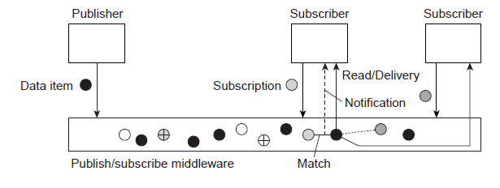
Architectures: Overview
A data item is described by means of attributes.
When made available, it is said to be published.
A process interested in reading an item, must provide a subscription: a description of the items it wants.
Middleware must match published items and subscriptions.

Slide 124
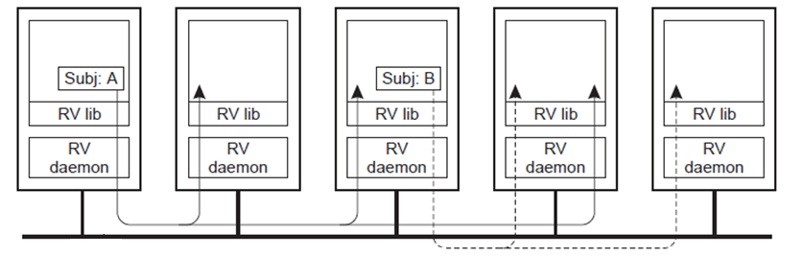
TIB/Rendezvous: Overview
Coordination model: makes use of subject-based addressing, leading to what is known as a publish-subscribe architecture
Receiving a message on subject X is possible only if the receiver had subscribed to X
Publishing a message on subject X, means that the message is sent to all (currently running) subscribers to X.
Publ. on A
Subs. to A
Subs. to A
Publ. on B
Subs. to A
Subs. to B
Subs. to B
Network
Edge server side
Edge server side

Slide 125
Communication
Content-based routing
Observation: When a coordination-based system is built across a wide-area network, we need an efficient routing mechanism (centralized solutions won’t do).
Solution
    Naive: Broadcast subscriptions to all nodes in the system and let servers prepend destination address when data item is published
    Refinement: Forward subscriptions to all routers and let them compute and install filters.

Slide 126
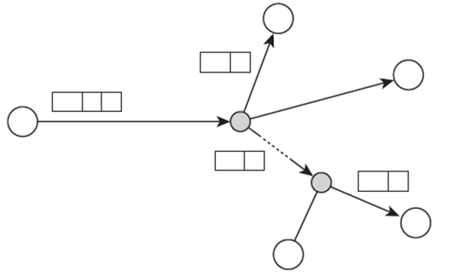
Content-based routing: naive solution
The other extreme solution is to let every server broadcast its subscriptions to all other servers. As a result, every server will be able to compile a list of (subject, destination) pairs.
Then, whenever an application submits a message on subjects, its associated server prepends the destination servers to that message.
When the message reaches a router, the latter can use the list to decide on the paths that the message should follow, as shown in Fig.
1
Interface | Filter
1
To node 3 | a ε [0,3]
2
3
1
R1
To node 4 | a ε [2,5]
5
Toward router R1 | (unspecified)
3
R2
3
3
4

Slide 127
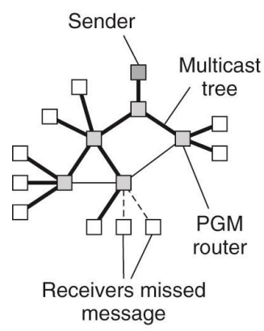
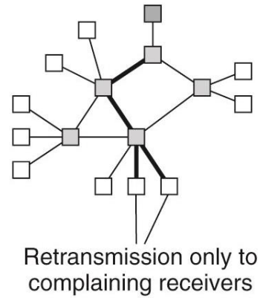
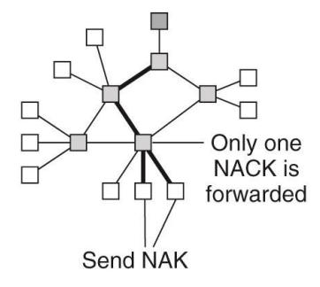
Fault Tolerance in TIB/Rendezvous
Problem: TIB/RV relies on multicasting for publishing messages to all subscribers. This mechanism needs to be extended to wide-area networks and requires reliable multicasting.
Solution: Pragmatic General Multicast (PGM): a NACK-based scheme in which receivers tell the sender that they are missing something(no hard guarantees).
A message is sent along a multicast tree
A router will pass only a single NAK for each message.
A message is retransmitted only to receivers that have asked for it

Slide 128
Jini: Overview
Coordination-based system from Sun Microsystems
Written in Java: one language everywhere
Uses RMI and Java Object Serialization to enable Java objects to move around the network
Offers network plug and play of services (Java objects)
Services may come and go without administration and reconfiguration
Federation, not central control
Programming interfaces designed for robustness

Slide 129
Jini: Main Components
Service: an entity that another program, service or user can use. It can be a piece of computation, a hardware device or software.
Client: a Jini device or component that becomes a member of the federation in order to use a Jini service.
Lookup Service: keeps track of the services offered in the federation.
    Repository of available services.
    Stores each service as Java objects.
    Clients download services on demand.

Slide 130
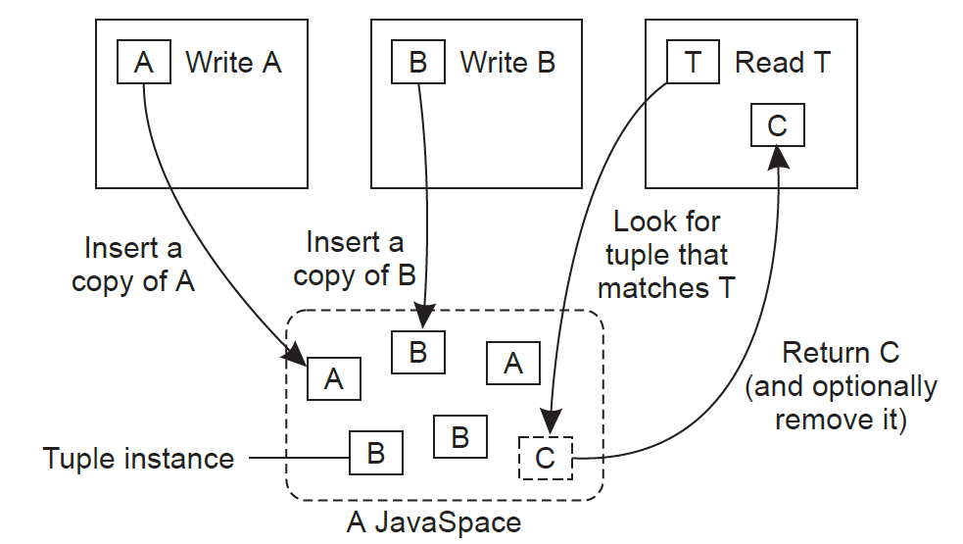
Jini: Javaspaces
Write: A copy of a tuple (tuple instance) is stored in a JavaSpace
Read: A template is compared to tuple instances; the first match returns a tuple instance
Take: A template is compared to tuple instances; the first match returns a tuple instance and removes the matching instance from the JavaSpace

