Slide 1


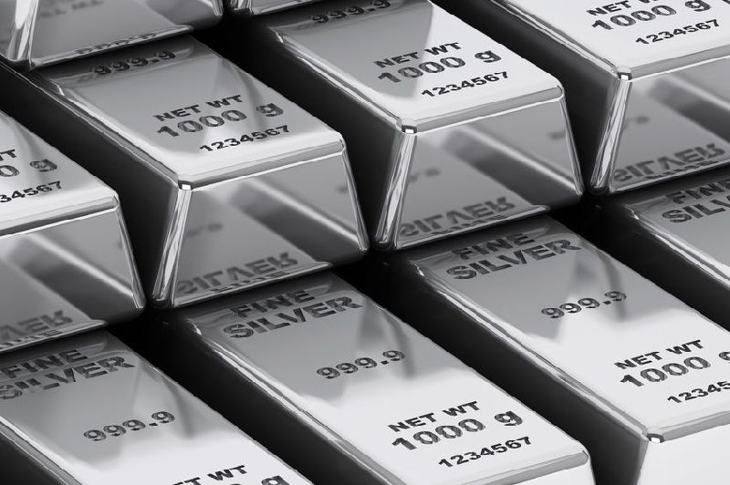
Objective -
THE ELEVATOR PITCH
Making the silver industry more transparent and traceable through SHINE
Name of presenter: DIVYANSHU DUBEY AND J. TANVI
Name of institution: Silver block solutions pvt. ltd
1

Slide 2

The great SILVER
CONNUNDRUM !
Silver is highly fungible and it can follow any path from mine to factory . SWIFT enables a closed network through which money flows , but the same isn’t present for silver .
Participants rely on implicit reputation of supplier upstream to ascertain quality and source of silver .
Traceability for the silver ecosystem will benefit all the players by bringing authenticity and trust .
SILVER supply chains are highly

Slide 3


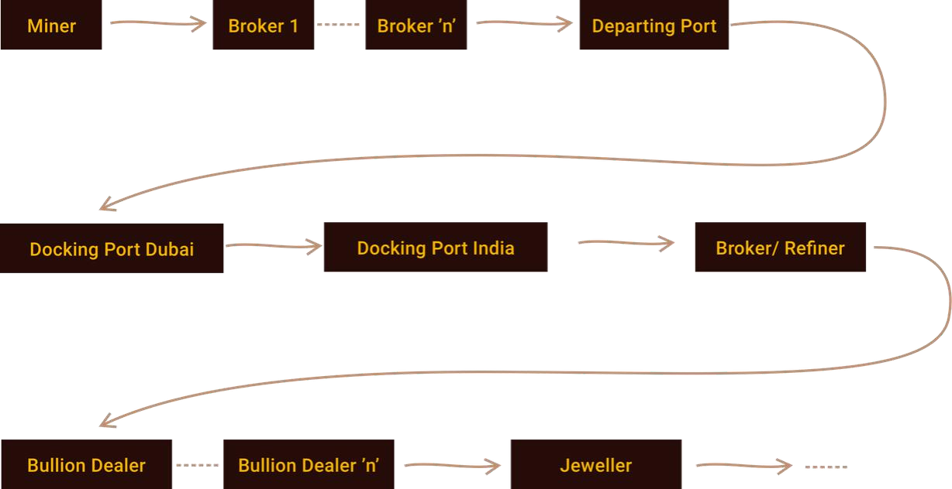
SILVER supply chain :

Slide 4
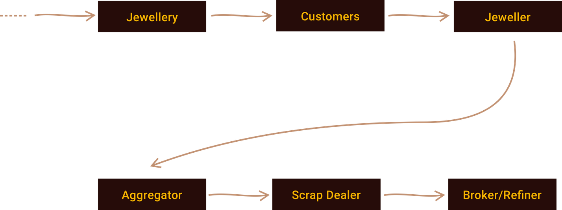
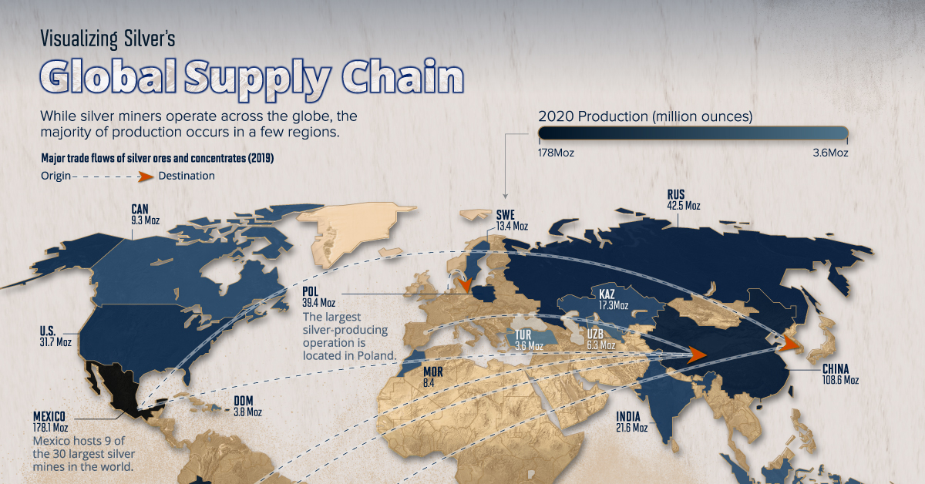

Slide 5

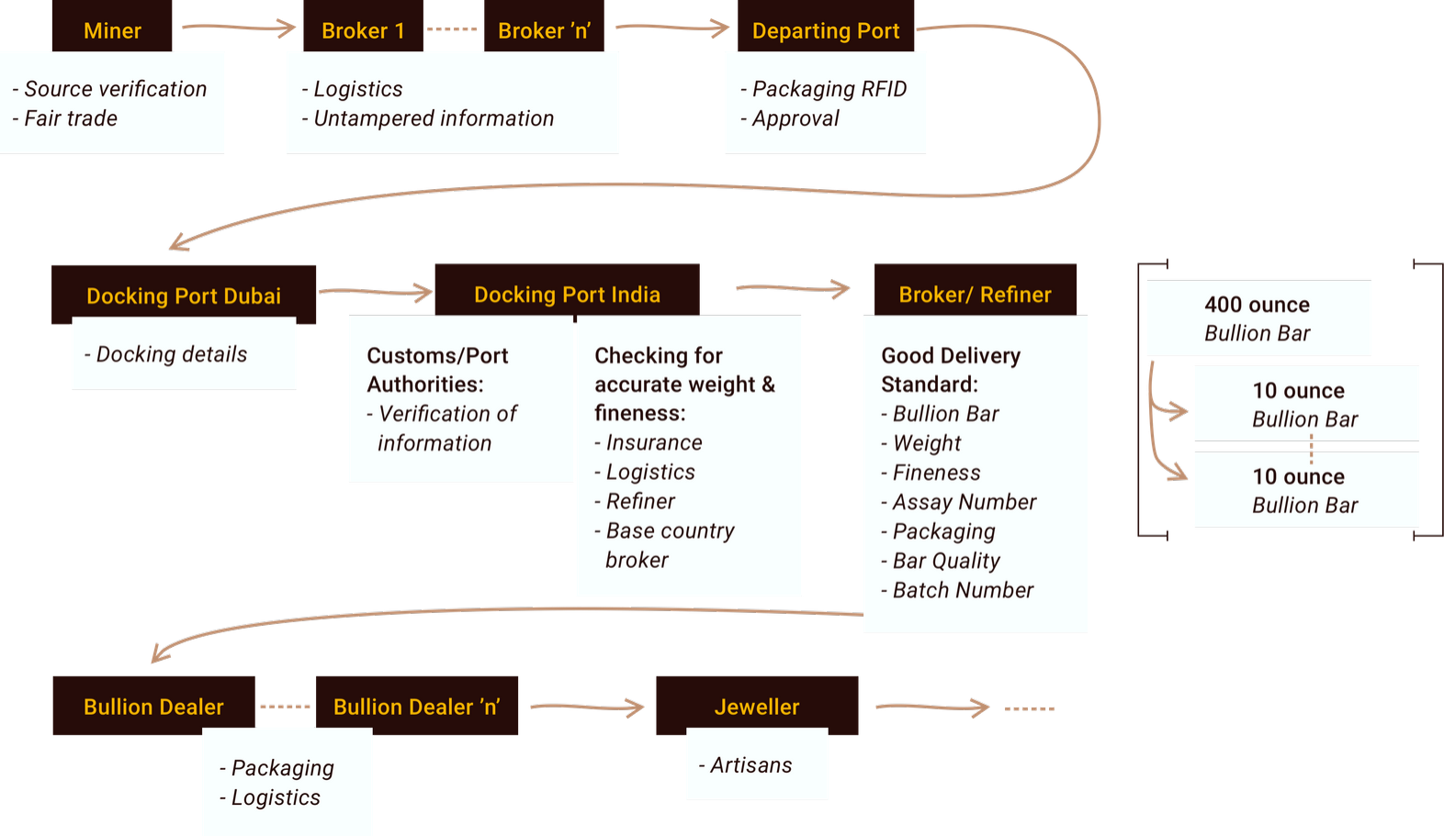
SILVER supply chain :

Slide 6
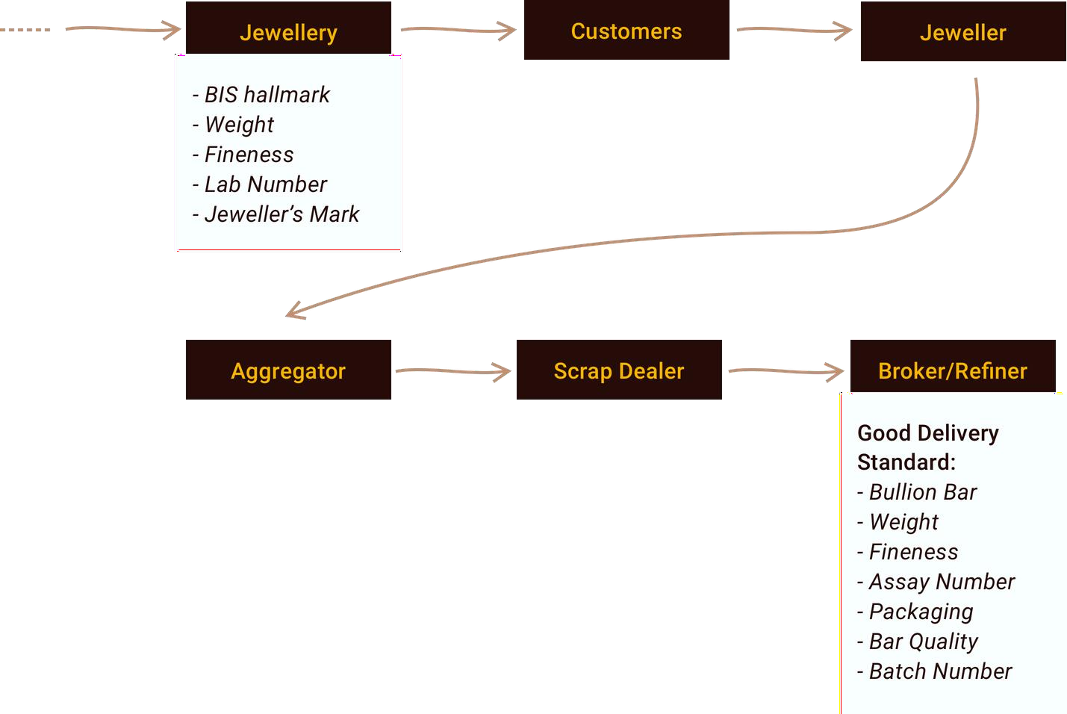
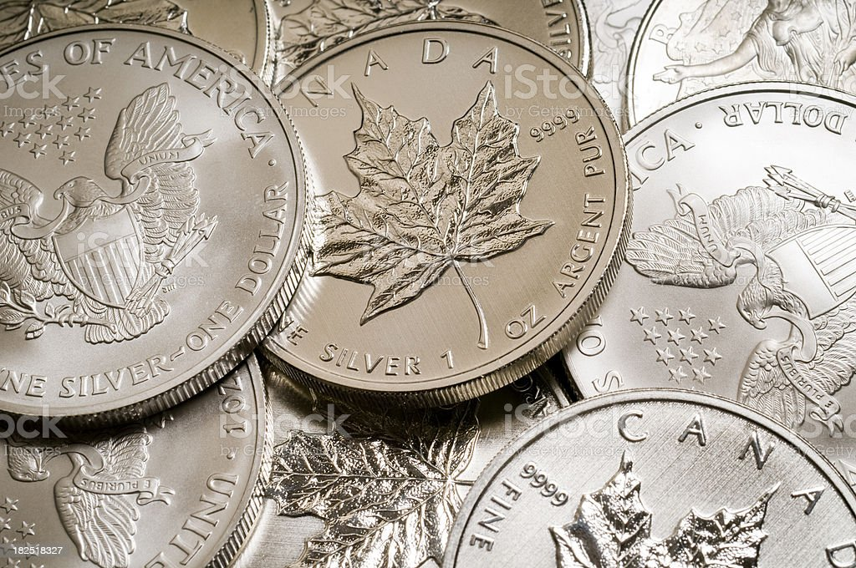


Slide 7
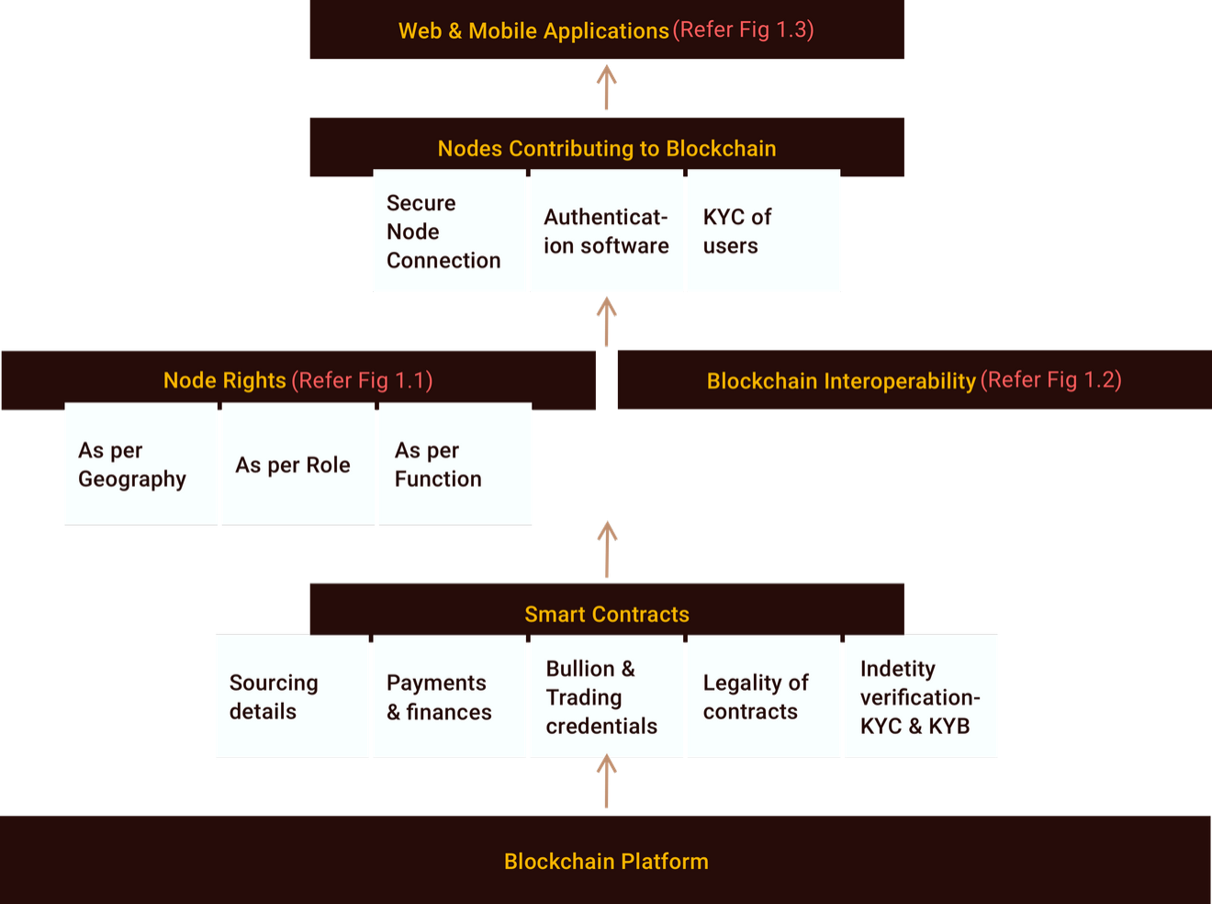

Slide 8
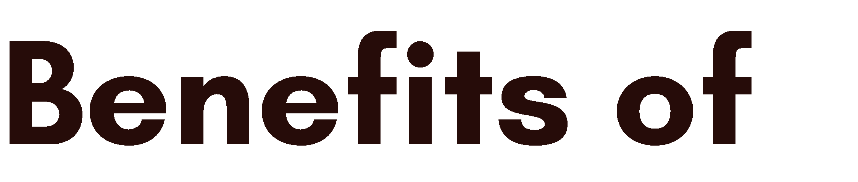







Shine system can make the entry of new players easier making the market more competitive and open .
•
Ownership of fungible metal like silver
•
•
24 of paper

Slide 9
Monetisation plan
We at Silver Block solutions plan to monetise this system with a system of transaction charge . The charge will be based on every bullion of silver purchased and will be flexible , based on the amount of transaction done .
We plan to implement our program in collaboration with IGPC , WGC And other reputed Precious metal exchanges
Our main motive is to bring about a change in the way in which silver transactions are made today and run a business on this concept while bringing about an impact in the society .

