Slide 1
Executive summary templates
Use the Layout dropdown menu to select a template or build your own using these layouts as inspiration.

Slide 2
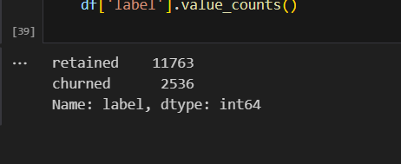
Waze EDA
EDA 101
Project Overview
The project aim to analyze and project customers churning
From the EDA it was discovered that the churn is not significantly represented in the data set as It contains 22% of the label variable
It was discovered that there was no significant difference in the customers that churn and was retained with respect to the km per drives
EDA also found that most churn is rampant based on the km per driving days
We also discovered that churn is also influenced by the drives per day
Churn Analysis
Extensive Explorative Data analysis
Data visualization and data cleaning
Statistics an hypothesis testing
Modelling
Evaluation
Communication
Deployment
Monitoring
Feedbacks

Slide 3
Title
Subtitle
Image Alt-Text Here
Image Alt-Text Here

Slide 4
Title
Subtitle
Image Alt-Text Here

Slide 5
Title
Subtitle

Slide 6
Title
Subtitle
Image Alt-Text Here

Slide 7
Title
Subtitle

