Slide 1

Q.1 Which of the following are true about information extraction?
A. It is the process of extracting meaningful information from text data.
B. It is the process of retrieving information from a corpus of text.
C. Both A and B
D. None of the above
Q2. Which of the following is/are a valid case of information extraction?
A. Looking for skill in resume
B. Extracting information from invoice
c. Finding relevant information from financial documents
D. All of the above

Slide 2
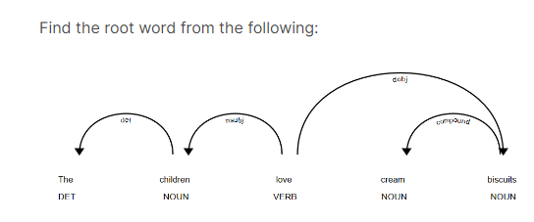
Children
Love
Cream
Biscuits
Noun
Verb
DET
AUX

Slide 3

Q.5 Which of the following is/are true about dependency parsing?
A. It looks for dependency between all words in a sentence.
B. The word at the end of the arrow of a dependency graph is a child of the word at the arrowhead.
C. We can find how two words are related in a text.
D. All of the above.
Q.6 Find the named entity/entities from the following.
A. Google B. Happy C. Paris D. Play
Q7. Identify the named entities in the following sentence - "We never planned to head to Oxygen restaurant to have dinner with Charles."
A. restaurant
B. Oxygen
C. dinner
D. Charles

Slide 4


Q8. Which of the following is true?
A. Regex is a form of information extraction.
B. Only a rule-based approach can solve the information extraction problem.
C. Relation extraction is a form of information extraction.
D. All of the above.
Q9. The rule-based relation extraction approach requires working with ---- patterns.
A. Regex B. Hearst C. Supervised D. All of the above
Q10. Which one of the following formulas gives the normalized hamming distance?
A. Length of string/ Hamming distance
B. Hamming distance /Length of string
C. Hamming distance * Length of string
D. Hamming distance + Length of string

Slide 5
Q11. Which of the following correctly explains the Levenshtein distance?
A. Number of positions with the same symbol in both strings.
B. Minimum number of insertions, deletions, and replacements needed for transforming string A into a string B.
C. Minimum number of symbols to be removed in both strings until resulting substrings are identical
D. Sum of absolute differences between N-gram vectors of both strings.
Q12. What is the Hamming distance between the binary vectors a =1101011111 and b = 0111011000?
A. 3 B. 5 C. 6 D. 2
Q13. Choose the correct hamming distance for the following two strings: "Caroline" and "Cathrine".
A. 5 B. 2 C. 3 D. 1S

Slide 6

Q14. Which of the following is/are the application(s) of hamming distance?
i. To calculate the genetic distance between genotypes of the virus
ii. For detecting and repairing wrong bits.
iii. To calculate the number of characters that need to be replaced to transform one string into another
iv. In identifying user intent from a given statement
A. Only ii and v B. Only i, ii, and iii c. Only ii D. Only ii and v
Q.16 What is the hamming distance of the following pairs of strings: "rocket, rockstar", and unbuttoned, unbuttered"?
A. 1,2
B. 3,2
C. 2,1
D. Cannot be calculated, 2

Slide 7
Q.17 Calculate the Hamming distance and Levenshtein distance for the following two strings: "man and "woman".
A. Hamming distance =2, Levensthein distance = 2
B. Hamming distance =0, Levensthein distance = 0
C. Hamming distance =2, Levensthein distance = 0
D. Hamming distance =Cannot be calculated, Levenshtein distance = 2
Q.18 The Levenshtein distance is an edit distance-based algorithm as it computes the number of edits required to transform one string to another. Choose all the options that the edits count as an operation.
A. Insertion of a character
B. Deletion of a character
C. Changing the case of a character
D. Substitution of a character

Slide 8


Q19. Compute the Levenshtein distance for the two strings: "transform" and "transmit".
A. 5
B. 4
C. 1
D. 3
Q20. Hamming distance is inversely proportional to the similarity of two strings. True or False?
True
False
Q21. What is the Hamming distance between the binary vectors a =10111011001 and b= 01110011011?
A. 2
B. 7
C. 3
D. 4

Slide 9
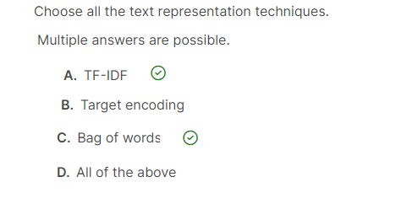
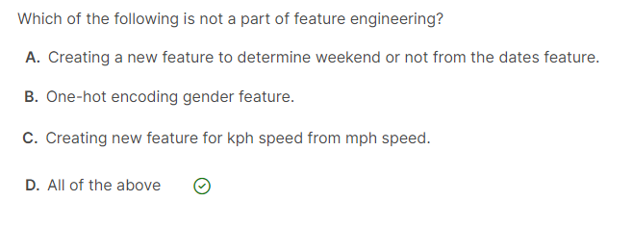
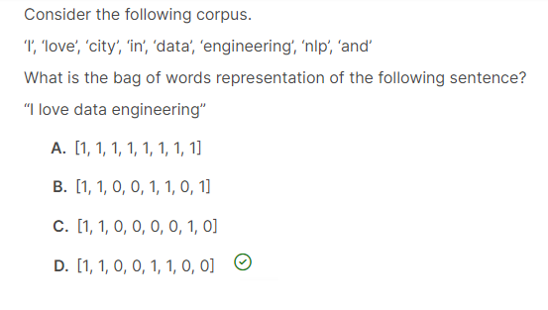
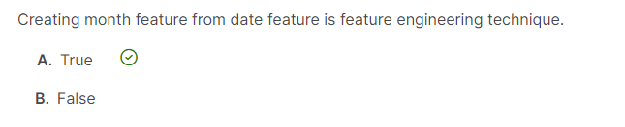

Slide 10
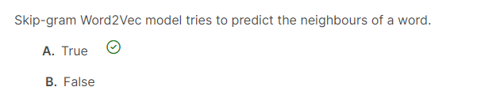
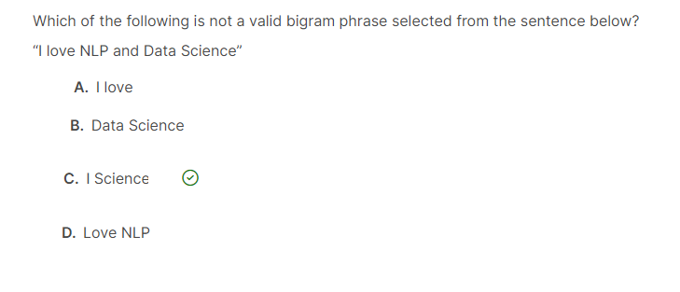

Slide 11
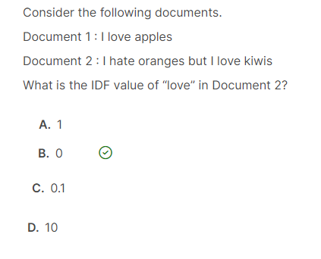

Slide 12
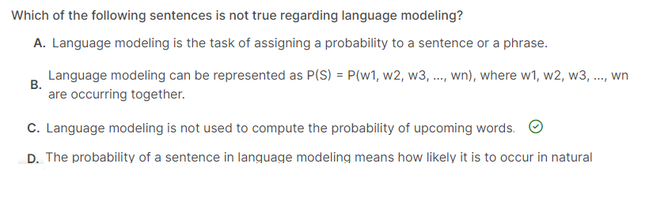
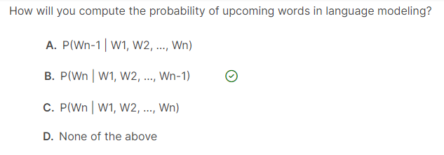

Slide 13
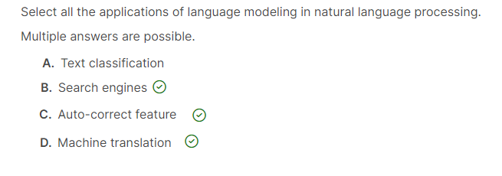
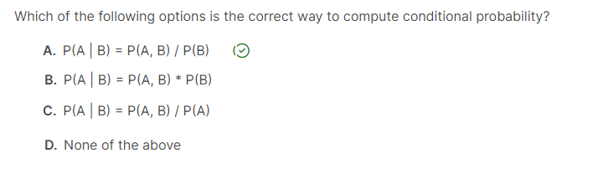

Slide 14
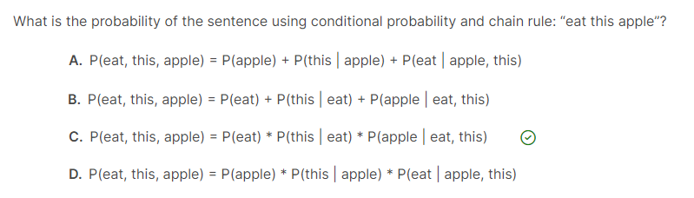
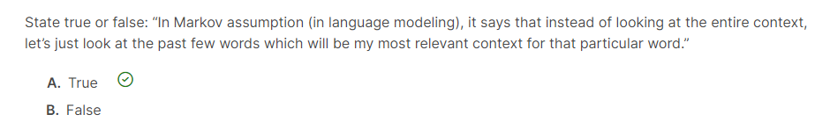

Slide 15
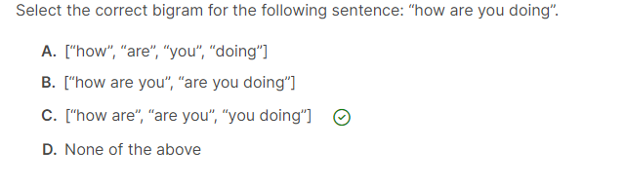
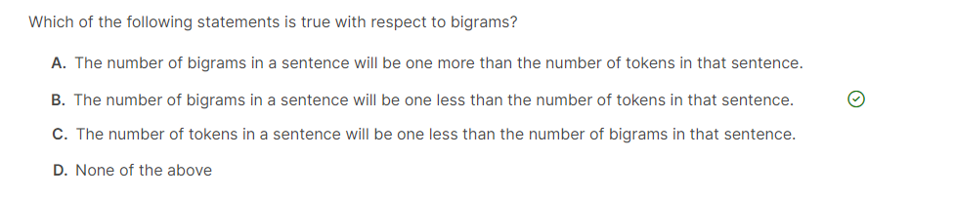

Slide 16
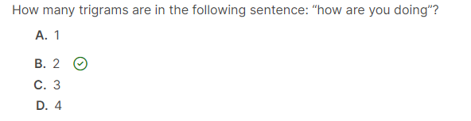
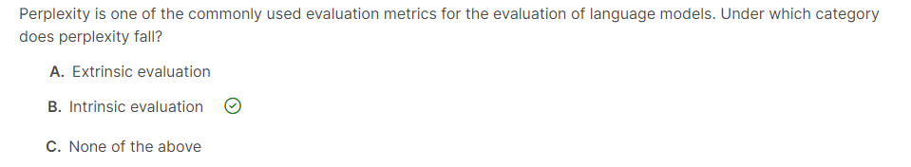
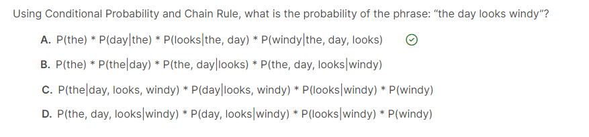

Slide 17
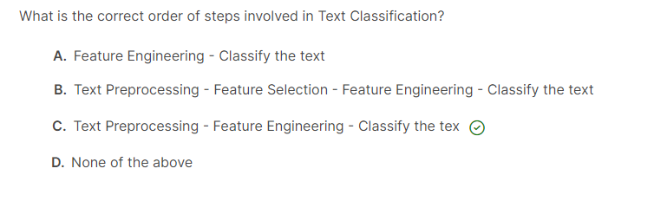
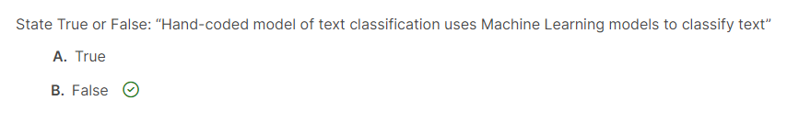

Slide 18
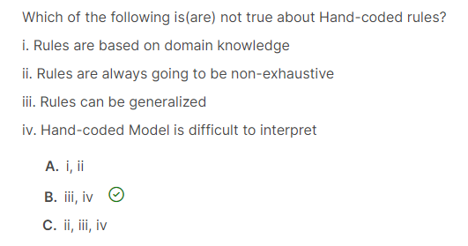
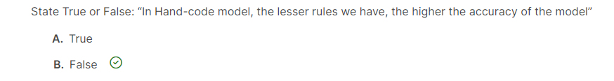

Slide 19
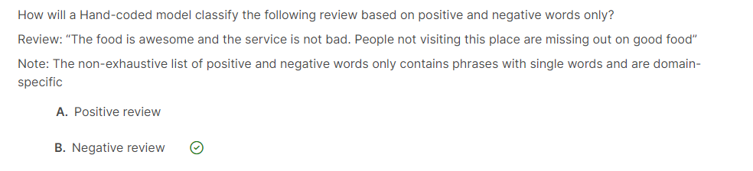
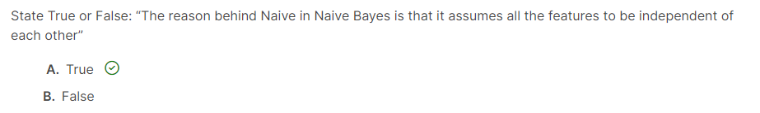

Slide 20
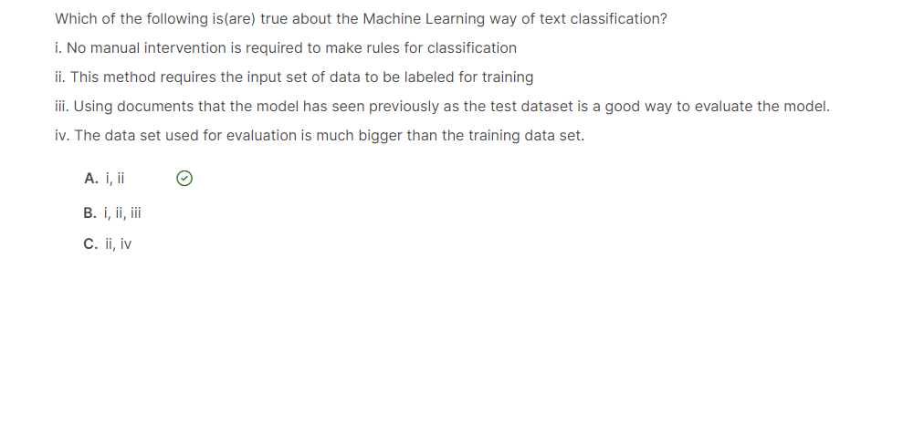

Slide 21
Q. Rapid changes in image intensity are caused following phenomena.
A. Surface Normal Discontinuity
B. Depth Discontinuity
C. Illumination Discontinuity
D. All of the Above
Q. Which one is not a valid type of edge?
A. Step Edge
B. Roof Edge
C. Line Edge
D. Circle Edge
Q. Which of the following is not a job of an Edge Operator/detector?
A. Detecting Edge Position
B. Detecting Edge Magnitude
C. Detecting Edge color
d. Detecting Edge Orientation

Slide 22

Q. The general criteria for edge detection include:
A. Low error rate
B. Good localization
C. Minimal response
D. All of the above
Q. Which one is correct for the Laplacian method?
A. Provides direction of the edge.
B. Detection based on Zero-Crossing.
C. Non-linear operation.
D. Detection using Maxima Thresholding
Q. Which of the following is not belong to the Canny edge detection algorithm?
A. Apply the Laplacien filter to smooth the image in order to remove the noise
B. Find the intensity gradients of the image.
C. Apply non-maximum suppression to get rid of spurious response to edge detection.
D. Apply a double threshold to determine potential edges.

Slide 23
Which of the following definition defines Boosting?
A. Boosting is a classification scheme that works by combining weak learners into a more accurate ensemble classifier
B. During each boosting round, we select a strong learner that does well on hard examples for the previous learners.
C. During each boosting round, we select a weak learner that does well on examples that were easy for the previous strong learners
D. Boosting is a classification scheme that combines strong learners into a more accurate ensemble classifier.
Q. Which of the following is not a correct reason to use Bag-of-word/Bag-of Features/bag-of-shape in computer vision?
A. Learn “visual vocabulary”
B. Quantize features using a visual vocabulary
C. Represent images by frequencies of “visual words”
D. Apply ML models to Image

Slide 24
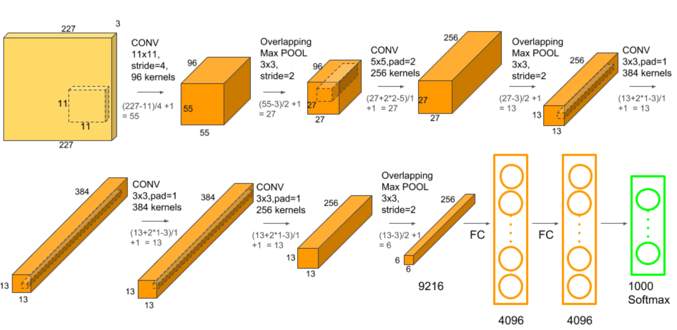
Q. Below architecture represents:
AlexNet
ResNet
ImageNet
GoogleNet

Slide 25
If your computer vision model identifies a painting as an object class, and “Mona Lisa” by Leonardo Da Vinci is an instance of that painting then it is known as.
CNN model
Instance Level Recognition
Object Level Recognition
RNN Model
YOLO algorithm is used to detect-------
A. Objects in real-time.
B. Offline Image processing
C. Edge Detection
D. Color Detection

Slide 26
-------- is only an encoder, while the original transformer is composed of an encoder and decoder
Transformer
GRU
LSTM
BERT
When there are more layers in the network, the value of the product of the derivative decreases until at some point the partial derivative of the loss function approaches a value close to zero. This is known as ------------.
Vanishing gradient problem.
Gradient Descent
LSTM
Attention Layer

Slide 27
Which of the following option is used You Only Look Once approach?
Fast RNN
Fatter RNN
YOLO
Sliding Window

