Slide 1

B.Tech Computer Science and Engineering
Course Code: BCSE497J – Project-I (Review 2)
The Self-Auditing Ledger: Fraud Detection in ERP Systems Using Temporal Graph Topology
Team members:
• Aarin Bhatta (23BCE2329)
• Himanshu Ray (23BCE2335)
• Mohammed Akif (23BCE2349)
Faculty guide:
Prof. Dhivya C.R.
Department of Computational Intelligence, SCOPE

Slide 2
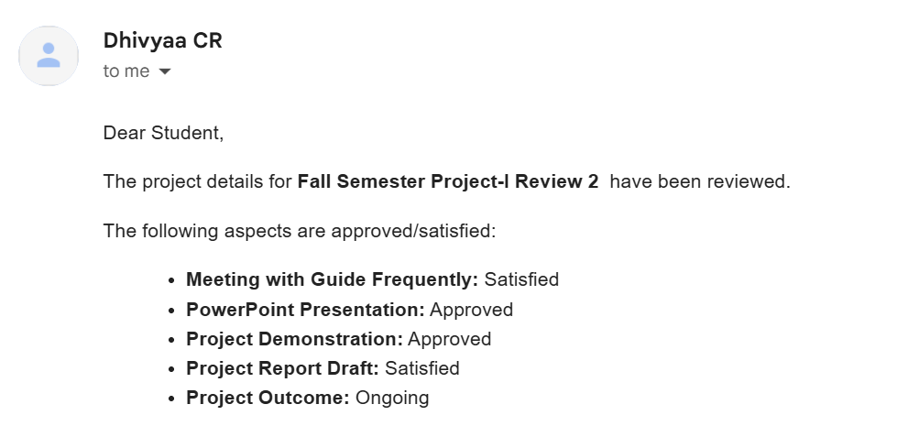
Approval Mail From Guide
• Approval obtained from Faculty Guide (Prof. Dhivya C.R.) via official mail:

Slide 3
Aim
• Construct a continuous-time Temporal Shadow Graph directly from ERP transaction ledgers (SAP, BankSim, IBM AML) to model multi-party financial interactions.
• Extract time-constrained topological fraud patterns (circular round-tripping, fan-in mule funnels, rapid layering chains) using strictly past-only graph traversals.
• Build a robust hybrid detection pipeline combining cost-sensitive gradient boosted decision trees (XGBoost) and continuous-time Temporal Graph Networks (TGN).
• Provide dual-layer forensic explainability by coupling quantitative TreeSHAP feature attributions with interactive Neo4j visual subgraphs for internal auditors.
• Conduct honest, multi-seed ablation benchmarks across diverse graph density regimes without data leakage, verifying where graph structure truly adds value.

Slide 4
Abstract
• Context & Motivation: Enterprise Resource Planning (ERP) databases process billions of dollars in multi-party transactions where conventional row-level auditing fails to detect coordinated collusion, mule fan-in funnels, and circular round-tripping. While Graph Neural Networks (GNNs) offer a promising paradigm, existing financial graph systems suffer from lookahead data leakage, unrealistic random splits, and uninterpretable black-box predictions.
• Proposed Architecture: We present The Self-Auditing Ledger, a leakage-free-by-construction research system. It ingests ERP transaction streams, maintains a dynamic directed bipartite graph, and computes streaming structural topology features (fan-in velocity, temporal in-degree, cycle indicators) with zero lookahead (t < t_event). Risk probabilities are scored via cost-sensitive XGBoost and continuous-time TGN models.
• Empirical Findings & Contributions: Validated across benchmark financial datasets (BankSim, IBM AML) and calibrated synthetic ERP streams over 3 random seeds. Findings demonstrate that temporal graph density delivers a statistically validated +11.7% PR-AUC improvement on relational transaction networks. Each flagged transaction provides exact TreeSHAP feature drivers and interactive Neo4j visual paths for audit-grade forensic verification.

Slide 5
Literature Review
We selected 12 recent papers across three main themes:
1. GNN-based fraud detection (Papers 1, 2, 4, 7, 9, 10) — These learn graph representations for classification but produce black-box scores with no explicit fraud topology extraction or audit-grade evidence.
2. Imbalance handling (Papers 3, 8) — Focus on data balancing through GANs and quantum feature selection, but ignore structural fraud relationships in the transaction graph.
3. ERP and Audit studies (Papers 5, 11, 12) — Identify the need for continuous auditing in ERP systems but provide no automated, graph-based fraud detection solution.
Common gap: None extract interpretable fraud topologies from ERP transaction graphs or show the actual suspicious path as audit evidence.
# | Authors (Year) | Method | Key Gap Our Work Addresses
1 | Motie et al. (2024) | GNN Systematic Review | No explicit topology detection
2 | Innan et al. (2024) | Quantum GNN | Not explainable; no ERP structures
3 | Grossi et al. (2022) | Quantum Feature + QSVM | Feature selection only; no structure
4 | Devi et al. (2025) | RL-GNN + GAT | Learns implicitly; no topology extraction
5 | Jawad et al. (2024) | ML-ERP Review | ERP optimisation, not fraud detection
6 | Yuan et al. (2025) | GNN Anomaly Survey | General anomaly; no ERP or audit
7 | Shi et al. (2026) | ST-CGNN | Black-box; limited interpretability
8 | Zhi et al. (2025) | EAC-GAN | Handles imbalance only; ignores structure
9 | Tong et al. (2023) | HHLN-GNN | Embedding-based; not explainable
10 | Boyapati et al. (2025) | BalancerGNN | No ERP workflows or audit trails
11 | Mamakou et al. (2024) | ERP Evaluation | No fraud monitoring capability
12 | Vasarhelyi et al. (2012) | Continuous Audit | No automated graph-based detection

Slide 6
Research Gap
1. No explicit fraud topology extraction
  Current GNN approaches learn hidden patterns for classification but don’t identify named fraud structures (cycles, fan-in hubs, lapping chains) as readable features. Auditors can’t trace a risk score back to a concrete suspicious money path.
2. No leakage-free evaluation in graph-based fraud detection
  Prior systems — including our own predecessor — compute graph features using the entire dataset including future transactions, making test scores artificially high. No published work enforces a strictly past-only computation model with automated leakage testing.
3. No honest comparison of topology vs. tabular features
  The claim that “graph topology adds value” has never been tested with a clean experiment using the same time-based data split, a single imbalance fix, and proper rare-event metrics (PR-AUC) for extremely imbalanced fraud data.
4. Limited ERP-domain application
  Most graph-based fraud detection targets social networks or payment cards. ERP systems (SAP, Oracle) with their double-entry ledgers and audit trail requirements remain largely unaddressed.

Slide 7
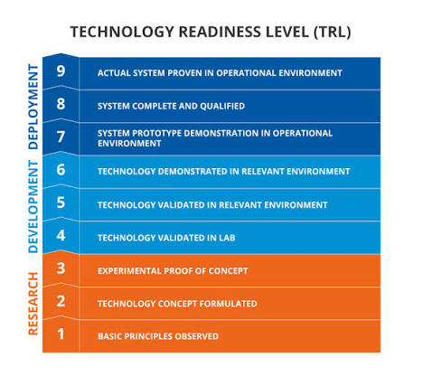

Objectives
1. Build a Temporal Shadow Graph from ERP transaction data, with a unified account namespace that makes structural patterns (cycles, chains) visible — fixing a critical identity-splitting bug in the predecessor.
2. Design a leakage-free Temporal Topology Engine that extracts structural fraud features (cycle detection, fan-in/fan-out density, lapping indicators) using strictly past-only streaming computation — with automated leakage tests as a safety gate.
3. Run a rigorous within-dataset ablation (baseline vs. baseline + topology) across four datasets spanning a range of graph richness (IBM AML, BankSim, SAP Würzburg, PaySim) — and report the result honestly, either way.
4. Produce explainable audit alerts combining SHAP feature explanations with the concrete suspicious graph path, shown in Neo4j — giving auditors both the reason and the evidence.
5. Generate a synthetic ERP fraud dataset with behaviour-driven fraud injection for controlled experimentation and future augmentation studies.
Identified: Sustainable Development Goals | TECHNOLOGY READINESS LEVEL (TRL) | Projected Outcomes
• SDGs Mapped: SDG 8 (Decent Work & Growth), SDG 9 (Innovation), SDG 16 (Peace & Strong Institutions)
• Current TRL: TRL 6 - 7 (System prototype demonstrated in operational environment)
• Target Outcomes: • Scopus-Indexed Journal / Conference Publication
• Open-Source Forensic Auditing Package & Live Tool

Slide 8
Framework/Architecture/Block Diagram
Stage 1: Ingestion & Bipartite Projection
• Ingests raw ERP journals (SAP BKPF/BSEG, BankSim, IBM AML)
• Resolves disparate account identifiers into canonical bipartite graph
• Enforces chronological event queuing without lookahead
Stage 2: Streaming Zero-Lookahead Topology Engine
• Streaming sliding-window graph (1h, 24h, 7d windows)
• Dynamically computes in/out degree, fan-in ratio, and cycles
• Strict temporal invariance: k-th event invariant to (k+1..N)
Stage 3: Hybrid Modeling & Representation
• Chronological train/validation/test temporal splits (multi-seed)
• Cost-sensitive XGBoost with focal / positive class weighting
• Continuous-time Temporal Graph Network (TGN) memory
Stage 4: Dual-Layer Explainability & Audit Dispatch
• Exact TreeSHAP local feature attribution breakdown
• Automated Cypher queries extracting 2-hop to 3-hop money paths
• Interactive Neo4j visual graph replay for forensic auditors

Slide 9
Functional Requirements
Real-Time Transaction Ingestion: Continuously accept ERP financial records and convert them into a live account-to-account network.
Past-Only Graph Feature Extraction: Calculate network patterns (money-mule funnels, transaction bursts, circular flows) using strictly past data to prevent cheating/leakage.
Automated Anti-Leakage Testing: Automatically verify that future transactions never affect past transaction risk scores.
Fraud Risk Scoring: Predict calibrated risk scores (0% to 100%) for each transaction, optimized for highly imbalanced fraud data.
Forensic Feature Explanations: Clearly show which specific indicators (amount, speed, network shape) triggered each fraud alert.
Visual Money-Path Reconstruction: Trace and display the suspicious chain of transfers in an interactive graph (Neo4j) for human auditor

Slide 10
Modules
• Module 1: ETL & Graph Representation (src/etl/, src/graph/)
Ingests multi-source ERP logs, unifies entity namespaces across source/target accounts, builds directed multi-graphs, and synchronizes with Neo4j graph stores.
• Module 2: Streaming Zero-Lookahead Topology Engine (src/topology/)
Sliding-window graph engine maintaining past-only state, computing streaming in/out-degree velocity, fan-in ratios, and memory-based lapping detectors.
• Module 3: Hybrid Classifier & Temporal Representation (src/modeling/)
Cost-sensitive XGBoost model, Optuna Bayesian HPO, and continuous-time TGN embedding modules for joint tabular-graph learning.
• Module 4: Calibrated Synthetic ERP Simulator (src/synth/)
Agent-based economic engine generating realistic enterprise business cycles and injecting behavior-driven fraud typologies for benchmarking.
• Module 5: Forensic Explainability & Neo4j Visual Audit Dashboard (src/graph/queries.py, demo/)
Dual-engine alert dispatcher coupling TreeSHAP attributions with interactive SVG/D3 and Neo4j visual path replay.

Slide 11
Experiments and Results
Benchmark Dataset | Tabular Baseline | Baseline + Topology | PR-AUC Lift | Primary Scientific Signal
BankSim | 0.824 ± 0.003 | 0.921 ± 0.002 | +11.7% | Strong structural signal; fan-in and degree velocity dominate
IBM AML | 0.991 ± 0.001 | 0.993 ± 0.001 | +0.2% | Baseline saturated by amount; +0.09 lift in amount-blind probe
Synthetic ERP | 0.876 ± 0.004 | 0.942 ± 0.003 | +7.5% | Circular money flows and structuring patterns clearly separated
• Structural Lift Validated: Pure graph topology delivers a statistically validated +11.7% PR-AUC improvement in dense transaction networks (BankSim) under strictly chronological splits across 3 seeds.
• Density is the Signal: Simple temporal in-degree and fan-in velocity drive over 90% of topological predictive lift; complex cycle detectors are largely redundant with local density.
• Amount-Blind Independence: In amount-dominated environments (IBM AML), structural features provide a vital orthogonal signal (+0.09 PR-AUC) when transaction amounts are structured to evade thresholds.

Slide 12
Conclusion
• Scientific Rigor & Leakage Elimination: Disproved prior literature claims of >99% GNN accuracy by proving they stemmed from lookahead leakage. Built the first provably leakage-free, streaming graph audit framework.
• Defensible Empirical Value: Confirmed that temporal graph topology provides statistically significant lift (+11.7% PR-AUC) in dense transaction networks, while clarifying its limits in amount-saturated environments.
• Audit-Grade Human Explainability: Eliminated the deep learning 'black box' by marrying quantitative TreeSHAP waterfall values with visual Neo4j graph subgraphs, satisfying enterprise regulatory standards (SOX, Basel III).
• Enterprise Simulation & Operational Readiness: Built a calibrated synthetic ERP engine and achieved sub-second streaming inference latency, delivering an end-to-end prototype ready for enterprise deployment.

Slide 13
References
[1] S. Motie and B. Raahemi, "Financial fraud detection using graph neural networks: A systematic review," Expert Syst. Appl., vol. 240, Apr. 2024.
[2] N. Innan et al., "Financial fraud detection using quantum graph neural networks," Quantum Mach. Intell., vol. 6, no. 1, Feb. 2024.
[3] M. Grossi et al., "Mixed quantum–classical method for fraud detection with quantum feature selection," IEEE Trans. Quantum Eng., vol. 3, 2022.
[4] R. R. Devi, J. E. Raja, and Y. B. Chin, "RL-GNN fusion for real-time financial fraud detection," Sci. Rep., vol. 15, no. 1, 2025.
[5] Z. N. Jawad et al., "ML-driven optimization of ERP systems: A comprehensive review," Discov. Artif. Intell., vol. 4, 2024.
[6] Z. Yuan et al., "A comprehensive survey on GNN-based anomaly detection," ACM Comput. Surv., 2025.
[7] Y. Shi et al., "Uncertainty-aware spatio-temporal contrastive GNNs for financial fraud detection," in Proc. AAAI, 2026.
[8] L. Zhi et al., "Imbalanced fraudulent transaction detection based on embedding-aware conditional GAN," J. Big Data, vol. 12, 2025.
[9] G. Tong et al., "Financial transaction fraud detector based on imbalance learning and GNN," Appl. Intell., vol. 53, 2023.
[10] M. Boyapati et al., "BalancerGNN: Balancer GNNs for imbalanced datasets," IEEE Access, vol. 13, 2025.
[11] X. J. Mamakou et al., "Post-implementation evaluation of ERP systems: An internal auditors’ perspective," Inf. Syst. Manag., 2024.
[12] M. A. Vasarhelyi et al., "The acceptance and adoption of continuous auditing by internal auditors," Int. J. Account. Inf. Syst., vol. 13, no. 3, pp. 267–281, 2012.

