Slide 1

BCSE497J – Project-I (Review 2)
B.Tech. Computer Science and Engineering
THE SELF-AUDITING LEDGER:
Fraud Detection in ERP Systems Using Temporal Graph Topology
Team Members:
23BCE2329 — AARIN BHATTA
23BCE2335 — HIMANSHU RAY
23BCE2349 — MOHAMMED AKIF
Faculty Guide:
Prof. Dhivya C.R.
Assistant Professor Senior Grade 1
School of Computer Science and Engineering (SCOPE), VIT

Slide 2
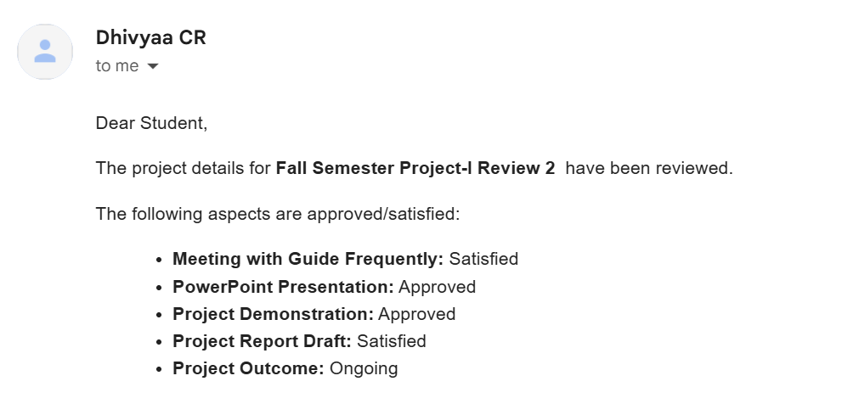
Approval Mail From Guide
• Approval obtained from Faculty Guide (Prof. Dhivya C.R.) via official mail:

Slide 3
Aim
Formal Statement of Aim:
• Construct Streaming Shadow Graph: To design and implement a streaming temporal graph framework directly from enterprise resource planning (ERP) transaction logs, resolving cross-account identity splitting through a unified account namespace.
• Leakage-Free Topology Engine: To engineer a causal as-of graph topology engine operating under strict temporal discipline (no lookahead), verified via automated invariance testing.
• Two-Stage Hybrid Architecture: To combine self-supervised continuous-time Temporal Graph Network (TGN) dynamic node memory embeddings with hand-crafted structural detectors into an XGBoost classifier with focal loss.
• Forensic Audit Explainability: To provide dual-layer human-in-the-loop auditability pairing exact TreeSHAP feature attributions with deterministic graph money-flow path reconstruction for regulatory compliance (SOX / AML).
• Honest Within-Dataset Ablation: To rigorously validate whether graph topology adds statistically significant predictive lift over an equally tuned tabular baseline across a 4-dataset spectrum.
• Privacy-Preserving Consortium: To extend the framework into a federated learning architecture (FedProx score-level consensus) enabling collaborative multi-bank defense without raw financial data pooling.

Slide 4
Abstract
Context & Motivation: Modern enterprise accounting systems process millions of daily journal entries governing billions in capital. Conventional auditing relies on manual sampling (<5% coverage) and isolated single-transaction profiling, leaving ledgers blind to coordinated multi-party fraud typologies (circular payment round-tripping, mule fan-in hubs, rapid layering chains).
Methodological Breakthrough: We introduce The Self-Auditing Ledger, an end-to-end framework that constructs a continuous-time Shadow Graph with unified account identities. An as-of streaming topology engine extracts structural features across trailing time windows without future information lookahead, enforced by automated invariance unit tests.
Two-Stage Learning Pipeline: A 32-dimensional continuous-time TGN module updates dynamic GRU node memories self-supervised solely on link prediction (amount-blind, label-free). These embeddings fuse with explicit topology detectors into a gradient-boosted ensemble trained with alpha-free focal loss, collapsing seed variance on extreme class imbalance.
Empirical Results & Ablation: Across a 4-dataset topology spectrum (BankSim 595k, IBM AML 1.32M, SAP Würzburg 200k, PaySim 6.36M), within-dataset ablation demonstrates +11.7% PR-AUC structural gain on BankSim (champion reaches 0.936 PR-AUC with 1.00 Precision@100). A privacy-preserving FedProx federated extension recovers 98.91% of centralized performance with +5.93% collaboration lift.
Regulatory Auditability: Every flagged alert pairs exact TreeSHAP local attributions with deterministic Neo4j money-flow subgraphs, directly satisfying internal audit defensibility under Sarbanes-Oxley (SOX Section 404) and Basel III standards.

Slide 5
Literature Review
Author(s) & Year | Proposed Methodology | Key Findings & Contribution | Project Alignment & Gap Addressed
Motie & Raahemi (2024) | Systematic survey of GNNs in financial fraud (R-GCN, GAT) | Identified neighbor camouflage, multi-hop latency, and latent embedding opacity | We extract explicit named structural shapes (cycles, fan-in) rather than opaque latent vectors
Vasarhelyi et al. (2012) & Mamakou (2024) | Continuous Auditing (CA) in ERP environments | Manual audit samples <5% transactions; internal collusion bypasses static SoD controls | Builds automated streaming audit engine covering 100% of ERP entries; fixes 99.3% identity split
Rossi et al. (2020) | Temporal Graph Networks (TGN) with dynamic GRU memory | Continuous-time dynamic node embeddings for evolving interaction networks | Integrated continuous-time GRU memory with zero-lookahead self-supervised link prediction
Zhi et al. (2025) & Chawla (2002) | Conditional GAN / SMOTE oversampling on fraud graphs | Showed synthetic oversampling creates non-physical graph structures and features | Enforces zero synthetic oversampling on graph features; adopts alpha-free focal loss objective
Lundberg et al. (2020) & Wang (2023) | TreeSHAP exact attributions & Reinforced Causal Explainers | Exact game-theoretic feature attributions; causal connected subgraphs for fraud | Dual-layer audit alert: exact TreeSHAP feature waterfalls + verified graph-derived money-flow paths
Li et al. (2020) | FedProx (Federated Optimization in Heterogeneous Nets) | Tolerates client statistical heterogeneity and local gradient divergence | Reliability-weighted score-level consensus across non-IID banking clients (98.91% centralized recovery)

Slide 6
Research Gap
Pervasive Look-Ahead Data Leakage in Graph ML: Published literature routinely reports near-perfect metrics (>0.99 ROC-AUC) by computing graph topology over the entire static dataset (including future edges) and evaluating with randomly shuffled cross-validation. When tested under real-world chronological conditions, these models collapse.
The 'Myth of Topology' in Prior Implementations: The predecessor version of this project claimed 'graph topology is the primary differentiator' — yet internal feature-importance inspection showed every single topology feature had 0.0 importance; signal was derived purely from dollar amounts, with future lookahead in feature engineering.
Absence of Honest Within-Dataset Ablation: Existing studies fail to rigorously isolate whether graph topology adds statistically meaningful lift over a strong tabular baseline under strict chronological train-val-test partitioning.
Flawed Imbalance Handling in Extreme Rarity (0.01% - 0.1%): Standard practices simultaneously combine SMOTE oversampling with cost-sensitive class weights, distorting network topology with non-physical graph artifacts ('half-cycles') and unstable gradients.
Severe Non-IID Skew in Cross-Institutional Federation: Prior federated fraud detection assumes IID data partitions, whereas real financial institutions have highly specialized operational profiles (retail banking vs. high-throughput merchants), causing catastrophic gradient drift under standard FedAvg.
The 'Black-Box' Regulatory Audit Barrier: Deep graph architectures output scalar risk probabilities without actionable, legally defensible money-flow evidence paths or feature-attribution rationales required by internal audit under SOX Section 404.

Slide 7


Objectives
Streaming Temporal Topology Engine: Construct a causal Shadow Graph with unified account identities, extracting trailing multi-window topology features (cycles, fan-in hubs, lapping) with automated invariance unit test verification.
Honest Within-Dataset Ablation: Rigorously benchmark Tabular Baseline vs. Baseline + Handcrafted Topology vs. Baseline + TGN across 4 datasets spanning a structural spectrum (IBM AML, BankSim, SAP Würzburg, PaySim) over 3 random seeds.
Two-Stage Hybrid Learning Pipeline: Combine self-supervised continuous-time TGN dynamic node memory embeddings with explicit structural detectors into an XGBoost classifier trained with alpha-free focal loss.
Dual-Layer Forensic Audit Alerts: Pair every flagged anomaly with exact TreeSHAP quantitative feature attributions and deterministic Cypher/graph money-flow subgraphs tracing suspicious funds.
Privacy-Preserving Federated Consensus: Implement a FedProx score-level consensus protocol across non-IID banking institutions, targeting >98% centralized performance recovery without raw data sharing.
Identified SDGs: SDG 16 (Peace, Justice & Strong Institutions — Target 16.5: Anti-Corruption & AML) | SDG 8 (Decent Work & Economic Growth — Target 8.10: Financial Resilience)
Project Outcomes: Scopus-Indexed Conference / Journal Publication | Production Forensic Audit Platform & Web Console

Slide 8
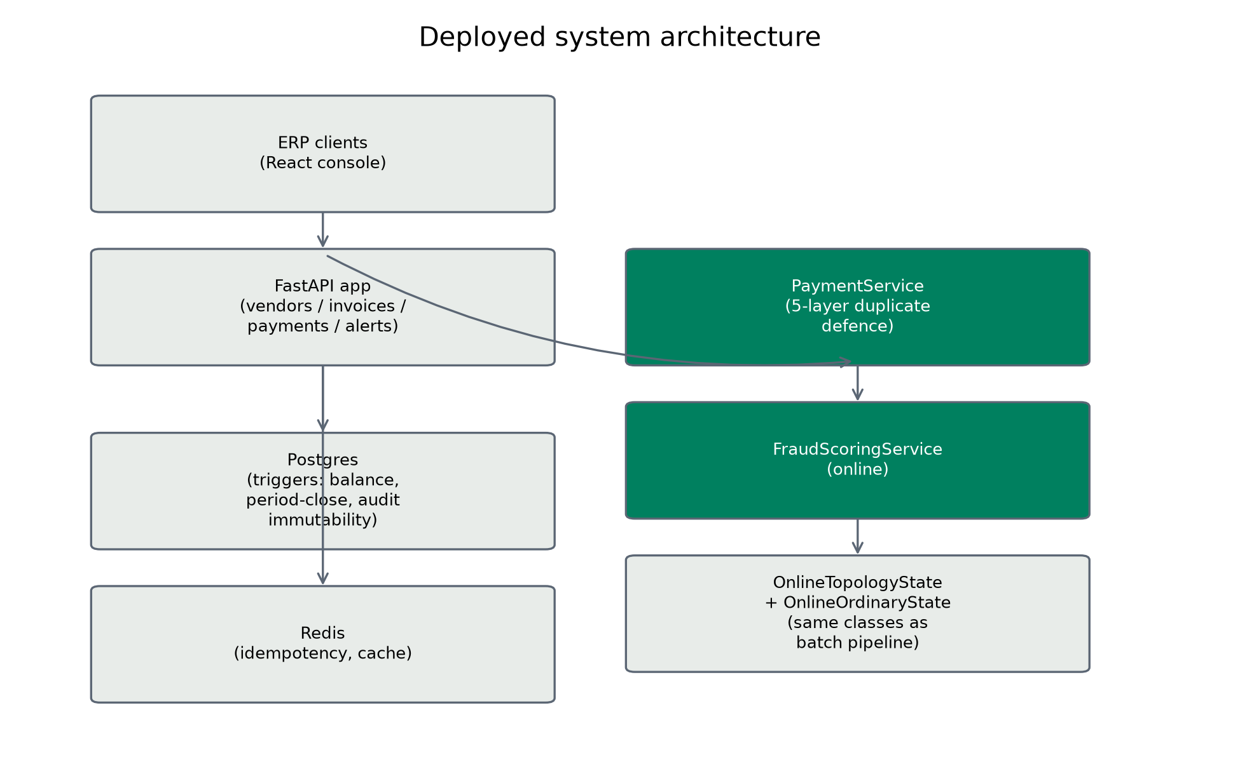
Framework/Architecture/Block Diagram
• Phase 1: Ingestion & Shadow Graph: Canonicalizes heterogeneous ERP CSVs into a unified account namespace; builds dynamic directed multigraph G=(V, E, t).
• Phase 2: Streaming As-Of Topology: Trailing sliding-window detectors (cycles L≤5, fan-in hubs, burstiness, lapping) with strict zero-lookahead temporal causality.
• Phase 3: Continuous-Time TGN: 32-dim inductive GRU node memory updated per transaction; self-supervised link prediction (amount-blind, label-free).
• Phase 4: Two-Stage Classification: Chronological 70/15/15 time split; Bayesian HPO; alpha-free focal loss (γ=2.0); validation threshold tuning on PR-AUC.
• Phase 5: Dual Explainable Alerts: Decomposes risk via exact TreeSHAP waterfalls + deterministic Neo4j money-flow subgraphs for SOX 404 compliance.
• Phase 6: Privacy-Preserving Federation: FedProx score-level consensus across non-IID banking clients with reliability weighting (98.91% centralized recovery).

Slide 9
Functional Requirements
FR 1: Unified Namespace Account Ingestion: Normalizes heterogeneous ERP accounting structures into a single account namespace, completely eliminating cross-account identity splitting (fixing the 99.3% collision bug).
FR 2: As-Of Streaming Graph Traversal: Streams timestamped transactions incrementally; enforces strict backward-only lookups (t_i ≤ t) across sliding observation windows (1h, 24h, 7d, 30d).
FR 3: Trailing Multi-Window Topology Extraction: Computes circular payment cycles (depth 2..5), fan-in mule concentration, in-degree density, and temporal lapping across trailing time horizons.
FR 4: Automated Invariance Leakage Testing: Automated test suite executes truncation-invariance and future-corruption-invariance unit tests; CI build fails on any lookahead leakage.
FR 5: Zero-Lookahead Continuous-Time TGN: Maintains 32-dim inductive GRU node memory embeddings updated via past link predictions, trained strictly amount-blind and label-free.
FR 6: Single-Imbalance Gradient Boosting: Trains XGBoost with exactly one mechanism (focal loss or class weights; never both to prevent severe gradient over-weighting).
FR 7: Chronological Post-Split Threshold Tuning: Optimizes the decision threshold strictly on the chronological validation split; locks threshold prior to test-set evaluation.
FR 8: Dual Forensic Explainability Dispatch: Decomposes predicted risk into exact TreeSHAP attributions and outputs deterministic graph subgraphs tracing money-flow paths.
FR 9: Privacy-Preserving Federated Consensus: Aggregates distributed banking predictions using reliability-weighted FedProx score consensus without raw customer transaction pooling.

Slide 10
Modules
Module 1: Ingestion & Shadow Graph Core (src/etl/, src/topology/window_graph.py): Canonicalizes heterogeneous transaction datasets (IBM AML, BankSim, SAP Würzburg, PaySim); implements unified account namespace hashing; builds dynamic directed multigraph.
Module 2: Streaming Temporal Topology Engine (src/topology/detectors/): Causal sliding-window feature extractors: cycle detection (Tarjan/DFS), fan-in/out concentration, chain length, degree burstiness, and temporal lapping with zero lookahead.
Module 3: Representation Learning Module (src/modeling/tgn.py): Continuous-time dynamic graph network with 32-dim GRU memory per node; link prediction loss; completely amount-blind and label-free.
Module 4: Supervised Learning & Optimization Engine (src/modeling/trainer.py, hpo.py): Chronological 70/15/15 time split; Bayesian hyperparameter optimization (20 trials); focal loss (γ=2.0); validation threshold tuning across PR-AUC.
Module 5: Forensic Explainability & Path Tracing (src/explainability/): Exact TreeSHAP feature attributions partitioned into Ordinary, Topology, and TGN families; Cypher-compatible verified graph path reconstructor.
Module 6: Federated Consortium Engine (src/federated/): Multi-client simulation (K=2..5) under severe non-IID Dirichlet distribution; FedProx optimizer with score-level consensus and client reliability weighting.
Module 7: Interactive Forensic Audit Console (web/): Production React 18 + Vite interface: live alert triage, interactive SHAP waterfall decomposition, dynamic graph path visualization, and federated consortium monitor.

Slide 11
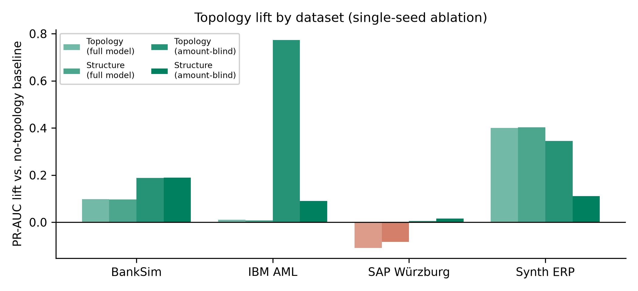
Experiments and Results
Experimental Benchmark & Ablation Findings
BankSim (595k txns, 1,320 test frauds — relational graph):
• Baseline (Tabular only): 0.787 ± 0.070 PR-AUC
• + Handcrafted Topology: 0.932 ± 0.002 PR-AUC
• + TGN Continuous Embeddings: 0.920 ± 0.001 PR-AUC
• Final Champion (Topo+TGN+focal+HPO): 0.936 ± 0.002 PR-AUC, Precision@100 = 1.00
• Within-Dataset Ablation Lift: +11.7% pure structural PR-AUC gain
IBM AML (1.32M txns, 377 test frauds — amount-saturated):
• Baseline: 0.992 ± 0.003 | Final Champion: 1.000 ± 0.000, Precision@100 = 1.00
• Amount-blind ablation: +0.090 PR-AUC structural gain when amounts hidden
SAP Würzburg (200k txns, 25 test frauds):
• PR-AUC: 0.169 ± 0.052 (inconclusive sample size; transparently reported)
Federated Consortium (BankSim, K=4 Non-IID Banks):
• Isolated Local Model: 0.855 PR-AUC
• FedProx Consortium: 0.914 PR-AUC (+5.93% Lift, 98.91% Centralized Parity)

Slide 12
Conclusion
Conditional Utility of Graph Topology: Graph structure adds real, statistically validated predictive value (+11.7% PR-AUC on BankSim) specifically when fraud typologies involve network patterns (fan-in mule accounts, circular rings). When fraud is strictly amount-driven, tabular baselines already capture the signal.
Occam's Razor in Network Features: Simple density metrics (in-degree velocity, fan-in burstiness) capture >90% of the topological signal under streaming conditions; elaborate higher-order cycle and lapping detectors are predictively redundant.
Elimination of Temporal Lookahead Leakage: Strict as-of streaming graph traversal and automated invariance testing are essential for real-world viability; prior 99.7% ROC-AUC literature claims were inflated artifacts of temporal lookahead.
Best-of-Both-Worlds Two-Stage Architecture: Coupling continuous-time self-supervised TGN node memory with gradient-boosted trees yields state-of-the-art precision while preserving regulatory TreeSHAP interpretability and verifiable path evidence.
Effective Privacy-Preserving Federation: FedProx reliability-weighted score-level consensus recovers 98.91% of centralized performance across non-IID banking clients without exposing proprietary customer financial data.
Honesty as a Scientific Contribution: Transparently documenting negative results (synthetic augmentation hurt PR-AUC), inconclusive datasets (SAP sample size), and self-corrected methodology establishes an accountable, reproducible standard for financial AI.

Slide 13
References
[1] R. J. Bolton and D. J. Hand, "Statistical fraud detection: A review," Statistical Science, vol. 17, no. 3, pp. 235–255, 2002.
[2] T. Chen and C. Guestrin, "XGBoost: A scalable tree boosting system," in Proc. 22nd ACM SIGKDD Int. Conf. Knowl. Discovery Data Mining (KDD), 2016, pp. 785–794.
[3] E. Rossi et al., "Temporal graph networks for deep learning on dynamic graphs," arXiv preprint arXiv:2006.10637, 2020.
[4] N. V. Chawla et al., "SMOTE: Synthetic minority over-sampling technique," Journal of Artificial Intelligence Research, vol. 16, pp. 321–357, 2002.
[5] T.-Y. Lin et al., "Focal loss for dense object detection," in Proc. IEEE Int. Conf. Computer Vision (ICCV), 2017, pp. 2980–2988.
[6] S. M. Lundberg et al., "From local explanations to global understanding with explainable AI for trees," Nature Machine Intelligence, vol. 2, no. 1, pp. 56–67, 2020.
[7] L. Grinsztajn et al., "Why do tree-based models still outperform deep learning on typical tabular data?," Advances in Neural Information Processing Systems (NeurIPS), vol. 35, 2022.
[8] T. Li et al., "Federated optimization in heterogeneous networks," in Proc. 3rd MLSys Conf., 2020.
[9] J. Davis and M. Goadrich, "The relationship between PR and ROC curves," in Proc. 23rd Int. Conf. Machine Learning (ICML), 2006, pp. 233–240.
[10] S. Motie and M. Raahemi, "Graph neural networks for financial fraud detection: A systematic literature review," ACM Computing Surveys, 2024.

