Slide 1

COMP6204 Software Project Management and Secure Development

Slide 2

Importance of standards
Avoid repetitions of past mistakes
Framework for quality assurance processes
Provide continuity (and compatibility)
Also useful when trading internationally

Slide 3

Importance of standards
Encapsulation of best practice- avoids repetition of past mistakes.
They are a framework for quality assurance processes - they involve checking compliance to standards.
They provide continuity - new staff can understand the organisation by understanding the standards that are used.

Slide 4
Problems with standards
They may not be seen as relevant and up-to-date by software engineers.
They often involve too much bureaucratic form filling.
If they are unsupported by software tools, tedious manual work is often involved to maintain the documentation associated with the standards.

Slide 5
Standards development
Involve practitioners in development.
Software Engineers should understand the rationale underlying a standard.
Review standards and their usage regularly.
Standards can quickly become outdated and this reduces their credibility amongst practitioners.
Detailed standards should have associated tool support.
Excessive clerical work is the most significant complaint against standards.

Slide 6

What is ISO?
ISO – International Standard Organization
An organisation set up to write standards
Develops voluntary technical standards adding value to all types of businesses
Contributes to the dissemination of technology and good business practice
Supports the development, manufacturing and supply of more safer, efficient and cleaner products and services
Safeguards the users and the customers

Slide 7
ISO 9000
An international set of standards for quality management.
Basis for establishing effective and efficient Quality Management Systems
Applicable to a range of organisations
Standard in which to conduct business
ISO 9001 applicable to organisations which design, develop and maintain products.
Set of rules which should be followed in order to meet the needs and the wants of the customer
ISO 9001 is a generic model of the quality process that must be instantiated for each organisation using the standard.

Slide 8
ISO implementation
Helps an organization to follow guidelines to improve relationships with the customer and the relationship within the business
ISO 9000 is generic so it can be applied virtually anywhere
Must think of the long term and short term transition period of the company
Depends on why companies choose ISO 9000

Slide 9
Parts of ISO 9000
ISO9000 isn’t a single standard, it’s a whole family
Most relevant here include:
ISO 9000 – Quality Management and Quality Assurance Standards, guidelines for selection and use
ISO 9001 – Quality Systems, model for quality assurance in design/development, production, installation and servicing
(ISO 9002 – Quality Systems, model for quality assurance in production and installation)
(ISO 9003 – Quality Systems, model for quality assurance in final inspection and testing)
ISO 9004 – Quality Management and Quality System elements, guidelines
ISO 9011: guidance on audits of quality management systems
But beware these standards are subject to revision (and combination)
ISO9001, 9002, and 9003 have been combined into ISO9001:2008

Slide 10
Cost of registering to ISO 9000
Most credible implementations of ISO9000 involve external certification
(It’s possible to do a “Self-certification”)
Number of locations
More locations – more cost
Size of facility in terms of employment
More employees – more money to achieve ISO 9000.

Slide 11
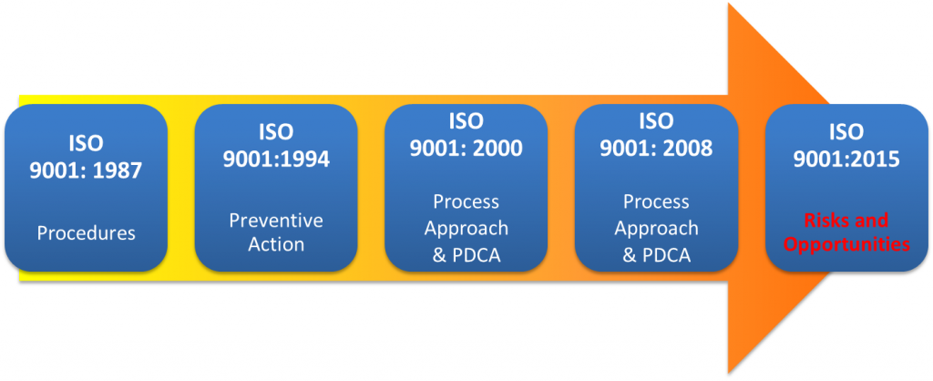

Slide 12
ISO 9001

Slide 13
ISO 9000 certification
Quality standards and procedures should be documented in an organisational quality manual.
An external body may certify that an organisation’s quality manual conforms to ISO 9000 standards.
Some customers require suppliers to be ISO 9000 certified although the need for flexibility here is increasingly recognised.

Slide 14
ISO 9000 and quality management

Slide 15
Quality planning
A quality plan sets out the desired product qualities and how these are assessed and defines the most significant quality attributes.
The quality plan should define the quality assessment process.
It should set out which organisational standards should be applied and, where necessary, define new standards to be used.

Slide 16
Quality plans
Quality plan structure
Software System introduction;
Quality Assurance goals;
Software development process descriptions;
Key performance indicators
Quality Controls
Risks and risk management.
Quality plans should be short, succinct documents
If they are too long, no-one will read them.

Slide 17
Product and process standards

Slide 18
TickIT
IT and Software Industry specific
Roots in government activity (by DTI and MoD) to promote use of IT standards, such as BS5750
Also considers behaviour and management of auditors in IT industry
TickIt certification requires conformance to ISO9000

Slide 19
TickIT
Supported by the UK and Swedish software industries
ISO 9001 certificate endorsed with TickIT logo proves that the management system is compliant with best practice for software quality management
Covers the assessment and certification of an organization’s software and quality management system to ISO 9001
Same as ISO 9001 but needs specially qualified auditors on how to interpret ISO 9001 in the software context
Applicable to software developers, software maintainers and provides of software services

Slide 20
Objectives of TickIT
Improve market confidence in third party quality management system certification through accredited software bodies for the software sector
Improve professional practice among quality management system auditors in the software sector
Also publishes the TickIT guide for all stakeholders

Slide 21
Where TickIT is relevant
Software product or service development
Internal software development
Software replication
Software related services
Facilities management
Computer operations services
Systems integrated services
Peripheral services
Software archiving and storage
Subcontracting

Slide 22

TickIT is no more
TickIt is finished
Existing certifications will expire…
Now there’s TickITplus !
adds a Capability Dimension to the existing TickIT scheme
The Capability Dimension is based on ISO/IEC 15504: an IT Process Assessment standard, (to which Capability Maturity Mode is referenced)
See link
Notes:
http://www.tickitplus.org/en/information/the-tickit-plus-scheme.html

Slide 23
Summary: What did we cover
What is ISO
Importance of standards
What is ISO 9000
ISO implementation
Parts of ISO 9000
Cost of implementing ISO 9000
Cost of registering to ISO 9000
TickIT
Objectives of TickIT
Where TickIT is relevant

Slide 24
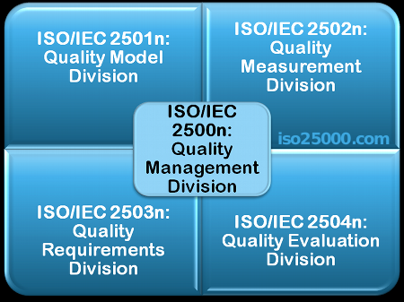
International Quality Standards
The series of standards ISO/IEC 25000, also known as SQuaRE (System and Software Quality Requirements has the goal of creating a framework for the evaluation of software product quality.

Slide 25
Summary
Software standards are an encapsulation of best practice.
Each project requires a software quality plan
Reviews are the most widely used approach for assessing software quality.

Slide 26
Questions
You have been asked to oversee the quality issues for the new POS systems,
what software quality process are you to put in place and why?
What role will standards plan in this process?
Describe the purpose and the principal features of ISO standards which are relevant to software development projects.

Slide 27
Directive Reading
Read Chapter 27. Quality management.
of Software Engineering (8th Edition), By Ian Sommerville, Addison Wesley, 2007
Software quality https://en.wikipedia.org/wiki/Software_quality

