Slide 1
COMP6204 Software Project Management and Secure Development
Capability Maturity Model
Notes:
https://insights.sei.cmu.edu/sei_blog/2019/03/towards-a-new-model-of-acquisition-product-line-architectures-for-the-dod.html

Slide 2
Moving on…
On the whole, the consensus is that…
Trying to use or having a good software development process is a desirable if you want to produce good software
Next problem:
What is a good process, and how do you decide if you have one?
One way is to compare yourself with some recognised benchmarks

Slide 3
Evaluation of S/W Development processes
We’ll look at just one proposed model: CMM
you may have encountered before
There are others; SPICE for example
The general principals are mostly similar
You should read about some of these other models

Slide 4
CMM
The Capability Maturity Model
Developed by Software Engineering Institute of Carnegie Melon University, Pittsburgh, USA. (SEI)
Outlines a series of stages in the development of a software developer
The idea is an organisation progresses through stages as it grows and matures

Slide 5
CMM continued
An organisation is imagined to start out building software informally, without much in the way of control or process
It then progresses to having some kind of understanding of its process – usually first applied at the project level and then more widely
Next measurement and control is introduced
Finally measures and controls are applied with specific goals and there’s a focus on process improvement
(In reality, few developers really reach the topmost level)

Slide 6
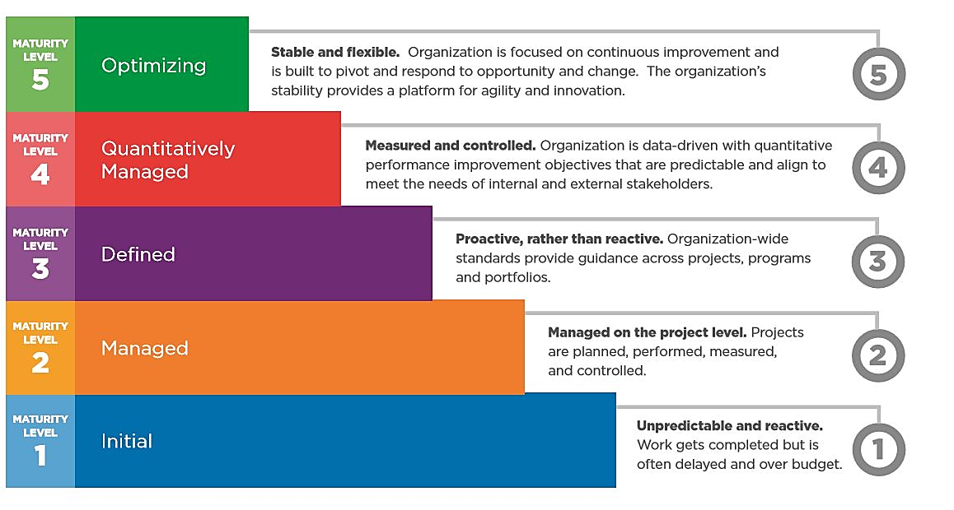
Notes:
In the public domain, from wikipedia

Slide 7
CMMI
More recently, CMM has been enlarged, refined and redefined as CMMI
I is for integration
24 process areas relevant to software development
Each is allocated to one of four groups
Also includes notion of Goals
Descriptions of desirable state
And practices which describe the way to achieve a goal

Slide 8
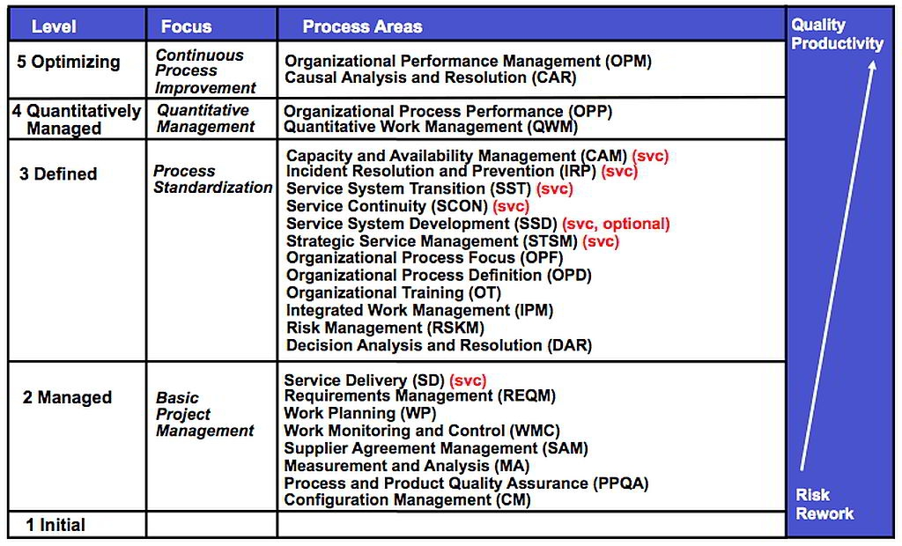
Notes:
http://www.plays-in-business.com/cmmi-for-services-cmmi-svc/
CMMI for Services
Previous Next
CMMI for Services — CMMI-SVC
Content [hide]
1 CMMI for Services
2 Process Areas of CMMI-SVC
3 Process Maturity
4 Value of CMMI-SVC
5 Synergies with CMMI-DEV
6 Further Readings
Main Takeaways
CMMI for Services (CMMI-SVC) is part of the CMMI product family of process maturity models. It is a framework to guide organisations in improving their IT service delivery processes and to characterize the maturity of their IT operations. CMMI-SVC is an industry neutral model that can apply to any service industry.
CMMI for Services
CMMI for Services (CMMI-SVC) is part of the CMMI product family of process maturity models. It is a framework to guide organisations in improving their IT service delivery processes and to characterize the maturity of their IT operations. CMMI-SVC is an industry neutral model that can apply to any service industry.
CMMI-SVC sets up proven practices into a structure that helps an organisation to assess its organisational maturity and process area capability, establish priorities for improvement, and guide the process improvementinitiative.
It is a compendium of proven practices which enables service-focused organisations to effectively
…decide what services they should be providing, define standard services, and let people know about them
…make sure they have everything they need to deliver a service, including people, processes, consumables, and equipment
…make sure they have the resources needed to deliver services and that services are available when needed— at an appropriate cost
…get new systems in place, change existing systems, retire obsolete systems, all while making sure nothing goes terribly wrong with the service
…set up agreements, take care of service requests, and operate service systems
…handle what goes wrong— and prevent it from going wrong in the first place if possible
…ensure they are ready to recover from potential disasters and get back to delivering services if the disaster occurs
Going by the CMMI model definition: "Services are useful intangible and non-storable results delivered through a service system."
CMMI-SVC has synergies with models & standards like CMMI-DEV, ITIL, ISO/IEC 20000, CobiT and IT Service Continuity Management.
Process Areas of CMMI-SVC
Capacity and Availability Management: Ensure effective service system performance and ensure that resources are provided and used effectively to support service requirements.
Configuration Management: Establish and maintain the integrity of work products using configuration identification (labelling), configuration control (known modifications and permission to modify), configuration status accounting (final status of work products), and configuration audits (checks to verify changes).
Decision Analysis and Resolution: Systematically select from alternative options using criteria, prioritization and an evaluation method.
Incident Resolution and Prevention: Ensure timely and effective resolution of service incidents and prevention of service incidents as appropriate.
Integrated Project Management: Perform work planning using company defined best practices and tailoring guidelines. Use organisational historical data for estimation. Identify dependencies and stakeholders for coordination, and comprehend this information into a master schedule or overall work plan. As work progresses, coordinate all key stakeholders. Use thresholds to trigger corrective action (such as schedule and effort deviation metrics).
Measurement and Analysis: Develop and sustain a measurement capability that is used to support management information needs.
Organisational Process Definition: Organize best practices and historical data into a useful and usable library.
Organisational Process Focus: Coordinate improvements. Take what is learned at the team level and organize and deploy this information across the organisation. The result is that all teams improve faster from the positive and negative lessons of others.
Organisational Training: Assess, prioritize and deploy training across the organisation, including domain-specific, technology and process skills needed to reduce errors and improve team efficiency.
Process and Product Quality Assurance: Provide staff and management with objective insight into processes and associated work products.
Requirements Management: a) Define the services of the group, b) trace defined services to team activities, c) verify that resources, service definition and actual work done match.
Risk Management: Assess and prioritize all types of risks in a project and develop mitigation actions for the highest priority ones. Start by considering a predefined list of common risks and use a method for setting priorities.
Service Continuity: Establish and maintain plans to ensure continuity of services during and following any significant disruption of normal operations.
Service Delivery: Deliver services in accordance with service agreements. Prepare, execute and improve.
Service System Development: Analyze, design, develop, integrate, verify, and validate service systems, including service system components, to satisfy existing or anticipated service agreements. [This is an optional Process Area.]
Service System Transition: Deploy new or significantly changed service system components while managing their effect on ongoing service delivery.
Strategic Service Management: Establish and maintain standard services in concert with strategic needs and plans. The remaining Level 3 Process Areas are summarized below.
Supplier Agreement Management: Manage the acquisition of products and services from suppliers. This Process Area can be declared Not Applicable (after discussion with the appraiser) if there are no custom, risky, or integrated suppliers.
The service-specific Process Areas are summarized below.
Work Monitoring and Control: Understand the group’s progress so that appropriate corrective actions can be taken when performance deviates significantly from the plan.
Work Planning: Establish and maintain plans (major tasks, estimates, risks and resources) for service work.

Slide 9
CMMI
Has a “staged” model which uses the recognised stages
Also recognises that process areas and groups can be at different levels in a “continuous” model
Instead of associating developer’s process with a single stage, the process has a “profile” giving values for each process or process group
Allows an organisation to pick which processes to improve according to their priorities

Slide 10
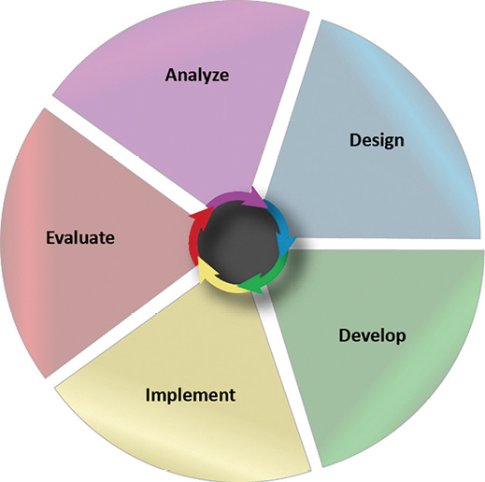
Process improvement in general
It’s a cycle
Measure, change, evaluate
But it’s not quite that simple
Before you start you have to decide what you want to improve…
You can’t just “measure”, you have to decide what to measure
Your changes may be constrained by requirements imposed by your clients

Slide 11
Product quality
Depends on
People quality
Process quality
Development technology
Cost, time, schedule
Importance and influence of these depends on size and nature of development

Slide 12
Postscript on product quality
Software development is an activity which isn’t usually carried out in isolation
It is generally associated with commercial activity where profit matters
Hence, time and cost matter
Quality and other standards may have to be compromised to get a product delivered at an acceptable time or cost

Slide 13
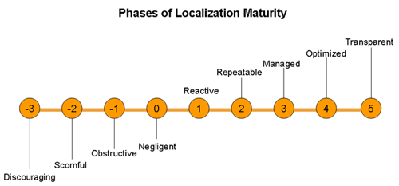
Capability Immaturity Model

Slide 14
Levels of the capability immaturity model
It should be recognised that we can actually not take this process seriously.
0: Negligent
– Failure to allow successful processes to proceed
– Lot of good activity and showmanship, but the organisation is just paying pays lip service to implementing engineering processes. No real effort in carrying out the task properly. Whereas CMM level 1 assumes eventual success in producing work.
(An aside from T. Schorsch. “The Capability im-Maturity Model” 1996 https://en.wikipedia.org/wiki/Capability_Immaturity_Model)
Notes:
https://en.wikipedia.org/wiki/Capability_Immaturity_Model

Slide 15
immaturity model
1: Obstructive
Counterproductive processes imposed
Processes over goals: however inappropriate and ineffective, procedures are implemented with rigor and tend to obstruct work. Any actual creation of viable product is incidental. The quality of any product is not assessed, in the belief that proper process leads to high quality products.
Process but lacking the will to measure the effectiveness of the procedures they rarely succeed at their basic task of creating work.
Government contracting models some times reward organisations for the number of hours spent on non-value-added activities related compliance, rather than the quality of the product.

Slide 16
immaturity model
2: Contemptuous –
Disregard for good Software Engineering
Measurements are fudged to make the organization look good.
Measures of activity (bugs fixed, lines of code written, hours worked) replace measures of productivity (% functions completed, test success rates).
Volatility in specifications and schedules is recast as evidence of organizational “agility.”
Certifications on “best processes” are presented as evidence that the organization is performing optimally; poor results are blamed on factors outside the organization's control.
The organization becomes committed to ineffective processes, leading to a feedback cycle of increasing disorganization.

Slide 17
immaturity model
3 : Undermining organizations
They routinely work to downplay and sabotage the efforts of rival organizations, especially those successfully implementing processes common to CMM level 2 and higher.
This behaviour may involve competing for scarce resources, drawing those resources from more effective departments or organizations.

Slide 18
Cybersecurity Maturity Model Certification (CMMC).
Combines various cybersecurity standards and best practices and map these controls and processes across several maturity levels
that range from basic cyber hygiene to advanced.
For a given CMMC level, the associated controls and processes, when implemented, will reduce risk against a specific set of cyber threats.
The goal is for CMMC to be cost-effective and affordable for small businesses to implement at the lower CMMC levels.
The intent is for certified independent 3rd party organizations to conduct audits and inform risk.
Notes:
Version 1.0 of the CMMC framework will be available in January 2020 to support training requirements. In June 2020, industry should begin to see the CMMC requirements as part of Requests for Information.
Unlike NIST SP 800-171, CMMC will implement multiple levels of cybersecurity. In addition to assessing the maturity of a company’s implementation of cybersecurity controls, the CMMC will also assess the company’s maturity/institutionalization of cybersecurity practices and processes.

Slide 19
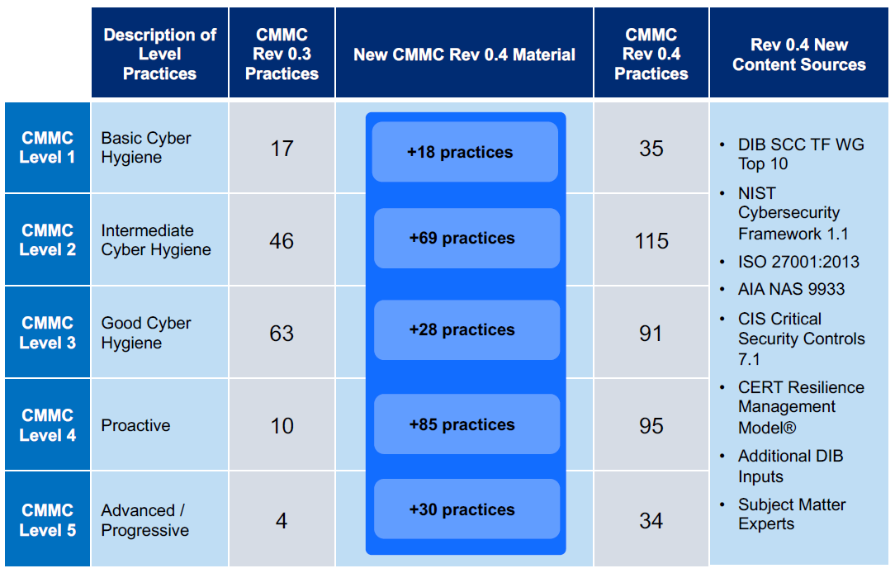
Notes:
https://www.acq.osd.mil/cmmc/docs/cmmc-draft-model-30aug19.pdf

Slide 20
Other Models

Slide 21
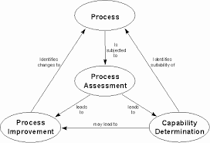
General Approach

Slide 22

SPICE
Software Process Improvement and
Capability Determination (SPICE)
set of technical standards documents for the software development process
related business management functions.
ISO/IEC 15504 contains a reference model.
The reference model defines a process dimension and a capability dimension.

Slide 23
SPICE Process
The process dimension defines processes divided into the five process categories of:
customer-supplier
engineering
supporting
management
organization
With new parts being published, the process categories will expand,.

Slide 24
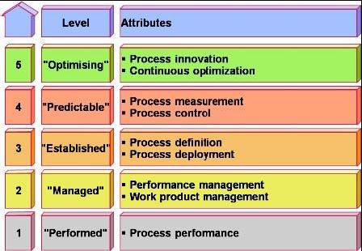
https://mubeenbth.wordpress.com/2012/08/25/software-process-improvement-and-capability-determination-spice-isoiec-15504/

Slide 25
SPICE Capability
Level Name
5 Optimizing process
5.1 Process innovation
5.2 Process optimization
4 Predictable process
4.1 Process measurement
4.2 Process control
3 Established process
3.1 Process definition
3.2 Process deployment
2 Managed process
2.1 Performance management
2.2 Work product management
1 Performed process
1.1 Process performance
0 Incomplete process

Slide 26
SPICE Capability
Each process attribute consists of one or more generic practices, which are further elaborated into practice indicators to aid assessment performance.
Each process attribute is assessed on a four-point (N-P-L-F) rating scale:
Not achieved (0 - 15%)
Partially achieved (>15% - 50%)
Largely achieved (>50%- 85%)
Fully achieved (>85% - 100%).
The rating is based upon evidence collected against the practice indicators, which demonstrate fulfilment of the process attribute.

Slide 27
Assessment process
The assessment process can be generalized as the following steps:
initiate an assessment (assessment sponsor)
select assessor and assessment team
plan the assessment, including processes and organizational unit to be assessed (lead assessor and assessment team)
pre-assessment briefing
data collection
data validation
process rating
reporting the assessment result

Slide 28
Process improvement
Process improvement is always difficult,
initiatives often fail,
it is important to understand the initial baseline level (process capability level), and to assess the situation after an improvement project.
Process improvement is the subject of part 4 of ISO/IEC 15504.
It specifies requirements for improvement programmes and provides guidance on planning and executing improvements, including a description of an eight step improvement programme.

Slide 29
Software Maturity
You may use software written by people other than those in your organisation.
It may even be open source.
Not only do you need to check it will meet your requirements
But will the vendor be around in 5 years
If so will the software still be maintained
What happens if they go bust.

Slide 30
Software maturity
The Open Preservation Foundation have a software maturity model
aimed to create a model that supports engineers while they’re developing software and users in assessing solutions against defined criteria.
Take into account ISO/IEC 25000 - System and Software Quality Requirements and Evaluation (SQuaRE) series of standards
The Strategy for software sustainability
supporting long-lasting communities of practice in adopting and maintaining mature products,
is based on five complementary approaches.

Slide 31
Software maturity
Quality: Ensuring that software products conform to standards-driven quality assurance.
Quality ensures the development of software inline with the business needs of memory institutions and includes the definition of maturity standards and community review processes.
Visibility : Providing integrated outreach to multiple audiences to maximise discoverability.
Visibility ensures the provision of appropriate information for different audiences to support discovery and take-up of software products. This approach includes offline and online media.

Slide 32
Software maturity
Training: Enabling skills development to further institutional adoption and capacity building.
Training supports the development of staff skills through a variety of media in building an understanding of software products.
This approach includes face-to-face workshops, practical demonstrations, introductory presentations, and online demonstrators.
Open licensing: Using open licences to encourage the adoption and reuse of source code and software.
Community integration: Integrating project outputs into commercial and non-commercial products and services.

Slide 33
Open Source Code
Open Source Software allows you to exam the code as well as the application
Bug-Fixing: All software releases contain bugs.
Any development team has a limited time in which to test a piece of software before it is released.
In proprietary software, the only people who can fix it are the original developers, as only they have access to the source code.
In open source software a large number of users can access and change the code, bugs tend to be more visible and more rapidly corrected.
A slogans of the open source movement is that given enough eyeballs, all bugs are shallow [Eric Raymond, The Cathedral and the Bazaar].
If you may not have the necessary skills in-house it is possible to subcontract toany third party since everyone has access to the source code.

Slide 34
Open Source Code
Customization
Open source applications may be customized by anyone with the requisite skill.
Thus, open source software can be readily adapted to meet specific user needs.
customize source code may enable improvements to the best practice provided by default installations, therefore improving efficiency and possibly providing a competitive advantage (check licences).
When modifying open source code it is good practice to contributed back to the main project. Failure to do this can result in unnecessary complexities when upgrading to newer versions of the software.
Notes:
Closed source applications can only be customized or adapted within the scope provided by the original vendor but never outside its boundaries.
Even if you cannot program yourself, if you would like something added or customized you can generally pay an appropriately skilled software developer to do it for you. The introduction of competition into the market for customisations, as observed in the bug-fixing section above, forces suppliers to offer high quality at a competitive price.

Slide 35
Open Source Code
Avoiding Lock-In
‘locked-in’ is when the costs of switching to alternatives are prohibitively high.
Another way is to ensure that products are not readily compatible with potential rivals. Allowing vendors to increase the cost of product upgrades or support without too great a risk of losing existing customers.
Open source software tends to use open standard formats reducing locked-in by a vendor.
Open source software does have switching costs of its own.
administrative and re-training costs
proprietary software may use open standards, too,
use of open standards ensures future access to data.
Notes:
Even when non-standard formats are used in open-source code, it is always possible to document them from the source code. On the contrary, closed formats used by proprietary software need to be reverse-engineered, a burdensome and expensive process that may need to be repeated if the format is subsequently changed.

Slide 36
Open Source Code
Mitigation Of Vendor Collapse Or Product Discontinuation
vendors go bust or get bought up from time to time, with no guarantee that their software products will continue to be available, supported, or updated.
Hence you need to switch, which can be difficult and expensive (undertaken at a time of crisis)
Note companies only continue to support older version of software for a limited time (windows 8.1)
open source software, this danger is greatly reduced.
Any one can now continue developing, actually often it is a new team (War hammer)
Successful open source projects gather user communities around them,
Notes:
where there is a potential revenue generating or cost saving opportunity there will probably be other interested parties willing to continue to maintain the software.

Slide 37
Open Source Code
Learning From Examples
Open source code provides an excellent resource from which to learn,
open source projects provide a practical environment in which to test your skills.
If you choose to submit code to an open source project, it will generally be checked and commented on by experienced programmers.
Being Part Of A Community
Programmers, in particular, can benefit from belonging to an open source community.
It can help them to establish reputation and respect, and gain valuable experience.
Notes:
Once you have convinced the project community that your code is of appropriate quality, you may be granted full committer rights yourself.

Slide 38
Open Source Code
Cost
Many open source programs can be obtained at no cost or at a very low cost.
However, other costs may arise: training, consulting, maintenance, etc.
As a result, the total cost of ownership may not differ greatly between a closed source solution and an open source alternative for institutions.
Notes:
However, in some markets the difference in price between a closed source solution and an open source solution can be significant.

Slide 39
Software Sustainability Maturity Model
OSS Watch provides advice and guidance on the use, development, and licensing of free software, open source software, and open source hardware.
http://oss-watch.ac.uk/resources/ssmm
The software Sustainability Institute
their mission is to cultivate better, more sustainable, research software to enable world-class research
However has a lot of advise on Building and maintaining open source software.

Slide 40
Summary
Model are used to aid your in grading our processes, and identifying where you need to improve.
CMMI can be used to guide process improvement across a project.
SPICE is a set of technical standards for software development process and related business management functions.
SSMM helps rate software that you may want to reuse form else where (open source)

Slide 41
Questions
What is the purpose of a capability Model and how is it used in software engineering projects.
List and describe each of the stages of the Capability Maturity Model (CMM) of the software development process
What is the Software maturity module
How can it be used to assess COTS products or Open Source Code

