Slide 1

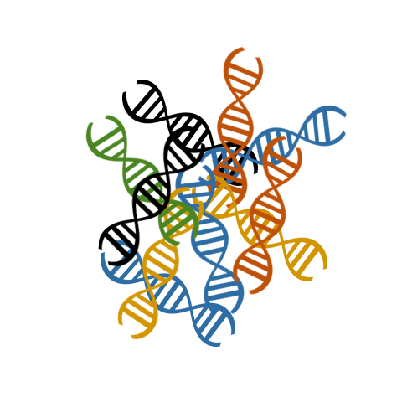
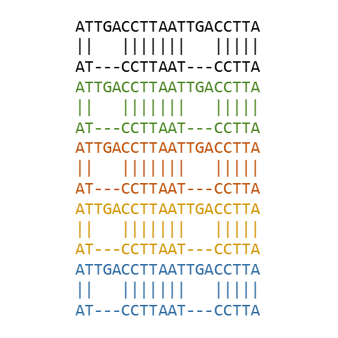
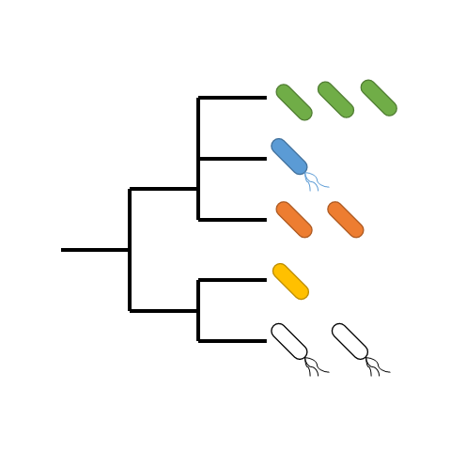
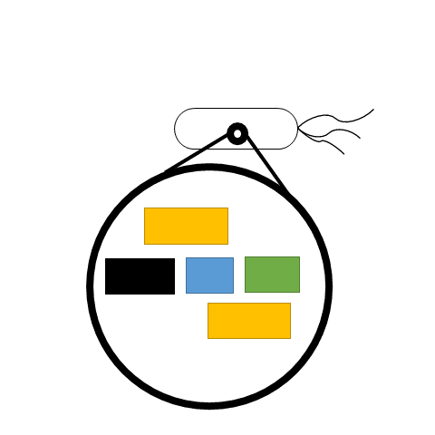
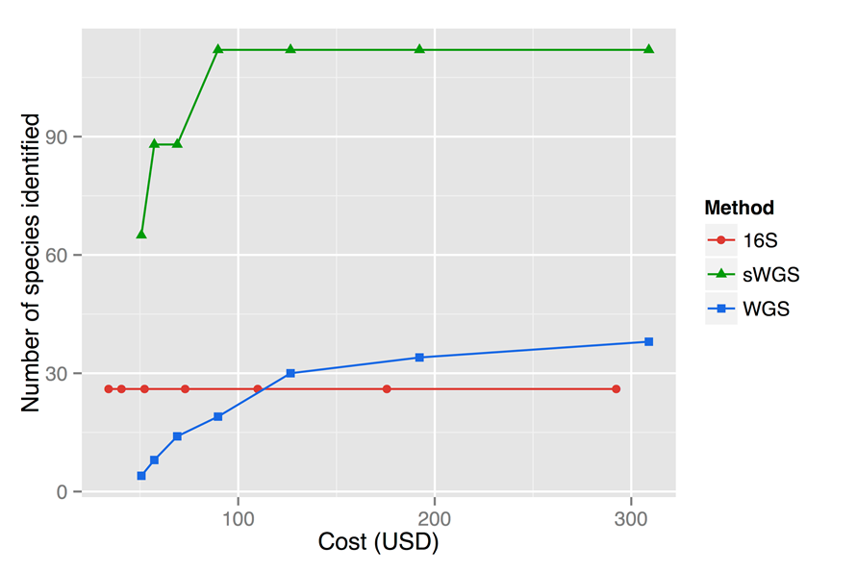
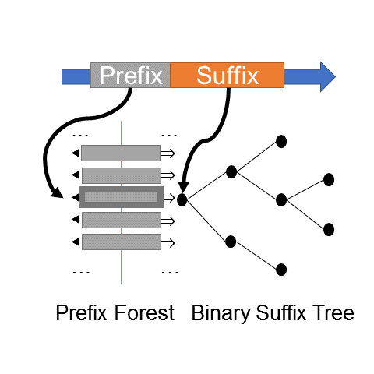
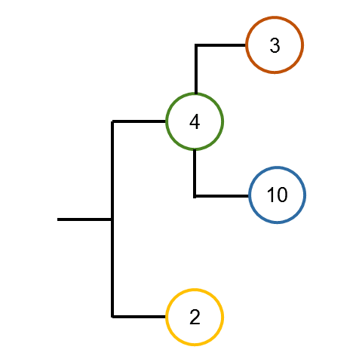
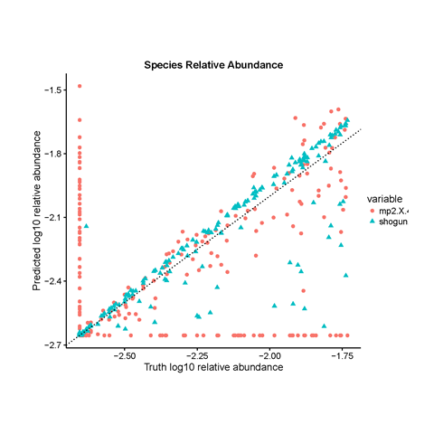
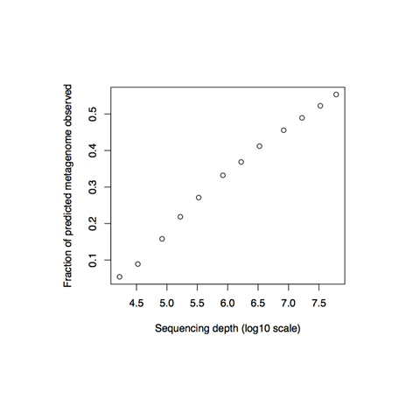
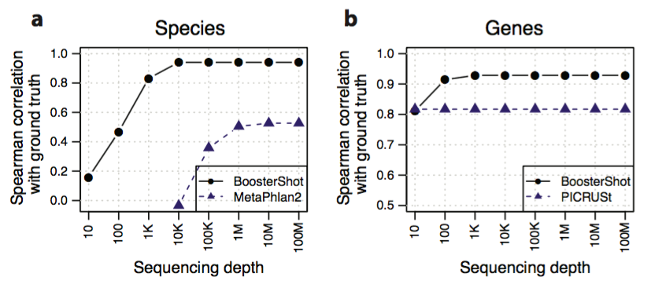
https://1drv.ms/p/s!Ag-2Yz3vBjx5k_0rReAZrQBdCp-MLA
Accurate, Scalable Microbiome Quantitation with Shallow Shotgun Sequencing
Benjamin Hillmann¹, Gabriel A. Al-Ghalith², Daryl Gohl³, Kenny Beckman³, Rob Knight^{4,5,6}, Dan Knights^{1,2,7}
¹Department of Computer Science and Engineering, University of Minnesota, Minneapolis, Minnesota 55455, USA
²Bioinformatics and Computational Biology, University of Minnesota, Minneapolis, Minnesota 55455, USA
³University of Minnesota Genomics Center, Minneapolis, Minnesota, USA
⁴Department of Computer of Science, University of California San Diego, San Diego, California, USA
⁵Department of Pediatrics, University of California San Diego, San Diego, California, USA
⁶Center for Microbiome Innovation, University of California San Diego, San Diego, California, USA
⁷Biotechnology Institute, University of Minnesota, Minneapolis, Minnesota 55455, USA
Motivation
Microbiome Sequencing Approaches
Amplicon (16S)
Cannot distinguish between species due to sequence homology
Does not allow high-accuracy prediction of the functional repertoire
Affordable
Whole-Genome Shotgun (WGS)
Allows strain-level characterization
Directly measures the functional repertoire of the microbiome
~ 10x more expensive than amplicon sequencing
Methods
Sequencing & Quality Control
De-multiplexing & stitching
Reference Database Alignment
Closed-reference alignment
Relative Abundance Estimation
Confidence, last common ancestor & coverage analysis for ambiguous mapping resolution along with genome length & DB normalization
Genome-Wide Functional Prediction
Relative abundance estimates predict metagenome functional capacity
SHOGUN
Library for analyzing “shallow-shotgun” sequencing reads
https://github.com/knights-lab/SHOGUN
How do we choose between affordability with amplicon methods, and accuracy with WGS?
Most Common WGS Alignment Approaches
First-hit (often described as “BLAST”)
Exact k-mer matching
Marker-gene alignment
SHOGUN Approach
Focus on precision and recall per sequence
Primary: exhaustive database alignment
Secondary: fast and precise alternative on a desktop with k-mer matching
Figure 1. Cost analysis of different sequencing methods.
Objectives
Develop a sample-to-analysis shallow shotgun workflows for accurate species measurement at or near the cost of amplicon sequencing
Develop novel methods for accurate functional characterization from shallow shotgun sequencing
Validate these methods for bacteria, archaea, fungi, and viruses
Table I. Summarization of previous closed-reference alignment approaches
a
b
Approach | Examples | Pros | Cons
"First hit" | BLAST, USEARCH, Bowtie2 | Fast | Low recall Low precision
Marker-Genes | mOTU, MetaPhlan | Fast, High precision | Low recall Information Loss
Exact K-mers | KRAKEN | Fast, High precision | Moderate recall Supercomputer
Exhaustive Alignment | Smith-Waterman Bowtie2 “all” mode | High recall, High precision | Slow Supercomputer
Figure 2. Fast and precise k-mer approach of SHOGUN on a desktop. (a) A database of uniquely identifying k-mers unique to each taxonomic clade is precomputed using a forest of k-mer binary search trees. Aligning reads against the database involves a splitting the query sequence into k-mers. Then, the k-mer preficcs are mapped directly into the prefix forest, followed by traversing the suffix tree in search of its suffix. (b) If multiple k-mers match within a read, the algorithm votes using different possible methods, to determine what taxonomic assignment can confidently be made.
Results
SHOGUN recovers nearly the full species profile with as few as 10,000 sequences compared to
> 10 million sequences required by a typical tool³
SHOGUN predicts genes not observed with deep sequencing
SHOGUN outperforms marker-gene alignments on a simulated microbiome containing a mixture of reference strains
Figure 3. Biological validation of SHOGUN. (a) Correlation with ground-truth (deep shotgun sequencing) of species profile using a pilot version of SHOGUN at different sequencing depths. b) Microbiome functional profile prediction is highly superior to tools based on marker genes⁴. Horizontal axes are on a log scale.
Figure 4. Performance of SHOGUN on simulated data with 10,000 sequences. Short-read (70 base-pair) data were simulated with Illumina-like sequencing error to resemble a mock community coming off of the sequencing machine
Figure 5. Ratio of directly observed genes versus SHOGUN-predicted genes by sequencing depth
References: 1. Langille, M.G.I., Zaneveld, J., Caporaso, J.G., McDonald, D., Knights, D., Reyes, J.A., Clemente, J.C., Burkepile, D.E., Vega Thurber, R.L., Knight, R., et al. (2013). Predictive functional profiling of microbial communities using 16S rRNA marker gene sequences. Nature Biotechnology 31, 814–821. 2. Markowitz, V.M., Chen, I.-M.A., Palaniappan, K., Chu, K., Szeto, E., Pillay, M., Ratner, A., Huang, J., Woyke, T., Huntemann, M., et al. (2014). IMG 4 version of the integrated microbial genomes comparative analysis system. Nucl. Acids Res. 42, D560–D567. 3. Sunagawa, S., Mende, D.R., Zeller, G., Izquierdo-Carrasco, F., Berger, S.A., Kultima, J.R., Coelho, L.P., Arumugam, M., Tap, J., Nielsen, H.B., et al. (2013). Metagenomic species profiling using universal phylogenetic marker genes. Nat Meth 10, 1196–1199. 4. Truong, D.T., Franzosa, E.A., Tickle, T.L., Scholz, M., Weingart, G., Pasolli, E., Tett, A., Huttenhower, C., and Segata, N. (2015). MetaPhlAn2 for enhanced metagenomic taxonomic profiling. Nat Meth 12, 902–903. 5. Turnbaugh, P.J., Ley, R.E., Hamady, M., Fraser-Liggett, C., Knight, R., and Gordon, J.I. (2007). The human microbiome project: exploring the microbial part of ourselves in a changing world. Nature 449, 804–810. 6. Wood, D.E., and Salzberg, S.L. (2014). Kraken: ultrafast metagenomic sequence classification using exact alignments. Genome Biology 15, R46.

