Slide 1
NINJA-SHOGUN Benjamin Hillmann Knights Lab

Slide 2

SHallow shOtGUN profiler
Problem
16S amplicon sequencing has too many biases
Current shotgun sequencing techniques are not cost effective
Goals
Use > 5% of shotgun reads for species level assignment
Methods
Direct mapping of sequences to organisms
Use Last Common Ancestor for ambiguous mappings
Notes:
Need to read Shogun by James Clavelle

Slide 3

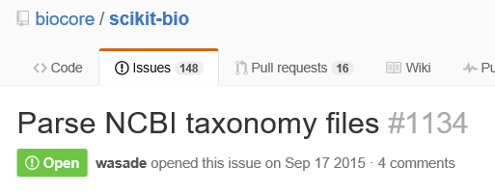
Taxonomy Representation
Human Consumption
QIIME format
k__Bacteria;p__Actinobacteria;c__Coriobacteriia;o__Eggerthellales;f__Eggerthellaceae;g__Gordonibacter
Computer representation
Map all ids to NCBI taxon ID
Represent phylogeny with networkx
Notes:
Bring up the PyCharm Profiler
Show the resulting

Slide 4
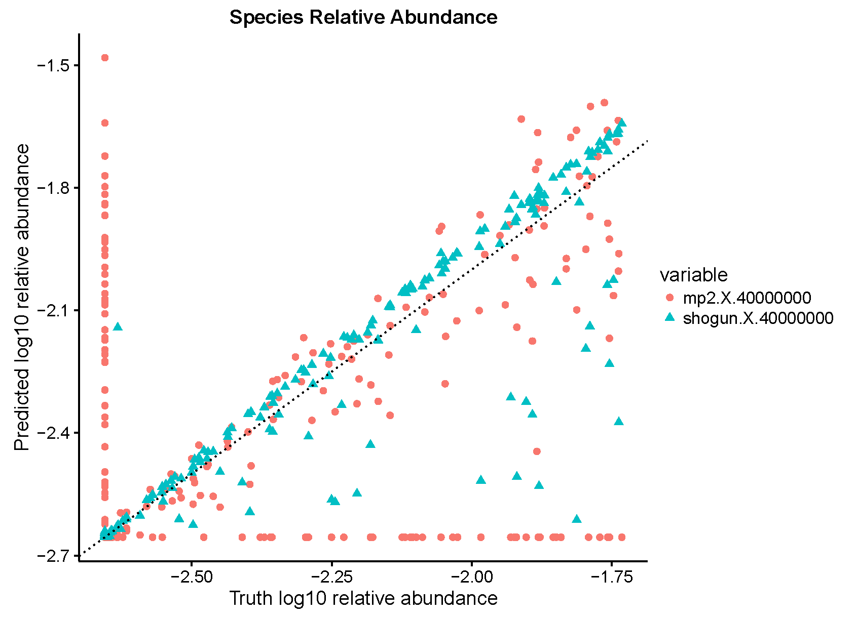
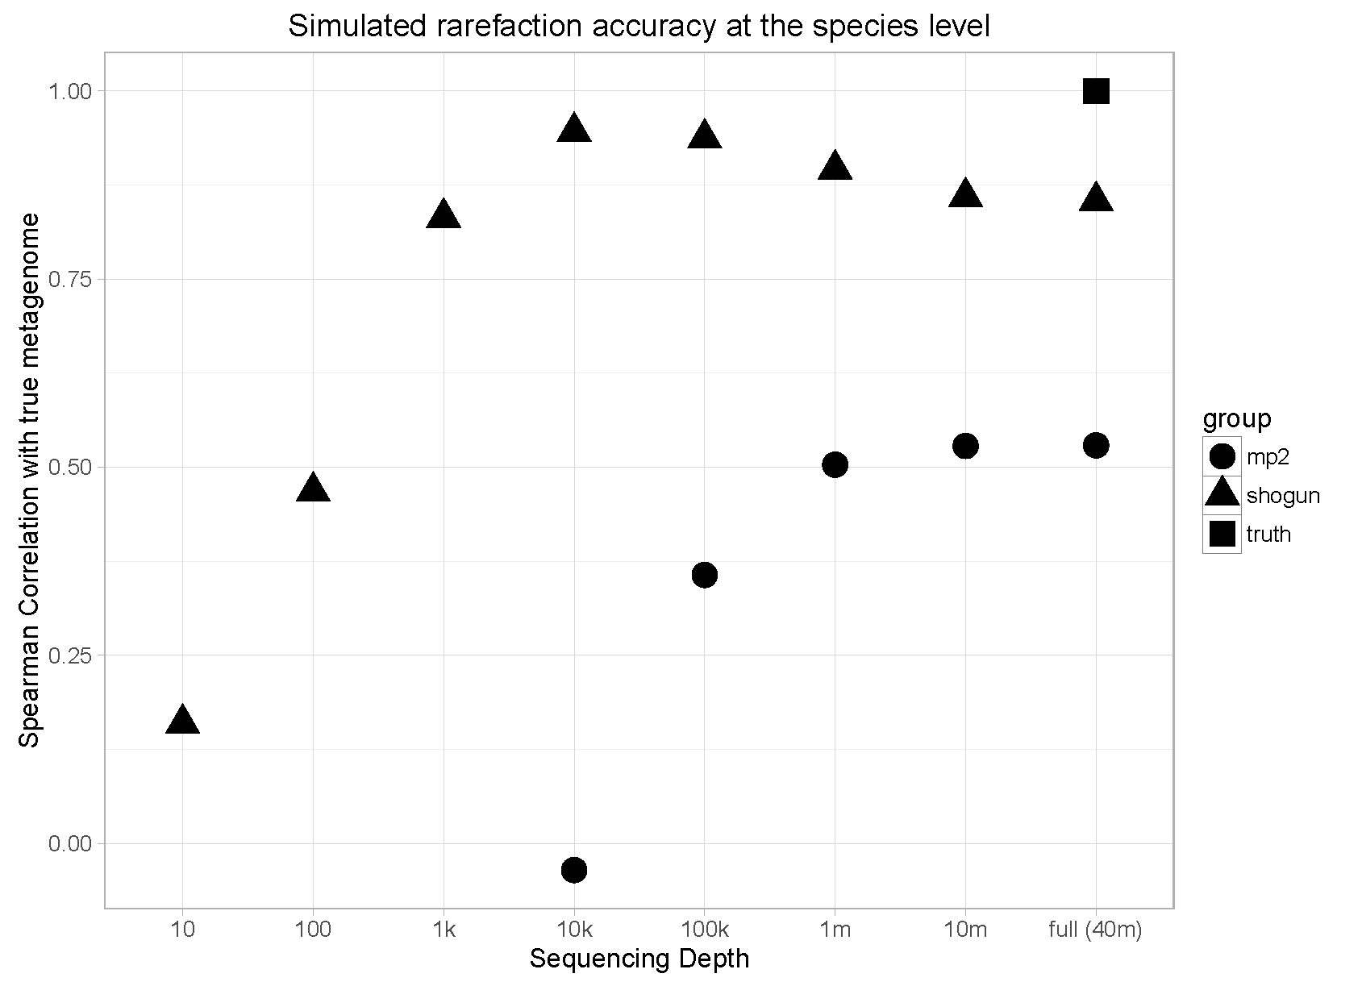
Taxonomic Profiling

Slide 5
Validation
Normalization
Uniqueness bias
Variance in amount of unique k-mers per genome
Length bias
More reads sequenced from longer genomes
RPKM
Simulating a ‘gold’ dataset
Genomes not in database confound the accuracy

Slide 6
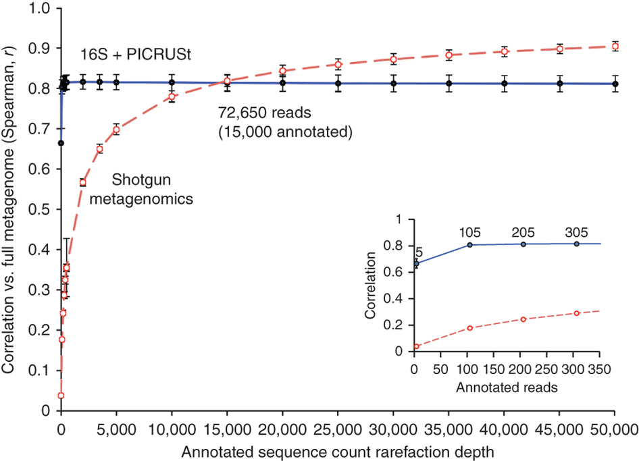
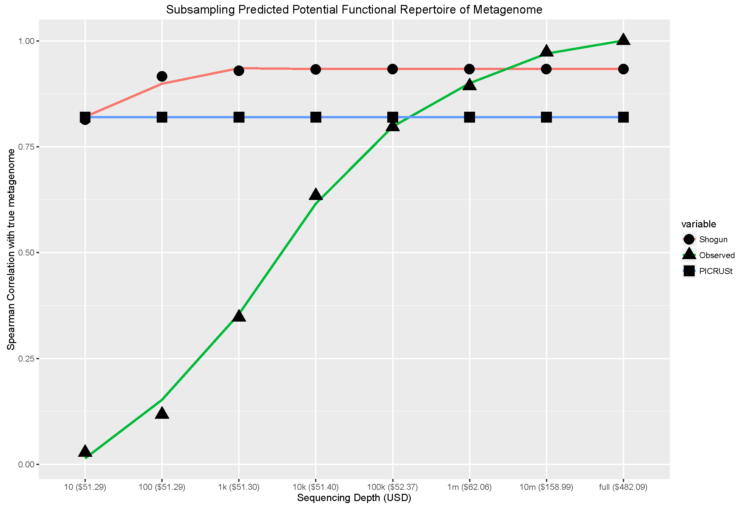
Functional Profiling

Slide 7
Functional Profiling

Slide 8
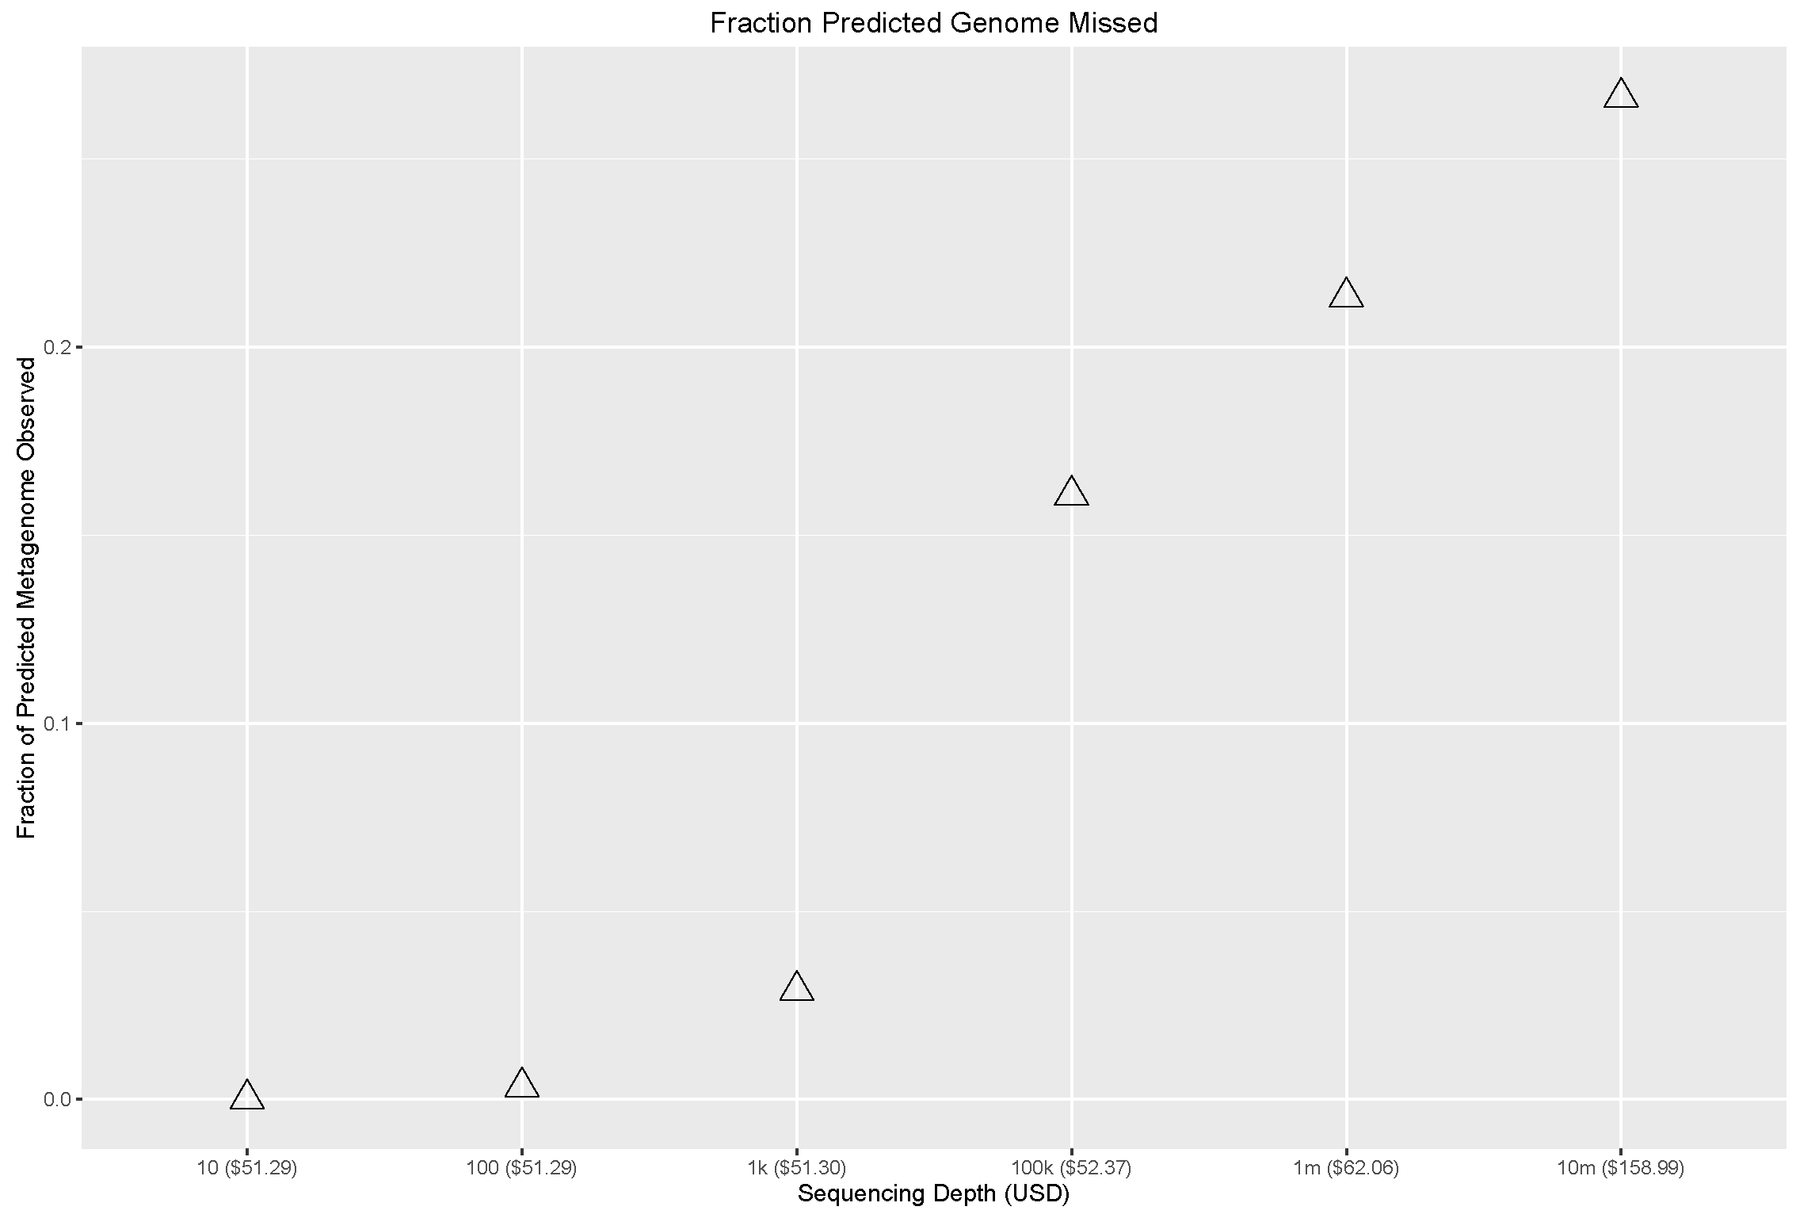
Full Depth Genes Hit versus Predicted Genes

Slide 9
NINJA-SHOGUN
Summary
General purpose library for translating sequence accession to taxonomy
Precise taxonomic and functional profiling of
Future Work
Needs a faster, more memory efficient LCA tree
20 second load
Controlling for false positives

