Slide 1

Climbing Trees Benjamin Hillmann

Slide 2
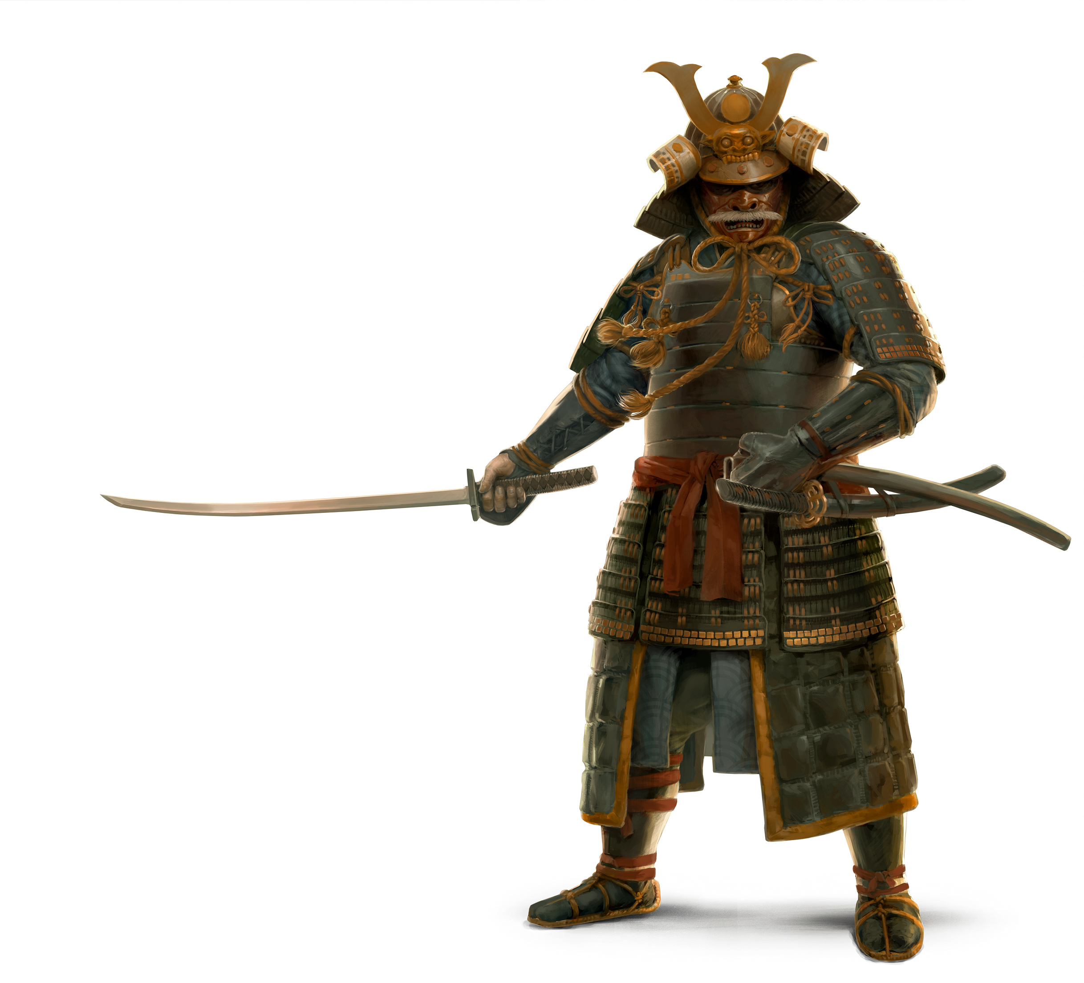
NINJA-Shogun
Goals
Use > 5% of shotgun reads for species level assignment
Concerns
Speeds
Database size
New Pipeline
bh_trimmomaticomatic <fastq_1> <fastq_2>
bowtie2 <img, silva, refseq…>
otu_lca.py [-h] -i INPUT [-p PARSER] [-o OUTPUT] [-t THREADS]

Slide 3

Trimo-matic
Program for trimming sequences
Used by the UMGC
Shotgun Data:
Clip adapters
Trim PE and SE sequences
Adapter Trimming
TruSeq2
TruSeq3
Nextgen
Notes:
ILLUMINACLIP:<fastaWithAdaptersEtc>:<seed mismatches>:<palindrome clip threshold>:<simple clip threshold>
Also need to try the UMGC adapters (mock adapters?)
Is it good to run all three?

Slide 4
Taxonomy Representation
Output Plain Text
Metaphlan/QIIME format
‘k__Bacteria;p__Actinobacteria;c__Coriobacteriia;o__Eggerthellales;f__Eggerthellaceae;g__Gordonibacter’
Computer representation
Plain text
IBS study
Networkx Digraph
Node operation is slow
Notes:
Bring up the PyCharm Profiler
Show the resulting

Slide 5
Results on RIBO

Slide 6
Working with Count Data
Simulating from Power Law Distribution
Should it be NB?
Biases
Uniqueness bias
Utree integration
Length bias
Probability to hit a gene is more likely with longer genes
RPKM?

Slide 7
NINJA-Shogun
In Summary
Ready for QIIME Downstream analysis
General purpose library for translating sequence accession to taxonomy
What was the format people wanted for NINJA?
Concerns
Needs a fast, memory efficient LCA structure
Dependencies

Slide 8

Chemotherapy and Dysbiosis
Goal:
To identify a risk index for a BSI from a microbiome in patients undergoing chemotherapy
Questions
Can you sequence blood samples?
What is the best way to handle a biopsy?

Slide 9
Timeline for Sampling
 | Chemo | Break | Antibiotics | Transplant | Discharge | Low Point* | Recovery
Myloma (25%) | -2 | -1 | -1 | 0 | +1 | +5-10 | +14
Lymphoma (25%) | -6 | No Break | -1 | 0 | +1 | +5-10 | +14
Allo (Myloma, Lymphona, AML, ALL, MDS, Benign Diseases) | -6 | No Break | -1 | 0 | Avg = +14…+28 | Reduced Intensity +10-14 (before discharge) Increased Intensity +5-10 (before discharge) | +14
*Start Antibiotics for Fever C. Diff.
Cephapin (broad gram -)
Zosyin (Anaerobes if severe)
Vencomycin

Slide 10
Timeline for Microiome Samples
Max of 22-30 samples per patient
 | WU | Inpatient | Readmissions | Home
Auto | 3 | 3-7 | 7 daily (~50%) | 5 (60d 100d 6m 1y 2y)
Allo | 3 | 15-20 |  | 7 (35d 42d 60d 100d 6m 1y 2y)

Slide 11
Chemotherapy and Dysbiosis
In summary
Samples will be coming in mid-April
If you need to contact someone who is willing to volunteer let me know!
Many thanks to everyone who is helping so far
Concerns
Do we have ink for the printer?

Slide 12
Comparing Shotgun and 16s Data
Goal
Locate a dataset with:
16s
Shotgun
On same subject
Problems
Mapping files for sample ids appeared to be mixed
Were we able to find one?

Slide 13

Migrating to Knights Lab
Create an empty github repo and copy the github https url.
# Remove the remote pointer for git umn (default name for remote is origin)
git remote rm origin
Then switch the origin to the new repo.
# Add the remote pointer for github (default name for remote is origin, could switch it to public)
git remote add origin <insert copied url>
To check that the remote is pointing properly run and see if it matches the pasted.
git remote -v
# Push the changes to the remote origin from your master branch and set the upstream
git push -u origin master
Notes:
Add to the internal lab wiki

Slide 14
Random Tricks
MSI to teraminx
sshfs
sftp
PyCharm Profiling
R you can share functions by sourcing URLs

