Slide 1
Serving Up the Phunctions

Slide 2
Functional Genomics
Purpose
  Predict the potential functional repertoire
Method
  Intersection of LCA genes
  Subsample at varying depths

Slide 3
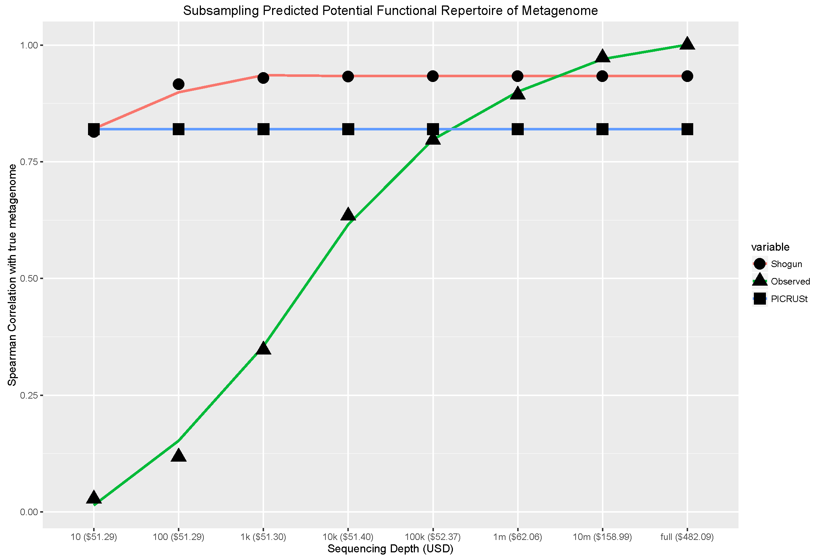

Slide 4
Research Question
At what depth would we able to directly map all predicted genes for the classified species?

Slide 5
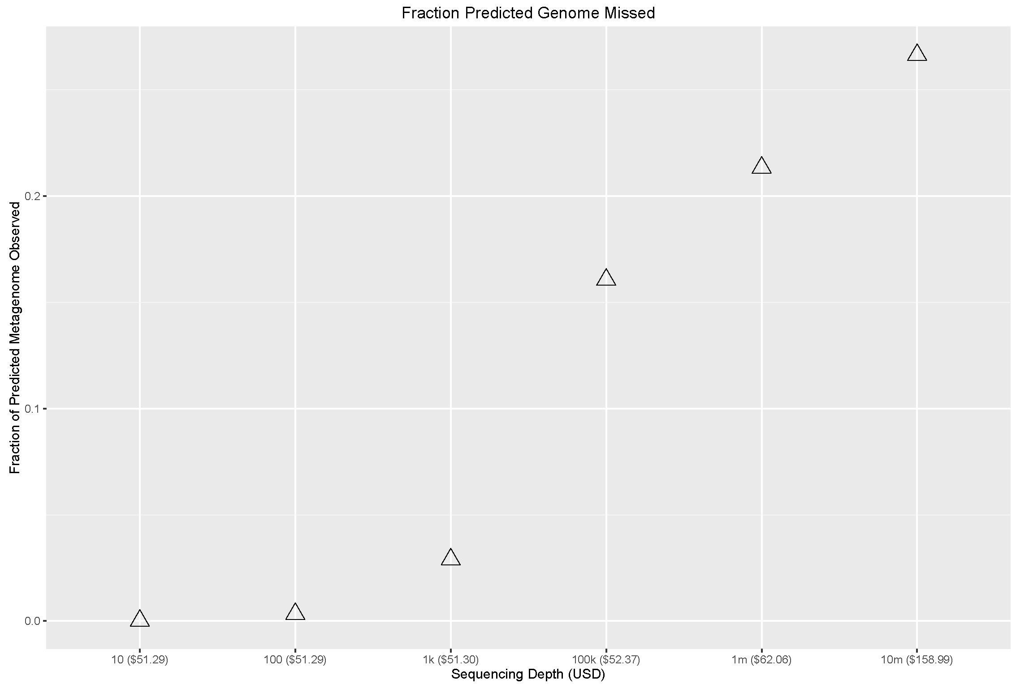

Slide 6
Research Question
At what depth would we able to directly map all predicted genes for the classified species?
  10^22

Slide 7
Taxonomic Classification
Purpose
  Detect the optimal depth for taxonomic classification
Method
  LCA on directly BT2 mapped reads (no normalization yet)

Slide 8
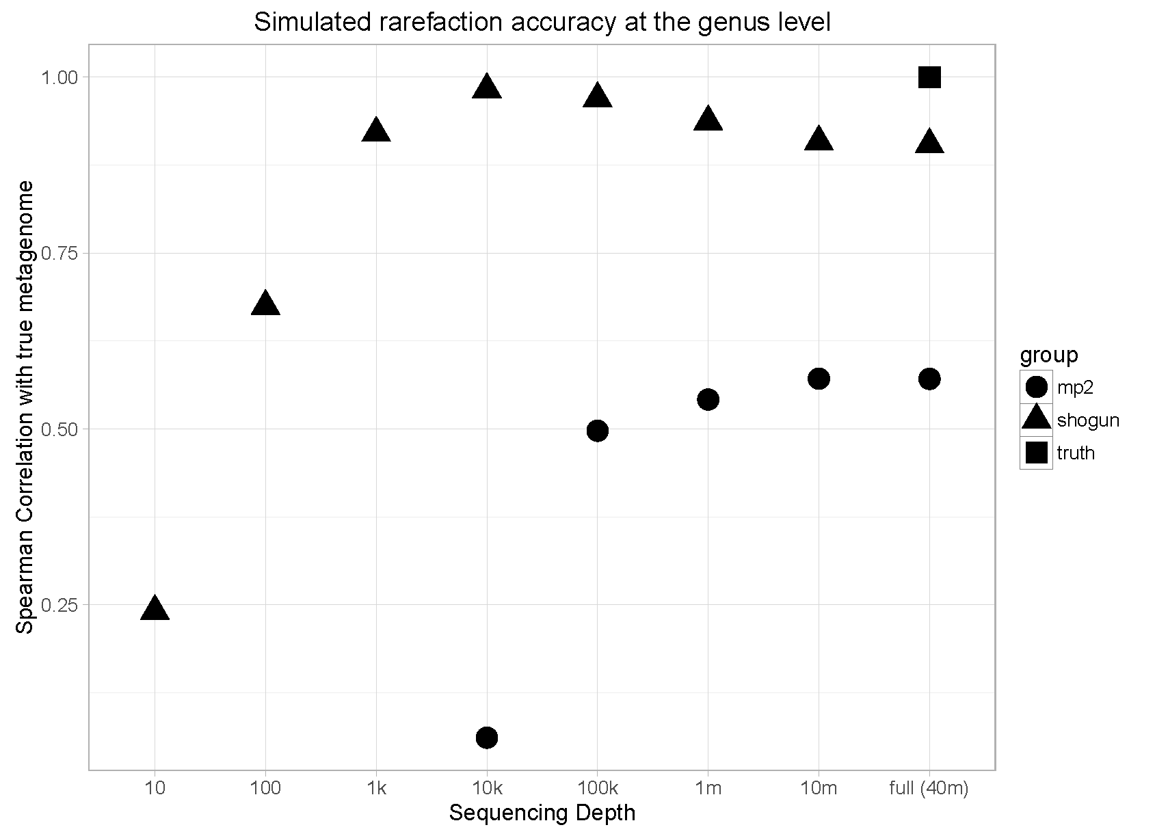
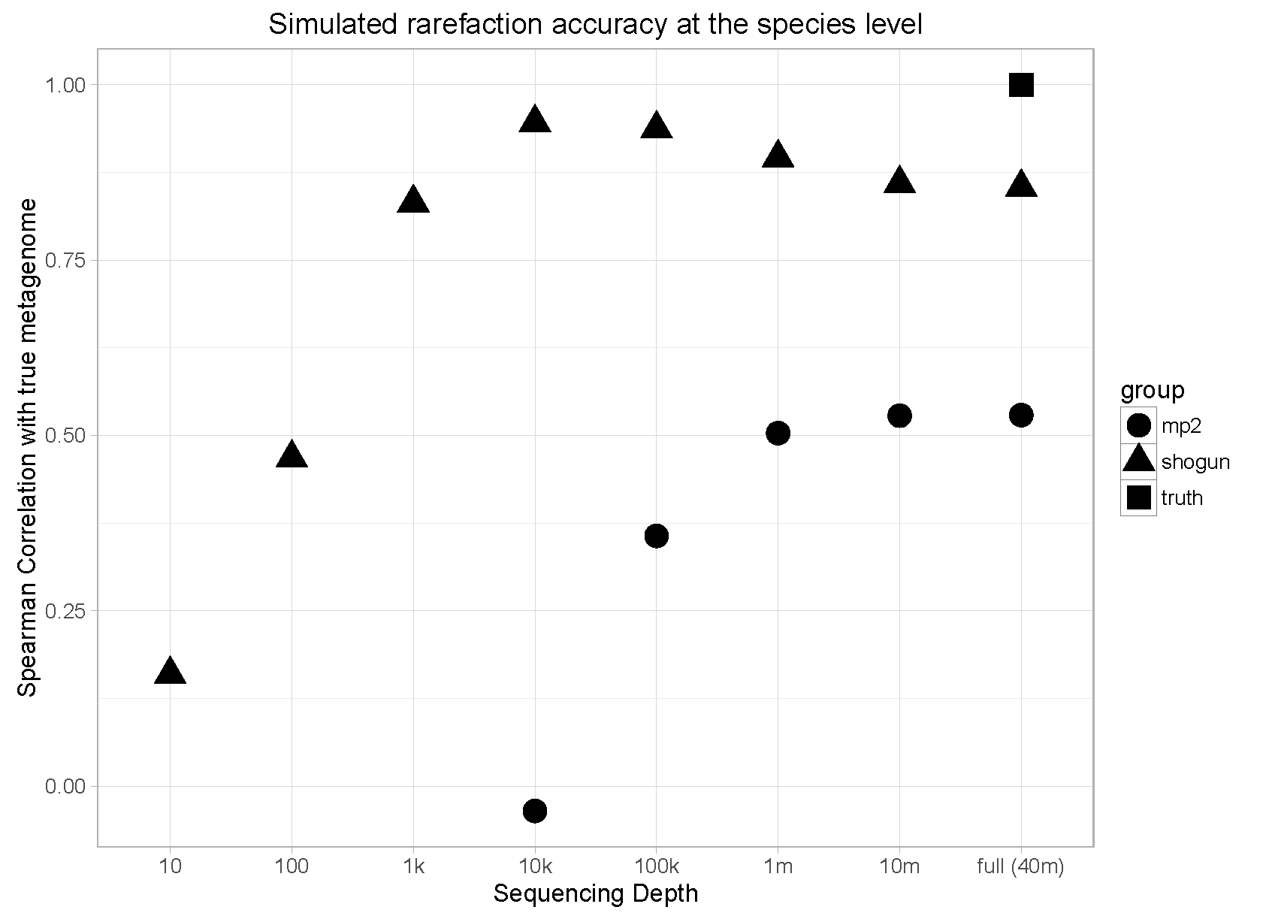

Slide 9
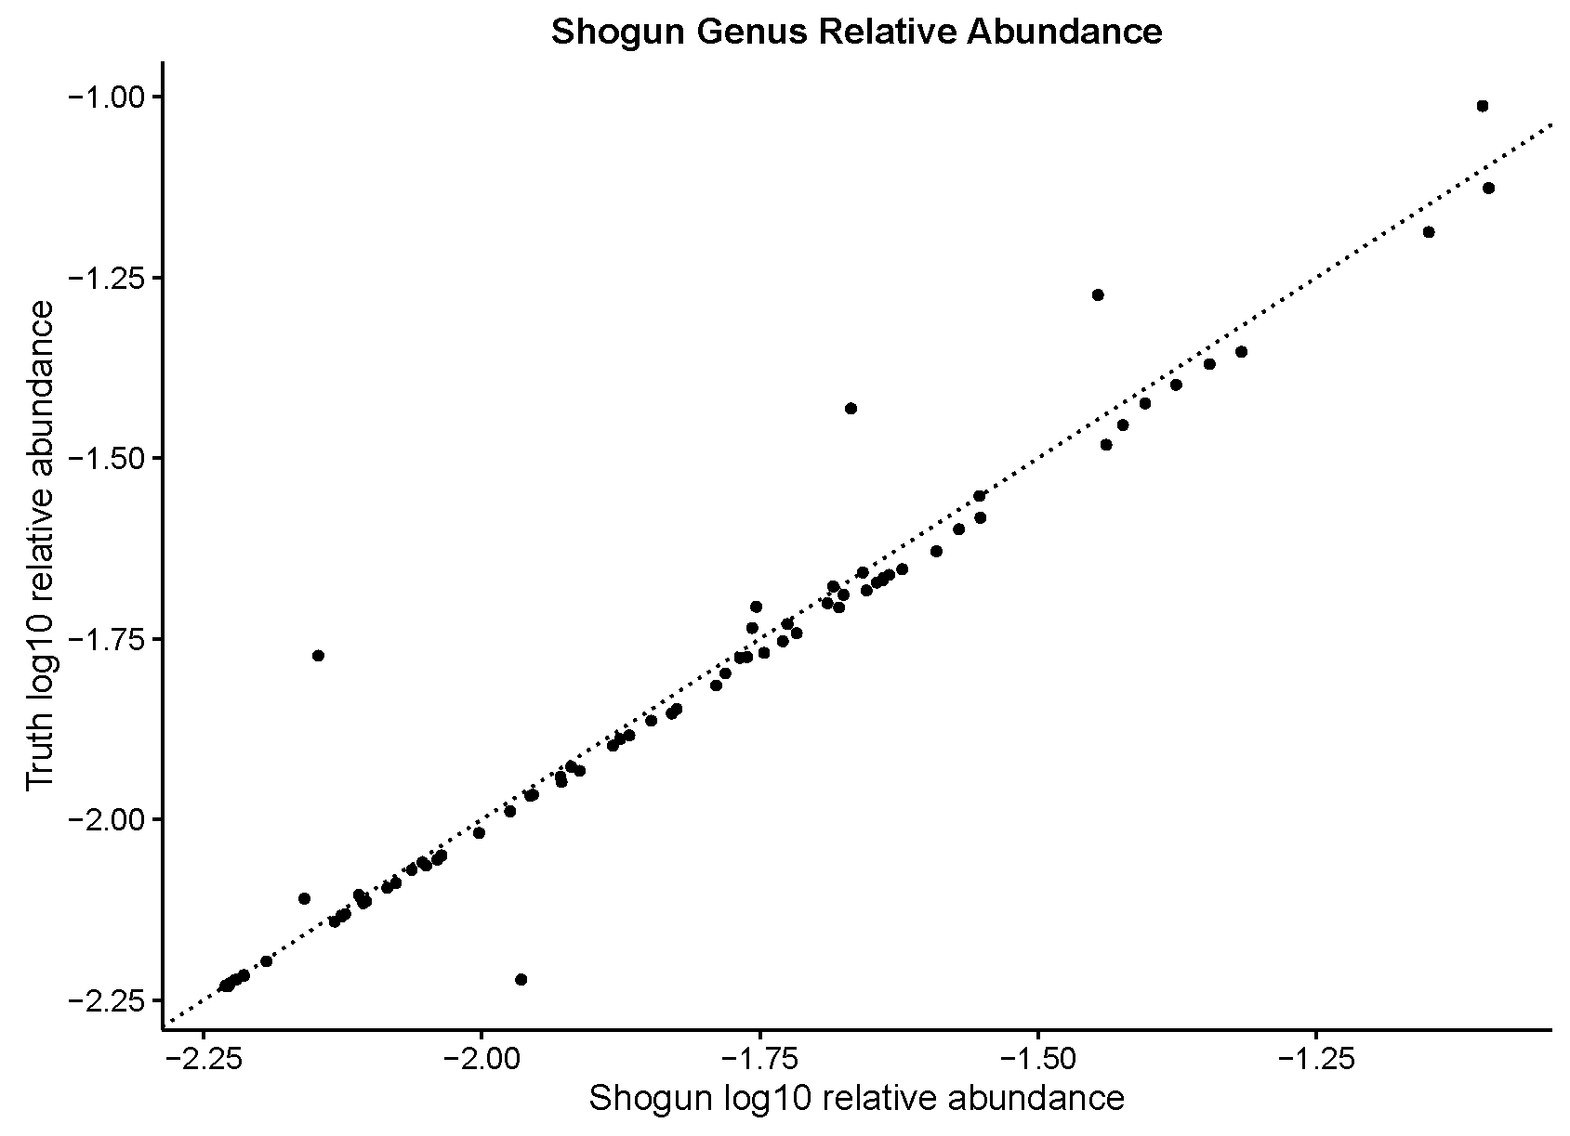
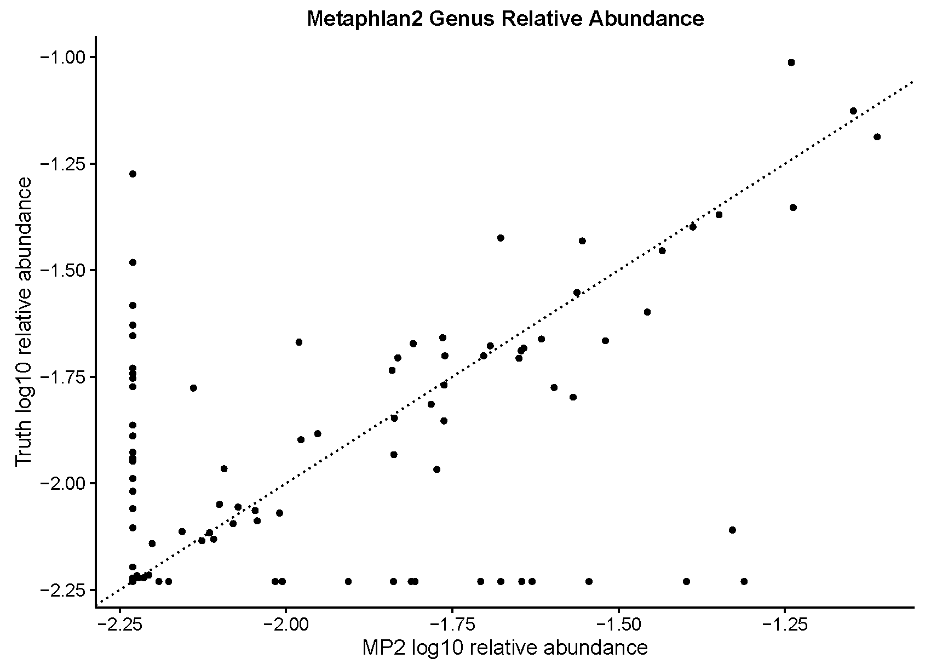

Slide 10
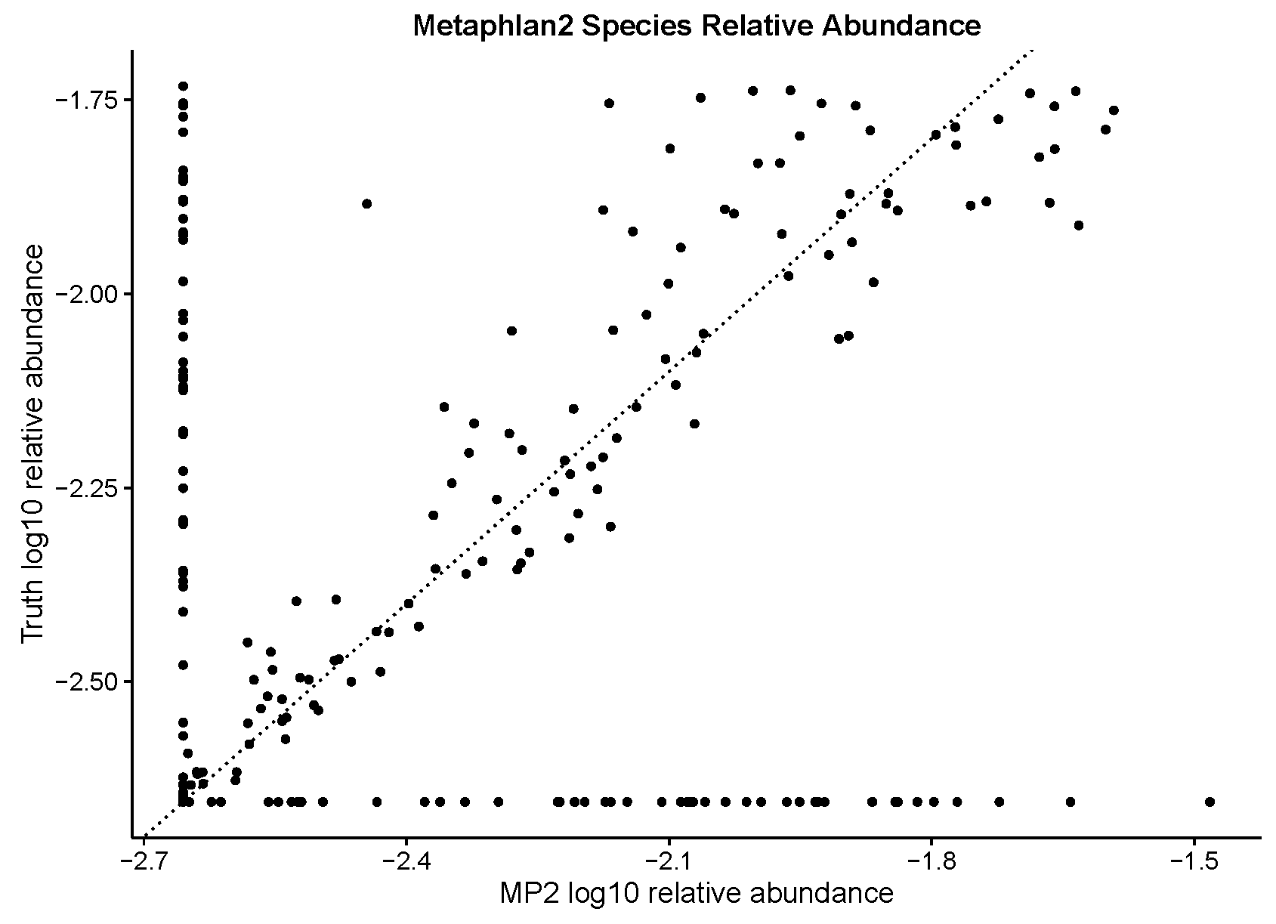
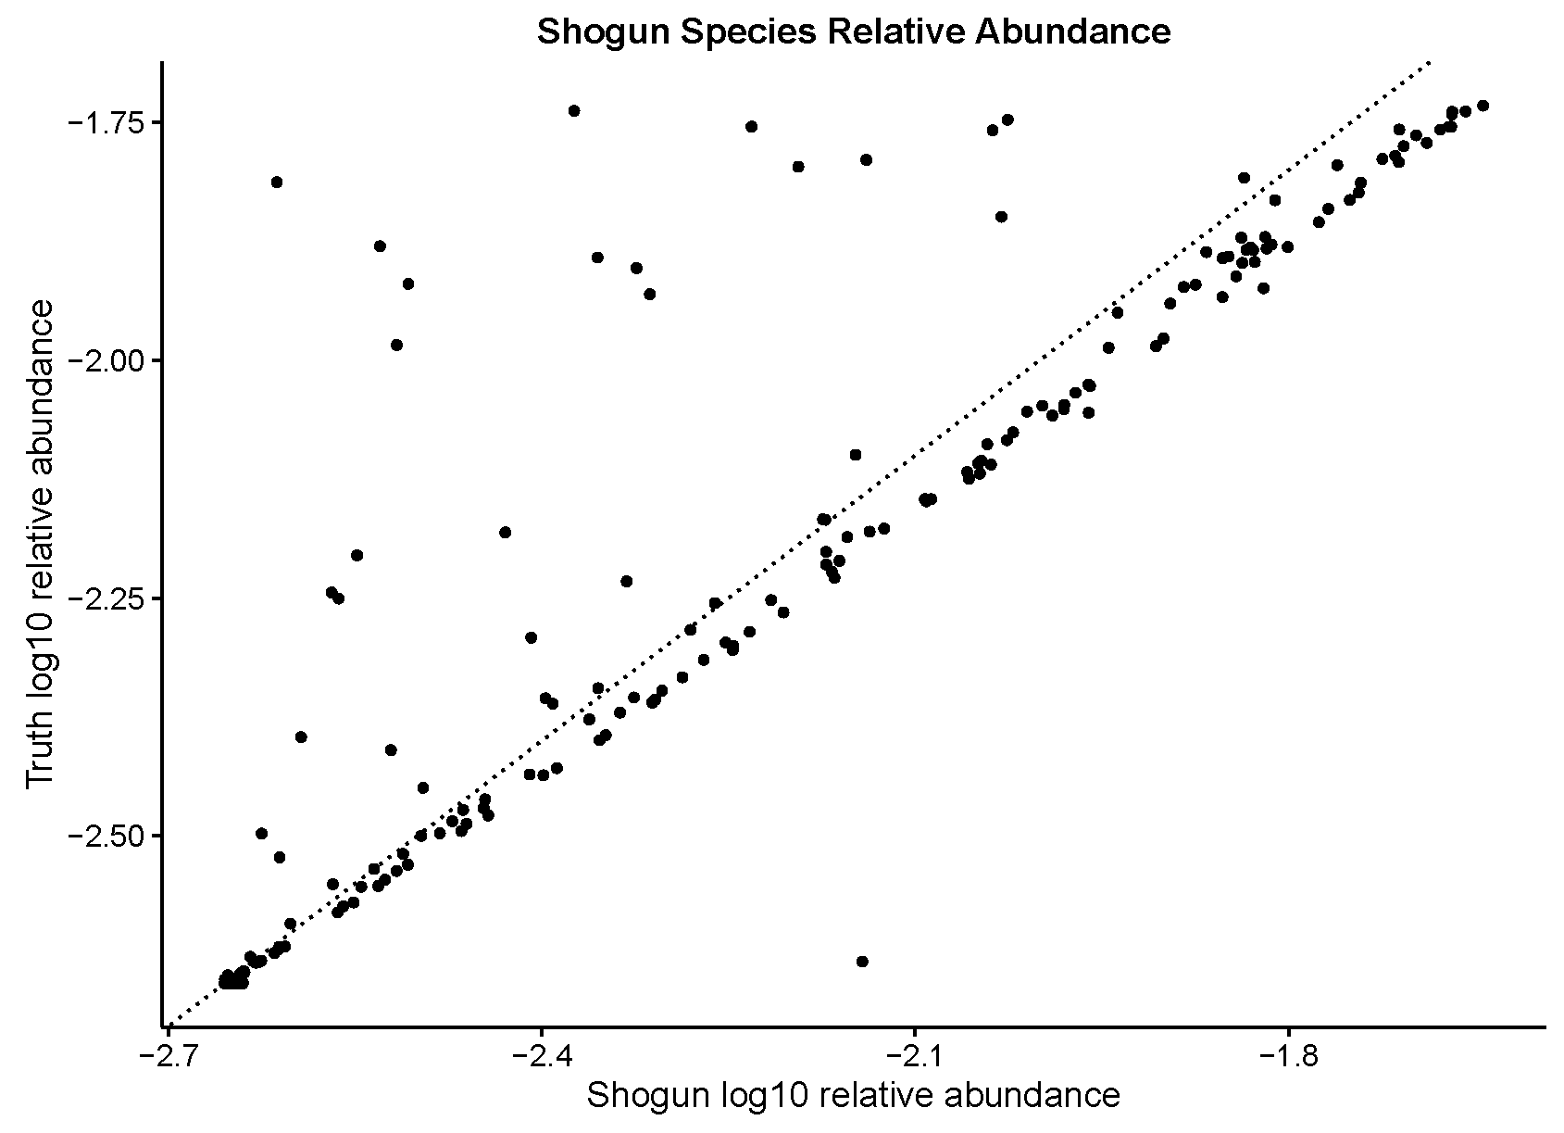
Notes:
Utree test the uniqueness of each genome
Look at the prediction accuracy of bugs over depths (do they remain the same?)
Are the same bugs being predicted poorly across Metaphlan2 and Shogun
Do it on the Metaphlan2 gold standard
Simulate from REFseq
EGGnog instead of KEGG for annotation

