Slide 1

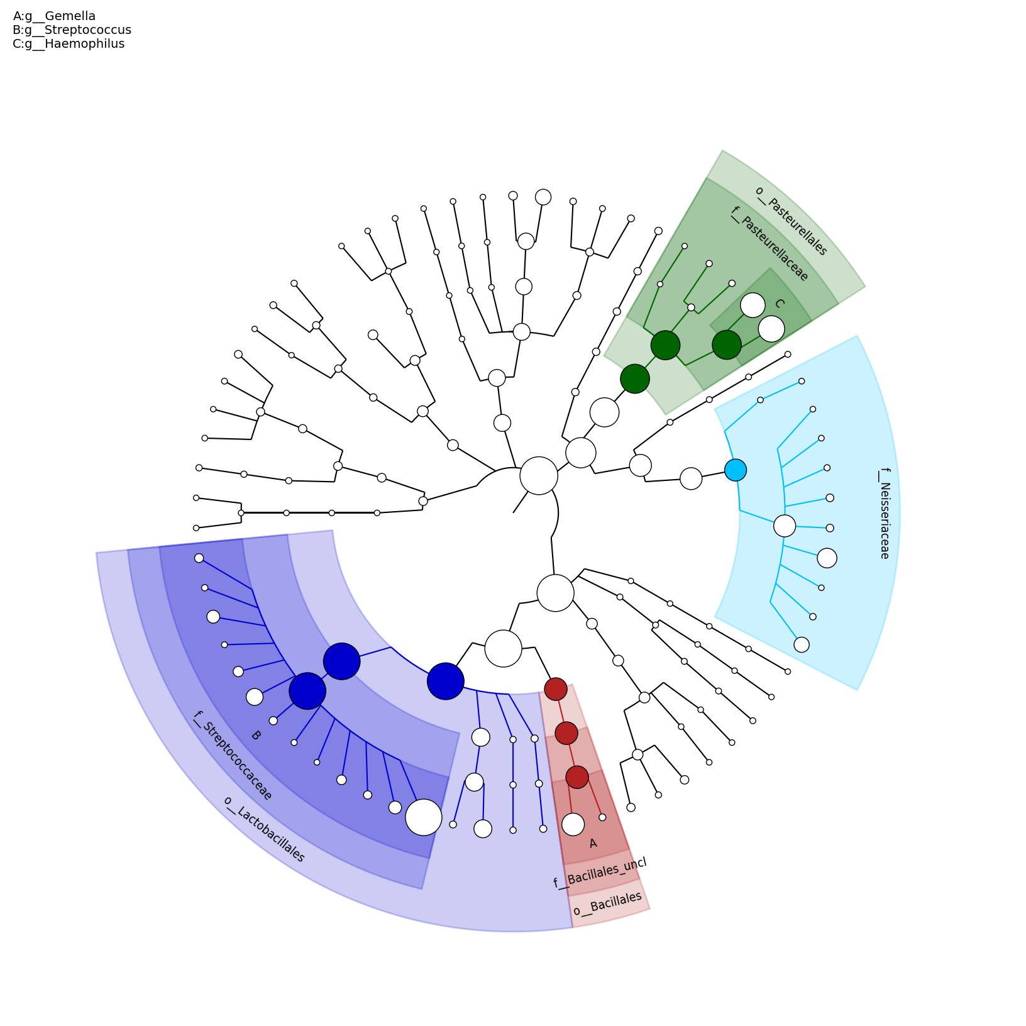
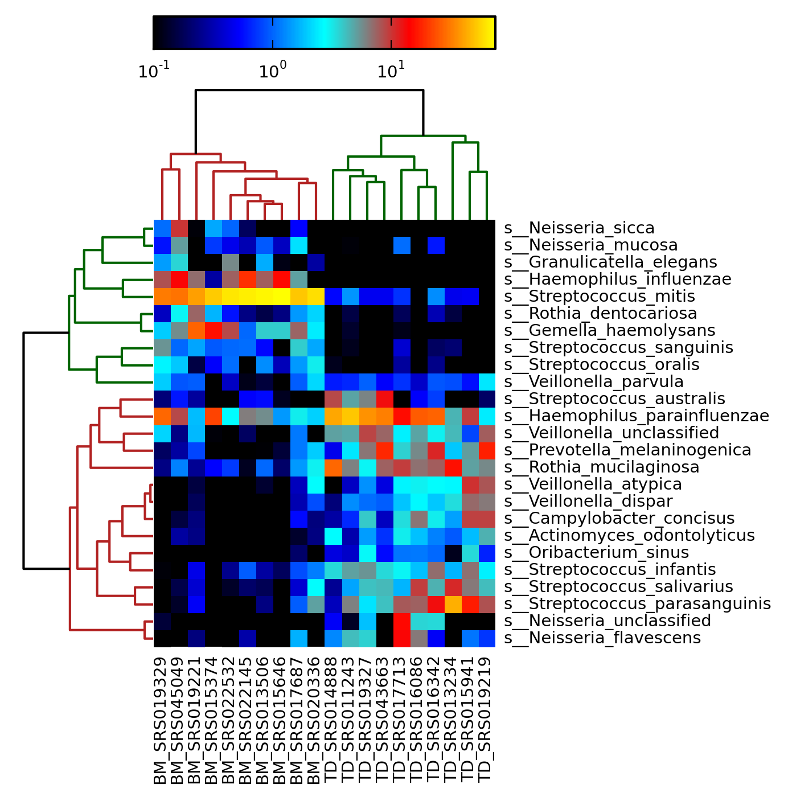
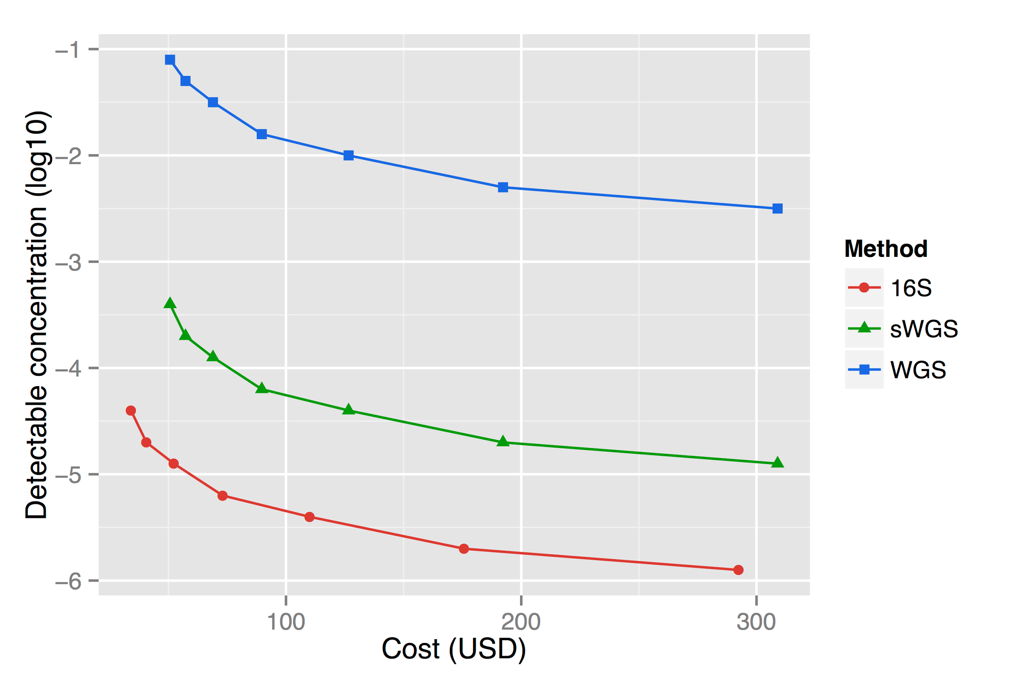
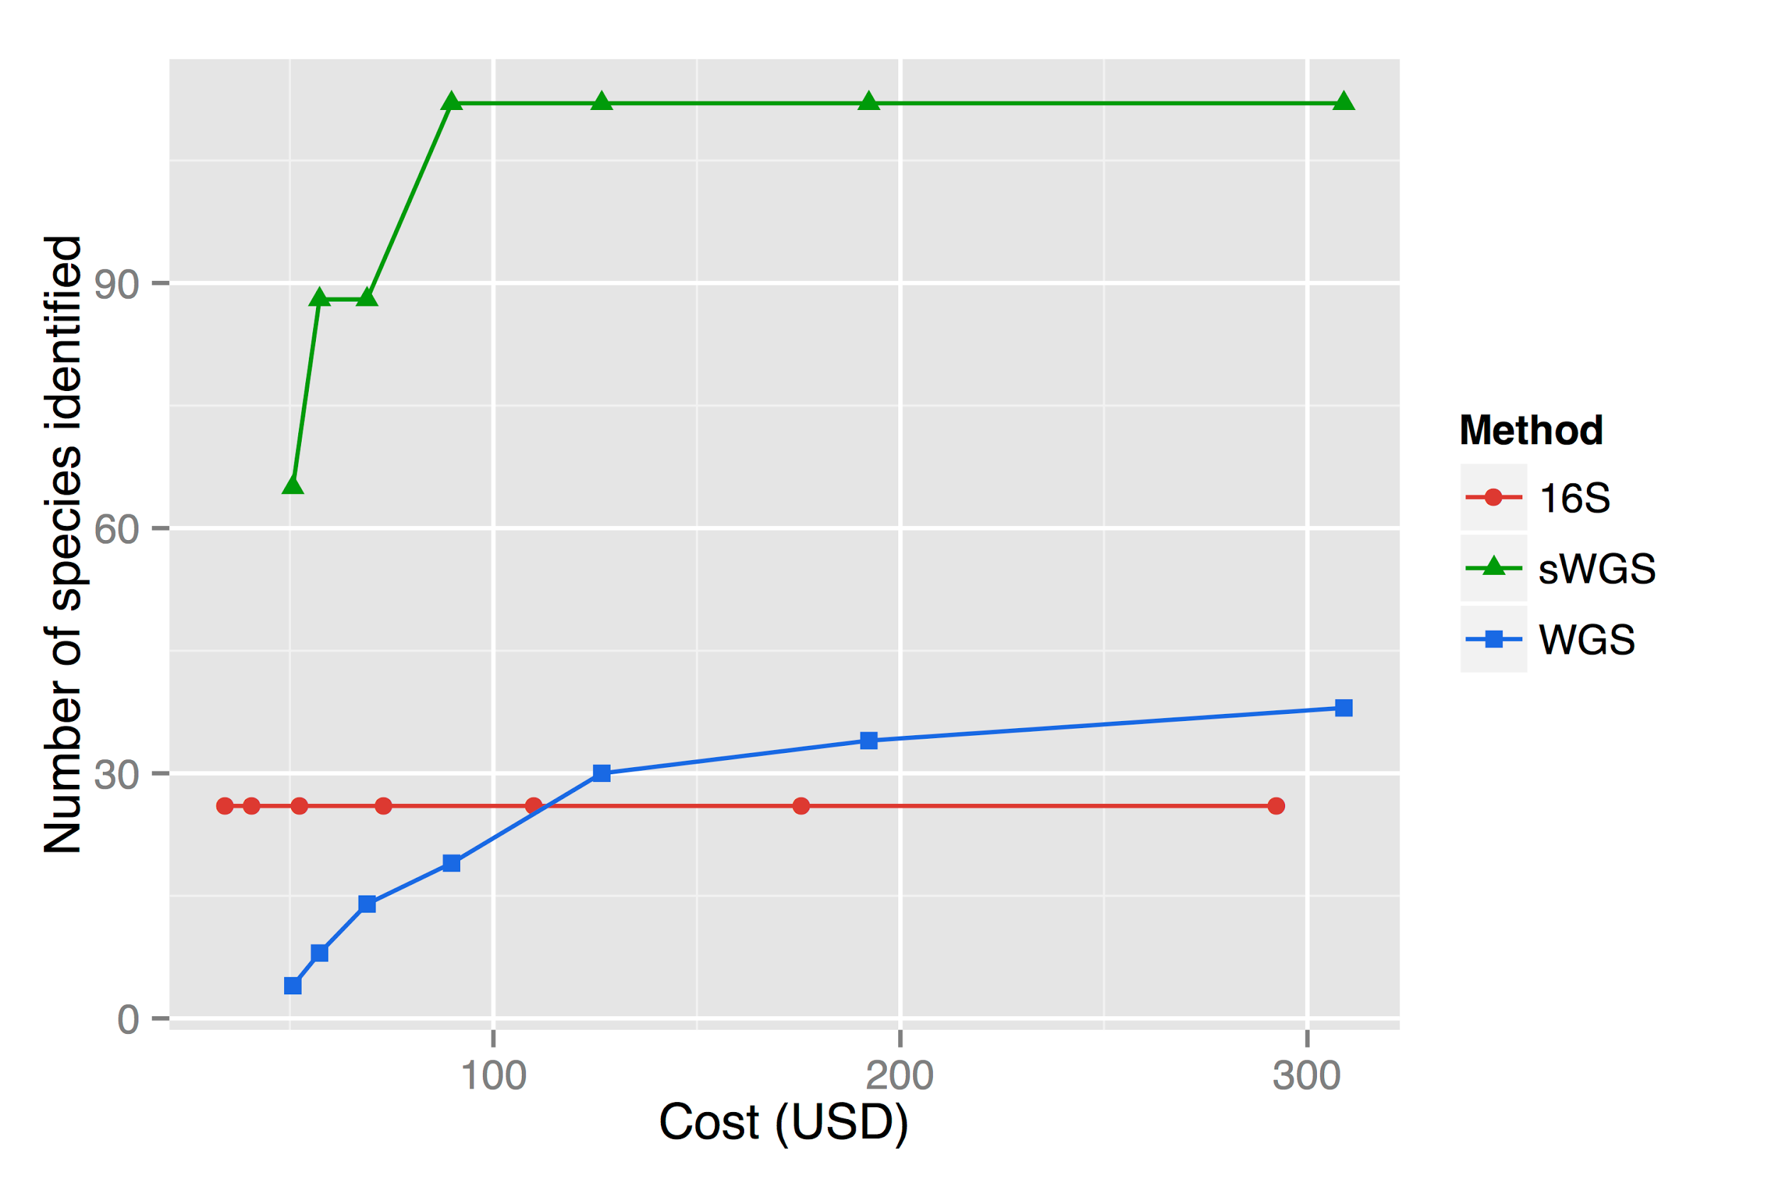
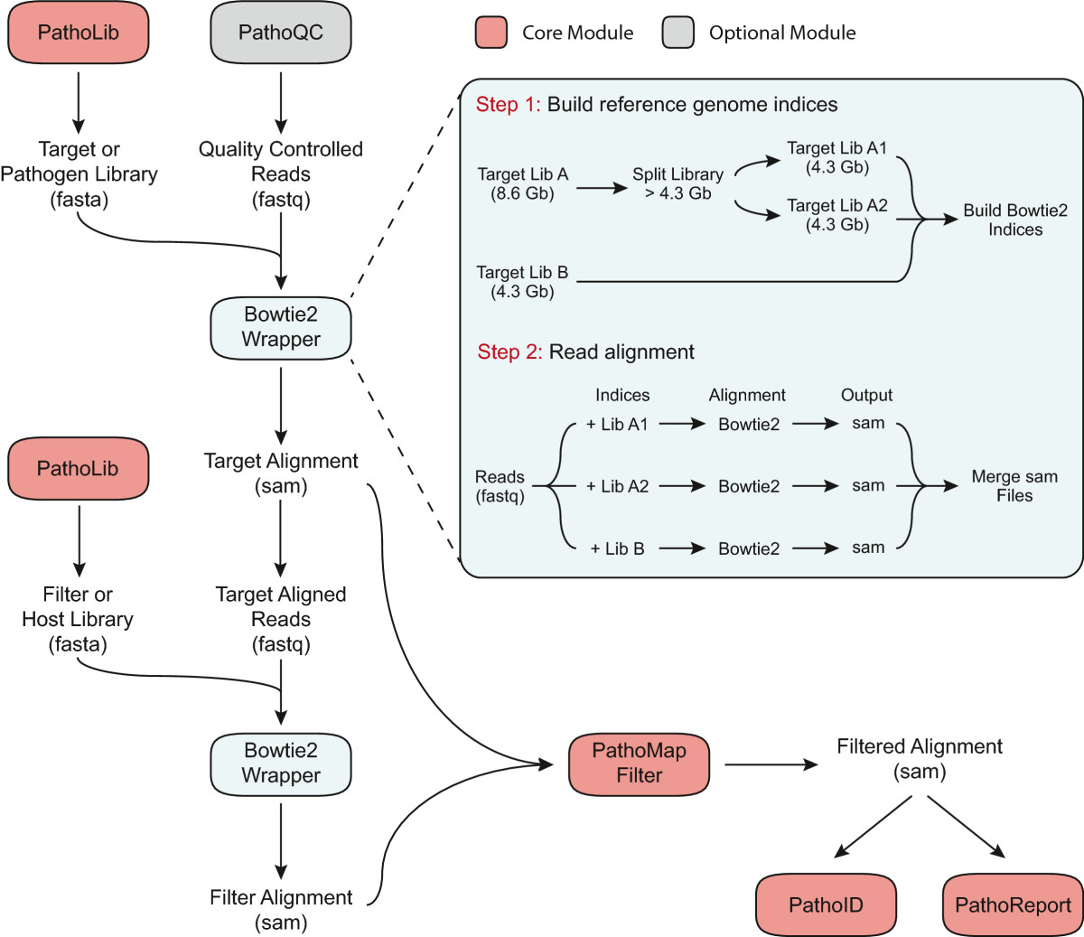
Shallow-Seq
Benjamin Hillmann and Knights Lab
Computer Science & Engineering
University of Minnesota
Overview
A crucial step in the metagenomics analysis pipeline is identifying the organisms present in an environmental sample. This project proposes novel, data-efficient methods for sequence-to-organism alignment.
Objectives
Detect the optimum sequencing depth for accurate shotgun metagenomic profiles
Compress a reference-sequence database without loss for uniquely identifying subsequences
Methods
Source: https://bitbucket.org/nsegata/metaphlan/wiki/MetaPhlAn_Pipelines_Tutorial
Results
Bowtie2 alignment against all of IMG
14:40.65 total for 10⁶ reads
A total of 5.68% unique mappings
1. AGTTT
2. GGCTA
3. GGCTT
4. GGTAA
A
GG
Dereplicate
GTTT
CT
TAA
Alignment
1
A
T
4
Last Common Ancestor
2
3
Future Work
Congregating in silico and real communities
Monte Carlo simulation for unique sequences
Testing the radix trie approach
Previous Work
References
1. Markowitz, V. M. et al. IMG 4 version of the integrated microbial genomes comparative analysis system. Nucl. Acids Res. 42, D560–D567 (2014).
2. Langmead, B. & Salzberg, S. L. Fast gapped-read alignment with Bowtie 2. Nat Meth 9, 357–359 (2012).
3. Segata, N. et al. Metagenomic microbial community profiling using unique clade-specific marker genes. Nat Meth 9, 811–814 (2012).
4. Hong, C. et al. PathoScope 2.0: a complete computational framework for strain identification in environmental or clinical sequencing samples. Microbiome 2, 33 (2014).
Source: http://www.microbiomejournal.com/content/2/1/33

