Slide 1
AIDS Foundation Houston
Community Needs Assessment: HIV/AIDS
Strategists: Zohra Baig, Reilly Brooks, Blessing Falade, Allison Yu, Sawyer Knight

Slide 2
The Problem
More than 27,000 Houstonians live with HIV
People are not connected to resources that are available to in the Houston community
People who start treatment don’t always stay

Slide 3
Why?
stigma against high-risk individuals
HIV/AIDS no longer considered pre-existing condition, not protected through ACA

Slide 4
Goal
Develop a community needs assessment and network of coordinated care to break down the stigma around HIV/AIDs in order to create systemic, sustainable treatment, prevention and advocacy. Also, connect with community allies to ensure a quality of life in Houston that can be implemented to others cities around the country.

Slide 5
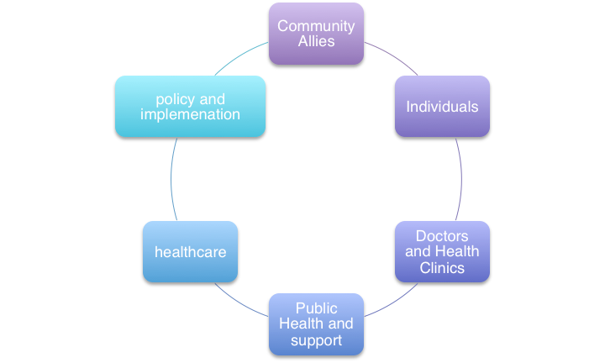
Bridge the Gap:
Mobilizing Community Support

Slide 6
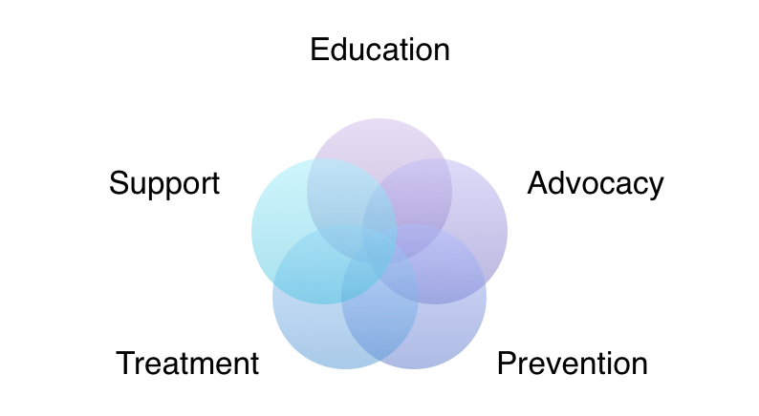
5 Pillars of Support

Slide 7
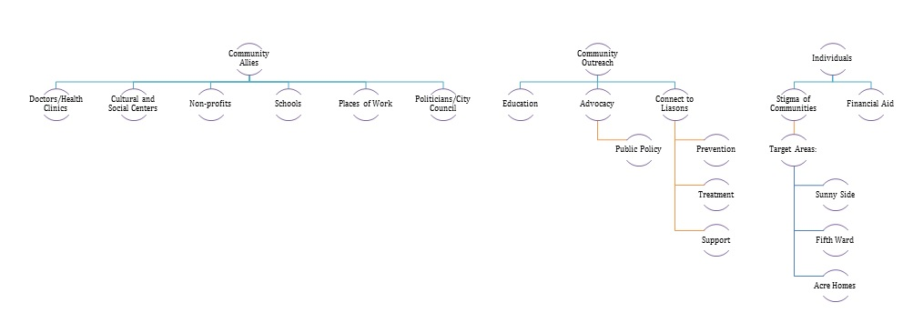
Concept Map: Tree of Implementation, Sustainability and Feasibility

Slide 8
Liaisons and Resources
reach out to influential community members from city council
identify liaisons to high risk communities
active organizations or individuals
create database of liaisons and resources

Slide 9
Target Communities: Houston
Montrose
Acres Home
Sunnyside
5th Ward

Slide 10
Case Study: Montrose
well-established resource
5 pillars
HIV testing in bars
AFH already has strong connections with them
stigma has already been broken
bring liaisons from city council and doctors/clinics to implement Montrose example

Slide 11
Why This Method?
Financially Feasible
Highly-influential individuals cultivate change in communities
Organic process

Slide 12
Impact: Assure a quality of life
Sustainable Prevention
Provide Holistic care
Destigmatize Community
Applicability to other cities
Drop in numbers of HIV/AIDS

