Slide 1

Publication And Workshop Details App.
Admin View
User View
Functions
Introduction
Working
Conclusion
Title
Save and retrieve publication and workshop detail Anytime Anywhere.

Slide 2
Fill Data Every Time Excel Sheet or Paper is Very boring for all us.
Data storage and Retrieval of Data from online Resource is very easy and Efficient.
Publisher is Solution for those work which repeat every year and also measure performance of users.
Publisher is Android Application work on cloud storage over the Internet.
Application Data Access anywhere anytime for users and also they generate Excel sheet as they required.
Application provide User performance measure for Admin.
Admin View
User View
Functions
Introduction
Working
Conclusion
Title

Slide 3
Store All Workshop And Publication Detail.
Retrieve Detail as Requirement.
Sort out detail as u want.
Export All Detail in Excel sheet which generate in file storage.
Analyze All detail to improve performance.
Record Of every faculty is separated and measurable.
Data Access anytime ,anywhere ,anyone.
Admin View
User View
Functions
Working
Introduction
Conclusion
Title

Slide 4
Start
Export
Excel
Main Activity
Show Workshop And Publication
Data Export
Login
Admin View
If Export
User View
Functions
Conclusion
Introduction
Title
Working
admin
user
verification
User ?
Add Detail
User Performance
Show Details
Search Details
Sort Details
N
Y
Exit
Stop

Slide 5
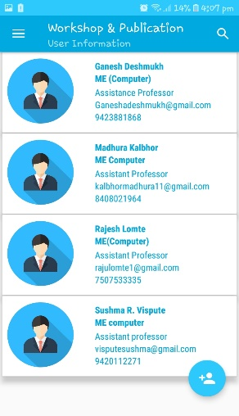
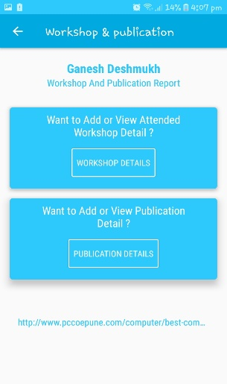
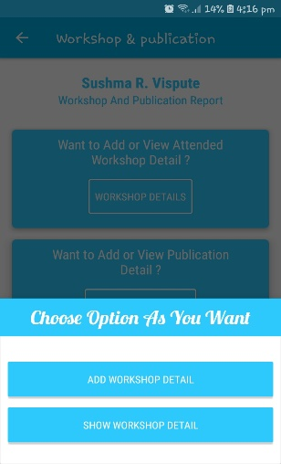
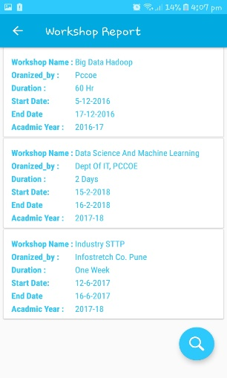
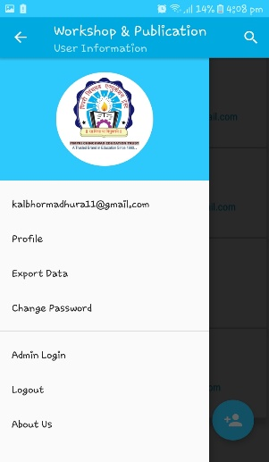
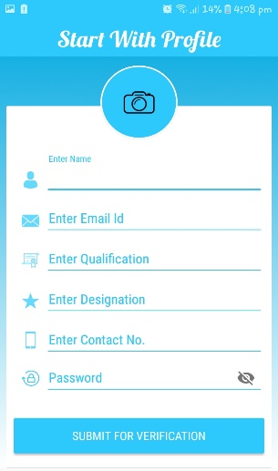
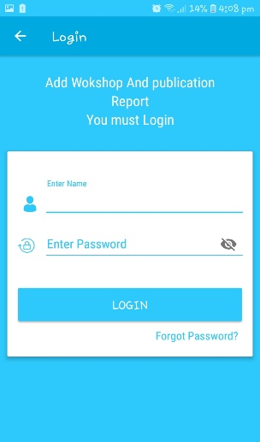
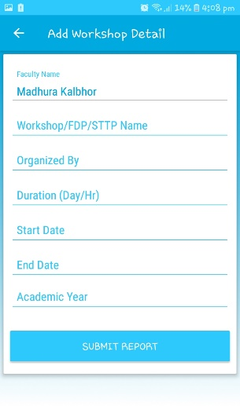
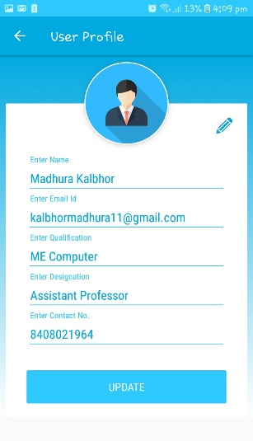
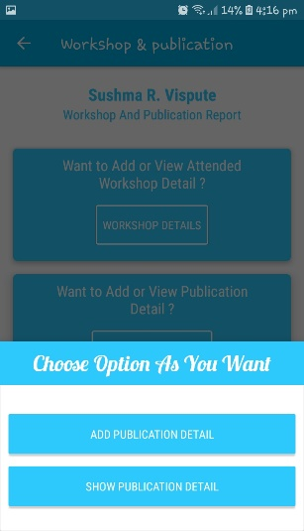
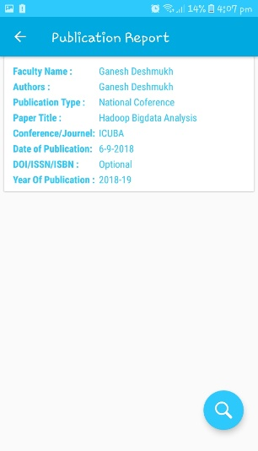
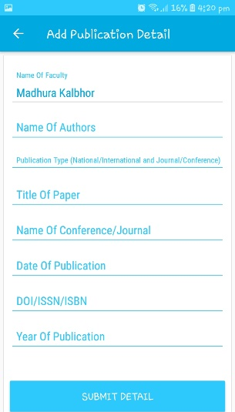
Admin View
User View
Working
Functions
Conclusion
Introduction
Title

Slide 6
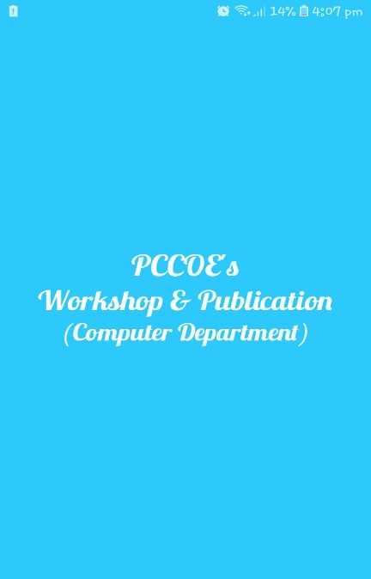

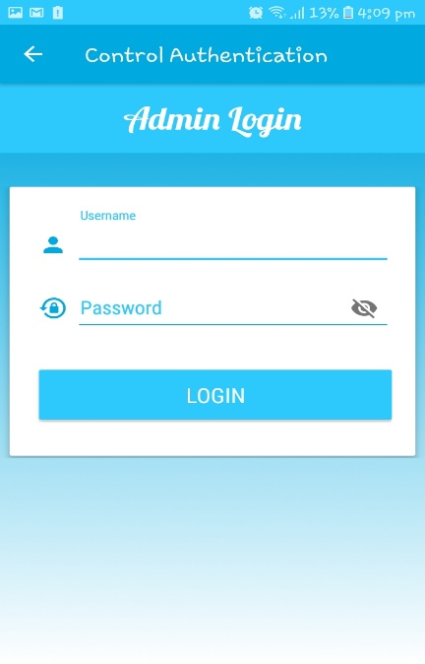
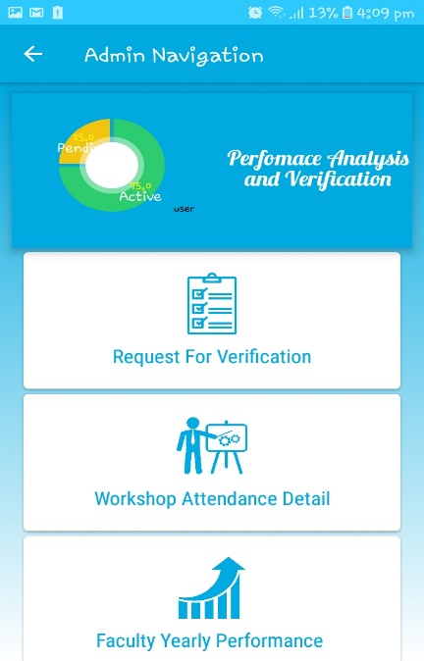
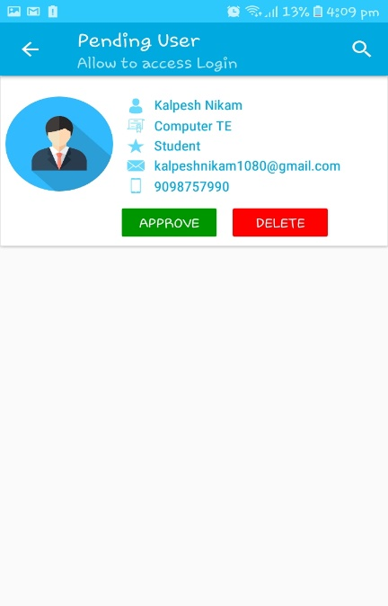
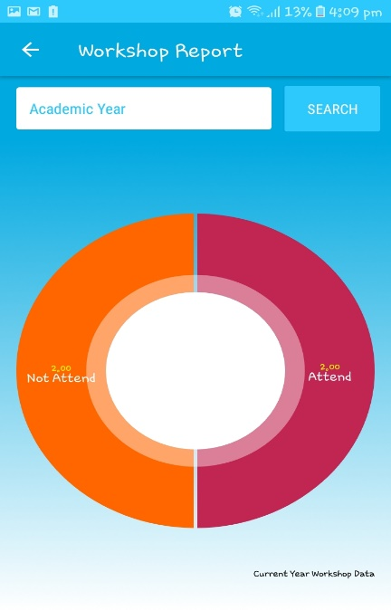
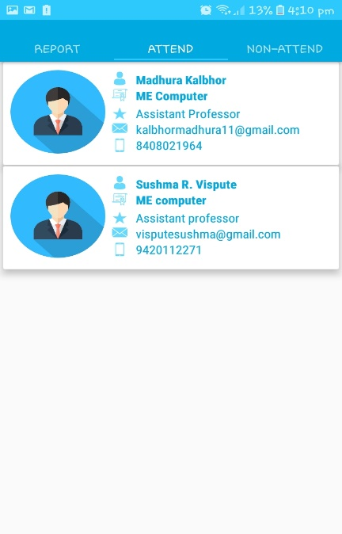
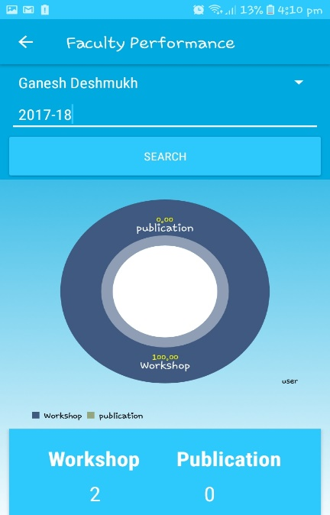
User View
Admin View
Working
Functions
Conclusion
Introduction
Title

Slide 7
Thank You !
Admin View
User View
Working
Functions
Conclusion
Introduction
Title

