Slide 1






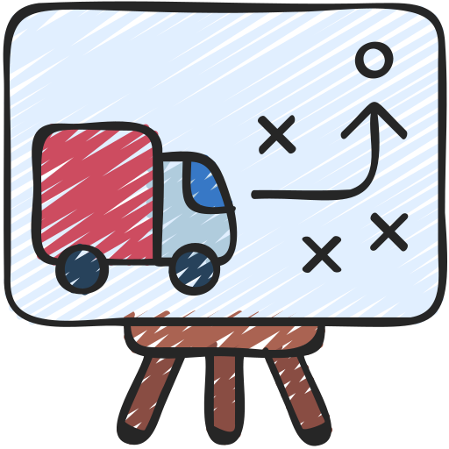
SCM
SECURITY
SCM typically stands for "Supply Chain Management." It involves the
management of the flow of goods and services, including the movement
and storage of raw materials, work-in-progress inventory, and finished
goods, from point of origin to point of consumption. SCM
encompasses a range of activities such as procurement, production,
logistics, and distribution, all aimed at creating value for
customers while optimizing costs and efficiency throughout the
supply chain.
MANAGEMENT
ANALYSIS
TAT
DISTRIBUTION
TRACKING
LOGISTIC

