Slide 1
Ai4i2020 Predictive Maintenance Dataset Analysis Presentation
Descriptive Statistics for Data Science - 420-972-VA
By: Konstantinos Nikopoulos

Slide 2
Project analysis slide 2
Dataset Analysis
Overview
Data Wrangling
PROJECT
Descriptive Statistics
Interpretations
Conclusion

Slide 3
Project analysis slide 3
Project Overview
Analyze data
Explore data
Libraries Used
Tasks Performed
Goal
Analyze the AI4I 2020 Predictive Maintenance dataset. .
Explore machine operating conditions and failure patterns.
Use Python libraries:
Pandas
NumPy
Matplotlib
Seaborn
.
Perform:
Data wrangling
Descriptive statistics
Data visualization
Result interpretation
Identify relationships between machine operating conditions and machine failures.

Slide 4
Project analysis slide 4
Dataset Description
Dataset Description
Key Variables
Failure Types
Air Temperature
Process Temperature
Rotational Speed
Torque
Tool Wear
Machine Failure.
Tool Wear Failure (TWF)
Heat Dissipation Failure (HDF)
Power Failure (PWF)
Overstrain Failure (OSF)
Random Failure (RNF)
The dataset contains operational and sensor data collected from industrial machines.
10,000 rows
14 columns

Slide 5
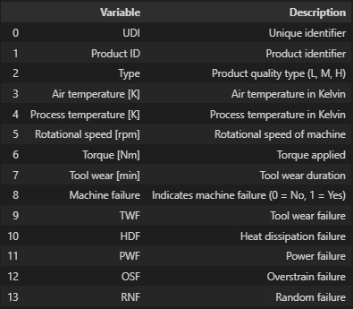
Data Wrangling
Outcome
Data Wrangling
Dataset was clean
No missing values detected
No significant duplicate issues
Tasks Performed
Loaded dataset using Pandas
Inspected:
Shape
Columns
Data types
Missing values
Checked for duplicates
Created variable description table
Variable Descriptions

Slide 6


Project analysis slide 8
Descriptive Statistics
Variables Analyzed:
Variables summary
Air Temperature [K]
Rotational Speed [rpm]
Torque [Nm]
Methods Used:
Python/Dataframe calculations
df.describe()
Python/Dataframe calculations
Manual NumPy calculations
Manual NumPy calculations

Slide 7



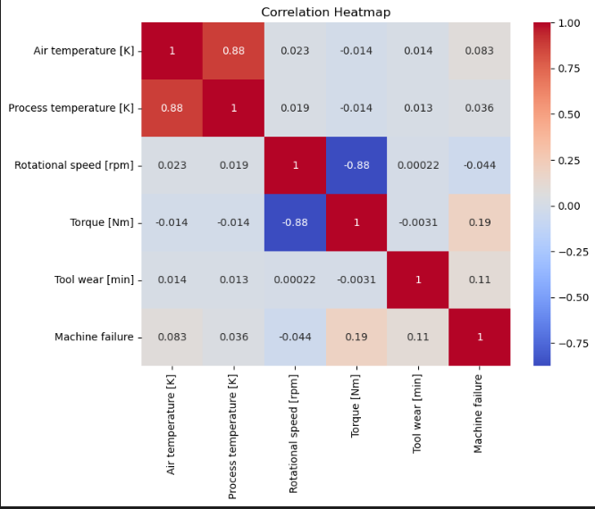



Project analysis slide 8
Descriptive Statistics
Mean
Statistics Calculated:
Mean
Median
Mode
Variance
Standard Deviation
Quartiles
Correlations
Quartiles
Median
Correlations
Mode
Variance
Standard Deviation
Correlation values close to +1 or -1 indicate strong relationships between variables

Slide 8
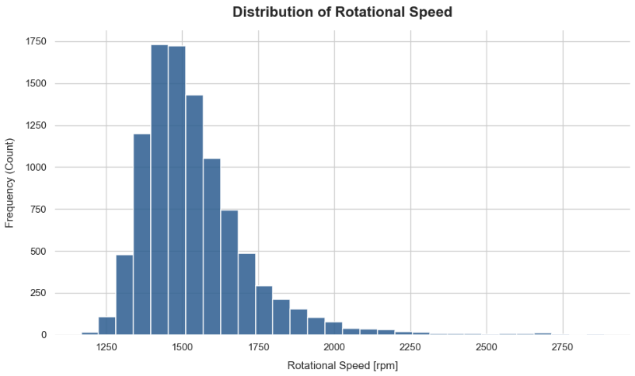
Project analysis slide 10
Rotational Speed
Purpose
Visualize the distribution of rotational speed values.
Findings
Approximately normal distribution
Most machines operate within a common RPM range
Few extreme values

Slide 9
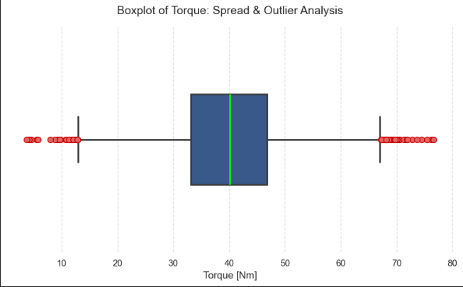
Project analysis slide 10
Distribution of Torque
Purpose
Identify spread and outliers
Findings
Torque values are concentrated around the median
Several outliers are present
Indicates occasional extreme operating conditions

Slide 10
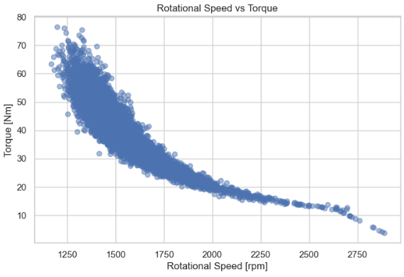
Project analysis slide 10
Rotational Speed vs. Torque
Purpose
Examine relationship between speed and torque.
Findings
Moderate negative relationship
Higher speeds tend to occur with lower torque values
Correlation
Correlation value: - 0.875
Negative correlation confirms the inverse relationship between the two variables

Slide 11
Project analysis slide 5
Failure Rate by Product Type
Purpose
Findings
Correlation/Legend
Compare machine failures across product types.
Strong correlations: variables connected to machine failures.
Heatmap: Instantly isolates which specific failure modes share the strongest bond with the target Machine failure flag.
Horizontal Bar Plot: Shows which failure modes are rare versus which ones happen most frequently in the dataset.
Failure rates differ between product categories
Product quality may influence reliability

Slide 12
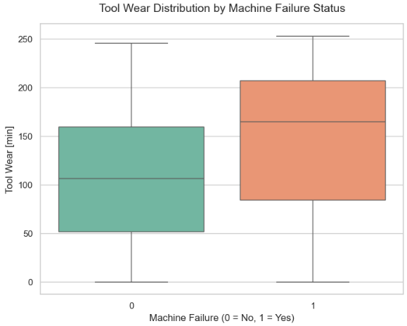
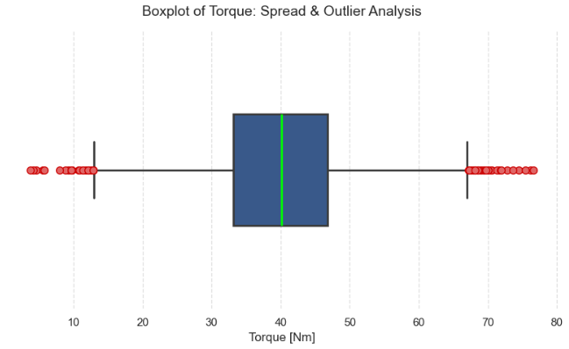
Project analysis slide 7
Distribution Insights
Distribution Insights:
Rotational speed appears approximately normally distributed.
Torque values contain some outliers.
Air and process temperatures show relatively small variation.
Tool wear exhibits a wide range of values.
Most machines operate under normal conditions with relatively few failures.

Slide 13
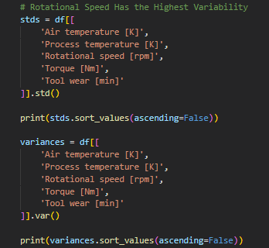
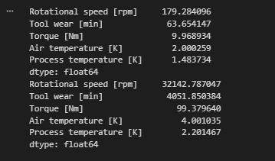
Project analysis slide 7
Highest Variability
Highest Variability:
Key Findings:
Rotational speed has the highest variability.
Temperatures remain relatively stable.
Tool wear shows substantial variation across machines.
Interpretation:
Machines operate under varying workloads while temperatures remain controlled.

Slide 14
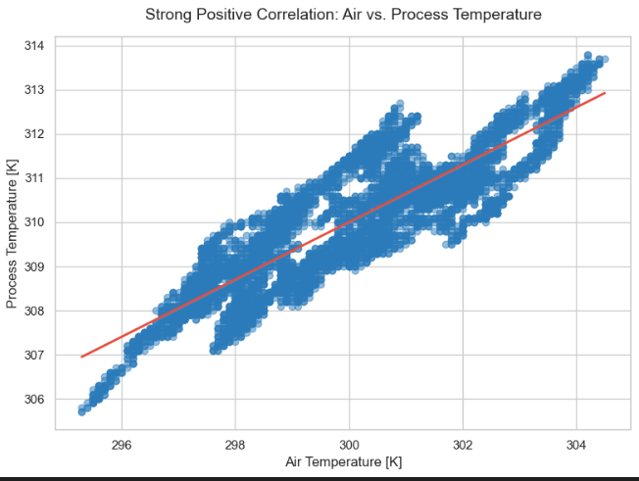
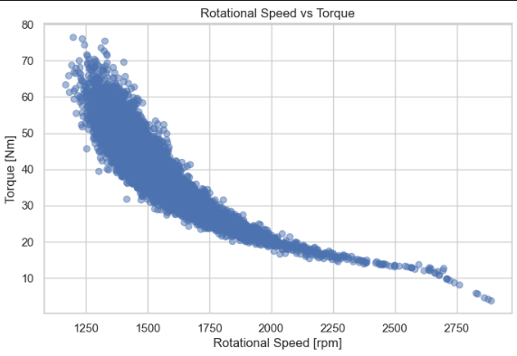
Project analysis slide 7
Strongest Correlations
Strongest Correlations:
Air Temperature & Process Temperature
Strong positive correlation.
Rotational Speed & Torque
Moderate negative correlation.
Interpretation
Environmental conditions influence operating temperatures.
Speed and torque demonstrate an engineering tradeoff.

Slide 15
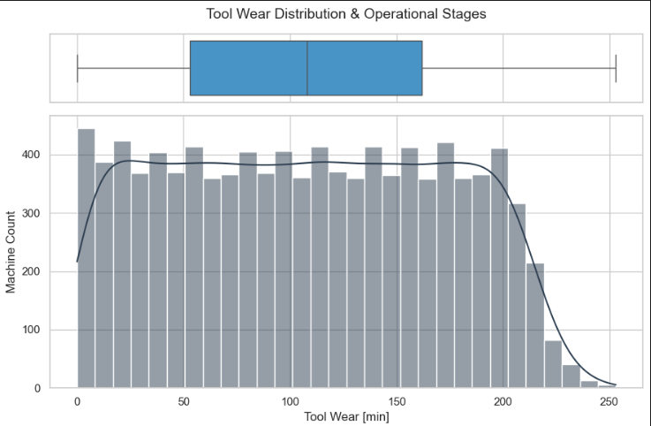
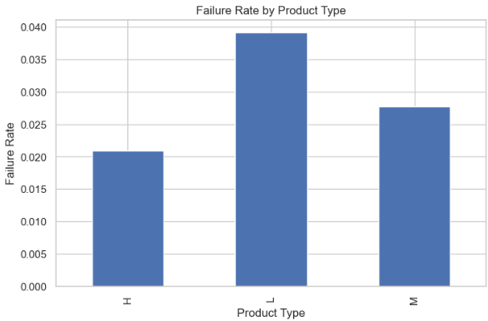

Project analysis slide 7
Group Differences
Group Differences:
Product Type
Failure rates vary among product types.
Tool Wear
Higher tool wear is associated with greater failure risk.
Interpretation
Machine reliability appears influenced by both product characteristics and component wear.

Slide 16
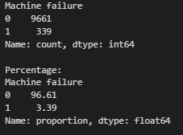
Project analysis slide 7
Surprising Insights
Surprising Insights:
Small operational changes can influence machine failures.
Some failures occur under normal operating conditions.
Machine failures are relatively rare.
Multiple failure mechanisms contribute to breakdowns.
Why It Matters
Predicting failures requires considering several factors simultaneously.

Slide 17
Project analysis slide 7
Conclusion
Key Findings
Dataset was clean and suitable for analysis.
Rotational speed exhibited the greatest variability.
Air and process temperatures were strongly correlated.
Rotational speed and torque showed a negative relationship.
Increased tool wear was associated with machine failures.
Failure rates differed across product types.
Overall Conclusion
The analysis demonstrates that machine reliability is influenced by operating conditions, equipment wear, and product characteristics. Understanding these relationships can support predictive maintenance strategies and help reduce unexpected equipment failures.

Slide 18
Project analysis slide 7
What’s Next?
Limitations:
Analysis is based on a single dataset.
Machine failures are rare → imbalanced dataset.
Analysis focuses on exploratory statistics and visualizations not predictive modeling.
Factors that could influence failures are not included in the dataset.
Failure-type variables describe failures that have already occurred, provide limited insight into predicting failures before they occur.
Impact:
Findings provide valuable insights into machine behavior but would require additional data and predictive models to support real-world maintenance decisions.
Next Steps:
Develop machine learning models to predict machine failures.
Compare different algorithms.
Perform feature engineering to create additional predictive values.
Address class imbalance using resampling techniques.
Investigate which variables are most important for predicting failures.
Evaluate model performance using metrics such as accuracy, precision, recall, F1-score, and ROC-AUC.
Expected Benefits:
Earlier detection of potential failures.
Reduced downtime and maintenance costs.
Improved machine reliability and operational efficiency.

Slide 19
Thank You

