Slide 1
Python v2
Community Extension for KNIME

Slide 2
Goal
Support Python 3
Support Jupyter notebooks (improve ‘Open external’ possibilities for troubleshooting or prototyping)

Slide 3
Data transfer

Slide 4
CSV-Format
Column Header : RowID + Column Names of supported types
Column Types:
PY_TYPE_INDEX (RowID)
PY_TYPE_BOOL
PY_TYPE_LONG
PY_TYPE_FLOAT
PY_TYPE_DATETIME
PY_TYPE_OBJECT (String)
Warning if data type is not supported
Missing values => next slide
Only pandas!

Slide 5



MISSING VALUES
Object (String)
NaN
Int64
Not possible! => column converted to float => Double
Float64
? => NaN => ?
NaN => NaN => ?
Bool
Imported from pandas as true
Datetime64, timedelta64
NaT

Slide 6
KNIME / pandas
KNIME => | Pandas => | KNIME
String | object | String
String-like (e.g. URI) | object | String
Double | float64 | Double
Int | int64 OR float64 with missing values | Int64 => Long
Long | not supported as missings can not be represented and long cannot be represented as float64
Bool | bool | Bool
Date / time types | Extra slides

Slide 7
Special cases and data types

Slide 8
Special characters - Issue
Push to Python works fine
No return of carriage return ‘\r’ – conflicts with line ending settings
No return of backslash ’\’ as it is not escaped by pandas when writing to CSV though the escape character is ‘\’
Tested with Pandas 0.23.4 and 0.25.3

Slide 9
DateTime
Python: pandas, numpy
KNIME: java.time
The following slides are valid for
Python2 or 3
Pandas 0.23.4, 0.25.3

Slide 10
DateTime issues
from dateutil.parser import parse
parse("-99999-01-01")
Pandas supports columns in numpy datetime64 format
Datetime64 has different time units
https://numpy.org/doc/1.18/reference/arrays.datetime.html
Each unit can represent a different time span +/- 1.1.1970
KNIME can set extreme year values like +/-999,999,999
Theoretically
Datetime64[ns] cannot handle it as the range is +/- 292 years
Datetime64[D] can handle it BUT
Pandas.dataframe.astype() will not convert it as it uses a python core functionality to parse the string instead of using numpy and fails
import numpy as np
np.datetime64(‘-99999-01-01T00:00:00.000000', 'D')

Slide 11
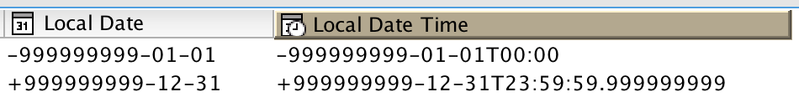
DateTime issues
Column will fail do to be converted into datetime64[D]
Due to parsing problem
Column will fail do to be converted into datetime64[ns]
Due to parsing problem
but it’s also out of time span

Slide 12
DateTime conversion- to Python
KNIME | pandas
LocalDate yyyy-MM-dd | datetime64[ns]
LocalDateTime yyyy-MM-dd'T'HH:mm:ss.SSS | datetime64[ns]
LocalTime HH:mm:ss.SSS | datetime64[ns] – NOTE: adds the current date
ZonedDateTime | Pandas has timezonesupport, but no straight forward solution to read from CSV; recommendation to use a single timezone as many methods cannot work with timezone dates => transfer as ‘object’ (string)

Slide 13
DateTime conversion – from Python
Datetime64 will be truncated to microseconds (21.04.2020)
https://github.com/pandas-dev/pandas/issues/29461
Export format '%Y-%m-%dT%H:%M:%S.%f’
Example: 2020-04-14T14:10:30.876000
=> Local Date Time in KNIME

Slide 14
Durations
Standard Representation ISO_8601
PnYnMnDTnHnMnS
Java side (KNIME-types)
Period (amount of time in years, month, days)
parse() with PnYnMnD
Duration (amount of time in (days), hours, minutes, seconds, nanoseconds)
parse() with PnDTnHnMnS
BUT KNIME fails to support days in ‘String to Duration’ node
toString() => ISO_8601 representation

Slide 15
Durations
Pandas side
Timedelta64 (amount of time in days, hours, minutes, seconds, …)
Why not years/month, see Python datetime.timedelta
isoformat() => ISO_8601 representation
to_timedelta() => support of ISO_8601 strings but with limitations (checked for pandas 1.0.3, does not work at all with pandas 0.23.4 but seems to be available since 0.24.x)
P23DT23H, not parsed correctly => 23 days, missing hours
P5D, not parsed correctly => 0 days
P4DT12H30M5S, works
No years, month, weeks

Slide 16
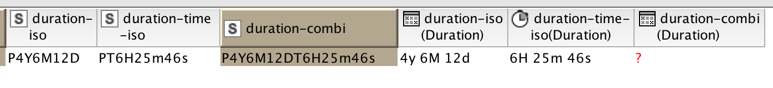
Durations
Node “String to Duration” can handle the strings (either date-based representation OR time-based representation)
Finally
From KNIME
Deliver ISO-Strings with column format timedelta64
Will fail to be converted for pandas < 1.0 (stays as string) but might change with bugfixes in pandas?
To KNIME
Deliver ISO-Strings with column format string
Parse as Duration (should work, as timedelta64 has the same ‘resolution’)

Slide 17
Pandas version>= 1.0.0 (Py > 3.6.1)
Since 01/2020
Changes /backward compatibility need to be checked
String and Boolean as new data types (experimental)
Quicker select_dtypes() method
pandas.NA for missing values (experimental)
convert_dtypes() method to get new datatypes
df.info() much more readable
to_markdown() method

Slide 18
Enhancements for the future?
As soon as not experimental anymore
Support String columns
Support Boolean columns
Support pandas.NA
Support Categorical Columns (=> Domain Data)?
Change to Parquet as exchange format instead of CSV
Transfer Flow-variables (as pandas data frame?)

Slide 19
Preferences / jupyter

Slide 20
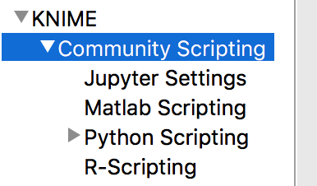
Preferences
Community Scripting Settings moved
Jupyter Settings (as it may provide Python and R kernels)
Python Scripting = Settings for Python nodes Version 2
Python Scripting (deprecated) = Settings for Python nodes Version 1

Slide 21
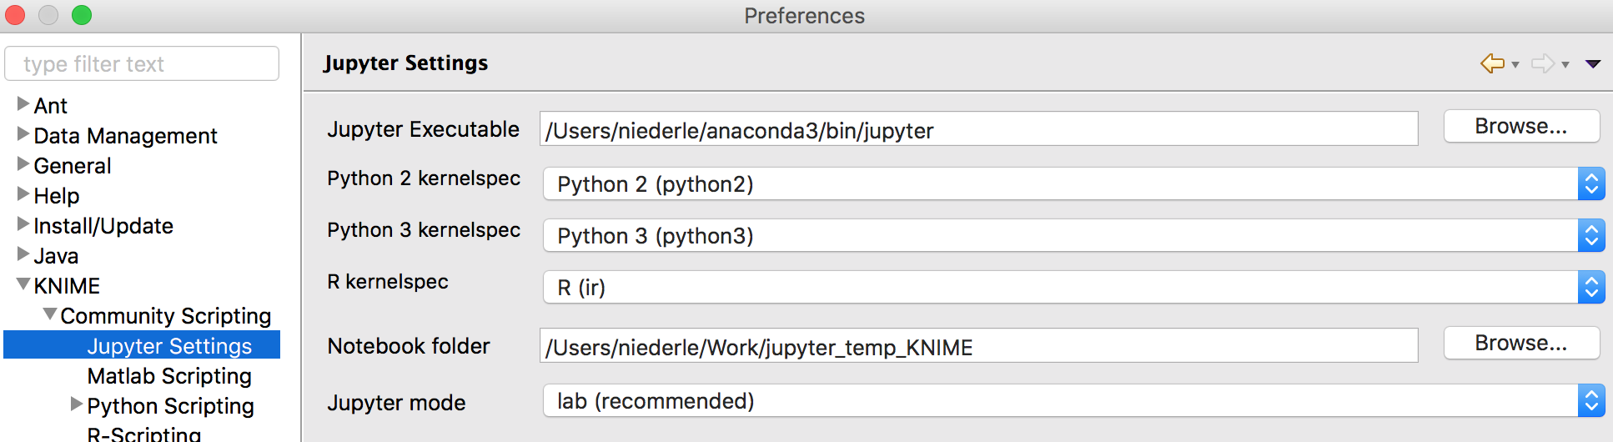
Jupyter Settings
Available Kernelspecs are automatically retrieved as soon as the jupyter executable is set
Jupyter can be started as lab or as notebook
Notebooks are created within a given notebook folder

Slide 22
Jupyter Setup (Recommendation)
Jupyter installed in base environment
Register Jupyter Kernel
> source activate myenv
> conda install ipykernel
> python -m ipykernel install --user --name myenv --display-name "Python (myenv)"

Slide 23
Plot nodes

Slide 24
Python Plot node(s)
View
(png)
Image Port
(png)
Plot Node
File Export (optional, various formats)

Slide 25
Python Plot Nodes - new features
Supported file export formats (Matplotlib – ‘Agg’-backend)
PNG
SVG
PDF
JPG
TIF
DPI
For presentation – recommended DPI = 75
For printing – recommended DPI = 300 (600 / …)
Adjust size: 72 dpi ≈ 28,35 px/cm

Slide 26
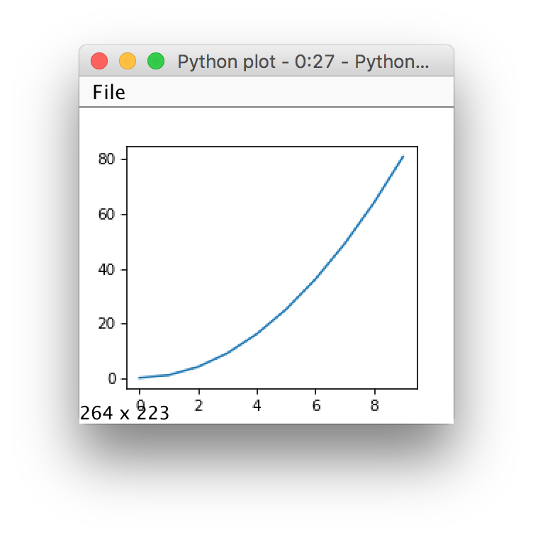
Python Plot Nodes - new features
Recreate Image
With mouse click in the view, the image can be recreated for a new size
Size (width x height) is displayed and updated while resizing view window => gives an idea how to best set dimensions for plot export as file
Note: KNIME input is put into a shelve-file during execution time and saved to node internals when saving the workflow. Take care of your disk space when dealing with large tables! Might help to reduce the table to plot-relevant information

Slide 27
Files in the background
Temporary location (during execution)
KNIME Input => CSV
Script => Py-Script (with procedures for reading input data and writing output data / plots)
Python Output => CSV (successful execution of py-script)
KNIME Input => pickle file (for plots only)
PNG (for plots only)
Destination location
Plot (various formats)
Node Settings folder (after saving the workflow)
PNG
pickle file to recreate image, Key file to know which input to expect

Slide 28
Further Notes
Error message with Python Plot
UserWarning: Matplotlib is currently using agg, which is a non-GUI backend, so cannot show the figure.
Do not use plt.show() – meaningless
Tested with Py 3.8 and Pandas 1.1

