Slide 1
Bar
File created on: 9/5/2019 6:42:04 PM

Slide 2
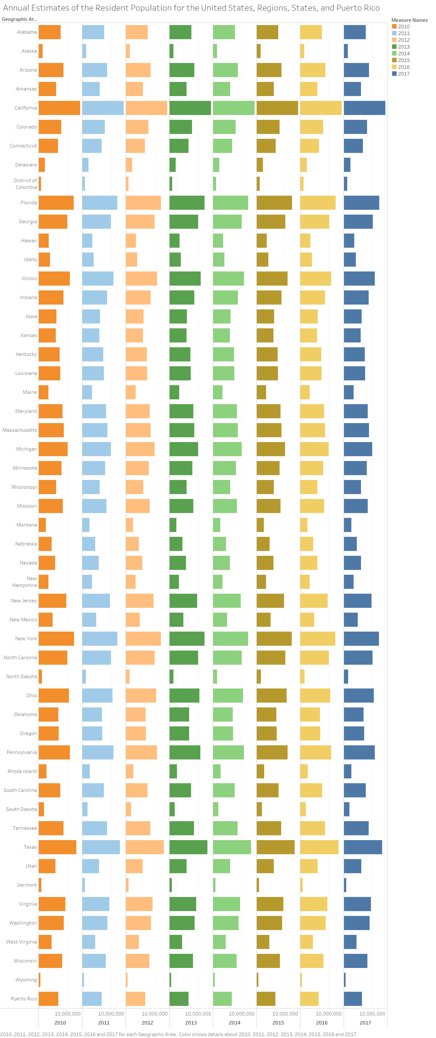

Slide 3
