Slide 1
Book1
File created on: 9/5/2019 5:36:19 PM

Slide 2
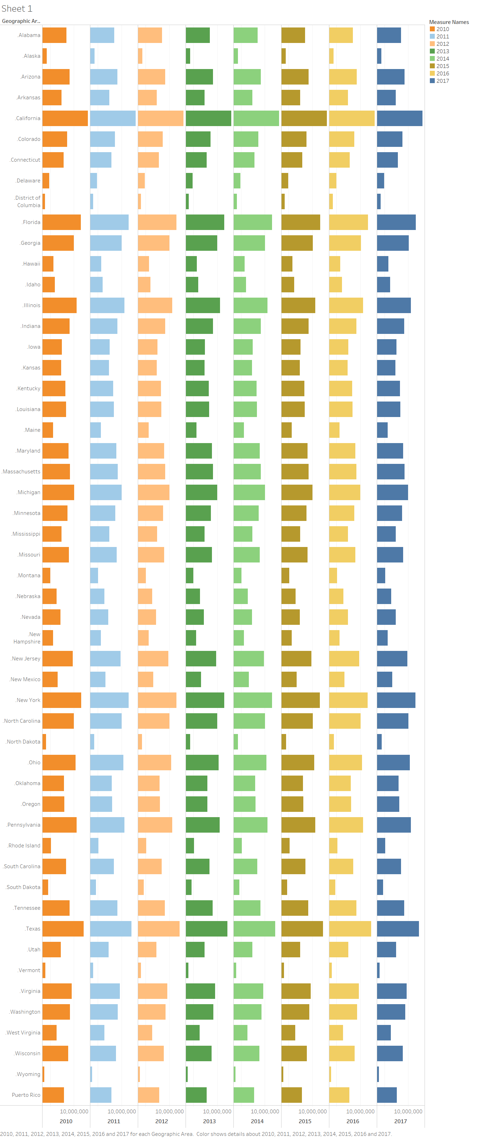

Slide 3
