Slide 1
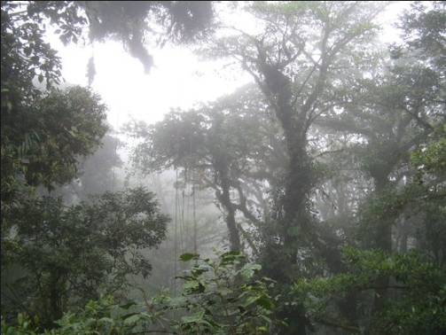
Job Searching in a Foggy Jungle
Goal: Find a cool data job close to home, kids, spouse, cat and chicken
Problems:
1)Too many job sites, too many duplicate listing, phishing listings
2) Commute times can vary widely depending in direction and time of day
Miles is a poor indicator of commute time. We can do better!!!
Solution: Let the computer hack on the jungle for you

Slide 2
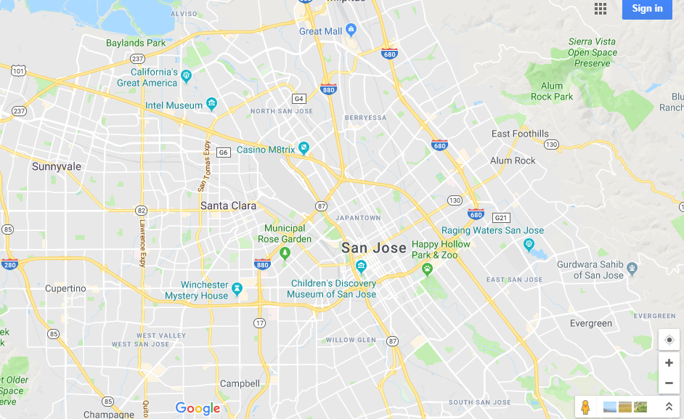
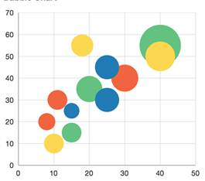


Meta Data
Top 5 Job Listings
#1—Data and Beer
Go Get Mo Job Listings
#2—Data and Food
#3—Data and Medicine
#4—Data and xxx
#5—Data and xxx
Tool Tip
Company
URL
Tool Tip
Company
Drive time
Drive time
Hynix
Kaiser
Percent match

Slide 3
Foggy Jungle Architecture
Scrape
Indeed
python
db
Scrape now
mongo
Combine DB
Delete dups
Travel time from home
Match to key words
Web page
Meta Data
Home location
Key words
Commute time
db
Flask Server
python
Html
JS
CSS
csv
Python libraries
Pymongo
NLP
Pandas
mongo
db
Scrape now
Scrape Glassdoor
mongo
python

