Slide 1
Recommending Neighborhoods
By Caitlin
Coursera Capstone

Slide 2
Introduction
The problem:
Relocate neighborhoods within a city or borough.
Replicate current situation as closely as possible.
Example case:
A business seeking to relocate or open a second location that is satisfied with its current neighborhood and thus would like to replicate it as closely as possible.

Slide 3
Data
Foursquare
Venues in each neighborhood are explored.
This provides an indication of the business landscape of each location
Rent Cafe
A table with rent information for each neighborhood is scraped and added to base data.

Slide 4
Methodology
Tables and maps are generated to show progress in data processing.
K-means clustering groups comparable neighborhoods.

Slide 5
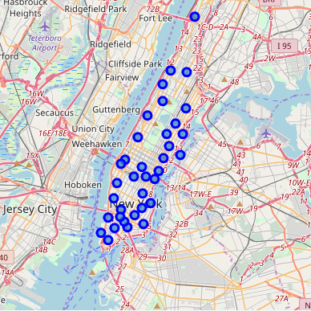
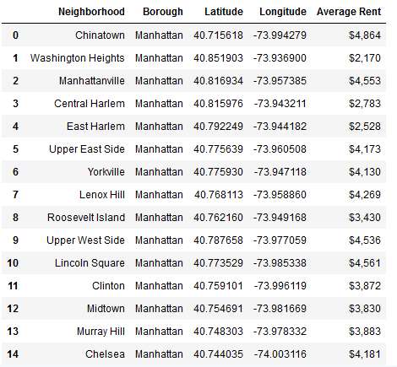
Selection of Results
To the right, we have the basic geographic data plotted out on map.
Below, it is in a table, with rent information.

Slide 6
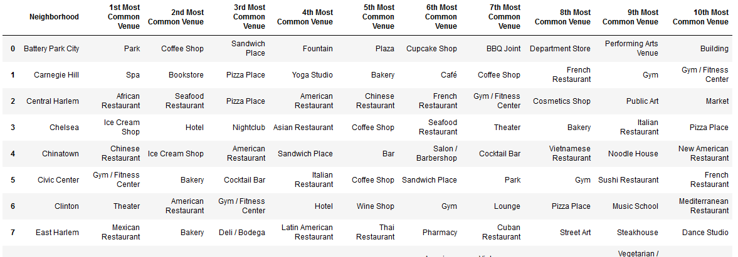
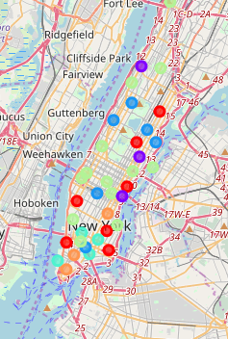
Selection of Results
A table with most common venues by neighbourhood.
A map with the neighborhoods clustered by venue and rent

Slide 7
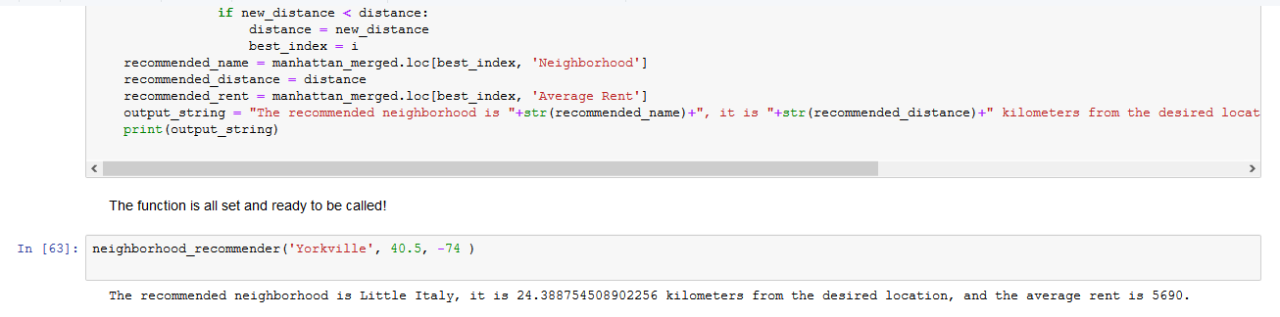
Selection of Results
Above is the function that comprises our end result.

Slide 8
Discussion
The results could easily be tweaked according to need
The model could be easily extended.
Greater refinement of the model might also be advisable in later iterations.

Slide 9
Conclusion
This project aimed to provide an aid to anyone seeking to switch neighborhoods within the borough of Manhattan.
It produced Python functions that utilize machine learning in order to make recommendations based on some combination of relevant paramaters.
The basic findings are also readily extensible in a variety of directions.

