Slide 1
Thesis Figures

Slide 2
Oscilloscope
Waveform Generator

Slide 3
Oscilloscope
Waveform Generator
Transducer
Laser
Laser Vibrometer
0000
Reflective Tape

Slide 4
Oscilloscope
Waveform Generator
Clamp
Sample
Transducers

Slide 5
Oscilloscope
Waveform Generator
Probe
Sample
Filter
Amplifier
Pump
0000

Slide 6
Motion of Particles in Rock
P-Wave:
Direction of propagation
(B) S-Wave:

Slide 7
Non-Linear
Stress [N/m ]
2
Linear
Strain

Slide 8
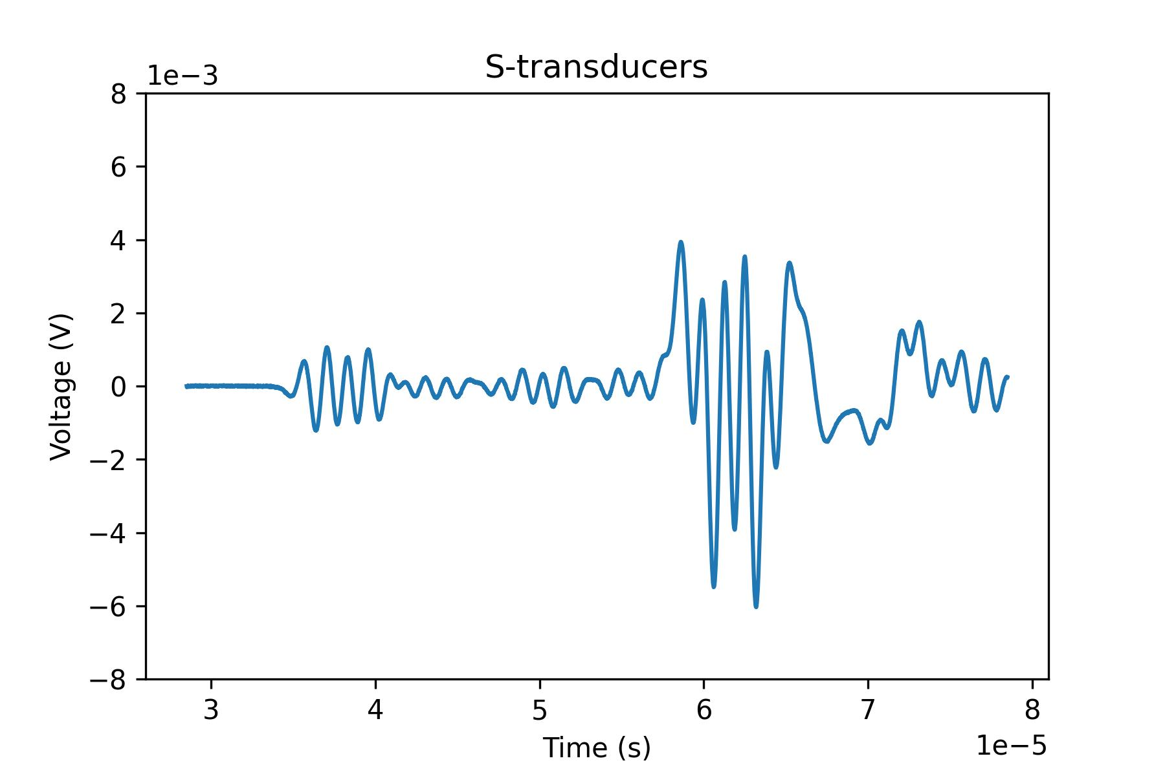
P-Wave
S-Wave

Slide 9
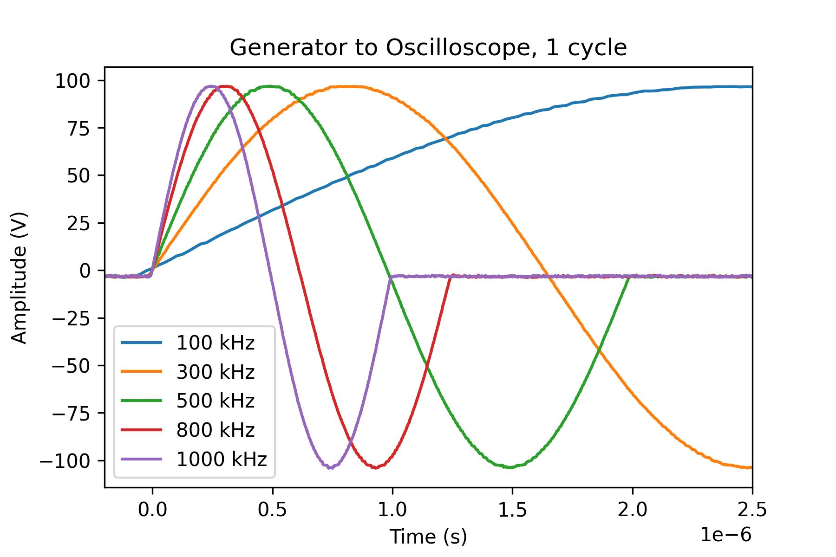
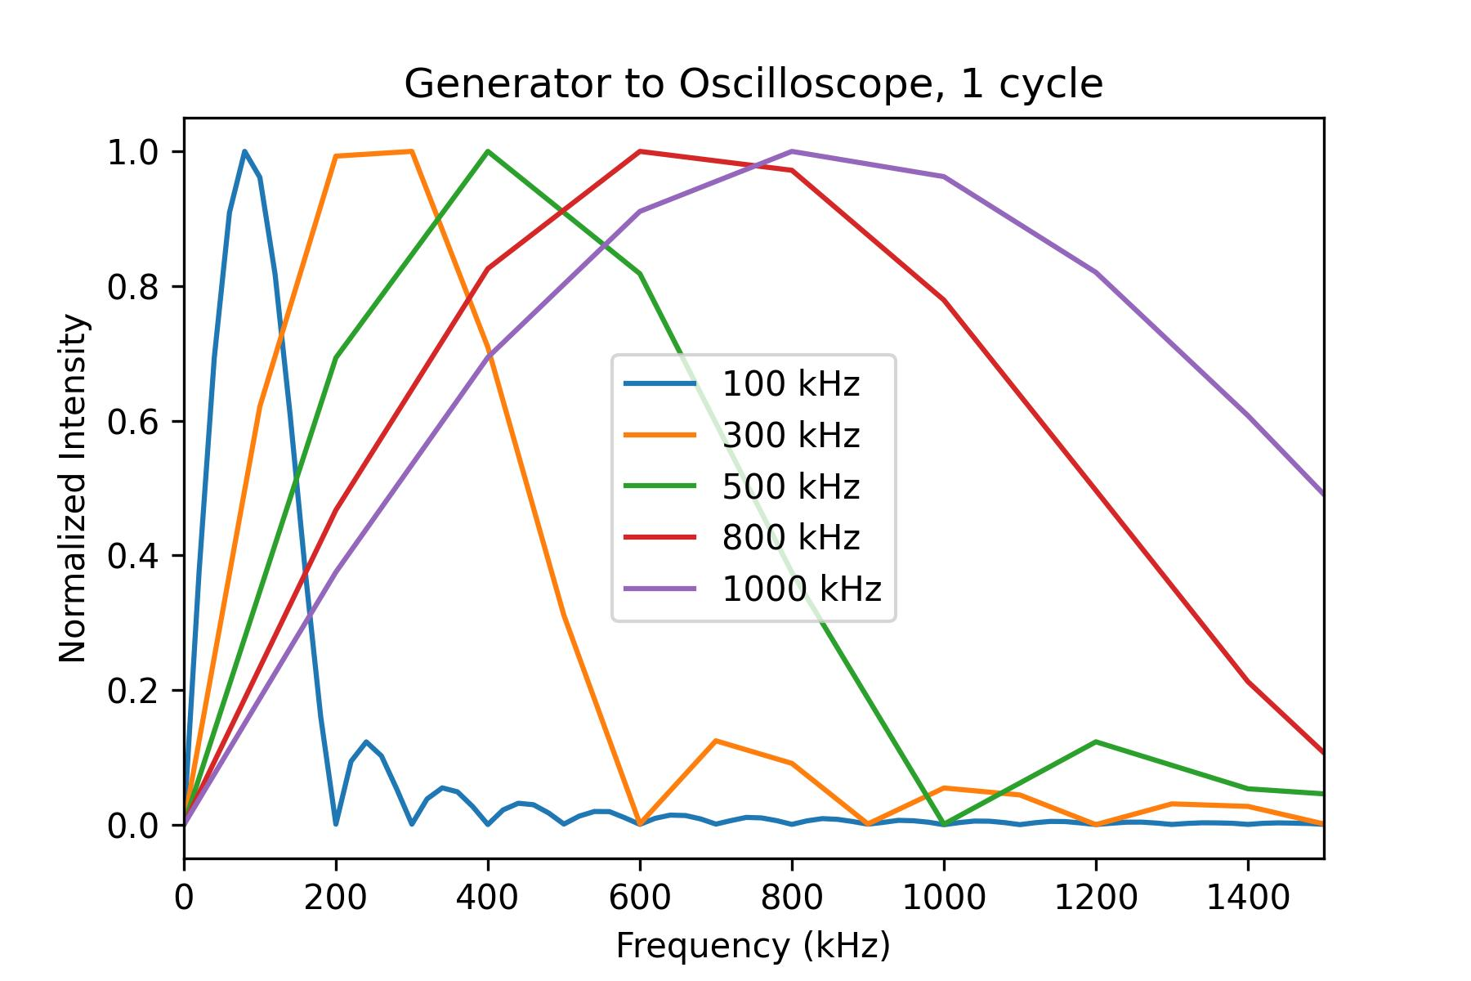
Generator to Oscilloscope, 1 cycle
(A)
(B)

Slide 10
