Slide 1

Net Domestic Migration:
An Analysis of US Migration Patterns 2005 - 2017
Images sourced from Google Images, 2019

Slide 2
QUESTIONS
Using US Census data investigate:
What does net migration look like across the US?
Which states show the most inflow / outflow of people?

Slide 3

METHODOLOGY
DATA RETRIEVAL PROCESS:
Pulled 12 years of spatial and temporal data from the US Census data
CSV was saved, converted to a SQLite database

Slide 4
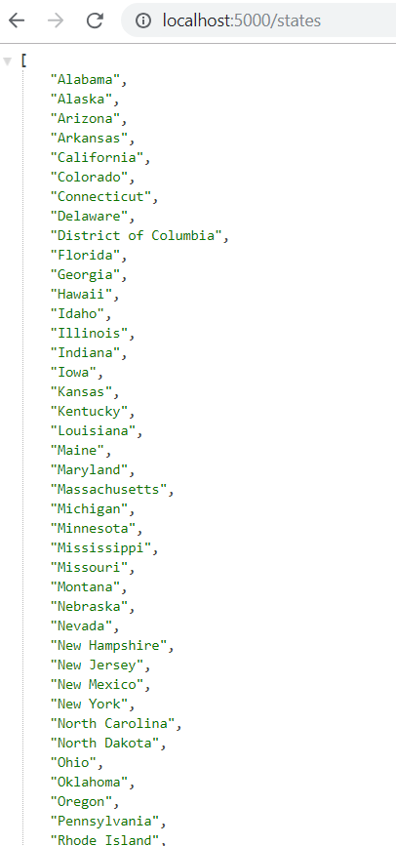
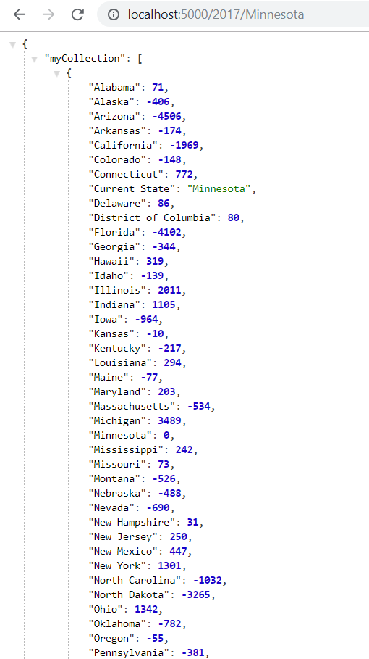
METHODOLOGY
DATA MANIPULATION:
Excel initially used to perform net-migration calculations
Flask routes created from the database for a list of states in the database and migration data for each year for each state
Year summaries were created in javascript from filtered yearly data

Slide 5
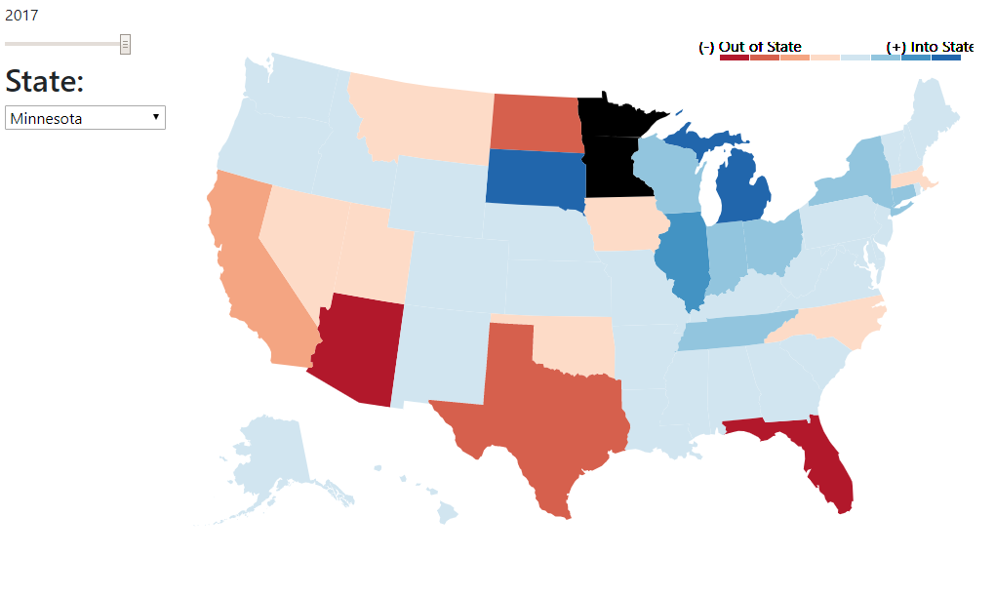
METHODOLOGY
CHLOROPLETH:
JSON for US state geometry was used to draw the base map
Based on an interactive slider and state drop down, the flask route year/state data was plotted on the map to form a D3 chloropleth.
Colors for the positive/negative net state migration data was dynamically generated for each year/state.

Slide 6
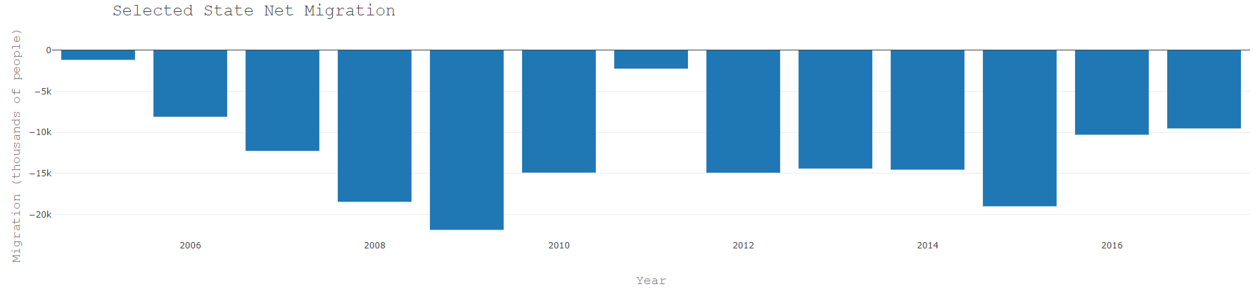
METHODOLOGY
YEAR BAR CHARTS:
Based on the state selected in the drop down the total data flask route was filtered and summed for the selected state.
The selected state migration data was plotted in Plotly over all the years in the data set.

Slide 7
FINDINGS (2005-2017)
The top 5 states to gain population:
Texas (1.47 MM)
Florida (1.08 MM)
North Carolina (850k)
Arizona (810k)
Georgia (558k)
Minnesota was in the bottom quarter losing 161k people
The bottom 5 states losing population:
New York (2.07 MM)
California (1.75 MM)
Illinois (1.16 MM)
New Jersey (915 k)
Michigan (595 k)

Slide 8
Live Demo of Website

