Slide 1
Turn Based Combat
Developed by The Flying Mongooses

Slide 2
Game Mode: Arena
The main mode of the game is an “endless wave”/arena mode.
In this mode, your character will fight increasingly harder ai-controlled enemies, possibly attaining items and equipment in addition to experience, which can then be used in the area itself, in other game modes, or possibly in an in-game online auction house.
Higher level enemies will have better/rarer drops and give more xp, and could be counterbalanced by making defeat more punishing for the player, and incentivizing strategy.
Difficulty: We could do this in a number of ways by utilizing a “run” mechanic. We could also have a character lose xp/items from losing a match. We could make health/status effects more punishing, or even have permadeath (once the character dies, they are gone). This would turn the game more into a roguelike, which could be very interesting. This would also place an even higher price on high level items, as they are simply harder to get.
Auto play: An option for the player to enable at any time will be “auto play”, in which our AI would take over the player’s character, and fight match after match, until the character dies, the character runs out of health items, or the player stops auto play themselves. In between autoruns, the player will likely stock their character’s inventory with helpful items to get them further in the arena. Having this option allows for both casual and direct play.

Slide 3
Game Mode: Online
In the online mode, the only main difference is that the player will always be facing another player’s character. Each person can enable auto play if they wish, but being more observant of the fight should have its benefits.
Matchmaking: We could organize matches between players by their character’s level, number of fights won (offline, online, or both), or by an option of the player’s choosing (direct challenge, certain game rules).
Match rules that could be changeable by the players when making an online custom match: To the death, no items, only spells or weapons or etc., no harm done, and so on.

Slide 4
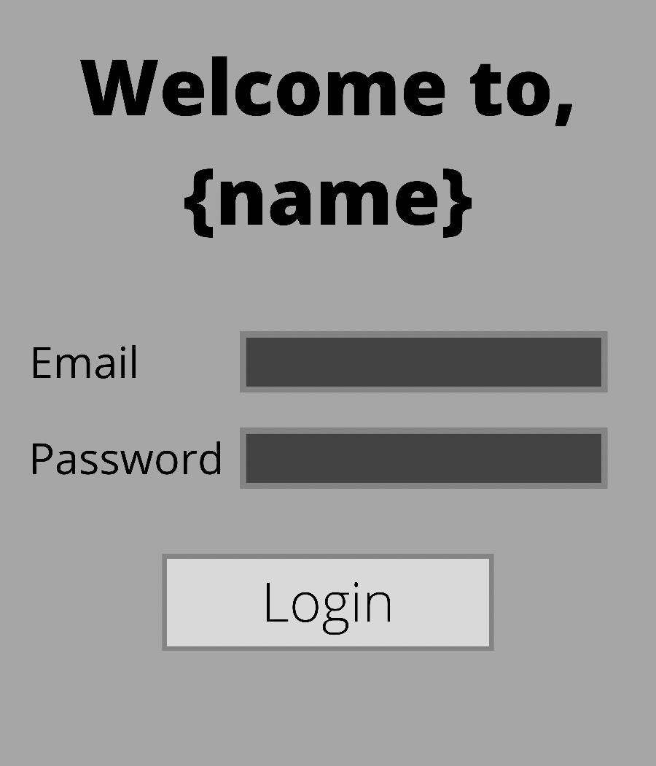
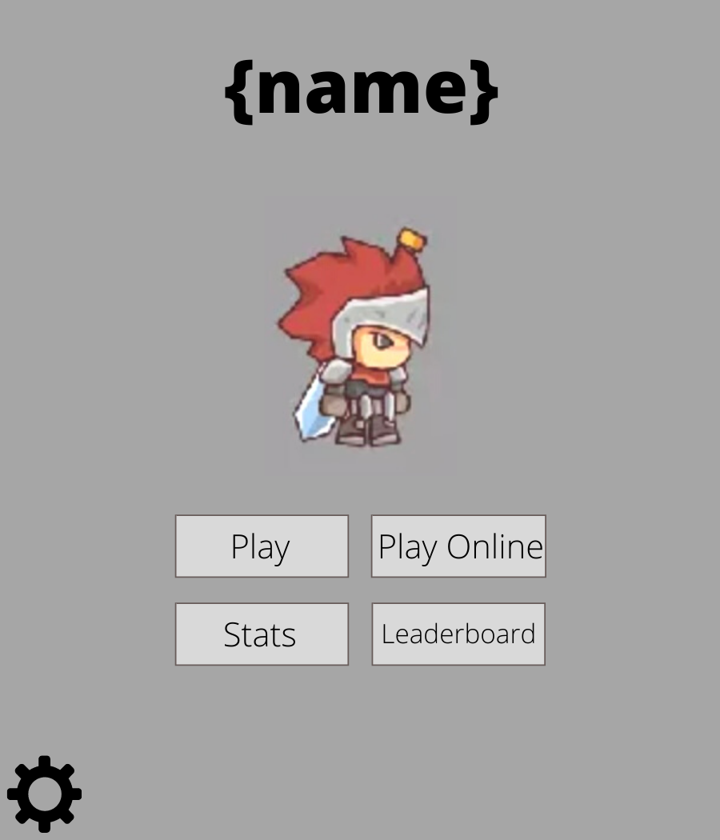
After logging in players will be brought to the home screen which will display their name and an image of their character.
Players can choose ‘Play’ to play against AI or ‘Play Online’ to play against another player
Players can check stats and leaderboard from the home page
When app is first opened the user will be prompted to login to the server.
{name} will be replaced with the name of the game once it is determined.

Slide 5
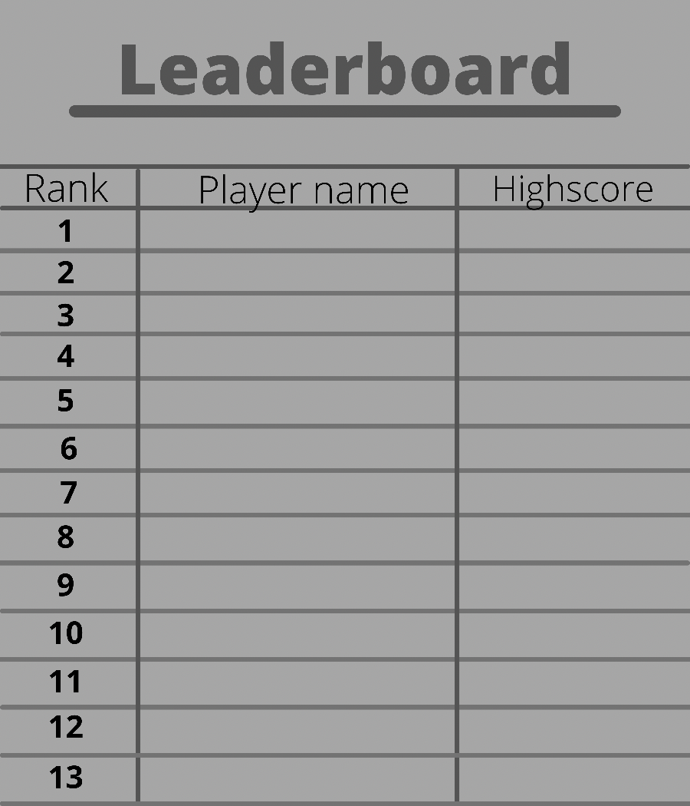
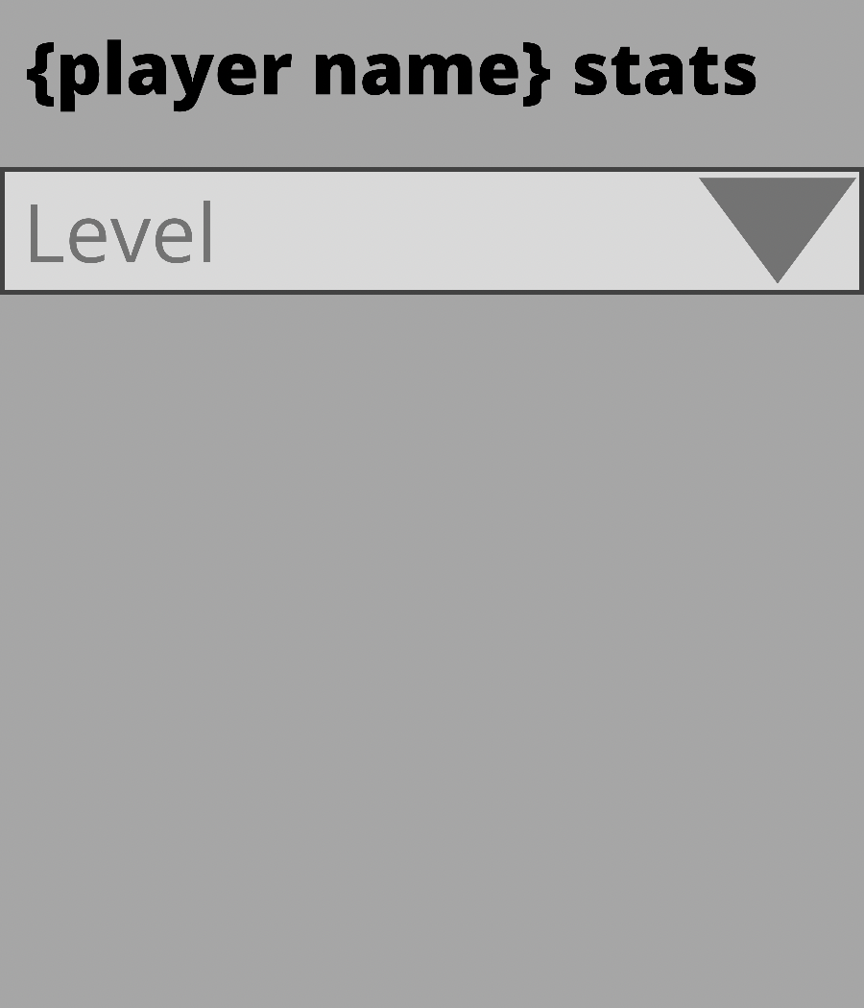
The leaderboard page stores players name and high score from highest to lowest.
The player’s stats page will have a drop-down menu offering player’s several choices to choose from such as each levels stats, combat statistics, and inventory.

Slide 6
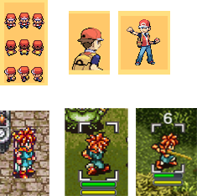
Artstyle: Simplified Pixel-art
Scenario dependent shifts in artstyle
One approach we are considering taking with the project’s artstyle is a pixelated artstyle similar to that of old-school turn-based RPGs such as Pokémon, Chrono Trigger, Final Fantasy, etc. Depending on if we can execute the overworld concept, the artstyle can have two different variations, with much smaller sprites in the overworld, or using universal and consistent sprites across the board.
or
consistent artstyle; despite scenario

Slide 7

Artstyle: Simple Stickmen
If none of us seem to have the artistic prowess for even a simplified pixel artstyle, we can always go down to one of the simplest way of displaying the game through simple stick figures.

Slide 8
The Combat
Turn based, starting with player vs computer.
Potential for randomized enemies with stats based off of preset enemy classes and some form of leveling system.
Turns based on either action points or just single action turns
Player loadouts could affect stats and types of enemies encountered
Enemy Ai based around current player stats and current enemy stats, to attempt to make the best choice for each situation.

Slide 9
The Combat Cont..
Some potential factors include:
A magic system or charging special attack
A leveling system that can affect player stats and enemy stat for future battles
A loot system or skill system where each enemy has a percent chance to drop loot or give bonuses to different abilities.
Damage done, amount of health, and other combat-related factors could be determined by stats such as armor, weapon type, or some form of attribute system, ala Pokémon or rock paper scissors.
The potential to heal at the end of each combat for a fixed amount or percentage, in order to give the best chance for progression.

Slide 10
Online Features
Character saving – able to store character level, inventory, and other statistics server-side
Player vs Player (PVP) – will be able to take characters online and battle other player characters, in either real time (both players at their computers) or with AI piloting one
Leaderboards – Shows high scores and other various statistics of player characters, sorted highest to lowest

Slide 11
Technical Aspects
Character states will be stored server side and will include such things as combat statistics, levels, inventory, as well as leaderboard statistics such as score, kill count, etc
When a player logs in, the client will fetch these stats from the server and present them to the player. On logout, it will save the new character state to the server
The leaderboard will draw stats straight from the server
In PVP, the server will retrieve both character states from the server and then update the states after the battle

