Slide 1
EXECUTIVE BRIEFING
Measuring What Marketing Spend Actually Drives
A validated view of how Search, Social, Direct Mail, and Affiliate spend convert into applications and funded revenue.
TIME HORIZON
CHANNELS MEASURED
VALIDATION
OUTCOMES TRACKED
78 weeks
4 channels
2 live experiments
Apps + Revenue
4 regions, all channels
Search, Social, Direct Mail, Affiliate
Independent market tests
Full funnel, region by region
Ties marketing spend directly to business outcomes, not just clicks or impressions.
Checked against real market experiments, not only historical patterns.
Built to guide budget decisions with a quantified level of confidence.
calmmm executive briefing / 1

Slide 2
THE QUESTION
Is our marketing spend working — and where should the next dollar go?
Across four channels and two outcomes, we need one model that tells us what's driving results, not four disconnected views.
WITHOUT A VALIDATED MODEL
WITH A VALIDATED MODEL
Budget calls rely on gut feel or last-touch attribution.
Spend is tied to applications and revenue, region by region.
No clean way to separate correlation from cause and effect.
Model predictions are checked against real controlled experiments.
Channel performance gets debated, not settled.
A clear, quantified view of what's actually working.
calmmm executive briefing / 2

Slide 3
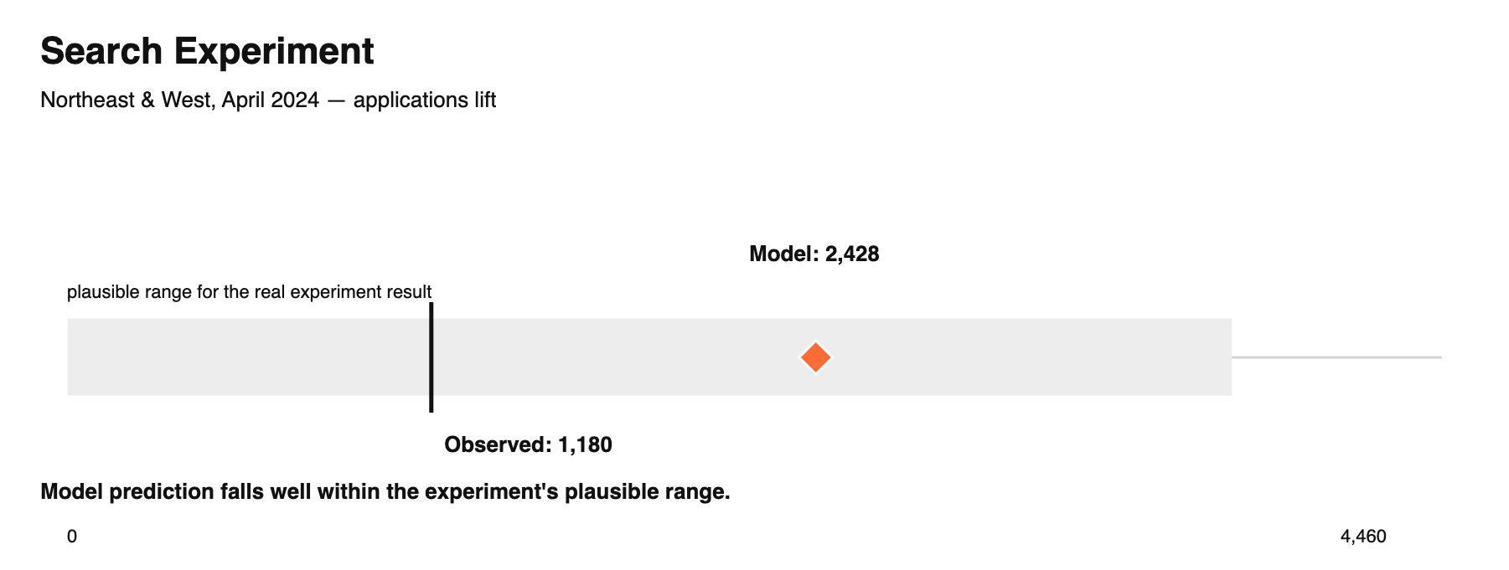
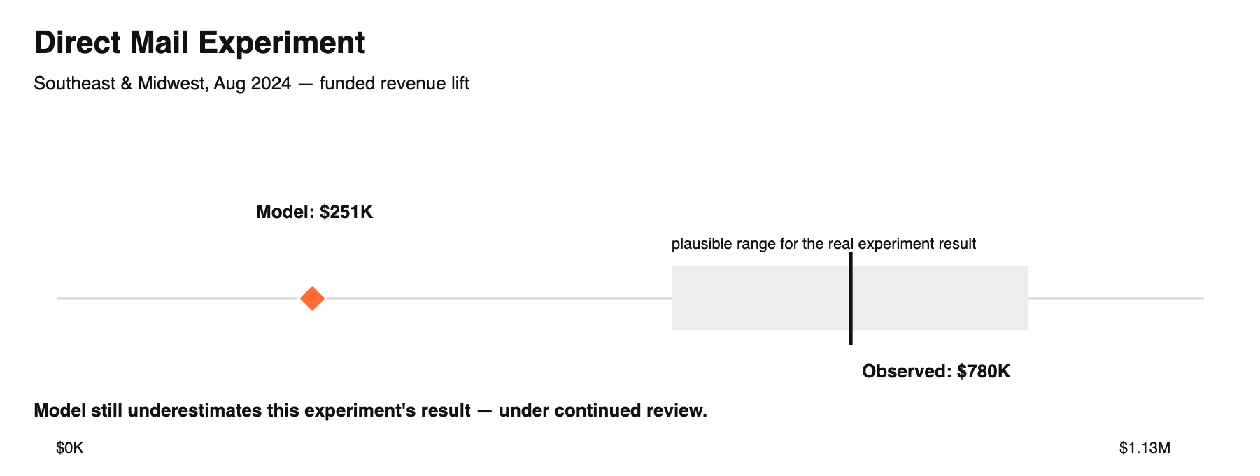
HOW WE VALIDATE
We check the model against real market tests
Two independent experiments — a search geo-holdout and a direct-mail matched-market test — tell us whether the model's math matches what actually happened.
calmmm executive briefing / 3

Slide 4
HEADLINE RESULT
Model accuracy roughly doubled for applications
We fixed how the model incorporated real-world experiment data. The result: substantially more trustworthy predictions, especially for applications.
APPLICATIONS ACCURACY (BEFORE)
APPLICATIONS ACCURACY (NOW)
48%
→
96%
of week-to-week movement explained
of week-to-week movement explained
FUNDED REVENUE ACCURACY
See the next page for what this improvement looks like week by week.
97%
already strong — confirmed stable through this update
calmmm executive briefing / 4

Slide 5
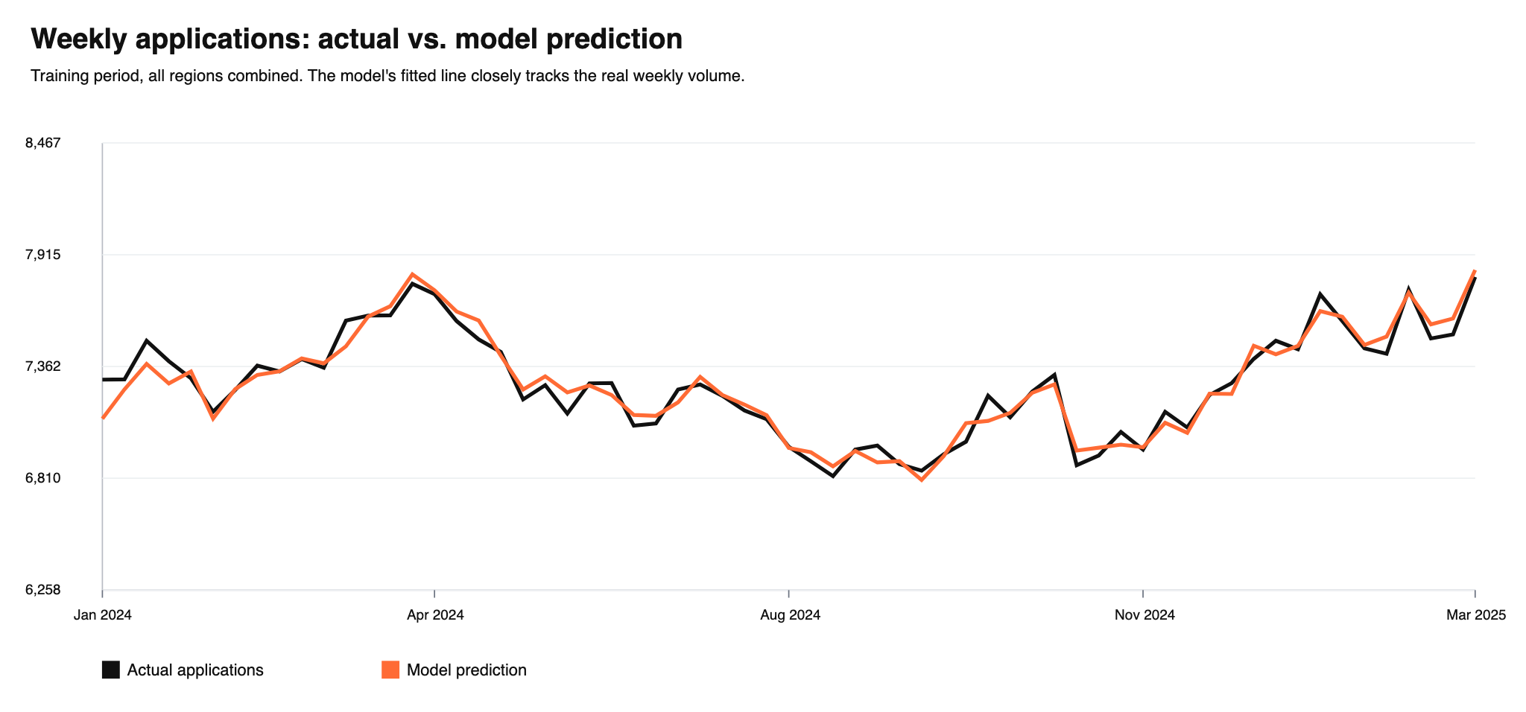
SEE IT WORK
The model's fitted line tracks real application volume
Every week, every region, summed to a national view — this is what a 96% accuracy score looks like in practice.
calmmm executive briefing / 5

Slide 6
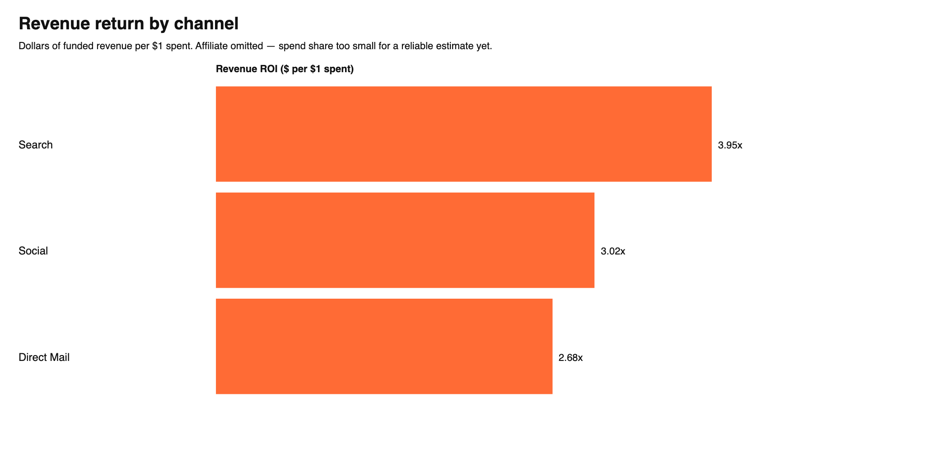
CHANNEL ROI
Search and Social show the strongest validated return
Revenue return per dollar spent, with confidence based on how well each channel's results match independent evidence.
Search & Social: high confidence — confirmed by experiment, stable across the model.
Direct Mail: medium confidence — directionally consistent, still reconciling with its experiment.
Affiliate: excluded — spend share too small for a reliable estimate yet.
calmmm executive briefing / 6

Slide 7
RECOMMENDATION
Use these results to guide Search and Social budget now
Direct Mail and Affiliate need one more validation cycle before we act on their numbers.
Shift incremental budget testing toward Search and Social, where the model and the live experiment agree.
Hold Direct Mail budget decisions to directional guidance only, until the next validation check closes the gap.
Commission a small experiment for Affiliate and Social to bring them to the same confidence level as Search.
Refresh this model each quarter as new experiment data lands.
calmmm executive briefing / 7

