Slide 1
CS 205M: Lecture 4 Comparing Infinities and Hopefully (Intro to Propositional Logic)

Slide 2

Comparing Infinities:
Countable vs Uncountable Sets
More precisely, we see how do we compare cardinalities (“sizes”) of infinite sets.
Infinite Sets- Sets containing infintely many distinct elements.
E.g. ℕ, {x : x|2} (set of even nos.).
Comparing cardinalities of finite set: Trivial. To check: |S| ≤ |S’|-
Count no. of elements in S (say k) and,
S’ (say k’). Is k ≤ k’?

Slide 3
Abstracting Notion of Comparing Sizes:
- Beyond the notion of counting.
“Universal” Carnival/Mela

Slide 4


Abstracting Notion of Comparing Sizes:
- Beyond the notion of counting.
“Universal” Carnival/Mela
.
.
.

Slide 5




Abstracting Notion of Comparing Sizes:
- Beyond the notion of counting.
“Universal” Carnival/Mela
.
.
.
.
.
.

Slide 6
Abstracting Notion of Comparing Sizes:
- Beyond the notion of counting.
“Universal” Carnival/Mela
.
.
.
.
.
.

Slide 7

Abstracting Notion of Comparing Sizes:
- Beyond the notion of counting.
“Universal” Carnival/Mela
.
.
.
.
.
.

Slide 8
Abstracting Notion of Comparing Sizes:
- Beyond the notion of counting.
“Universal” Carnival/Mela
.
.
.
.
.
.

Slide 9

Abstracting Notion of Comparing Sizes:
- Beyond the notion of counting.
“Universal” Carnival/Mela
.
.
.
.
.
.

Slide 10
Abstracting Notion of Comparing Sizes:
- Beyond the notion of counting.
If there is an injective function from
set of Kids to
set of Ice-creams then
“Universal” Carnival/Mela
.
.
.
.
.
.

Slide 11
Abstracting Notion of Comparing Sizes:
- Beyond the notion of counting.
If there is an injective function from
set of Kids to
set of Ice-creams then
“Universal” Carnival/Mela
≤
|Kids|
|Ice-creams|
.
.
.
.
.
.

Slide 12
Abstracting Notion of Comparing Sizes:
- Beyond the notion of counting.
If there is an injective function from
set of Kids to
set of Ice-creams then
“Universal” Carnival/Mela
|Kids|
=
|Ice-creams|
≤
|Kids|
|Ice-creams|
iff
|Kids|
≤
|Ice-creams| and
|Ice-creams|
≤
|Kids|
.
.
.
.
.
.

Slide 13
No. of Naturals vs. No. of Rationals?
|ℕ| < |ℚ|?

Slide 14
No. of Naturals vs. No. of Rationals?
|ℕ| ≤ |ℚ| - Trivial - Map every natural no. to itself.
|ℚ| ≤ |ℕ| ?
F: ℚ ↦ ℕ². F(p/ q) = (p, q). Hence, |ℚ| ≤ |ℕ²|.
G: ℕ² ↦ ℕ. G((p, q)) = 2^{p} × 3^{q}. Notice that if (p′, q′) ≠ (p, q) then G((p′, q′)) ≠ G((p, q)) (Unique Prime Factorization)
In fact one could show that for any finite sequence of natural numbers (a₁, …, a_{n}), we can associate a unique integer 2^{a1} × 3^{a2} × … × k^{an}, where k is the n^{th} prime.

Slide 15
|ℕ| ≤ |ℝ|?
No. of Naturals vs. No. of Reals?
|ℕ| ≤ |ℝ| - Trivial - Map every natural no. to itself. n₁
|ℝ| ≤ |ℕ| ? Assume yes. This implies, F: [0,1) ↦ ℕ, and F is an injective function.
. . .
. . .
. . .
. . .
. . .
n₁ | ^{m}1,1 | ^{m}1,2 | ^{m}1,3 | . | . | . | . | . | . | . | . | . | . | . | . | . | . | . | . | .
n₂ | ^{m}2,1 | ^{m}2,2 | ^{m}2,3 | . | . | . | . | . | . | . | . | . | . | . | . | . | . | . | . | .
n₃ | ^{m}3,1 | ^{m}3,2 | ^{m}3,3 | . | . | . | . | . | . | . | . | . | . | . | . | . | . | . | . | .
n₄ | ^{m}4,1 | ^{m}4,2 | ^{m}4,3 | ^{m}4,4 | ^{m}4,5 | . . | . . | . . | . . | . . | . . | . . | . . | . . | . . | . . | . . | . . | . . | . .
n5 | ^{m}5,1 | ^{m}5,2 | ^{m}5,3 | ^{m}5,4 | ^{m}5,5

Slide 16

|ℕ| ≤ |ℝ|?
No. of Naturals vs. No. of Reals?
|ℕ| ≤ |ℝ| - Trivial - Map every natural no. to itself. n₁
|ℝ| ≤ |ℕ| ? Assume yes. This implies, F: [0,1) ↦ ℕ, and F is an injective function.
. . .
. . .
. . .
. . .
. . .
n₁ | ^{m}1,1 | ^{m}1,2 | ^{m}1,3 | . | . | . | . | . | . | . | . | . | . | . | . | . | . | . | . | .
n₂ | ^{m}2,1 | ^{m}2,2 | ^{m}2,3 | . | . | . | . | . | . | . | . | . | . | . | . | . | . | . | . | .
n₃ | ^{m}3,1 | ^{m}3,2 | ^{m}3,3 | . | . | . | . | . | . | . | . | . | . | . | . | . | . | . | . | .
n₄ | ^{m}4,1 | ^{m}4,2 | ^{m}4,3 | ^{m}4,4 | ^{m}4,5 | . . | . . | . . | . . | . . | . . | . . | . . | . . | . . | . . | . . | . . | . . | . .
n5 | ^{m}5,1 | ^{m}5,2 | ^{m}5,3 | ^{m}5,4 | ^{m}5,5

Slide 17
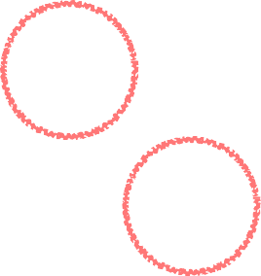
|ℕ| ≤ |ℝ|?
No. of Naturals vs. No. of Reals?
|ℕ| ≤ |ℝ| - Trivial - Map every natural no. to itself. n₁
|ℝ| ≤ |ℕ| ? Assume yes. This implies, F: [0,1) ↦ ℕ, and F is an injective function.
. . .
. . .
. . .
. . .
. . .
n₁ | ^{m}1,1 | ^{m}1,2 | ^{m}1,3 | . | . | . | . | . | . | . | . | . | . | . | . | . | . | . | . | .
n₂ | ^{m}2,1 | ^{m}2,2 | ^{m}2,3 | . | . | . | . | . | . | . | . | . | . | . | . | . | . | . | . | .
n₃ | ^{m}3,1 | ^{m}3,2 | ^{m}3,3 | . | . | . | . | . | . | . | . | . | . | . | . | . | . | . | . | .
n₄ | ^{m}4,1 | ^{m}4,2 | ^{m}4,3 | ^{m}4,4 | ^{m}4,5 | . . | . . | . . | . . | . . | . . | . . | . . | . . | . . | . . | . . | . . | . . | . .
n5 | ^{m}5,1 | ^{m}5,2 | ^{m}5,3 | ^{m}5,4 | ^{m}5,5

Slide 18
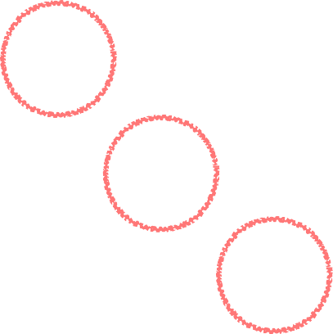
|ℕ| ≤ |ℝ|?
No. of Naturals vs. No. of Reals?
|ℕ| ≤ |ℝ| - Trivial - Map every natural no. to itself. n₁
|ℝ| ≤ |ℕ| ? Assume yes. This implies, F: [0,1) ↦ ℕ, and F is an injective function.
. . .
. . .
. . .
. . .
. . .
n₁ | ^{m}1,1 | ^{m}1,2 | ^{m}1,3 | . | . | . | . | . | . | . | . | . | . | . | . | . | . | . | . | .
n₂ | ^{m}2,1 | ^{m}2,2 | ^{m}2,3 | . | . | . | . | . | . | . | . | . | . | . | . | . | . | . | . | .
n₃ | ^{m}3,1 | ^{m}3,2 | ^{m}3,3 | . | . | . | . | . | . | . | . | . | . | . | . | . | . | . | . | .
n₄ | ^{m}4,1 | ^{m}4,2 | ^{m}4,3 | ^{m}4,4 | ^{m}4,5 | . . | . . | . . | . . | . . | . . | . . | . . | . . | . . | . . | . . | . . | . . | . .
n5 | ^{m}5,1 | ^{m}5,2 | ^{m}5,3 | ^{m}5,4 | ^{m}5,5

Slide 19

|ℕ| ≤ |ℝ|?
No. of Naturals vs. No. of Reals?
|ℕ| ≤ |ℝ| - Trivial - Map every natural no. to itself. n₁
|ℝ| ≤ |ℕ| ? Assume yes. This implies, F: [0,1) ↦ ℕ, and F is an injective function.
. . .
. . .
. . .
. . . . . . . . . . . . . . . . . .
. . .
n₁
^{m}1,1
^{m}1,2
^{m}1,3
.
.
.
.
.
.
.
.
.
.
.
.
.
.
.
.
.
n₂
^{m}2,1 ^{m}2,2 ^{m}2,3
.
.
.
.
.
.
.
.
.
.
.
.
.
.
.
.
.
n₃
^{m}3,1
^{m}3,2
^{m}3,3
.
.
.
.
.
.
.
.
.
.
.
.
.
.
.
.
.
n₄
^{m}4,1
^{m}4,2
^{m}4,3
^{m}4,4
^{m}4,5
n₅
^{m}5,1
^{m}5,2
^{m}5,3
^{m}5,4
^{m}5,5
.
.
.
.
.
.
.
.
.
.
.
.
.
.
.

Slide 20

|ℕ| ≤ |ℝ|?
No. of Naturals vs. No. of Reals?
|ℕ| ≤ |ℝ| - Trivial - Map every natural no. to itself. n₁
|ℝ| ≤ |ℕ| ? Assume yes. This implies, F: [0,1) ↦ ℕ, and F is an injective function.
. . .
. . .
. . .
. . . . . . . . . . . . . . . . . .
. . .
n₁
^{m}1,1
^{m}1,2
^{m}1,3
.
.
.
.
.
.
.
.
.
.
.
.
.
.
.
.
.
n₂
^{m}2,1 ^{m}2,2 ^{m}2,3
.
.
.
.
.
.
.
.
.
.
.
.
.
.
.
.
.
n₃
^{m}3,1
^{m}3,2
^{m}3,3
.
.
.
.
.
.
.
.
.
.
.
.
.
.
.
.
.
n₄
^{m}4,1
^{m}4,2
^{m}4,3
^{m}4,4
^{m}4,5
n₅
^{m}5,1
^{m}5,2
^{m}5,3
^{m}5,4
^{m}5,5
.
.
.
.
.
.
.
.
.
.
.
.
.
.
.

Slide 21

|ℕ| ≤ |ℝ|?
No. of Naturals vs. No. of Reals?
|ℕ| ≤ |ℝ| - Trivial - Map every natural no. to itself. n₁
|ℝ| ≤ |ℕ| ? Assume yes. This implies, F: [0,1) ↦ ℕ, and F is an injective function.
. . .
. . .
. . .
. . . . . . . . . . . . . . . . . .
. . .
n₁
^{m}1,1
^{m}1,2
^{m}1,3
.
.
.
.
.
.
.
.
.
.
.
.
.
.
.
.
.
n₂
^{m}2,1 ^{m}2,2 ^{m}2,3
.
.
.
.
.
.
.
.
.
.
.
.
.
.
.
.
.
n₃
^{m}3,1
^{m}3,2
^{m}3,3
.
.
.
.
.
.
.
.
.
.
.
.
.
.
.
.
.
n₄
^{m}4,1
^{m}4,2
^{m}4,3
^{m}4,4
^{m}4,5
n₅
^{m}5,1
^{m}5,2
^{m}5,3
^{m}5,4
^{m}5,5
.
.
.
.
.
.
.
.
.
.
.
.
.
.
.
Add 1 modulo 10.

Slide 22
|ℕ| ≤ |ℝ|?
No. of Naturals vs. No. of Reals?
|ℕ| ≤ |ℝ| - Trivial - Map every natural no. to itself. n₁
|ℝ| ≤ |ℕ| ? Assume yes. This implies, F: [0,1) ↦ ℕ, and F is an injective function.
. . .
. . .
. . .
. . . . . . . . . . . . . . . . . .
. . .
n₁
^{m}1,1
^{m}1,2
^{m}1,3
.
.
.
.
.
.
.
.
.
.
.
.
.
.
.
.
.
n₂
^{m}2,1 ^{m}2,2 ^{m}2,3
.
.
.
.
.
.
.
.
.
.
.
.
.
.
.
.
.
n₃
^{m}3,1
^{m}3,2
^{m}3,3
.
.
.
.
.
.
.
.
.
.
.
.
.
.
.
.
.
n₄
^{m}4,1
^{m}4,2
^{m}4,3
^{m}4,4
^{m}4,5
n₅
^{m}5,1
^{m}5,2
^{m}5,3
^{m}5,4
^{m}5,5
.
.
.
.
.
.
.
.
.
.
.
.
.
.
.
Add 1 modulo 10.
The new no. differs from i^{th} number at i^{th} digit. Hence, entirely new number, violating the assumtion.

Slide 23

In General,
|X | < | 2^{X} |, trivial for finite sets. For infinite sets,
Let X = {n₁, n₂, …}
n₁ n₂ n₃
. . .
. . .
. . .
. . .
. . .
N1
^{m}1,1
^{m}1,2
^{m}1,3
.
.
.
.
.
.
.
.
.
.
.
.
.
.
.
.
.
N2
^{m}2,1 ^{m}2,2 ^{m}2,3
.
.
.
.
.
.
.
.
.
.
.
.
.
.
.
.
.
N3
^{m}3,1
^{m}3,2
^{m}3,3
.
.
.
.
.
.
.
.
.
.
.
.
.
.
.
.
.
N4
^{m}4,1
^{m}4,2
^{m}4,3
. . . . . . . . . . . . . . .
^{m}4,4
^{m}4,5
N5
^{m}5,1
^{m}5,2
^{m}5,3
^{m}5,4
^{m}5,5
.
.
.
.
.
.
.
.
.
.
.
.
.
.
.
m_{i,j}s are either 0 or 1.
Flip 0s and 1s.

Slide 24
Why Study Logic?
Foundation of mathematics and computer science
Helps in:
Designing circuits
Writing correct software (specifications and verification)
Constructing valid arguments and proofs
Used in AI, algorithms, databases, security protocols, and more

Slide 25
Propositions.
Building Blocks of Logics. That is why, it is also called as atoms.
Proposition: A declarative sentence that is either true or false, but not both.
Examples:
"The Earth is round." ✔ (Proposition)
"2 + 2 = 5" ✔ (Proposition)
"Close the door." ✘ (Not a proposition)
"x + 3 > 5" ✘ (Depends on x; not a proposition unless x is defined)

Slide 26
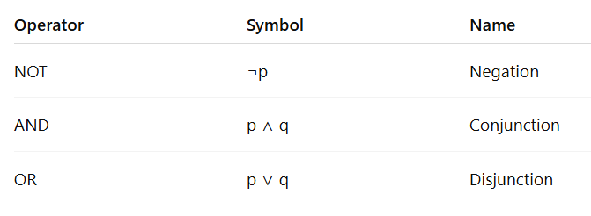
Logical Operators: ∧, ∨, ¬

Slide 27
Logical Operators: ∧, ∨, ¬
Examples:
¬(2 < 3) ⇒ False
(2 > 1) ∧ (4 = 4) ⇒ True
(5 > 10) ∨ (3 = 3) ⇒ True

Slide 28
Logical Operators: ∧, ∨, ¬
Examples:
Conjunction (AND) – p ∧ q : "It is raining and it is cold.“ True only if both are true.
Disjunction (OR) – p ∨ q: "I will go for a walk or I will stay home.“ True if either (or both) happen.
Negation (NOT) – ¬p: "It is not raining.“ True if the statement "it is raining" is false.

Slide 29
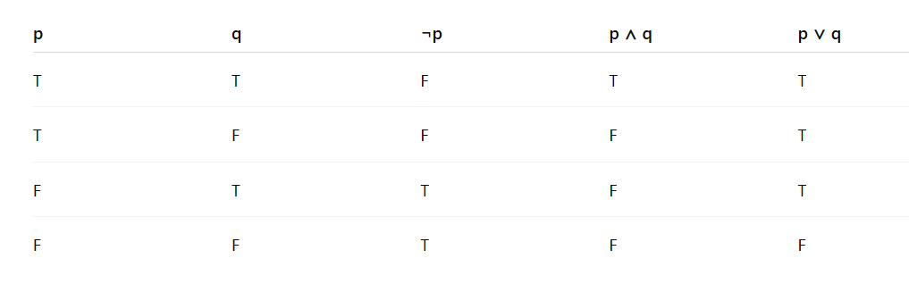
Truth Tables.

Slide 30
Truth Tables.

Slide 31
Truth Tables.

Slide 32
Truth Tables.

Slide 33
Implication: →
If it rains, then the ground is wet.
When is the above statement false?

Slide 34
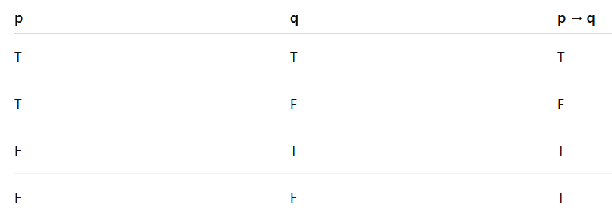
Implication: →
p → q: “If p, then q”
False only when p is true and q is false.

Slide 35
Bi-implication, if and only if: →
It rains if and only if the ground is wet.
When is the above statement false?

Slide 36
Bi-implication, ↔
p ↔ q: “p if and only if q”, p → q and q → p
True when both p and q are same.
p ↔ q
F

Slide 37
Propositions to Bits – Bitwise Logic
Propositions can be represented as bits: T → 1, F → 0
Logical operations correspond to bitwise operators.
p | q | p ∧ q | p ∨ q | ¬p
1 | 0 | 0 | 1 | 0
1 | 1 | 1 | 1 | 0
Bitwise Ops: AND: 0101 & 1100 = 0100, OR: 0101 | 1100 = 1101, NOT: ~0101 = 1010 (bitwise complement)

Slide 38
Equivalence of Boolean Expressions: Next Class

