Slide 1
DA 351 Computer Systems
The Infantry School, MHOW, MP, INDIA
-Dr. Khushraj Nanik Madnani
Asst. Prof., Dept. of CSE, IIT Guwahati

Slide 2
What is a Computer?
A computer is a machine that solves problems by taking inputs, processing them according to instructions, and producing outputs.
A computer is not just a laptop or desktop—it can be a smartphone, ECU of a car, a tank, or a controller of a UAV.
Even though these computers look very different, they all follow some similar principles for representing data, executing instructions, managing resources, and communicating with the outside world.

Slide 3
What is this Course about
Combination of three different courses:
Computer Organization: Components of a computer and its organization.
Operating Systems: The manager deciding how those components of the computers will be used for performing different tasks.
Computer Networks: Going beyong a single agent (a computer) to a society (a network of computers).
Let’s understand this via Human <-> Computer Analogy.

Slide 4
Levels of existence of an individual
Body and Senses
Mind
Breath
Intellect
Memory
Ego
Self/Soul/Consciousness

Slide 5
Aspects of Individuals as problem solver
Body and Senses
Mind
Breath
Intellect
Memory
Ego
Self/Soul/Conciousness

Slide 6
Aspects of Individuals as problem solver
Body: Knowledge Senses (Ears, Tongue, etc.), Action Senses (Speech, movement etc.)
Mind: Analysis, complex computations, calculations etc.
Breath
Intellect: The decision making part (what is safe/unsafe, appropriate/inappropriate etc.)
Memory: Used to remember the perceived information.
Ego
Self/Soul/Conciousness

Slide 7
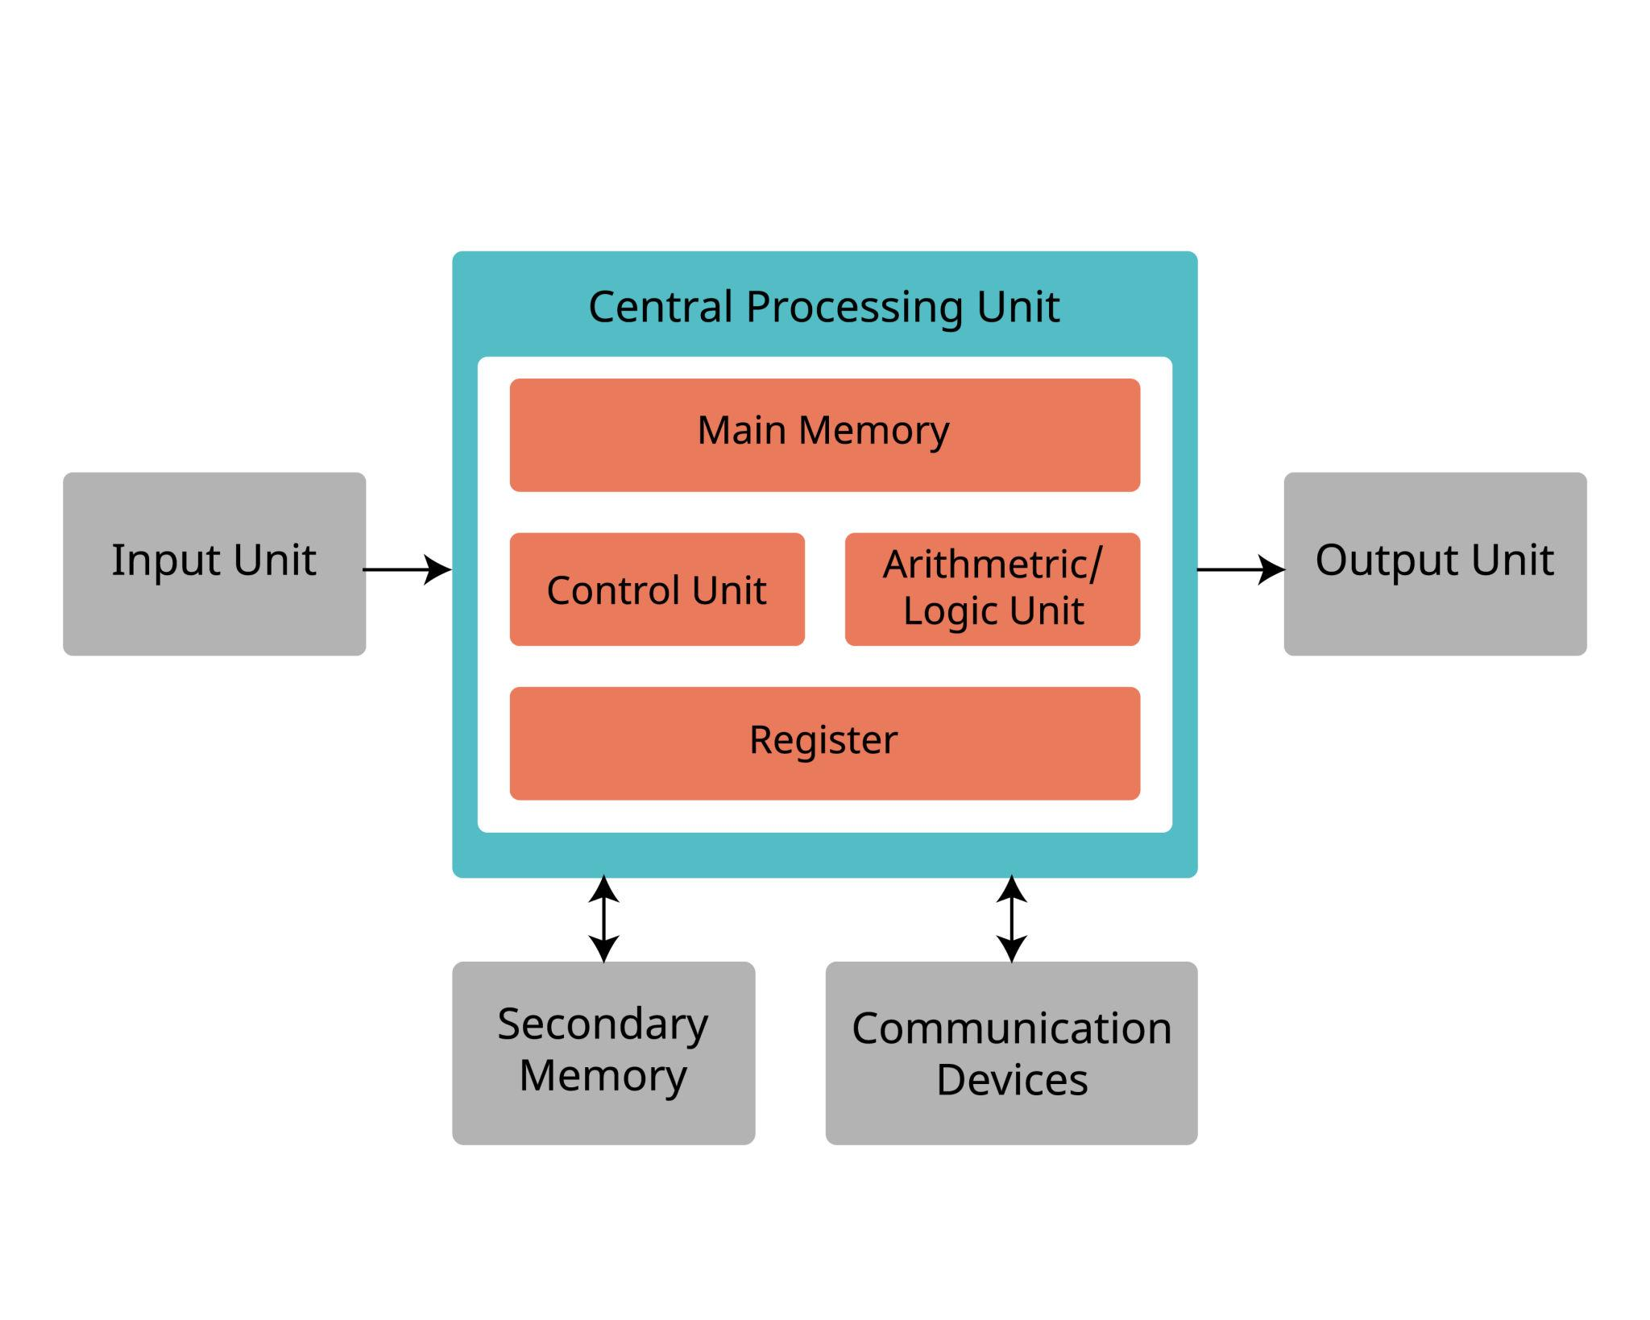
Computer Organization
Study of Senses-Mind-Memory interaction of a computer.
Mind
Knowledge Senses
Action Senses
Memory

Slide 8

Operating Systems
Study of a special software that decides and manages the working of Mind, Memory, Senses – The intellect.
Operating Systems: Control and Coordinate
Mind
Knowledge Senses
Action Senses
Memory

Slide 9
Operating Systems
The operating system is not part of the computation — it is the system that controls access to computation
Operating Systems: Control and Coordinate
Mind
Knowledge Senses
Action Senses
Memory

Slide 10

From Individuals to Society
In computer networks, we abstract away the internal behavior of individual computers
and study the interaction among independent agents. The fundamental problems we begin with are:
Protocols – rules of interaction
Congestion – delay and loss
Communication medium
… and related issues such as routing, reliability, and security

Slide 11
Data Representation
Information from a Finite Alphabet(English alphabet analogy)
English uses a finite alphabet of 26 letters. Yet we can form infinitely many words and sentences
Meaning comes from:symbols ordering context
A small set of symbols can express unbounded information.
Systems parallel:
Computers use a very small alphabet — {0,1} — to represent all information.

Slide 12
Bits as an Alphabet
A bit is a symbol with two possible values 0 or 1
Bit strings are sequences over a binary alphabet
Any information can be encoded as:text, numbers, images, programs
Key idea:
Bits are not data; bit patterns become data through interpretation.

Slide 13
Binary and Decimal: Intuitive Mapping
Decimal | Binary
0 | 0
1 | 1
2

Slide 14
Binary and Decimal: Intuitive Mapping
Decimal | Binary
0 | 0
1 | 1
2 | 10

Slide 15
Binary and Decimal: Intuitive Mapping
Decimal | Binary
0 | 0
1 | 1
2 | 10
3

Slide 16
Binary and Decimal: Intuitive Mapping
Decimal | Binary
0 | 0
1 | 1
2 | 10
3 | 11

Slide 17
Binary and Decimal: Intuitive Mapping
Decimal | Binary
0 | 0
1 | 1
2 | 10
3 | 11
4 | 100

Slide 18
Binary and Decimal: Intuitive Mapping
Decimal | Binary
0 | 0
1 | 1
2 | 10
3 | 11
4 | 100
5 | 101
… | …

Slide 19
Binary and Decimal: Intuitive Mapping
Binary is base-2, decimal is base-10
  Decimal (Base-10). Each position is a multiplier of 10. Example broken down explicitly:
  decimal 123 = 1×10² + 2×10¹ + 3×10⁰
  Binary (Base-2) Same idea, different base. Each position is a multiplier of 2. Example:
  binary 101 = 1×2² + 0×2¹ + 1×2⁰ = 5 in decimal
Position determines value
Same idea, different base
Intuition:
Binary numbers count the same way — they just run out of symbols faster.

Slide 20
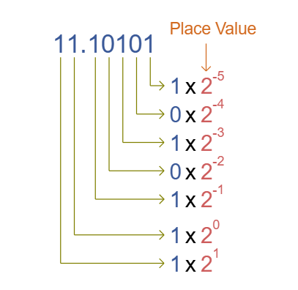
Binary and Decimal for rationals

Slide 21

Why Study Data Representation?
The system used a 24-bit fixed-point register to store time in tenths of a second and then convert it to seconds.
The value 1/10, which has a non-terminating binary representation, was chopped at 24 bits, introducing a small error.
Error of 0.34 s in every 100 hours
Caused failure to intercept Scud missile
28 soldiers killed in Dhahran, Saudi Arabia
Patriot Missile Defence System Failure,
Gulf War 1991

Slide 22
Why Only Two Symbols?
Physical systems are imperfect: voltages fluctuates, signals degrade, noise is unavoidable. Using only two symbols allows us to represent information robustly.
Binary Representation: Two well-separated voltage levels
LOW voltage → 0 HIGH voltage → 1
  Large separation ⇒ high noise margin: Small fluctuations do not change the interpreted value
  Enables reliable storage, transmission, and computation
Multi-level Representation (More than two symbols): Multiple closely spaced voltage levels. Small fluctuations can shift a signal into a neighbouring level cause misinterpretation. Requires precise hardware and tight control. More susceptible to errors.
Key Insight:
Binary is chosen not for expressiveness, but for reliability.

Slide 23
What Is a Processor?
A Processor is the “mind” of a computer. A processor is the core component of a computer system that:
Executes "basic” instructions
Operates on data
Controls the flow of computation – to execute complex instruction using a set of basic instructions.

Slide 24
What Is a Processor?
At a high level, a processor consists of:
  Circuit elements to compute some basic set of operations, and
  Registers (fast local temporary memory) - not to be confused with the main memory.
  Clock (timing mechanism)
The processor interacts with main memory, but does not store programs permanently.
Analogy: The processor is the “mind” of the system — it executes actions, but relies on memory to remember.

Slide 25
What Does a Processor Contain?
Control Unit (CU): decides which operation to perform and when.
Arithmetic & Logic Unit (ALU): performs arithmetic and logical operations
Registers: small, fast storage inside the processor
Clock: provides a global notion of time
Interfaces to Memory and I/O: Provides connections to “memory” and “I/O”.

Slide 26
Basic Terms: Clock and Instructions
Clock: Generates periodic pulses. Each pulse is a clock cycle. This is the smallest unit of a time.
Clock Speed: Number of cycles per second (e.g., GHz).
Instruction: A single operation executed by the processor.
Instruction Set: Collection of all instructions the processor understands.
Program: A sequence of instructions from this instruction set.

Slide 27
Instruction Set Architecture (ISA)
The Instruction Set Architecture (ISA) defines:
a set of “basic” instructions supported by the processor
the behavior of each instruction
how data is represented and accessed
how memory and computation interact
Key idea: The ISA is a contract between software and hardware.

Slide 28
Example: Assembly Instructions
LOAD R1, A ; load value of A into register R1
LOAD R2, B ; load value of B into register R2
ADD R3, R1, R2 ; R3 = R1 + R2
STORE R3, C ; store result into C
Complex programs are built from simple instructions.

Slide 29
How Long Does an Instruction Take?
Instruction execution involves:
  Fetch (take input)
  Decode
  Execute
  Memory access (if needed)
  Write back (output)
These steps are synchronized using the clock.
An instruction may take multiple clock cycles.

Slide 30
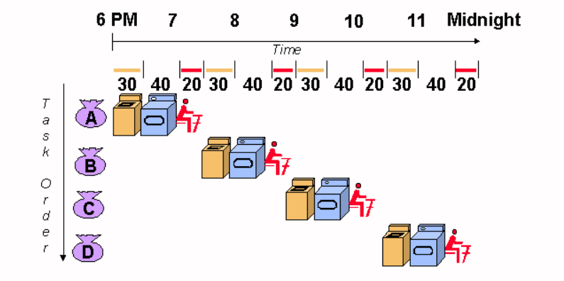
Washing Clothes

Slide 31
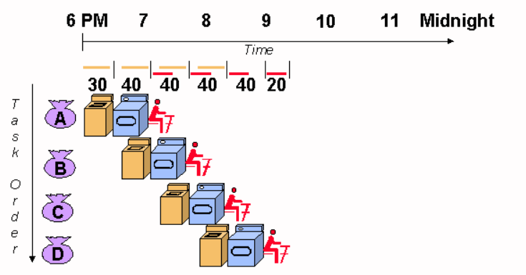
A Faster way to do things

Slide 32
Sequential Execution (Without Pipelining)
Instruction 1: | F | D | E | M | W |
Instruction 2: | F | D | E | M | W |
Instruction 3: | F | D | E | M | W |
Instruction 4: | F | D | E | M | W |
Total time = 4 × 5 = 20 cycles

Slide 33
Idea of Pipelining
Pipelining overlaps instruction execution:
  While one instruction executes
  Another can be decoded
  Another can be fetched and so on…
Key idea: Pipelining improves throughput, not individual instruction latency.

Slide 34
Pipelined Execution
Cycle: 1 2 3 4 5 6 7 8
Instr 1: F | D | E | M | W
Instr 2: F | D | E | M | W
Instr 3: F | D | E | M | W
Instr 4: F | D | E | M | W
Same instructions, same ISA — higher throughput.

Slide 35
Why Pipelining Matters
Better utilization of hardware
Higher instruction throughput
Fundamental performance technique
But pipelining introduces dependencies and hazards.
Transition: To go faster, we overlap work — but overlap introduces complexity.

Slide 36
What I do?
Use maths/logic/game theory to prove system correctness and certify system.
Analyze all possible behaviors, rather than just rely on sampling and testing.
EXPENSIVE BUT SAFE - USE CASE: SAFETY CRITICAL SYSTEMS.
Patriot Missile Defence System Failure, Gulf War 1991. Many more such failures in history

Slide 37
Memory Organization

Slide 38
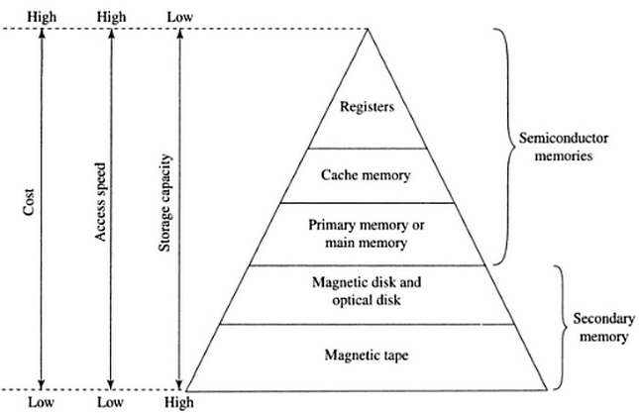
Hierarchy of Memories
Programs want memory that is fast, large, and cheap.
In practice:
  Fast memory is small and expensive
  Large memory is slow and cheap
Key idea: No single memory technology can satisfy all requirements.

Slide 39
Hierarchical Memory Organization
Memory is organized as multiple levels:
  Registers: Very small memory used for storing data very temporarily.
  Cache : A small, fast memory between processor and main memory. It stores copies of frequently accessed memory blocks.
  Main Memory- RAM
  Secondary Storage- Hard Disk, SSD.
As we go down the hierarchy:
Speed decreases, Capacity increases, Cost per bit decreases

Slide 40
Hierarchical Memory Organization
To access a particular piece of data, the CPU first sends a request to its nearest and the fastest memory, usually cache.
If the data is not in cache, then main memory is queried.
If the data is not in main memory, then the request goes to disk or secondary memory.
Once the data is located, then the data, and a number of its nearby data elements are fetched into cache memory.
Key takeaway: Hierarchy gives the illusion of fast, large, and cheap memory.

Slide 41
Principle of Locality
Programs exhibit locality of reference.
  Temporal locality: Recently accessed data is likely to be reused.
  Spatial locality: Nearby data is likely to be accessed.
Key idea: Locality makes memory hierarchy effective.

Slide 42
Cache Hits and Miss
  Cache hit: What we require is available in cache.
  Cache miss: What we require is not available in cache and has to be fetched from main memory.
  Key idea: Cache reduces average memory access time.

Slide 43
Memory Basics: Addresses, Words, and Blocks
Memory Word: The fundamental unit of data transfer between the CPU and memory (e.g., 32-bit or 64-bit).
Memory Block (Cache Block): A contiguous group of words transferred between main memory and cache together (typical size: 64 bytes).
…………………….
Memory Address: A unique binary identifier assigned to each word in main memory, allowing the CPU to locate data.
30
31
30+N

Slide 44
Cache Lines (Cache Blocks)
Cache Memory: A small, fast SRAM located between the CPU and main memory.
Cache Line: The physical storage unit in the cache that holds one block from main memory.
Each cache line contains:
  Data Block: the actual data (e.g., 64 bytes)
  Tag: identifies which memory block is stored
  Valid Bit: indicates whether the cache line contains valid data
Key idea: Cache lines hold both data and information about that data.

Slide 45
Cache Mapping: The Where
Cache Mapping: The rule that determines where a memory block can be placed in the cache.
Direct Mapping: Each memory block maps to exactly one cache line (Line = Block % Number of Lines). Simple and fast, but causes conflict misses.
Fully Associative Mapping: A memory block can be placed in any cache line. Flexible but expensive lookup.
Set-Associative Mapping: Cache divided into sets; a block maps to one set but can occupy any line within the set. A compromise between cost and performance.

Slide 46
Anatomy of a Memory Address
A memory address is divided into fields for cache lookup:
  Tag: Identifies which memory block is stored.
  Index (or Set Index): Selects the cache line or set to check.
Block Offset: Selects the specific word or byte within the block.
Cache Access Workflow:
1. Use Index to select cache line/set
2. Compare Tag
3. If Valid Bit = 1 and tags match → Cache Hit
4. Otherwise → Cache Miss

Slide 47
Cache Replacement Algorithms
When cache is full, a block must be replaced.
Common policies:
  Least Recently Used (LRU)
  First In First Out (FIFO)
  Random
Key idea: Replacement decides what data stays close to the processor.

Slide 48
Cache Write Policies
When data is written:
  Write-through: update cache and memory
  Write-back: update cache, write later
Tradeoff: Simplicity vs performance
Key idea: Writes introduce additional design choices.

Slide 49
The 8 great ideas

Slide 50
Design for Moore’s Law
Hardware resources grow rapidly, so systems must be designed for future technology.
  Transistor count roughly doubles every 18–24 months
  Designs take years, but technology changes during design
Example: Processors are designed assuming more transistors will be available, enabling more cores and larger caches.
Key takeaway: Designers must anticipate change, not react to it.

Slide 51
Abstraction
Abstraction hides lower-level details to manage complexity.
  Enables productivity and modularity
  Each level exposes a simpler interface
Example: Programmers write high-level code without worrying about registers or pipelines.
Key takeaway: Abstraction lets us build complex systems from manageable pieces.

Slide 52
Make the Common Case Fast
Optimizing frequent operations improves performance more than optimizing rare cases.
  Requires workload measurement
  Common cases are often simpler
Example: Cache memory speeds up frequent memory accesses. Training for particular scenarios which are common.
Key takeaway: Fast systems focus on what happens most of the time.

Slide 53
Performance via Parallelism
Improve performance by performing multiple operations simultaneously.
  Appears at many system levels
  Exploits independent work
Example: Multi-core processors execute multiple threads in parallel.
Key takeaway: Parallelism increases throughput by doing more at once.

Slide 54
Performance via Pipelining
A special form of parallelism that overlaps stages of execution.
  Improves hardware utilization
  Increases throughput
Example: Instruction pipelines overlap fetch, decode, execute, memory access, and write-back.
Key takeaway: Pipelining overlaps work rather than speeding up individual steps.

Slide 55
Performance via Prediction
Guess future behavior to improve average performance.
  Correct predictions speed up execution
  Recovery handles wrong guesses
Example: A missile that predicts the trajectory of the moving target and hitting there.
Key takeaway: Prediction improves performance when guesses are usually correct.

Slide 56
Hierarchy of Memories
Organize memory into levels with different speed, size, and cost.
  Fast memory is small and expensive
  Slow memory is large and cheap
Example: Registers → Cache → Main Memory → Disk
Key takeaway: Hierarchy gives the illusion of fast, large, and cheap memory.

Slide 57
Dependability via Redundancy
Systems are made reliable by adding redundant components.
  Failures are inevitable
  Redundancy enables fault tolerance
Example: RAID systems store redundant data to survive disk failures.
Key takeaway: Reliable systems assume components will fail.

Slide 58


