Slide 1
SCALA
What is it
And what is it used for

Slide 2
introduction

Slide 3

SCALA
GENERAL-PURPOSE PROGRAMMING LANGUGAGE
MULTI-PARADIGM (OBJECT ORIENTED + FUNCTIONAL)
WORKS (ORIGINALLY) ON JAVA VIRTUAL MACHINE (jvm)

Slide 4
SCALABLE LANGUAGE
THE NAME SCALA COMES FROM SCALABLE
SCALA COMBINES CONCISE SYNTAX WITH SCALABILITY

Slide 5
usage
Data engineering
Distributed systems
Concurrency, Parallel processing
Web development

Slide 6
Brief history
Created and developed by martin odersky
2001 – martin started working on scala at the ecole polytechnique federale de lausanne (EPFL)
2004 – scala officially released
2006 – scala 2.0
2012 – started working on scala 3
2021 – scala 3

Slide 7
How is program executed?

Slide 8
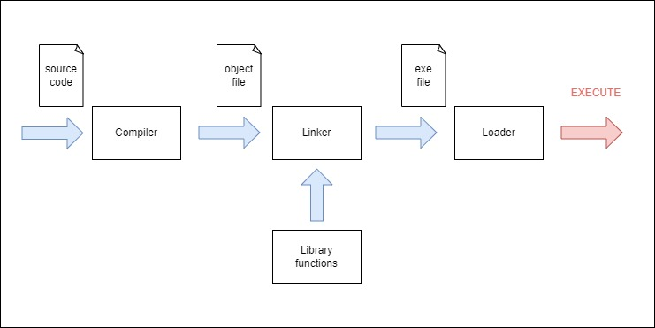
how c code runs
In general:
Source code → Compilation → Machine code → run

Slide 9
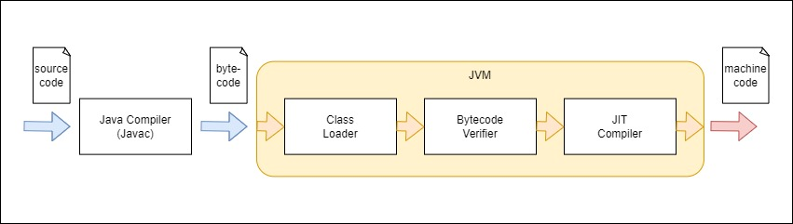
How java code runs
In general:
Source code → Compilation → Bytecode → JVM → run

Slide 10
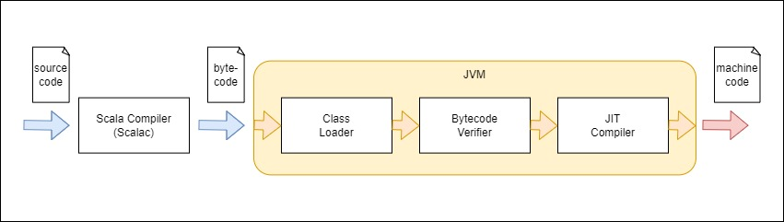
How scala code runs
In general:
Source code → Compilation → Bytecode → JVM → run

Slide 11
So let’s run it!

Slide 12
Hello World
Scala 2
object hello {
def main(args: Array[String]) = {
println("Hello, World!")
}
}
Scala 3
@main def hello() = println("Hello, World!")
We can put this code in the hello.scala file

Slide 13

HOW TO RUN SCALA CODE?
From command line
scalac – compile scala source code
scala – run compiled code

Slide 14
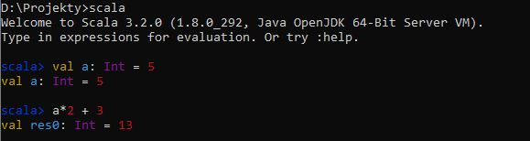
How to run scala code?
From repl
Just type scala in command line

Slide 15
How to run scala code?
From ide
Popular ide’s for scala:
Scala ide for eclipse
Intellij idea (with scala plugin)
VSCode (with metals extension)

Slide 16
How to run scala code?
Using sbt …

Slide 17

sbt
Sbt (scala build tool) is a popular build tool for scala projects
Sbt enables you to conveniently:
compile
run
test
publish
project of any size

Slide 18
Scala and programming paradigms

Slide 19
Scala’s paradigm
Scala is a Fusion of object-oriented and functional programming
Objects in scala are used for modularity and functions are used for logic
Scala is designed so that to show that Fusion of object-oriented and functional programming is possible and practical

Slide 20
Worth reading – programming paradigms
https://www.geeksforgeeks.org/introduction-of-programming-paradigms/

Slide 21
Bird’s eye view

Slide 22
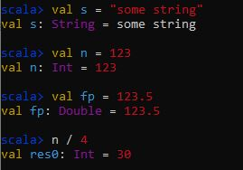
Statically typed but …
Scala is a statically-typed langugage – variable’s type has to be known at compile time
That said, scala’s code often looks like dynamically typed due to type inference

Slide 23
Write it like functional!
IMPERATIVE
FUNCTIONAL
import scala.collection.mutable.ListBuffer
def double(ints: List[Int]): List[Int] =
val buffer = new ListBuffer[Int]()
for i <- ints do
buffer += i * 2
buffer.toList
val oldNumbers = List(1, 2, 3)
val newNumbers = double(oldNumbers)
val newNumbers = oldNumbers.map(_ * 2)
(Example from Scala 3 – Book from docs.scala-lang.org)

Slide 24

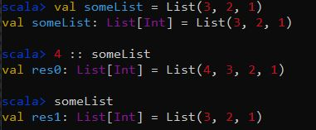
IMMUTABILTY
PYTHON
SCALA

Slide 25
SYNTAX

Slide 26
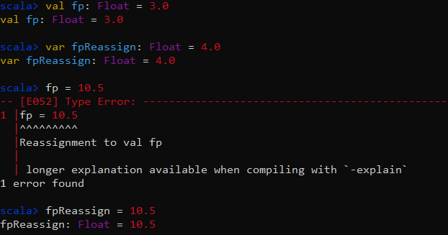
Creating variables – var and val
val / var variable_name[: variable_type] = variable_value
val creates immutable variable (meaning you can not reassign it)
var creates mutable variable (meaning you can reassign it)
It is recommended to create always val variables unless you know it will have to change over time

Slide 27
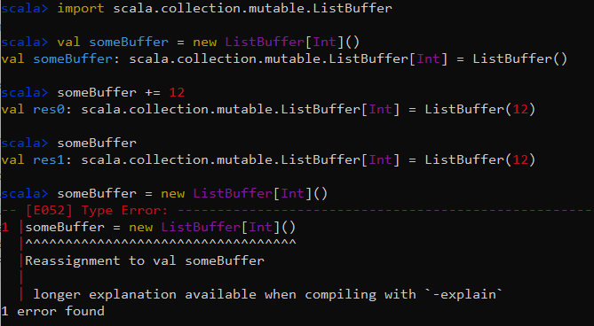
Val = immutable – REALLY??
Val creates immutable variable in the sense that you cannot reassign it
But if val variable contains object which is mutable itself and you modify the object (without variable reassingment) then it will work

Slide 28
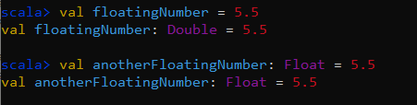
Declaring variable types
As it’s been already mentioned, you can omit type declaring when creating a new variable – the compiler can infer the variable type
On the other hand, if you explicitly declare the variable type, you have more control over it

Slide 29
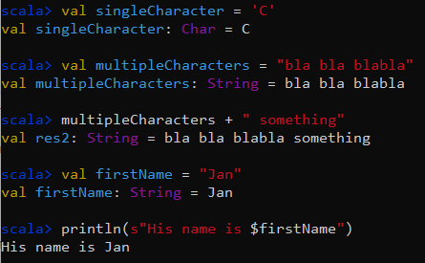
Chars and strings
CHAR variable contains a single character; we create chars using single quotes
STRING can contain more characters; we create strings using double quotes
we can concatenate strings using + and interpolate them using s and $

Slide 30
Conditionals – if/else
Scala 2
if (x < 0) {
println("negative")
} else if (x == 0) {
println("zero")
} else {
println("positive")
}
Scala 3
if x < 0 then
println("negative")
else if x == 0 then
println("zero")
else
println("positive")

Slide 31
For loop
Scala 2
val ints = List(1, 2, 3, 4, 5)
for (i <- ints) println(i)
Scala 3
val ints = List(1, 2, 3, 4, 5)
for i <- ints do println(i)
and many additional possibilities …

Slide 32
WHILE loop
Scala 2
while (x >= 0) { x = f(x) }
Scala 3
while x >= 0 do x = f(x)

Slide 33
SOURCES
SCALA-LANG.ORG
WIKIMEDIA COMMONS
Geeksforgeeks.org
intellipaat.com
javatpoint.com
livebook.manning.com
towardsdatascience.com

