Slide 1

CMPE 521: PRINCIPLES OF DATABASE SYSTEMS
AGILE: Adaptive Indexing for Context-Aware Information Filtres
by
Jens-Peter Dittrich Peter M. Fischer Donald Kossmann
Presented by
Şerif BAHTİYAR
Fall 2005

Slide 2
Outline
Introduction
Problem Statement
Context-Aware Information Filters
State-of-the-Art
Adaptive Indexing: AGILE
Performance Experiments and Results
Conclusion

Slide 3
Introduction
Information filtering has become a key technology for modern information systems
The goal of an information filter is to route messages to the right recipients (possibly none) according to declarative rules called profiles.
This paper presents AGILE, a way to extend existing index structures so that the indexes adapt to the message/update workload and show good performance in all situations.
The focus of all that work was on the development of scalable index structures in order to group and index profiles.

Slide 4
Introduction
A major shortcoming of the existing approaches is that they are very inefficient if profiles refer to values in a database that are subject to change.
This paper presents Context-aware Information Filters (CIF)
Differences of CIF
  Has two input streams
    a stream of messages,
    a stream of context updates
  Provides a unified solution to tailor information delivery
  The challenge of building a CIF is to route messages and record contex updates efficiently

Slide 5
Introduction
Use Cases for CIF
Message broker with state: A message broker routes messages to a specific application and location.
Generalized location-based services: With an increased availability of mobile, yet network-connected devices, the possibilities for personalized information delivery have multiplied.
Stock brokering: Financial information systems require sending only the relevant market updates to specific applications or brokers.

Slide 6
Introduction
Contribution Summary
Introduce the concept of a Context-Aware Information Filter
Introduce a CIF-architecture in which intermediary filter stages are allowed to generate false positives as trade-in for higher update rates. To ensure correctness, false positives are eliminated in a separate post-filtering step
Presents the generic algorithm AGILE. This algorithm extends best-of-breed index structures to automatically adapt to high update rates
The results of comprehensive performance experiments

Slide 7
Problem Statement
Given a large set of profiles, high message rates and varying rates of context updates, provide the best possible throughput of messages. No message must be dropped or sent to the wrong user because a change in context has not yet been considered by the filter. This constraint rules out methods that update the context only periodically.

Slide 8
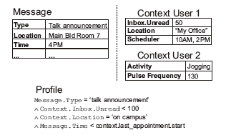
Problem Statement
Context: a set of attributes associated with an entity; the values of those attributes can change at varying rates.
The only assumption that is made in this work is that the values of an attribute of a context can change and that these changes are triggered by a stream of context updates.

Slide 9
Problem Statement
Messages: A message is a set of attributes associated to values.

Slide 10
Problem Statement
Profiles: A profile is a continuous query specifying the information interests of a subscriber. Expressions in profiles can refer to a static condition or a dynamic context. Static conditions change relatively seldom In contrast, context information can change frequently.

Slide 11
Context-Aware Information Filters
CIF Processing Model
The CIF keeps profiles of subscribers and context information. The CIF receives two input streams: a message stream and a context update stream. These two streams are serialized so that at each point in time either one message or one update is processed.
handle_message(Message m): Find all profiles that match the given message m, considering the current context state.
update_context(Context c,Attribute a,Value v): Set the attribute a of context c to the new value v, i.e. c.a := v. All profiles referencing this context must consider this new value.

Slide 12
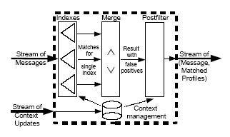
Context-Aware Information Filters
CIF Architecture
A CIF has four main components.

Slide 13
Context-Aware Information Filters
CIF Architecture
Context management: manages context information.
  stores the values of static attributes and values of context attributes which are used in predicates of profiles
  any context change is recorded by this component
  interacts heavily with indexes and postfiltering

Slide 14
Context-Aware Information Filters
CIF Architecture
Indexes: filtering can be accelerated by indexing the profiles or predicates of the profiles.
  The most important method supported by an index is probe, which is invoked by the CIF’s handle_message method. probe takes a message as input and returns a set of profiles that potentially match that message.
  An index can be classified by four different aspects:
    Target (value index or structure index)
    Accuracy (exact index or fuzzy index): probing can result false positive
    Dimensionality (single index or several index)
    Scope (full index or partial index)
  The key idea to implementing adaptive context-aware information filters is to control the accuracy and scope of indexes.

Slide 15
Context-Aware Information Filters
CIF Architecture
Merge: takes several intermediate result sets of profiles as input and carries out conjunctions and disjunctions on those sets of predicates

Slide 16
Context-Aware Information Filters
CIF Architecture
Postfilter: eleminates false positives. In other words, it takes a set of profiles as input and checks which profiles match the message by reevaluating the predicates of the profiles based on the current state of the context.

Slide 17
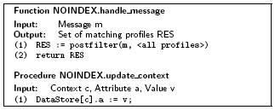
State-Of-the-Art
No Index
The brute-force approach is to use no index at all.
All the work is carried out in the postfilter operation.
The main advantage is the update_context operation is cheap.
Negative side, the handle_message operation is expensive because the postfilter operation is applied to all profiles.

Slide 18
State-Of-the-Art
Eager Full Indexing
The opposite to the NOINDEX approach is an approach that makes aggressive use of indexes and keeps all indexes uptodate and 100 percent accurate.
The big advantage of EAGER is that the handle_message operation is as cheap.
The big disadvantage of the EAGER approach is that the update_context operation is expensive because it involves maintaining indexes, potentially with every context update.

Slide 19
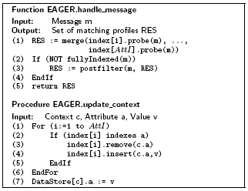
State-Of-the-Art
Eager Full Indexing

Slide 20
State-Of-the-Art
Partial Indexing
The idea of partial indexes is to reduce the cost of the update_context operation by reducing the scope of an index.
If an update is outside the scope of an index, then the index need not be updated.
All non-indexed values must be processed in a brute-force manner.
The most important issue is how to define the scope of a partial index.

Slide 21
State-Of-the-Art
Lazy Updates, GBU
Lately, there has been work on moving object databases and the basic insight of that work is that updates often exhibit a high degree of locality.
The idea is that updates that remain within the bounding box of a leaf node of an index are not propagated to non-leaf nodes of the index; propagation only occurs if the new value is outside of the bounding box of the old value. If propagation is necessary, then locality is also exploited as much as possible.

Slide 22
Adaptive Indexing:AGILE
General Idea
The key idea of AGILE is to dynamically reduce the accuracy and scope of an index if context updates are frequent and to increase the accuracy and scope of an index if context updates are seldom and handle_message calls are frequent.
The operation to reduce the accuracy is called escalation
The operation that increases the accuracy of an index is called deescalation

Slide 23


Adaptive Indexing:AGILE
General Idea - Example
In order to implement AGILE on a binary tree, the structure of a node is extended. In addition to the key k, every node has three sets of identifiers:
  left: this is a set of escalated identifiers (i.e., profiles) which are associated with the key range ] − , k[
  right: this is a set of escalated identifiers (i.e., profiles) which are associated with the key range ]k,+ [
  exact: the set of non-escalated identifiers which are associated with k

Slide 24
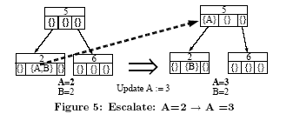
Adaptive Indexing:AGILE
General Idea – Example Escalation
Figure 5 shows how an identifier, A, is escalated. This operation is triggered by increasing the stock of Warehouse A by one; i.e., a context update from two to three.

Slide 25
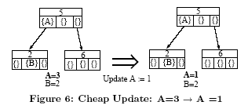
Adaptive Indexing:AGILE
General Idea – Example Cheap Update
The index need not be adjusted at all in order to reflect this change and, thus, the update_context operation is as cheap as for the NOINDEX approach in this case.

Slide 26
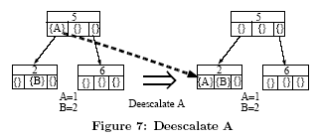
Adaptive Indexing:AGILE
General Idea – Example Deescalation
It is triggered if the handle_message operation is called several times for orders and Warehouse A was returned by the index as a potential candidate and had to be filtered out by the postfilter step.
Deescalating from a left or right set of a leaf node involves inserting a new leaf node and moving the identifier into the exact set of this new node.

Slide 27
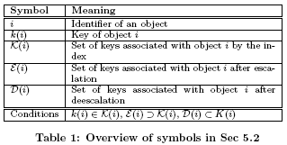
Adaptive Indexing:AGILE
Properties of AGILE Indexes
Formally, every index maps each key k to a set of identifiers {i}. This mapping is returned by the probe operation of an index, i.e. probe(k) ->{i}.

Slide 28
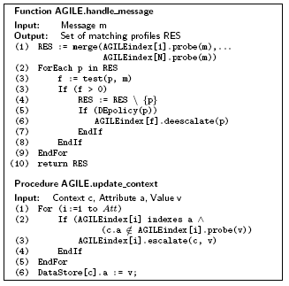
Adaptive Indexing:AGILE
AGILE Algorithm

Slide 29
Adaptive Indexing:AGILE
AGILE Indexes – AGILE Interval Skip Lists (ISL)
An ISL is a hierarchical index structure that is applicable to all ordered domains (e.g., numerical values, dates).
Each identifier of a profile is associated with one or more ranges of values. Furthermore, each range is associated with a set of identifiers. Ranges are organized hierarchically so that all ranges covering a given value can be found more quickly (logarithmic complexity in the average case)

Slide 30
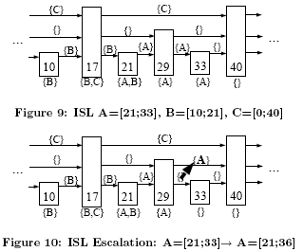
Adaptive Indexing:AGILE
AGILE Indexes – AGILE Interval Skip Lists (ISL)

Slide 31
Adaptive Indexing:AGILE
AGILE Indexes – Other AGILE Index Structures
Hash Table: An escalation is implemented by associating an identifier with the whole domain of values. Effectively, this means deleting the identifier from the hash table and keeping it in a separate list of identifiers that are returned for every probe. Deescalations are implemented by re-inserting the identifier into the hash table and deleting it from the escalate list.
B-Tree, B⁺-Tree,R-Tree: Logically, an escalation is implemented by moving an identifier into the buffer of its parent. Deescalations are implemented by moving an identifier to a child node.

Slide 32

Adaptive Indexing:AGILE
AGILE Indexes – Deescalation Policies
Ideally, an index should be deescalated if the cost for the deescalation is lower than the cost of eliminating false positives in the postfilter step of future handle message operations.
Some simple heuristics
  Always : Every false positive encountered by the postfilter triggers a deescalation.
  Fixed: A fixed number of false positives FP is ignored until a deescalation is performed.
  Auto : auto operates like fixed and ignores a certain number of false positives FP before a deescalation is triggered.

Slide 33
Performance Experiments and Results
Software and Hardware used
In order to implement the individual components, the following design choices were made:
  Context Management
  Indexes
  Merge
  Postfilter
All software was implemented in C++. All experiments were performed on a 3.2 GHz Pentium 4 machine with 2 GB of RAM running Linux 2.4.

Slide 34
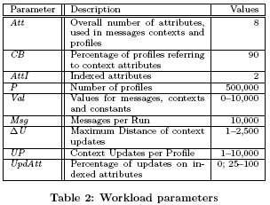
Performance Experiments and Results
Workload
When selecting the workloads to test the different methods, researchers followed the requirements derived from the Use Cases. The number of profiles is high, most profiles refer to contexts. Low, high and varying context update rates are studied.

Slide 35
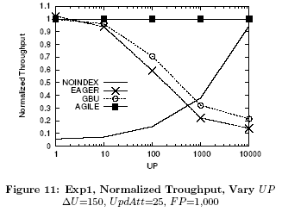
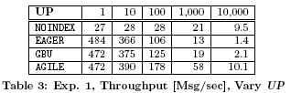
Performance Experiments and Results
Experiment 1:Throughput in Steady State
Figure 11 shows the relative throughput, normalized to the throughput of AGILE. Table 3 shows the absolute throughput results.

Slide 36
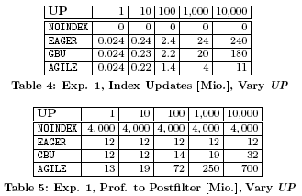
Performance Experiments and Results
Experiment 1:Throughput in Steady State
A more detailed understanding of these results can be gained by looking at the number of executed index updates (Table 4) and the number of profiles that need to be inspected in the postfilter operation (Table 5).

Slide 37
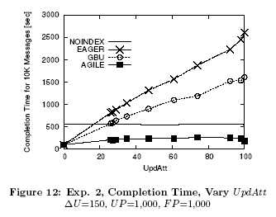
Performance Experiments and Results
Experiment 2: Vary UpdAtt
The experiment studies the impact of varying the distribution of updates to indexed and non-indexed attributes (UpdAtt). Figure 12 shows the total time used to execute a workload of 10.000 messages and 500 Mio. updates (UP=1000).

Slide 38
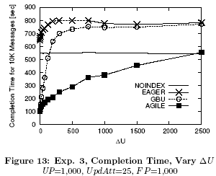
Performance Experiments and Results
Experiment 3: Vary ∆U
Both GBU and AGILE take advantage of the locality of context updates.
Figure 13 shows the completion time for varying ∆U from very high update locality (∆ U close to 0) to very low update locality (∆ U = 2,500 which is 25 percent of the whole scope of possible attribute values).

Slide 39
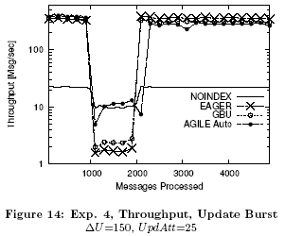
Performance Experiments and Results
Experiment 4:Update Burst
Figure 14 shows the throughput at different moments in time; the throughput is computed for every batch of 100 messages. It can be seen that the message throughput drops during the update burst (between Message 1,000 and Message 2,000)

Slide 40
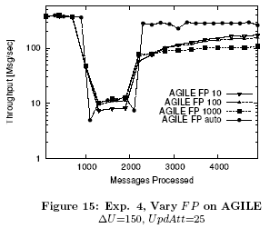

Performance Experiments and Results
Experiment 4:Update Burst
Figure 15 and Table 6 show how alternative deescalation strategies fare in this experiment. Indeed, auto outperforms fixed in this experiment, but the differences are not large.

Slide 41
Conclusion
Information filtering has matured to a key information processing technology.
This work provides simple extensions to existing index structures for information filtering systems.
The key idea is to adapt the accuracy and scope of an index to the workload of a context-aware information filter.
Improve the message throughput of a context-aware information filter
Robust to poor physical design
Can gradually adjust to changes in the locality of updates
Is able to deal with workloads with bursts

Slide 42
QUESTIONS ?

