Slide 1
Proactive Query
Re-optimization
by
Çetin Meriçli
12.10.2005

Slide 2

Overview
Query Processing
Query Optimization
  Idea
  Problems
Solutions to problems in query optimization
  Reactive re-optimization
  Proactive Re-optimization
RIO Implementation Details

Slide 3
Query Processing
A SQL statement is subjected to four phases of processing
  Parsing
  Optimization
  Code Generation
  Execution

Slide 4
Query Optimization
Same result set for a query can be obtained in more than one way.
Depending on the query, different execution plans may have different costs.
Query optimizers try to find an execution plan with the lowest cost for a given query based on some statistical estimations about the data.

Slide 5
Query Optimization (cont’d)
Traditional optimization follows a plan-first-execute-next approach
This approach enumerates all execution plans, computes the cost of each plan and picks the plan with the lowest cost
Performance highly depends on the accuracy of the estimated statistics used to compute costs

Slide 6
Query Optimization (cont’d)
Example:
select * from R, S
where R.a = S.a and
R.b > K1 and
R.c > K2

Slide 7
Query Optimization (cont’d)
Assume that
  DB Buffer cache size is 200 Mb
  |R| = 500 Mb
  |S| = 160 Mb
  | σ(R) | = 300 Mb
Due to skew and correlations in the data, optimizer estimates | σ(R) | to be 150 Mb

Slide 8
Query Optimization (cont’d)
Two parts of the query
  S
  σ(R) (result of the selection on R )
P1a
P1b

Slide 9
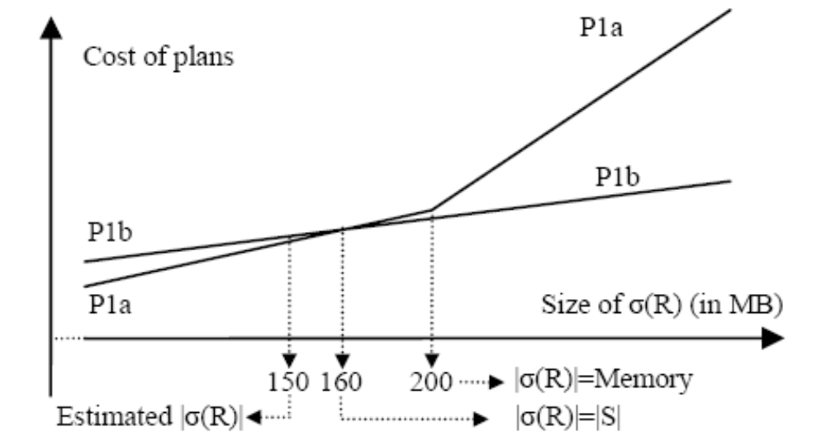
Query Optimization (cont’d)
Since | σ(R) | is underestimated, P1a is selected as the optimal plan, but P1b should have been selected by the optimizer since the estimation is wrong and P1a gets more costly for greater values of
| σ(R) | .

Slide 10
Reactive Optimization
Reactive optimizers works in the following way
  Use a traditional optimizer to find the best plan.
  Use check operators to detect sub-optimality during execution.
  Trigger re-optimization, if required.

Slide 11
Problems with Reactive
Re-optimization
The optimizer may pick plans whose performance depends heavily on uncertain statistics, making re-optimization very likely
The partial work done in a pipelined plan is lost when re-optimization is triggered and the plan is changed
The ability to collect statistics both quickly and accurately during execution is limited
So, when re-optimization is triggered, the optimizer may make new mistakes, leading potentially to thrashing

Slide 12
Proactive Re-optimization
A novel approach
Uses Bounding boxes instead of single point estimations to represent uncertainty
Bounding boxes are used during optimization to generate robust and switchable plans, minimizing the need for re-optimization (hence, the loss of pipelined work)
Random-sample processing is merged with query execution to collect statistics quickly and accurately

Slide 13
Proactive Re-optimization

Slide 14
Representing Uncertainty
Most of the current optimizers uses single-point estimates of the statistics needed to cost plans
Using intervals instead of single points allows the optimizer to handle uncertainty about the estimates
As the confidence about the estimate increases, bounding box gets narrower

Slide 15
Representing Uncertainty

Slide 16
Using Bounding-boxes During Optimization
There is always one optimal plan for a single-point estimate
For a bounding box B, following cases can occur:
  Single optimal plan: A single plan is optimal at all points within B
  Single robust plan: There is a single plan whose cost is very close to the optimal at all points in B
  A switchable plan: Explained in the next slide
  None of the above: Different plans are optimal at different points in B, but no switchable plan is available

Slide 17
Switchable Plans
A switchable plan in B is a set S of plans with the following properties
  At each point pt in B, there is a plan p in S whose cost at pt is close to that of the optimal plan at pt
  The decision of which plan in S will be executed can be deferred until accurate estimates of uncertain statistics are available
  If the actual statistics lie within B, an appropriate plan from S can be picked and run without losing any significant fraction of the execution work done so far

Slide 18
RIO Implementation Details
Computing Bounding-boxes
Optimizing with Bounding-boxes
  Generating the Seed Plans
  Generating the Switchable Plan
Extensions to Query Execution Engine
Experiments

Slide 19
Computing Bounding-boxes
RIO restricts the computation of bounding boxes to size and selectivity estimates
For each such estimate E, a bounding box B is computed using the following process
  An uncertainty bucket U is assigned to E
  The bounding box is computed from the (E, U) pair
An integer domain [0,6] is assigned to U according to some information (is there an accurate value of E exists in the catalog, etc..) from 0 (no uncertainty) to 6 (very high uncertainty)

Slide 20
Optimizing with Bounding-boxes
RIO computes bounding boxes for all input sizes used to cost plans
Then it tries to compute a switchable plan for each distinct (JS, IO) pair (JS : Join Subset, IO : Interesting Orders )
If RIO fails to find a switchable plan, it picks the optimal plan based on single-point estimates

Slide 21
Computing switchable plans
RIO computes switchable plans in two steps
  First, it finds three seed plans for each (JS, IO) pair
  Then, it creates the switchable plan from the seed plans

Slide 22
Generating seed plans
In RIO, each enumeration for plans considers three different costs
  CLOW
  CEST
  CHIGH
CEST is the traditional single-point estimation
CLOW and CHIGH are lower left and upper right corners of the bounding box
For each (JS, IO) pair, we end up with three seed plans
  BestPlanLow: plan with minimum cost CLOW
  BestPlanEst: plan with minimum cost CEST
  BestPlanHigh: plan with minimum cost CHIGH

Slide 23
Generating the Switchable Plan
Given the seeds BestPlanLow, BestPlanEst and BestPlanHigh, one of the following cases arises
  C1 : The seeds are all the same plan
  C2 : They are not the same, but one is a robust plan
  C3 : Neither they are the same, nor one is a robust plan, but, a switchable plan can be created from the seeds
  C4 : A single optimal plan, a single robust plan or a switchable plan cannot be found

Slide 24
Generating the Switchable Plan (cont’d)
In C1, the single optimal plan is the switchable plan
In C2, RIO finds the robust plan among the seeds and uses it as a singleton switchable plan
In C3, RIO tries to find a switchable plan (next slide)
In C4, RIO picks BestPlanEst as the optimal plan

Slide 25
Finding Switchable Plans
RIO tries to find the set S of plans satisfying the following constraints by enumerating the seeds
  All plans in S have a different joint operator as the root operator
  All plans in S have the same subplan for the deep subtree input to the root operator
  All plans in S have the same base table, but not necessarily the same access path, as the other input to the root operator

Slide 26
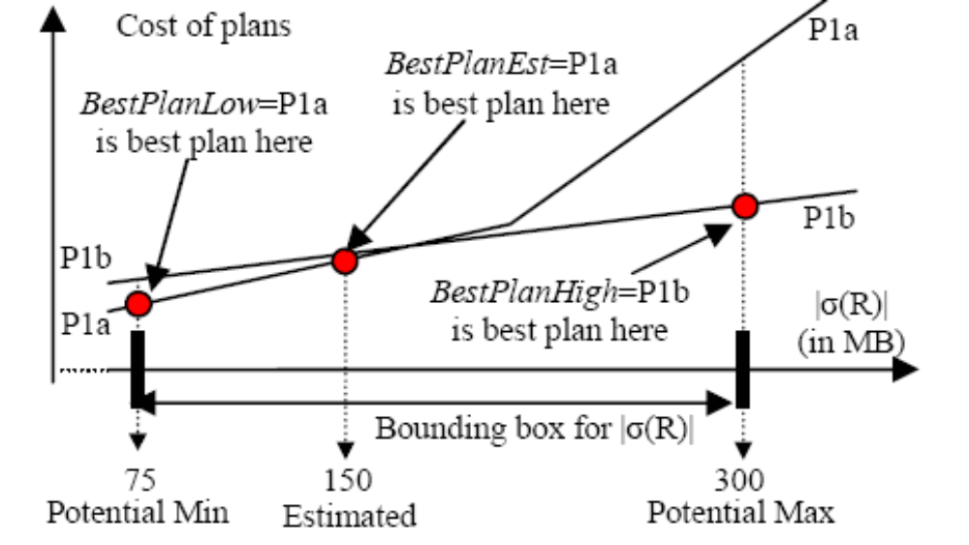
Using Switchable Plans
Contrary to the single point optimization, it is seen that P1b is more robust since it has a cost near to the optimal at all points in bounding box. But, since two plans are switchable as long as |σ(R)| lies within the bounding box, it is preferable to select P = {P1a, P1b} switchable plan instead of selecting P1b

Slide 27
Extensions to Query Execution Engine
Following extensions have been made in order to satisfy requirements of the proactive
re-optimization
  A switch operator for handling switchable plans
  A buffer operator for buffering the tuples until it can compute an input-size estimate needed by the switch operator
  Randomization-aware operators for performing random sampling for more accurate estimations of the statistics
  An inter-operator communication mechanism allowing operators to exchange estimates and random samples

Slide 28
Experiments
RIO has been tested with the following cases
  Two-way join queries
  Three-way join queries
  Correlation-based mistakes
  Thrashing
  More increased query complexity

Slide 29
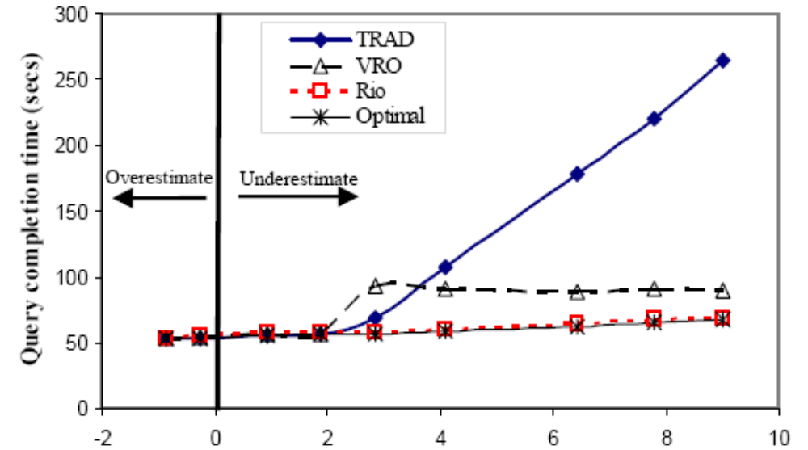
Results for two-way join queries experiments

Slide 30
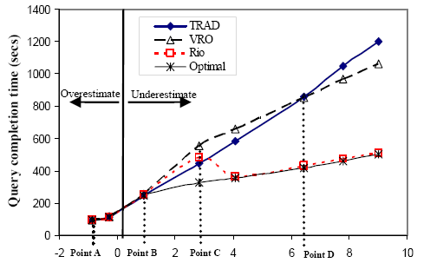
Results for three-way join queries experiments

Slide 31
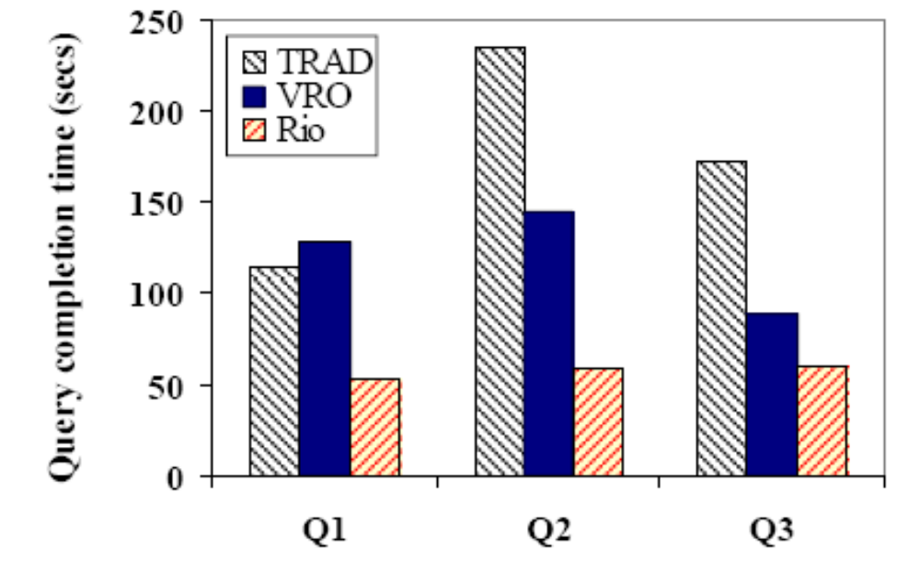
Results for correlation mistakes experiments

Slide 32
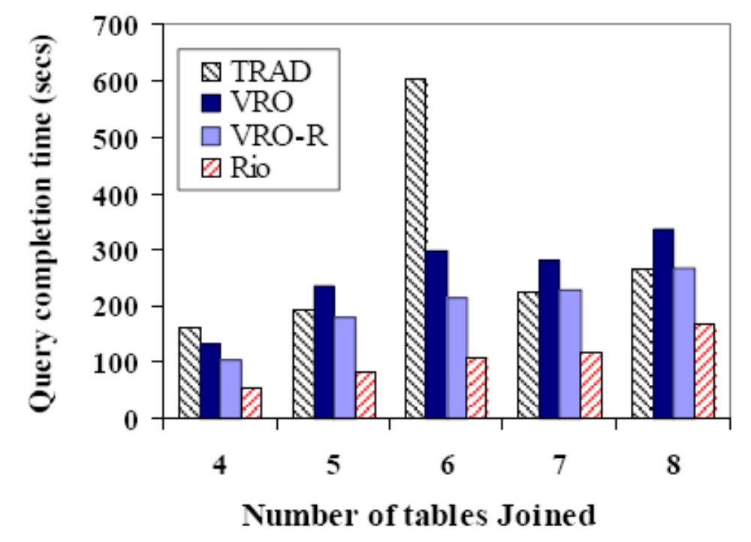
Results for more increased query compexity experiments

Slide 33
Conclusions
Proactive re-optimization is a novel approach to query optimization
RIO is a prototype that uses
  Bounding boxes instead of single point estimates for handling uncertainty
  Switchable plans for reducing the loss in pipelined work
  Random sampling techniques for collecting statistics quickly and more accurately
In the experiments, RIO outperforms the current re-optimizers by up to a factor of three

Slide 34
References
Babu, et. al, “Proactive Re-optimization”
Babu and Bizarro, “Adaptive Query Processing in the Looking Glass”
Selinger et. al, “Access Path Selection in a Relational Database Management System”

Slide 35
Thanks…
Any Questions?

