Slide 1



Adaptive Stream Filters for Entity-based
Queries with Non-value Tolerance
VLDB 2005
Reynold Cheng (Speaker) | Ben Kao, Alan Kwan | Sunil Prabhakar, Yicheng Tu
The Hong Kong Polytechnic University | The University of Hong Kong | Purdue University
Notes:
The topic of my talk is adaptive stream filters for entity-based queries with non-value tolerance.

Slide 2
Data Streams and Applications
Data Stream Management Systems (DSMS)
  Sensor networks, location-based applications
  STREAM [ABB03], STEAM [HAFME03], AURORA [ACC03], CACQ [MSH02]
Stream applications
  Telecom call records
  Network security [BO03]
  Habitat monitoring [MPS02]
  Structural health monitoring
Continuous
Queries
Notes:
Recently, data stream applications have attracted a lot of of research interests.
Several DSMS prototypes have been proposed, e.g. the STREAM, the AURORA, and the CACQ.
There are also various data stream applications, e.g. the network monitoring and traffic engineering, telecom call records, network security, habitat monitoring, and structural health monitoring.

Slide 3
DSMS Model
Limited memory, CPU, network bandwidth
Massive, Fast
stream
stream
Continuous Query
Query
Processing
Unit
User
stream
Result (Refreshed
if needed)
Central Processor
Network
Real-time, Response Time requirement
stream
Notes:
In these kinds of applications, distributed data sources with centralized control is very common.
Therefore, the data stream application we considered is like the diagram shown:
There is a central processor to perform query processing.
At the right-hand-side, you will see a large amount of distributed data sources, e.g. the sensors in last example.
The updates arrive as streams to the central query processor over the network.
User submits continuous query to the central processing server, e.g. in a network monitoring application, user may submit a standing query to monitor the routers whose network traffic ranked the top 10.

Slide 4
Trading Accuracy for Query Timeliness
A user may accept an answer with a carefully controlled error tolerance
  wide-area resource accounting
  load-balancing in replicated servers
The system exploits error tolerance to reduce communication and computation costs
Notes:
Translate error tolerance to filter bound

Slide 5
Value-based Tolerance
Often assumed in literature [OJW03, JCW04]
Maximum error is a numerical value ε specified by user
MAX Query: Return sensor id with the highest temperature
Guarantee the sensor id returned has temperature value not lower than ε from that of the true answer
Notes:
However, in most approximation-based algorithms, the value-based queries and numerical tolerance are assumed.
For example, user may issue a standing query to monitor the average number of packets pass through the network channels, and the query may allow to specify an value-based error tolerance, e.g. within 10 packets of error.

Slide 6
Is Selecting ε Easy?
Location-based application: a user inquires about his closest neighbor
  Should the tolerance be 0.1, 1, or 100 meters?
Sensor network collects humidity, temperature, UV-index, wind speed
  Does user know the range of error for each type?
Multi-dimensional data streams (e.g., location)
Multimedia data streams (e.g., CCTV images)
Notes:
Knowledge about relative distances or spread is required

Slide 7
Is Selecting ε for MAX Query easy?
Suppose a user accepts an object that ranks 2nd or above.
ε_{small}
ε_{ideal}
Tolerance
wasted
ε_{large}
Error
unacceptable
The ideal ε……
If ε is too large……
If ε is too small……
Notes:
In this motivating example, if only numerical tolerance is allowed, the ideal setting of tolerance would be the difference between the maximum object and the second.
However, user may not be aware how far the differences between the ranks are. User may choose to set a very small error tolerance. Then a lot of unnecessary updates will be generated even the object deviates very small. This results in poor performance in communication cost reduction.
On the other hand, user may choose to set a large tolerance. Then the essential updates may loss, and the quality of answer would become very bad.
These are the problems with numerical error tolerance with entity-based queries.

Slide 8
Rank-based Tolerance
Express error tolerance as a rank
Error tolerance = no. of positions the returned sensor could rank below the highest one
More intuitive and easier to specify
Rank-based tolerance = 1

Slide 9
Non-Value Tolerance
Rank-based tolerance is non-value- tolerance
  numerical value ε not used
Fraction-based Tolerance
  False Positive F⁺(t): % of returned answers that are incorrect at time t
  False Negative F⁻(t): % of correct answers not returned at time t
  F⁺(t) ≤ ε⁺; F⁻(t) ≤ ε⁻
Notes:
The numerical values of answers are not important

Slide 10
Entity-based Queries
Return sets of object ids, not numerical values [CKP03]
Rank-based queries: order of stream values decides the final answer
  e.g., top-k query, k-nearest-neighbor query
Non-rank-based queries: order of stream values is not important
  e.g., range query
Non-value tolerance matches entity-based queries!

Slide 11
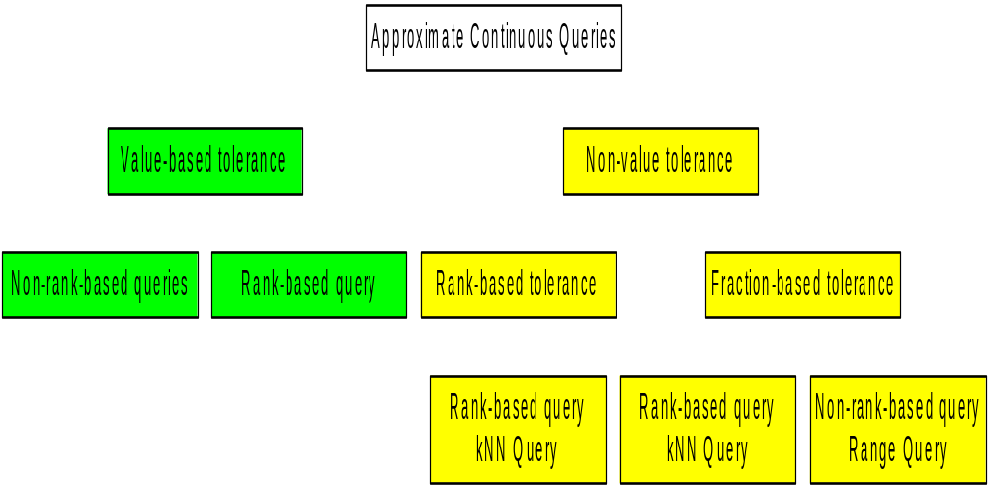
Continuous Query Classification
Notes:
This hierarchical chart summarizes our contributions.
Under the umbrella of approximate continuous queries, the previous works have addressed the value-based tolerance, which is shown at the left-hand-side.
Our works differ from them that we exploit the non-value tolerance.
Under the non-value tolerance sub-tree, we developed the algorithms for both rank-based tolerance and the fraction-based tolerance.
In our study, the rank-based tolerance is adopted to address the kNN query.
For the fraction-based tolerance, we studied for both rank-based and non-rank-based queries.
In fraction-based tolerance, we first developed the protocols for the range query, we then tried to view a kNN query as a range query, and apply the same protocol with slight modifications.
In the experiments, these protocols achieve significant saving in communication costs.
Now I will present the protocols we developed followed by the experimental results.

Slide 12
Adaptive Filter [OJW03]:
Initialization Phase
Approximate
Answer
Query
Processing
Unit
[l₁,u₁]
Filter
Bounds
Data Stream
1
User-defined Tolerance
[l₂,u₂]
Constraint
Assignment
Unit
Data Stream
2
Answer tolerance is met
as long as
no update is generated
[l₃,u₃]
Data Stream
3
Notes:
Now we discuss our Rank-based Tolerance Protocol, or RTP in short, that maintains the correctness of answer w.r.t. epsilon at all time.
In general, all of our proposed protocols can be divided into 2 phases.
The first phase is initialization. In this phase, the filter bound is derived based on the initial values of streams w.r.t. the tolerance constraint, epsilon.
The second phase, called maintenance phase, is ongoing. Whenever the update violates the correctness criteria, fix of filter bounds will take place. We will discuss this by scenario in following slides.

Slide 13
Adaptive Filter: Maintenance Phase
Corrected Approximate
Answer
Approximate
Answer
[l₁,u₁]
Query
Processing
Unit
Data Stream
1 (v₁)
Update (v₂>u₂ or v₂ < l₂)
[l₂,u₂]
User-defined Tolerance
New Filter Bound
[l₂,u₂]
Constraint
Assignment
Unit
Data Stream
2 (v₂)
Request
Value v₃
Tolerance violated!
trigger
Maintenance Phase
[l₃,u₃]
Data Stream
3 (v₃)
Notes:
Now we discuss our Rank-based Tolerance Protocol, or RTP in short, that maintains the correctness of answer w.r.t. epsilon at all time.
In general, all of our proposed protocols can be divided into 2 phases.
The first phase is initialization. In this phase, the filter bound is derived based on the initial values of streams w.r.t. the tolerance constraint, epsilon.
The second phase, called maintenance phase, is ongoing. Whenever the update violates the correctness criteria, fix of filter bounds will take place. We will discuss this by scenario in following slides.

Slide 14
Contributions
Apply filter bounds to
rank-based / non-rank-based queries
subject to
rank-based / fraction-based tolerance
to reduce
message costs
Correctness proofs, cost analysis and experimental evaluation of each protocol

Slide 15
Filter Bound Protocols
RTP
FT-RP
ZT-RP
FT-NRP
ZT-NRP
Notes:
This hierarchical chart summarizes our contributions.
Under the umbrella of approximate continuous queries, the previous works have addressed the value-based tolerance, which is shown at the left-hand-side.
Our works differ from them that we exploit the non-value tolerance.
Under the non-value tolerance sub-tree, we developed the algorithms for both rank-based tolerance and the fraction-based tolerance.
In our study, the rank-based tolerance is adopted to address the kNN query.
For the fraction-based tolerance, we studied for both rank-based and non-rank-based queries.
In fraction-based tolerance, we first developed the protocols for the range query, we then tried to view a kNN query as a range query, and apply the same protocol with slight modifications.
In the experiments, these protocols achieve significant saving in communication costs.
Now I will present the protocols we developed followed by the experimental results.

Slide 16
Non-Rank-based Queries
Answer Set
Example: 1D Range Query
S₆
S₅
S₃
S₂
S₁
S₄
S₇
S₈
2 6 11 14 23 25 34 41
Range = [10, 30]
Ordered Values
Notes:
Now let’s discuss how the fraction-based tolerance protocol applied on non-rank-based query. Specifically the range query will be discussed.
Suppose we have a range query Qj given the query range of [li,ui].
The idea of fraction-based tolerance is that, initially, the number of FP streams are selected from answer set A(t) to shutdown. That is the filter bound of these streams will be set to infinity so that even they jump out from the query range, update will not be transmitted to server and they are still be treated as answer. For example, S2 and S4 will not send update to server even their values deviate out of the range of [l,u]. We call these stream as non-updating streams.
Similarly, the number of FN streams are selected to shutdown from non-answer set at initialization. The update of these streams will also not be transmitted to server. For example, S5 and S8 will not be included into answer set even their values jump into range of [l,u].
By shutting down those non-updating streams, the communication cost is saved.
For all other streams, the query range is installed as filter bounds such that the update for those streams will be sent to server. We call these streams as updating streams.

Slide 17
Fraction-based Tolerance
False Negative
False Positive
Update
Update
S₆
S₅
S₃
S₂
S₁
S₄
S₇
S₈
Range of Q = [l, u]
Ordered Values
Notes:
Now let’s discuss how the fraction-based tolerance protocol applied on non-rank-based query. Specifically the range query will be discussed.
Suppose we have a range query Qj given the query range of [li,ui].
The idea of fraction-based tolerance is that, initially, the number of FP streams are selected from answer set A(t) to shutdown. That is the filter bound of these streams will be set to infinity so that even they jump out from the query range, update will not be transmitted to server and they are still be treated as answer. For example, S2 and S4 will not send update to server even their values deviate out of the range of [l,u]. We call these stream as non-updating streams.
Similarly, the number of FN streams are selected to shutdown from non-answer set at initialization. The update of these streams will also not be transmitted to server. For example, S5 and S8 will not be included into answer set even their values jump into range of [l,u].
By shutting down those non-updating streams, the communication cost is saved.
For all other streams, the query range is installed as filter bounds such that the update for those streams will be sent to server. We call these streams as updating streams.

Slide 18
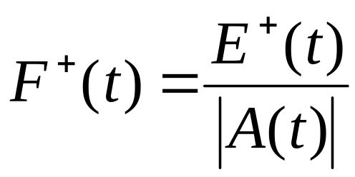
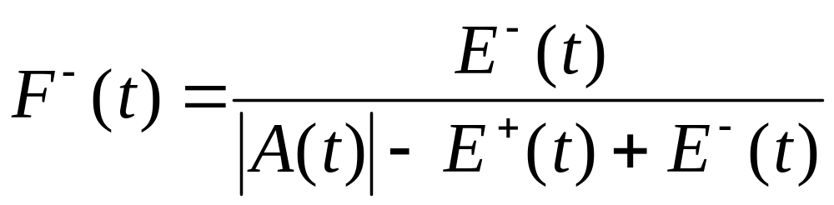
Fraction-based Tolerance
E⁺(t)
|A(t)|-E⁺(t)
E⁻(t)
Answer actually returned A(t)
True answer at time t
= |A(t)| - E⁺(t) + E⁻(t)
Notes:
Now, Let’s define the false positive and false negative formally.
We have the answer set returned to user denoted as A(t). And there is a true answer set at any given time.
Inside the A(t), there are maximum number of streams that do not satisfy query, we denote it as E+(t).
Also, there are maximum number of streams in true answer but they are excluded from A(t). We call this E-(t).
Then the false positive is defined as E+(t) over the size of answer set.
And the false negative is defined as E-(t) over the size of true answer, which is A(t)-E+(t)+E-(t).

Slide 19
Initialization Phase
  Given ε⁺ and ε⁻
  Collect current stream values
  For streams satisfying the range query
    Calculate no. of streams (E_{max}⁺) that can be false positives
    Assign false +ve filters [-∞, + ∞] to E_{max} streams
    Assign [l,u] to remaining ones
  For streams failing the range query
    Calculate no. of streams (E_{max}⁻) that can be false negatives
    Assign false -ve filters [+∞, +∞] to E_{max}⁻ streams
    Assign [l,u] to remaining ones
  Tolerance is satisfied if no new updates are received
  At any time t without update,
  F⁺(t) ≤ ε⁺
  F⁻(t) ≤ ε⁻

Slide 20
Maintenance Phase: Good Update
time t_{c}
time t₀
S₆
S₅
S₃
S₂
S₁
S₄
S₇
S₈
Range of Q = [l, u]
Filter [l,u]
Insert S₇ into A(t_{c})
F⁺ and F⁻ drop
  F⁺(t_{c}) < F⁺(t₀) ≤ ε⁺
  F⁻(t_{c}) < F⁻(t₀) ≤ ε⁻
Tolerance is met
Notes:
In this case, the stream Si is inserted into the answer set.
Since the insertion of Si increases the size of answer by 1, therefore, both FP and FN will become smaller and thus the correctness is satisfied.

Slide 21
Maintenance Phase: Bad Update
Filter [l,u]
time t₀
time t_{c}
S₆
S₅
S₃
S₂
S₇
S₁
S₄
S₈
Range of Q = [l, u]
  Remove S_{i} from A(t_{c})
  F ⁺ (t_{c}) ≤ ε⁺ and F ⁻ (t_{c}) ≤ ε⁻ may not be true
  Quality of answer becomes worse
  Procedure Fix to maintain tolerance
Notes:
In this case, the stream Si is removed from the answer set.
The deletion of Si will only decrease the size of answer by 1, therefore, both FP and FN are no longer to satisfy the error tolerance, and fix is required to recover the inequalities.

Slide 22
Fix: Consulting False Positive Filter
Filter [-∞, +∞]
S₆
S₅
S₃
S₂
S₄
S₇
S₈
S₁
Range of Q = [l, u]
Select stream S₄∈ A(t_{c}) with [-∞, +∞] filter
Request S₄ for its updated value
If V₄ ∈ [l, u]
  install [l, u] filter to S₄
  prove that F ⁺(t_{c}) ≤ ε⁺ and F ⁻ (t_{c}) ≤ ε⁻ are satisfied
If V₄ ∉ [l, u], consult a false –ve filter
Worst case: 5 messages
Notes:
If value of Sy is inside the range, then the correctness is immediately confirmed, because the fraction of false positive is decreased as there is one FP less.
On the other hand, the fraction of false negative will remain unchanged as the decreased FP cancels out the decreased answer size.
Therefore, correctness is fixed.

Slide 23
Filter Bound Protocols for Rank-based Queries
k-NN query is a representative of NN, Min, Max
Fraction-based tolerance / k-NN query
  View a k-NN query as a range query, by using the kth nearest neighbor as the “range”
  Adapt fraction-based tolerance/range query
Rank-based tolerance / k-NN query
  Maintain knowledge about (k+r)^{th} and (k+r+1)^{st} item
  Filter bound is defined by the average of the (k+r)^{th} and (k+r+1)^{st} item

Slide 24
Experiments
Compare
  No filter is used at all
  Filter protocols with zero tolerance
  Our tolerance-based protocols
Measure total no. of messages required for executing a continuous query

Slide 25
Experimental Setup
Real Data
  30 days of wide-area traces of TCP connections based on TCP trace [ITA20]
Synthetic Data
  Generated by CSIM 18
  Data value: Uniform distribution
  Fluctuation of updates: Normal distribution
  Interarrival time of updates: Exponential distribution

Slide 26
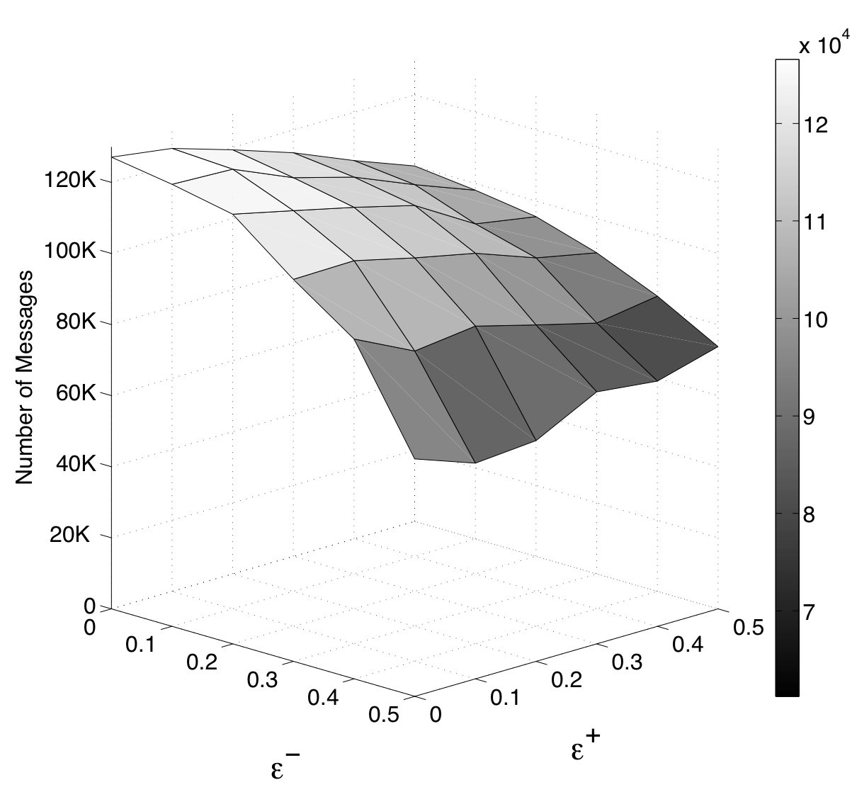
Fraction-based Tolerance for Range Query with Real Data

Slide 27
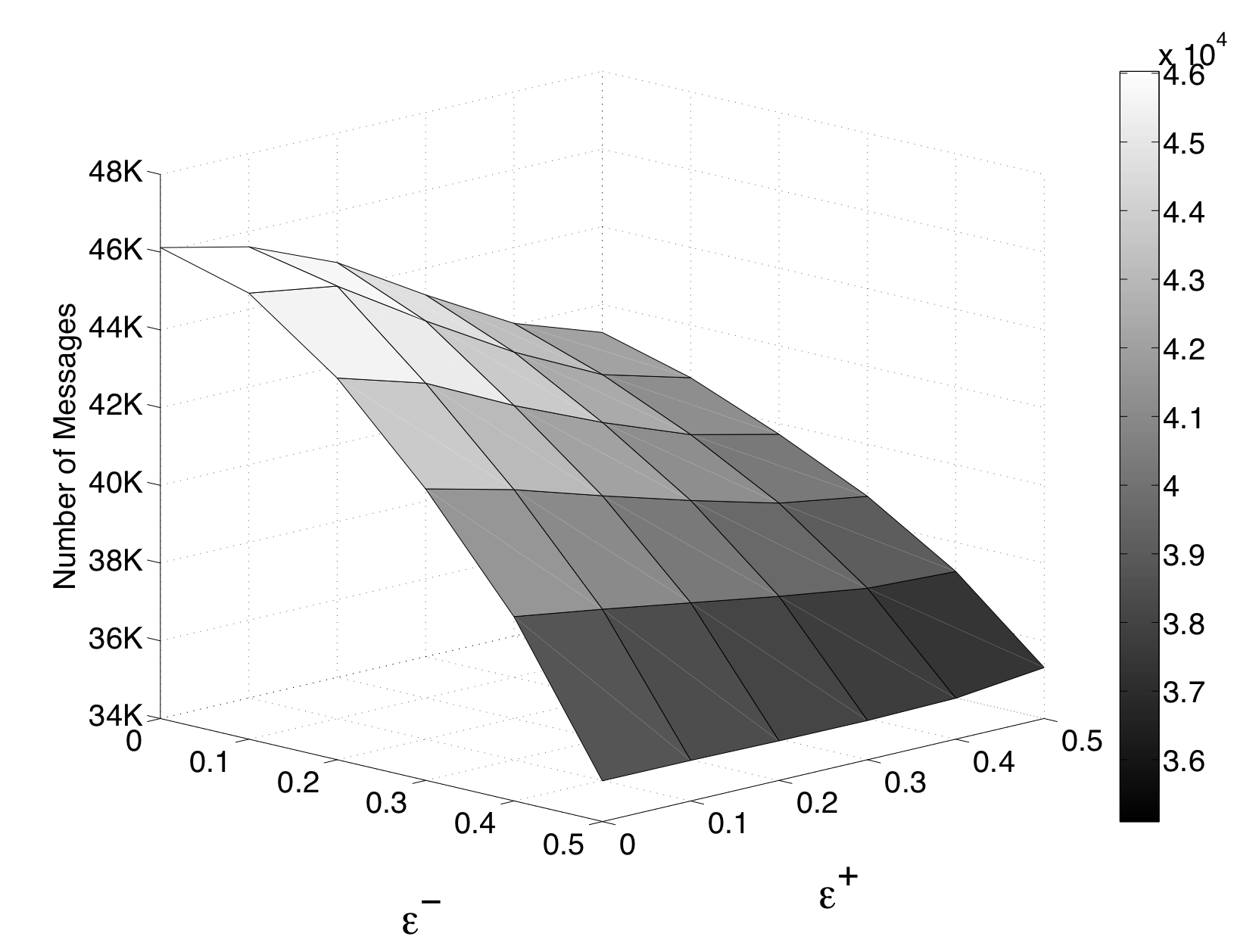
Fraction-based Tolerance for Range Query with Synthetic Data

Slide 28
Conclusions
Value-based tolerance can be difficult to specify for continuous queries in stream systems
Rank-based and fraction-based tolerance
Applied to rank- queries and non-rank- queries
Filter bound protocols translate non-value- tolerance to filter bounds
Experiments illustrate protocol effectiveness
Please contact Reynold Cheng (csckcheng@comp.polyu.edu.hk) for details

Slide 29

Contact Information
Reynold Cheng
Hong Kong Polytechnic University
Email: csckcheng@comp.polyu.edu.hk
http://www.comp.polyu.edu.hk/~csckcheng
Thank You!

Slide 30
Issues of Running Out of Filters
If all false positive and false negative filters run out, the system degrades to one in which no tolerance is exploited
To improve performance, initialization phase may be executed again
Experiments over long-running queries

Slide 31
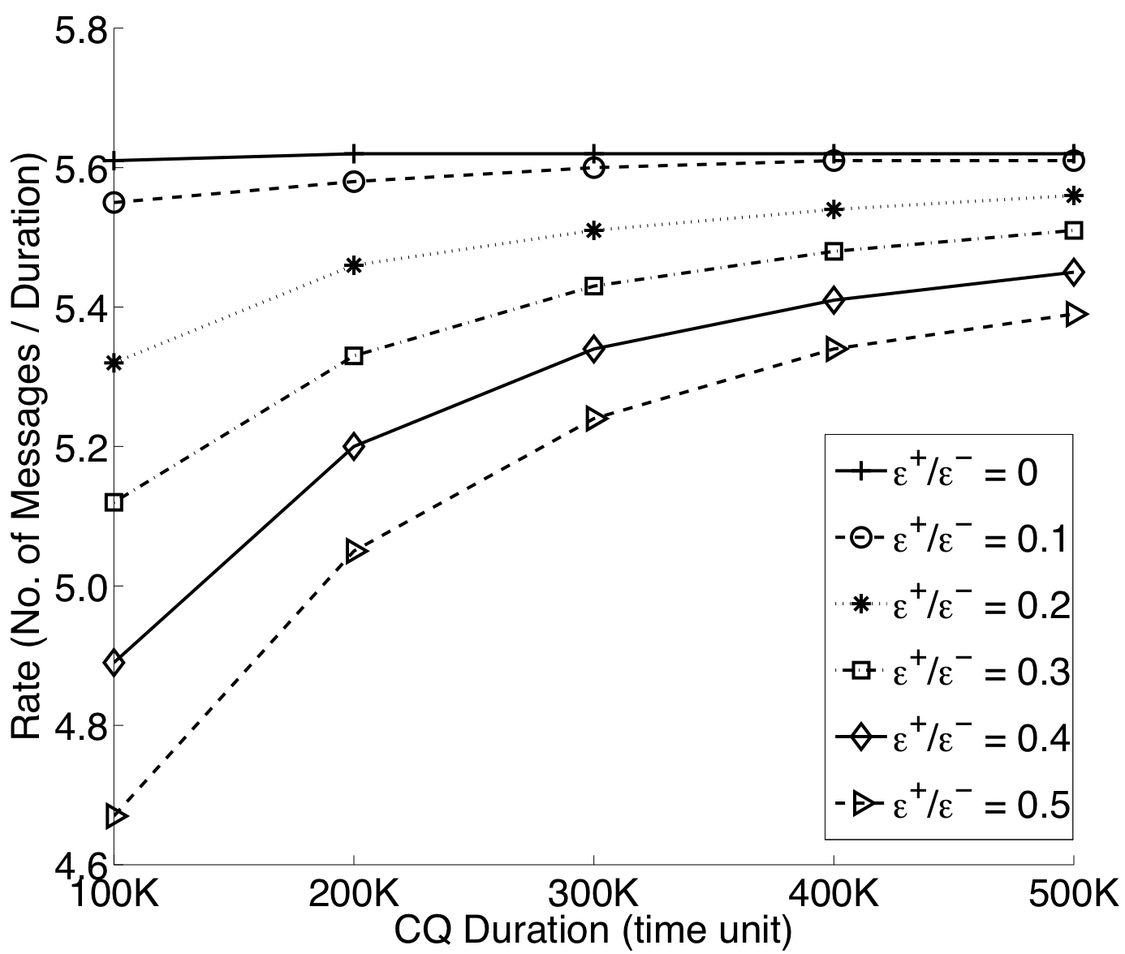
Long-Running Queries

Slide 32
Talk Outline
Non-value-based Tolerance
Filter Bound Framework
Filter Bound for Fraction-based Tolerance for Non-rank-based Queries
Experimental Results
Conclusions
Notes:
This is the outline of the talk.
First of all, I will briefly introduce some backgrounds of data streams and the related applications.
Through the introduction of the characteristics of stream applications, we will see why the approximate query processing is important for stream applications.
Our focus is on entity-based queries with non-value tolerance. I will discuss our motivation by introducing the current techniques on value-based approximate query processing, and what their shortcomings are in entity-based queries.
We developed a set of protocols to address the entity-based queries with non-value error tolerance. Specifically, I will discuss the Rank-based Tolerance Protocols, and the Fraction-based Tolerance Protocols we developed.
We conducted extensive experiments based on both synthetic data and real data to evaluate the performance of the protocols. I will also discuss some results and findings.
Finally, I will conclude my talk.

Slide 33
Talk Outline
Non-value-based Tolerance
Filter Bound Framework
Filter Bound for Fraction-based Tolerance for Non-rank-based Queries
Experimental Results
Conclusions
Notes:
This is the outline of the talk.
First of all, I will briefly introduce some backgrounds of data streams and the related applications.
Through the introduction of the characteristics of stream applications, we will see why the approximate query processing is important for stream applications.
Our focus is on entity-based queries with non-value tolerance. I will discuss our motivation by introducing the current techniques on value-based approximate query processing, and what their shortcomings are in entity-based queries.
We developed a set of protocols to address the entity-based queries with non-value error tolerance. Specifically, I will discuss the Rank-based Tolerance Protocols, and the Fraction-based Tolerance Protocols we developed.
We conducted extensive experiments based on both synthetic data and real data to evaluate the performance of the protocols. I will also discuss some results and findings.
Finally, I will conclude my talk.

Slide 34
Talk Outline
Non-value-based Tolerance
Filter Bound Framework
Filter Bound for Fraction-based Tolerance for Non-rank-based Queries
Experimental Results
Conclusions
Notes:
This is the outline of the talk.
First of all, I will briefly introduce some backgrounds of data streams and the related applications.
Through the introduction of the characteristics of stream applications, we will see why the approximate query processing is important for stream applications.
Our focus is on entity-based queries with non-value tolerance. I will discuss our motivation by introducing the current techniques on value-based approximate query processing, and what their shortcomings are in entity-based queries.
We developed a set of protocols to address the entity-based queries with non-value error tolerance. Specifically, I will discuss the Rank-based Tolerance Protocols, and the Fraction-based Tolerance Protocols we developed.
We conducted extensive experiments based on both synthetic data and real data to evaluate the performance of the protocols. I will also discuss some results and findings.
Finally, I will conclude my talk.

Slide 35
Tolerance & Filter Bounds [OJW03]
constraint
stream
Filter
bound
Update sent only when value crosses [l,u]
Constraint
Assignment
Unit
[l,u]
stream
Continuous Query +
Tolerance
stream
[l,u]
Query
Processing
Unit
User
stream
[l,u]
Result with Error Guarantee
data
Processor
dropped
Notes:
The system model of approximate query processing with error tolerance we considered is like the diagram:
Compared with the DSMS model shown before, a constraint assignment unit and the adaptive filters are added. Also user is allowed to specify the error tolerance with the continuous queries.
User submits continuous query together with the error tolerance to the central processing server, e.g. user submits a standing query to monitor the routers whose network traffic ranked the top 10 with not more than a rank of error.
The adaptive filters just mentioned are installed at each data source.
Based on the user-specified error tolerance, the Constraint assignment unit in central server distributes this tolerance budget as the filter bounds and deploys to the filters.
Only the updates exceed the filter bounds will be sent to the central server.
The constraint assignment unit also continuously interacts with the query processing unit to adaptively adjust the filter bound settings according to the latest updates of streams.

Slide 36
Fraction-based Tolerance
E⁺(t)
|A(t)|-E⁺(t)
E⁻(t)
Answer actually returned A(t)
True answer at time t
= |A(t)| - E⁺(t) + E⁻(t)
Notes:
Now, Let’s define the false positive and false negative formally.
We have the answer set returned to user denoted as A(t). And there is a true answer set at any given time.
Inside the A(t), there are maximum number of streams that do not satisfy query, we denote it as E+(t).
Also, there are maximum number of streams in true answer but they are excluded from A(t). We call this E-(t).
Then the false positive is defined as E+(t) over the size of answer set.
And the false negative is defined as E-(t) over the size of true answer, which is A(t)-E+(t)+E-(t).

Slide 37
Zero Tolerance
Update
Update
S₆
S₅
S₃
S₂
S₁
S₄
S₇
S₈
Notes:
Now let’s discuss how the fraction-based tolerance protocol applied on non-rank-based query. Specifically the range query will be discussed.
Suppose we have a range query Qj given the query range of [li,ui].
The idea of fraction-based tolerance is that, initially, the number of FP streams are selected from answer set A(t) to shutdown. That is the filter bound of these streams will be set to infinity so that even they jump out from the query range, update will not be transmitted to server and they are still be treated as answer. For example, S2 and S4 will not send update to server even their values deviate out of the range of [l,u]. We call these stream as non-updating streams.
Similarly, the number of FN streams are selected to shutdown from non-answer set at initialization. The update of these streams will also not be transmitted to server. For example, S5 and S8 will not be included into answer set even their values jump into range of [l,u].
By shutting down those non-updating streams, the communication cost is saved.
For all other streams, the query range is installed as filter bounds such that the update for those streams will be sent to server. We call these streams as updating streams.

Slide 38
Zero-Tolerance Protocol (ZT-NRP)
Given a range query [l,u]
Initialization Phase
  Emit [l,u] to each stream source
Maintenance Phase
  For any stream source, if its value crosses [l,u], send its new value to the server
  No message from server is needed
Generates a lot of updates!

Slide 39
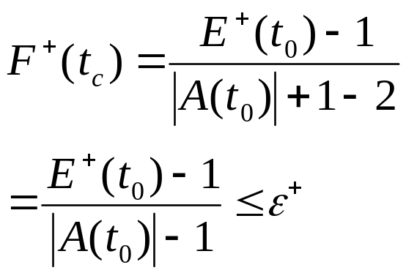
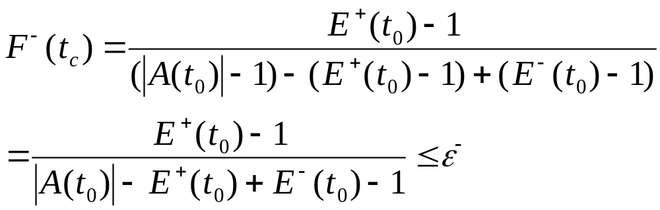
Fix: Consulting False Positive Filter
Filter [-∞, +∞]
S₆
S₅
S₃
S₂
S₄
S₇
S₈
S₁
Notes:
This proof shows correctness is satisfied if Vz is inside the range.

Slide 40
Fix Step 2: Consulting False -ve Filter
Filter [-∞, +∞]
Filter [+∞, +∞]
S₆
S₅
S₃
S₂
S₄
S₇
S₈
S₁
Range of Q = [l, u]
If S₄ ∉ A(t_{c})
  remove S₄ from A(t)
  Select stream S₇ ∉ A(t_{c}) with [+∞, +∞] filter
  If V₇∈ [l, u], insert S₇ into answer set
  install the [l, u] filter to S₇
  Prove that F ⁺(t_{c}) ≤ ε⁺ and F ⁻(t_{c}) ≤ ε⁻ are satisfied
Worst case: 5 messages
Notes:
If value of Sy is inside the range, then the correctness is immediately confirmed, because the fraction of false positive is decreased as there is one FP less.
On the other hand, the fraction of false negative will remain unchanged as the decreased FP cancels out the decreased answer size.
Therefore, correctness is fixed.

Slide 41
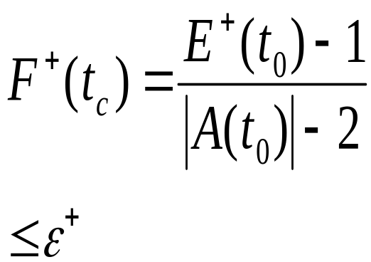
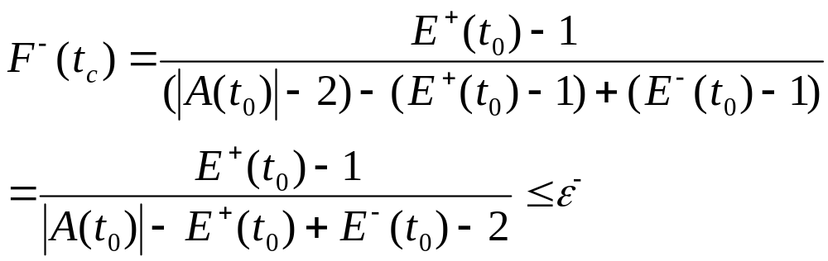
Fix Step 2: Consulting False -ve Filter
Filter [-∞, +∞]
Filter [+∞, +∞]
S₆
S₅
S₃
S₂
S₄
S₇
S₈
S₁
Notes:
This proof shows correctness is satisfied if Vz is outside the range.

Slide 42
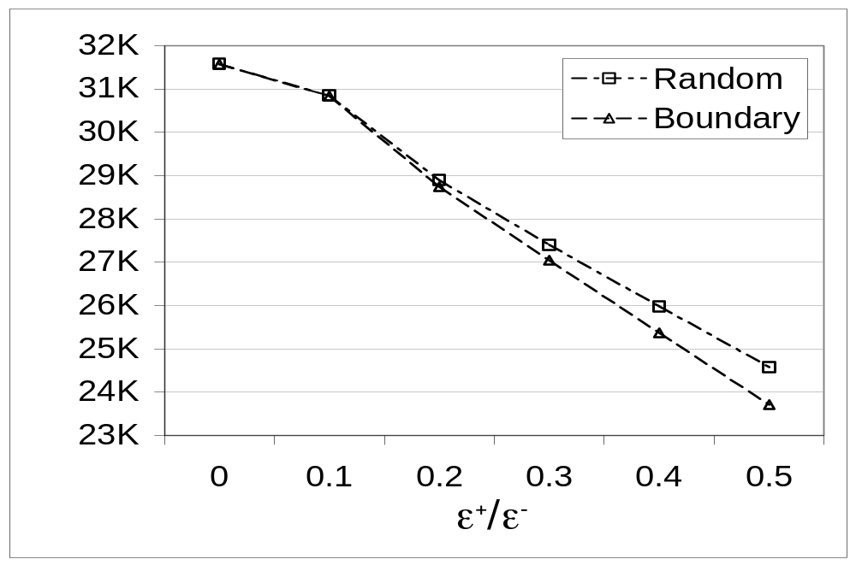
False +ve / -ve Filters Selection Heuristic

