Slide 1
Summarizing and mining inverse distributions on data streams via dynamic inverse sampling
Presented by
Graham Cormode
cormode@bell-labs.com
S. Muthukrishnan
muthu@cs.rutgers.edu
Irina Rozenbaum
rozenbau@paul.rutgers.edu

Slide 2
Outline
Defining and motivating the Inverse Distribution
Queries and challenges on the Inverse Distribution
Dynamic Inverse Sampling to draw sample from Inverse Distribution
Experimental Study

Slide 3
Data Streams & DSMSs
Numerous real world applications generate data streams:
  IP network monitoring – financial transactions
  click streams – sensor networks
  Telecommunications – text streams at application level, etc.
Data streams are characterized by massive data volumes of transactions and measurements at high speeds.
Query processing is difficult on data streams:
  We cannot store everything, and must process at line speed.
  Exact answers to many questions are impossible without storing everything
  We must use approximation and randomization with strong guarantees.
Data Stream Management Systems (DSMS) summarize streams in small space (samples and sketches).

Slide 4




DSMS Application:
IP Network Monitoring
Needed for:
  network traffic patterns identification
  intrusion detection
  reports generation, etc.
IP traffic stream:
  Massive data volumes of transactions and measurements:
    over 50 billion flows/day in AT&T backbone.
  Records arrive at a fast rate:
    DDoS attacks - up to 600,000 packets/sec
Query examples:
  heavy hitters
  change detection
  quantiles
  Histogram summaries

Slide 5
Forward and Inverse Views
Consider the IP traffic on a link as packet p representing (i_{p}, s_{p})
pairs where i_{p} is a source IP address and s_{p} is a size of the packet.
Problem A.
Which IP address sent the
most bytes?
That is , find i such that
∑_{p|ip=i} s_{p} is maximum.
Forward distribution.
Problem B.
What is the most common
volume of traffic sent by an
IP address?
That is , find traffic volume W
s.t |{i|W = ∑_{p|ip=i} s_{p}}| is
maximum.
Inverse distribution.
Notes:
Message here: a lot of focus has been on problems on the forward distribution, defined by packet arrivals (eg Heavy hitters, quantiles, etc.).
But same queries applied to the inverse dbn are just as meaningful, and have not been well-studied before.

Slide 6
The Inverse Distribution
If f is a discrete distribution over a large set X, then inverse
distribution, f⁻¹(i), gives fraction of items from X with count i.
Inverse distribution is f⁻¹[0…N],
f⁻¹(i) = fraction of IP addresses which sent i bytes.
= |{ x : f(x) = i, i⁻¹≠0}|/|{x : f(x)⁻¹≠0}|
F⁻¹(i) = cumulative distribution of f⁻¹
= ∑_{j > i} f⁻¹(j) [sum of f⁻¹(j) above i]
Fraction of IP addresses which sent < 1KB of data = 1 – F⁻¹(1024)
Most frequent number of bytes sent = i s.t. f⁻¹(i) is greatest
Median number of bytes sent = i s.t. F⁻¹(i) = 0.5
Notes:
This formalizes previous slide (and to some extent repeats it).

Slide 7
Queries on the Inverse Distribution
Particular queries proposed in networking map onto f⁻¹,
  f⁻¹(1) (number of flows consisting of a single packet) indicative of network abnormalities / attack [Levchenko, Paturi, Varghese 04]
  Identify evolving attacks through shifts in Inverse Distribution [Geiger, Karamcheti, Kedem, Muthukrishnan 05]
Better understand resource usage:
  what is dbn. of customer traffic? How many customers < 1MB bandwidth / day? How many use 10 – 20MB per day?, etc.
  → Histograms/ quantiles on inverse distribution.
Track most common usage patterns, for analysis / charging
  requires heavy hitters on Inverse distribution
Inverse distribution captures fundamental features of the distribution, has not been well-studied in data streaming.

Slide 8
Forward and Inverse Views on IP streams
Consider the IP traffic on a link as packet p representing (i_{p}, s_{p})
pairs where i_{p} is a source IP address and s_{p} is a size of the packet.
Forward distribution:
Work on f[0…U] where f(x) is the number of bytes sent by IP address x.
Each new packet (i_{p}, s_{p}) results in f[i_{p}] ←f[i_{p}] + s_{p}.
Problems:
  f(i) = ?
  which f(i) is the largest?
  quantiles of f ?
Inverse distribution:
Work on f⁻⁻¹[0…K]
Each new packet results in
f⁻¹[f[i_{p}]]←f⁻¹[f[i_{p}]] − 1 and
f⁻¹[f[i_{p}] + s_{p}]←
f⁻¹[f[i_{p}] + s_{p}]+1.
Problems:
  f⁻¹(i) = ?
  which f⁻¹(i) is the largest?
  quantiles of f⁻¹ ?
Notes:
This says, suppose we are seeing a stream packets defining the distribution, how does each arrival affect the relevant distribution?
Queries we may ask are the same on each distribution.
Implication here is that inverse distribution is harder to maintain information about.
When viewing packet arrivals, one can easily update information about the forward distribution, but it is more challenging to process data of this form and maintain information about the inverse distribution.

Slide 9
Inverse Distribution on Streams: Challenges I
7/7
6/7
5/7
4/73/7
2/7
1/7
5
4
3
2
1
f(x)
F⁻¹(x)
f ⁻¹(x)
3/7
2/7
1/7
x
1 2 3 4 5
i
1 2 3 4 5
i
If we have full space, it is easy to go between forward and inverse distribution.
But in small space it is much more difficult, and existing methods in small space don’t apply.
Find f(192.168.1.1) in small space, with query give a priori – easy: just count how many times the address is seen.
Find f⁻¹(1024) – is provably hard (can’t find exactly how many IP addresses sent 1KB of data without keeping full space).
Notes:
This slide attempts to give an example of the forward and inverse distribution on the same data set. It shows the effect of a new packet arrival on the forward, inverse, and cumulative inverse distribution.
The colors of blocks here indicate count classes: all items with the same count have same color. Also, note that there is a “conservation of mass” effect: number of blocks in forward dbn is same as number of blocks in cumulative inv dbn. Each column in forward dbn corresponds to one block in inv dbn.
Animation here shows effect of a new item arriving.
Count of the item in forward distribution f(x) increases by 1
This causes the inverse distribution to shift: since count changes from 1 to 2, the block shifts from column 1 to col 2
In cumulative inverse distribution an extra block arrives, preserving the conservation of mass.
The text on the slide emphasizes the separation between forward and inverse views of the world: querying a fixed point is easy if that point is given before the data on the fwd dbn, but hard on the inverse distribution.

Slide 10
Inverse Distribution on Streams: Challenges II, deletions
How to maintain summary in presence of insertions and deletions?
Insertions only
updates s_{p} > 0
Insertions and Deletions
updates s_{p} can be arbitrary
Stream of arrivals and departures
Stream of arrivals
+
original
distribution
original
distribution
-
estimated
distribution
estimated
distribution
Can
sample
How to summarize?
?
?
Notes:
Need to explain the difficulty of summarizing in the presence of deletions.
With arrivals only, we can sample, and this is an effective summary for a variety of problems.
A careful sampling approach will work for inverse distributions.
For insertions and deletions, it can be hard to maintain a sample.
We want our summary to be good, whatever the sequence of insertions and deletions.
But, if there are millions of insertions, followed by deletions of all but a handful, then if the summary is accurate we must be able to identify all the remaining items exactly.
Using random sampling it is very unlikely that we pick the remaining items in our sample.
We need an approach that will adapt to this situation.

Slide 11
Our Approach: Dynamic Inverse Sampling
Many queries on the forward distribution can be answered effectively by drawing a sample.
  Draw an x so probability of picking x is f(x) / ∑_{y} f(y)
Similarly, we want to draw a sample from the inverse distribution in the centralized setting.
  draw (i,x) s.t. f(x)=i, i≠0 so probability of picking i is
  f⁻¹(i) / ∑_{j} f⁻¹(j) and probability of picking x is uniform.
Drawing from forward distribution is “easy”: just uniformly decide to sample each new item (IP address, size) seen
Drawing from inverse distribution is more difficult, since probability of drawing (i,1) should be same as (j,1024)
Notes:
Insight here: the uniform sampling from the forward distribution can be thought of as returning each item with probability proportional to the size of its column out of the total number of blocks (in the block diagram).
For the inverse distribution, we also sample each block uniformly, but here a block corresponds to a unique item (with non-zero count).
So we want to sample uniformly from the set of items with non-zero count, and return the item and count.
The key idea is that we can use appropriately chosen hashing techniques to pick items to track.
We will show how this works in the presence of deletions.

Slide 12
Dynamic Inverse Sampling: Outline
Data structure split into levels
For each update (i_{p}, s_{p}):
  compute hash l(i_{p}) to a level in the data structure.
  Update counts in level l(i_{p}) with i_{p} and s_{p}
x
count
unique
x
M
l(x)
Mr
Mr²
Mr³
…
…
0
At query time:
  probe the data structure to return (i_{p}, Σ s_{p}) where i_{p} is sampled uniformly from all items with non-zero count
  Use the sample to answer the query on the inverse distribution.

Slide 13
Hashing Technique
Use hash function with exponentially decreasing distribution:
Let h be the hash function and r is an appropriate const < 1
Pr[h(x) = 0] = (1-r)
Pr[h(x) = 1] = r (1-r)
…
Pr[h(x) = l] = r^{l}(1-r)
Track the following information as updates are seen:
x: Item with largest hash value seen so far
unique: Is it the only distinct item seen with that hash value?
count: Count of the item x
Easy to keep (x, unique, count) up to date for insertions only
x
count
unique
x
M
l(x)
Mr
Mr²
Mr³
…
…
0
Challenge:
How to maintain in presence of deletes?
Notes:
For example, if r = ½ then prob of an item going to first level is ½, to second level is ¼, to third level is 1/8 and so on.
Once we fix the hash function, same item goes to same level every time it is seen.
The idea of using exponentially decreasing probability of hashing to different levels occurs in several streaming approaches.
It spreads out the items, and so there is a good chance of there being a level where there is only one item.
This item is picked uniformly from the set of items with non-zero count, so it can be used as a sampled item from inverse distribution.
Procedure fails if multiple items collide at the same level.
Challenge is to maintain this information (x, uniq, count) in the presence of both insertions and deletions.

Slide 14
Collision Detection: inserts and deletes
sum
count
coll. detection
x
M
Level 0
Mr
update
output
l(x)
Mr²
insert 13
13/1=13
Mr³
insert 13
26/2=13
insert 7
collision
…
delete 7
26/2=13
…
0
33
1
16 8 4 2 1
2
26
3
13
0
1
+1
+2
+3
+1
+1
+2
+2
+1
+1
+2
+3
+1
+1
+2
+3
Simple: Use approximate distinct element estimation routine.

Slide 15
Outline of Analysis
Analysis shows: if there’s unique item, it’s chosen uniformly from set of items with non-zero count.
Can show whatever the distribution of items, the probability of a unique item at level l is at least constant
Use properties of hash function:
  only limited, pairwise independence needed (easy to obtain)
Theorem: With constant probability, for an arbitrary sequence of insertions and deletes, the procedure returns a uniform sample from the inverse distribution with constant probability.
Repeat the process independently with different hash functions to return larger sample, with high probability.
Level l

Slide 16
Application to Inverse Distribution Estimates
Overall Procedure:
  Obtain the distinct sample from the inverse distribution of size s;
  Evaluate the query on the sample and return the result.
    Median number of bytes sent: find median from sample
    The most common volume of traffic sent: find the most common from sample
    What fraction of items sent i bytes: find fraction from the sample
Example:
  Median is bigger than ½ and smaller than ½ the values.
  Answer has some error: not ½, but (½ ± ε)
Theorem: If sample size s = O(1/ε² log 1/δ) then answer from the sample is between (½-ε) and (½+ε) with probability at least 1-δ.
Proof follows from application of Hoeffding’s bound.

Slide 17
Experimental Study
Data sets:
Large sets of network data drawn from HTTP log files from the 1998 World Cup Web Site (several million records each)
Synthetic data set with 5 million randomly generated distinct items
Used to build a dynamic transactions set with many insertions and deletions
(DIS) Dynamic Inverse Sampling algorithms – extract at most one sample from each data structure
(GDIS) Greedy version of Dynamic Inverse Sampling – greedily process every level, extract as many samples as possible from each data structure
(Distinct) Distinct Sampling (Gibbons VLDB 2001) draws a sample based on a coin-tossing procedure using a pairwise-independent hash function on item values

Slide 18
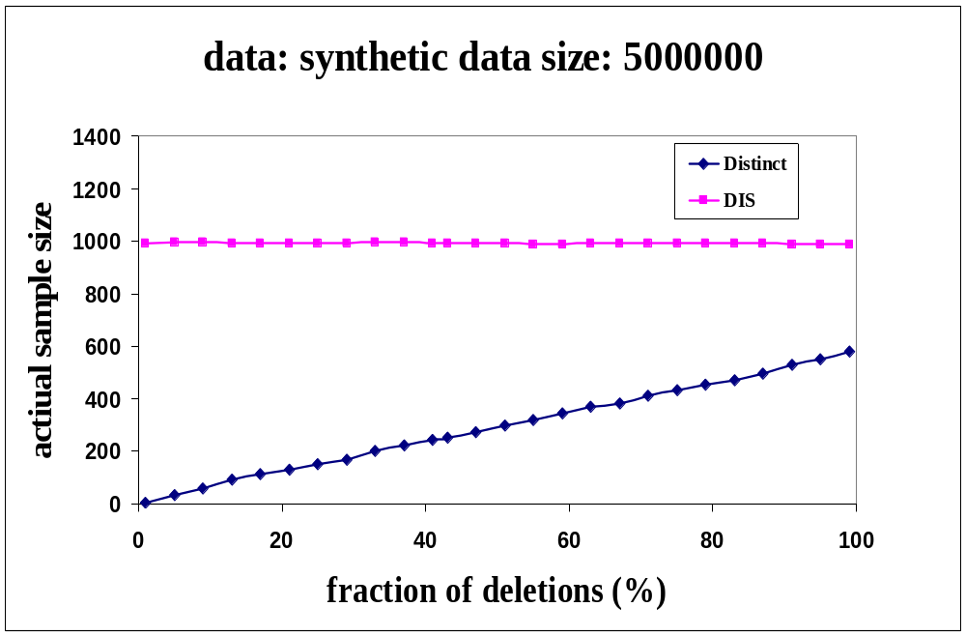
Sample Size vs. Fraction of Deletions
Desired sample size is 1000.
X = 80%
Distinct ≈ 12%
DIS ≈ 100%
X = 99%
Distinct < 1%
DIS ≈ 100%
Notes:
Shows that as the data set becomes more dynamic (ie there are a greater fraction of deletions), existing methods return a smaller sample while the proposed method retains same sample size.

Slide 19
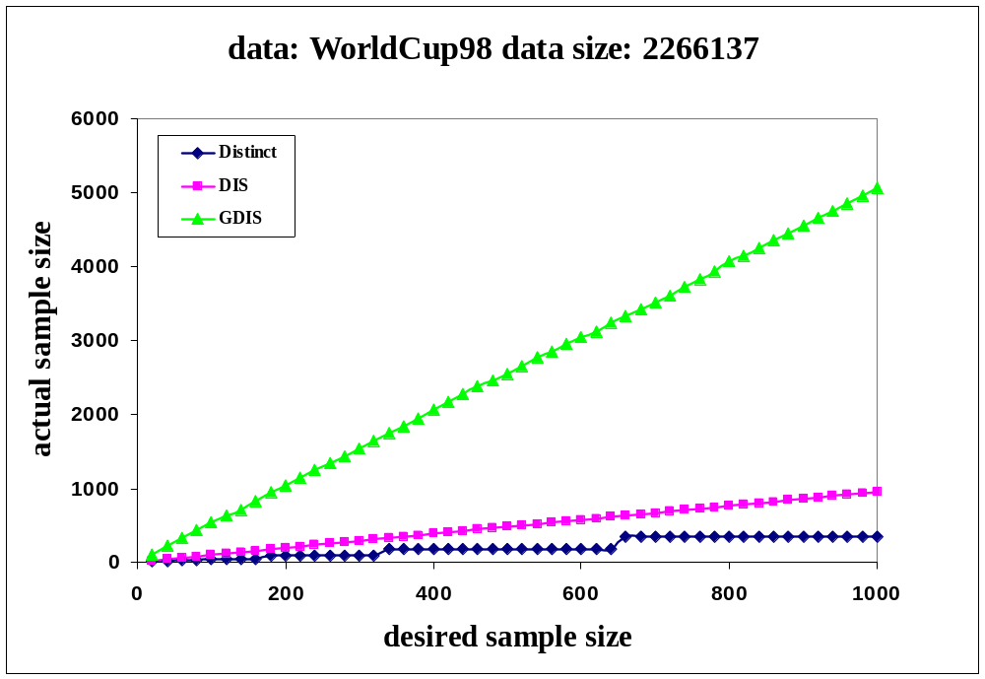
Returned Sample Size
Experiments were run on the client ID attribute of the HTTP log data. 50% of the inserted records were deleted.
X = 100
Distinct – 45%
DIS – 99%
GDIS ≈ 5 items per
data structure
X = 1000
Distinct – 30%
DIS – 95%
GDIS ≈ 5 items per
data structure
Notes:
On real data set, we see that as desired sample size increases, returned sample size scales linearly

Slide 20
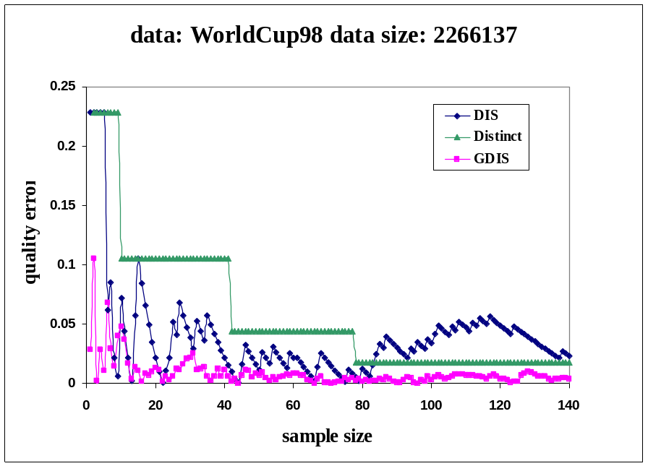
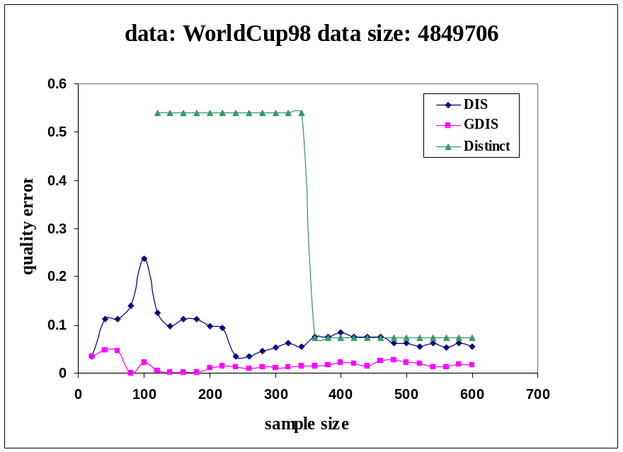
Sample Quality
Inverse range query:
  Compute the fraction of records with size greater than i=1024 and compare it to the exact value computed offline
Inverse quantile query:
  Estimate the median of the inverse distribution using the sample and measure how far was the position of the returned item i from 0.5.
Notes:
Shows that the sampling approach is effective at answering queries on the inverse distribution.

Slide 21
Related Work
Distinct sampling under insert only:
  Gibbons: Distinct Sampling, VLDB 2002.
  Datar and Muthukrishnan: Rarity and similarity, ESA 2002.
Distinct sampling under deletes also:
  Frahling, Indyk, Sohler: Dynamic geometric streams, STOC 2005.
  Ganguly, Garofalakis, Rastogi: Processing Set Expressions over Continuous Update Streams, SIGMOD 2003.
Inverse distributions:
  Has recently informally appeared in networking papers.
Notes:
Message from this slide: there has been some related work in the past that can be applied to this problem, mostly on special cases (ie insertions only).
Some recent work can be applied to the problem with deletions with some modifications, in our work we showed tighter bounds and limited independence requirements for the specific problem of sampling from the inverse distribution.

Slide 22
Conclusions
We have formalized Inverse Distributions on data streams and introduced Dynamic Inverse Sampling method that draws uniform samples from the inverse distribution in presence of insertions and deletions.
With a sample of size O(1/ε²), can answer many queries on the inverse distribution (including point and range queries, heavy hitters, quantiles) up to additive approximation of ε.
Experimental study shows that proposed methods can work at high rates and answer queries with high accuracy
Future work:
  Incorporate in data stream systems
  Can we also sample from forward dbn under inserts and deletes?
Notes:
Can mention future work (From back up slide):
Try to extend results to sampling from forward dbn when there are deletions (turns out to be hard, it seems) and put into streaming system eg. Gigascope.
Speed ups are possible, but analysis yet to be done for faster implementations.

Slide 24

Future Work
Incorporate Inverse Distribution into Data Stream Management System
Development of sampling techniques from forward distribution under inserts and deletes

Slide 25
DIS (example of insertions)
We consider the following example sequence of insertions of items:
Input: 4, 7, 4, 1, 3, 4, 2, 6, 4, 2
Suppose these hash to levels in an instance of our data structure as follows:
x
1 2 3 4 5 6 7 8
l(x)
1 3 2 1 1 1 2 1
Time Level 1 Level 2 Level 3
Step item count unique item count unique item count unique
1. 4 1 T 0 0 T 0 0 T
2. 4 1 T 7 1 T 0 0 T
3. 4 2 T 7 1 T 0 0 T
4. 4 3 F 7 1 T 0 0 T
5. 4 3 F 7 2 F 0 0 T
6. 4 4 F 7 2 F 0 0 T
7. 4 4 F 7 2 F 2 1 T
8. 4 5 F 7 2 F 2 1 T
9. 4 6 F 7 2 F 2 1 T
10. 4 6 F 7 2 F 2 2 T
(count,item)
(1,4)
(1,4)(2,7)
(1,4)(2,7)
(2,7)
(1,2)
(1,2)
(1,2)
(2,2)

Slide 26
Inverse Distribution on Streams: Challenges II, deletions
Maintain summary in presence of insertions and deletions?
Insertions only
updates s_{p} > 0
Insertions and Deletions
updates s_{p} can be arbitrary
Stream of arrivals and departures
Stream of arrivals
+
original distribution
original distribution
-
estimated distribution
estimated distribution
Can
sample
How to summarize?
?
?
Notes:
Need to explain the difficulty of summarizing in the presence of deletions.
With arrivals only, we can sample, and this is an effective summary for a variety of problems.
A careful sampling approach will work for inverse distributions.
For insertions and deletions, it can be hard to maintain a sample.
We want our summary to be good, whatever the sequence of insertions and deletions.
But, if there are millions of insertions, followed by deletions of all but a handful, then if the summary is accurate we must be able to identify all the remaining items exactly.
Using random sampling it is very unlikely that we pick the remaining items in our sample.
We need an approach that will adapt to this situation.

Slide 27
Sampling Insight
Each distinct item x contributes to one pair (i,x)
Need to sample uniformly from these pairs.
Basic insight: sample uniformly from the items x and count how many times x is seen to give (i,x) pair that has correct i and is uniform.
How to pick x uniformly before seeing any x?
Use a randomly chosen hash function on each x to decide whether to pick it (and reset count).
5
4
3
2
1
f(x)
f ⁻¹(x)
3/7
2/7
1/7
1 2 3 4 5
i
x

Slide 28
Hashing Analysis
Theorem: If unique is true, then x is picked uniformly.
Probability of unique being true is at least a constant.
(For right value of r, unique is almost always true in practice)
Proof outline: Uniformity follows so long as hash function h is at least
pairwise independent.
Hard part is showing that unique is true with constant prob.
Let D is number of distinct items. Fix l so 1/r · Dr^{l} · 1/r².
In expectation, Dr^{l} items hash to level l or higher
Variance is also bounded by Dr^{l}, and we ensure 1/r² · 3/2.
Analyzing, can show that there is constant probability that there are either 1 or 2 items hashing to level l or higher.

Slide 29
Collision Detection: inserts and deletes
sum
count
coll. detection
x
M
Level 0
Mr
update
output
l(x)
Mr²
insert 13
13/1=13
Mr³
insert 13
26/2=13
insert 7
collision
…
delete 7
26/2=13
…
0
16 8 4 2 1
+1
+1
+2
+2
1
+3
+1
0
1
2
13
3
33
26
+2
+1
+1
+2
+3
+1
+3
+2
+1
Simple: Use approximate distinct element estimation routine.

Slide 30
Collision Detection: inserts and deletes
sum
count
coll. detection
x
M
Level 0
Mr
update
output
l(x)
Mr²
insert 13
13/1=13
Mr³
insert 13
26/2=13
insert 7
collision
…
delete 7
26/2=13
…
0
33
1
16 8 4 2 1
2
26
3
13
0
1
+1
+2
+3
+1
+1
+2
+2
+1
+1
+2
+3
+1
+1
+2
+3
Simple: Use approximate distinct element estimation routine.
Notes:
When there are deletions, we keep track of the sum of item identifiers seen at each level, and the count of items seen.
Note that these are easy to maintain correctly with insertions and deletions: we just have to add or subtract the appropriate values.
We also need to track whether there is one distinct item (possibly occurring many times), or a mixture of different items.
This is done by the “collision detection” section, which tracks information about the set of items hashing to that level, and indicates whether there is a unique item or more than one.
For simplicity, suppose that this is an approximate distinct element counter that allows insertions and deletions, and approximates the number of unique items that are currently present.
(might be best to skip over detailed explanation of the example.
Key observation is that if there is a unique item, then the identity of the item is revealed by (sum/count).
This item is then returned as the sampled item, along with its count.

Slide 31
Hashing Analysis
If only one item at level l, then unique is true
If two items at level l or higher, can go deeper into the analysis and show that (assuming there are two items) there is constant probability that they are both at same level.
If not at same level, then unique is true, and we recover a uniform sample.
Probability of failure is p = r(3+r)/(2(1+r)).
Number of levels is O(log N / log 1/r)
Need 1/r > 1 so this is bounded, and
1/r2 ¸ 3/2 for analysis to work
End up choosing r = p(2/3), so p is < 1
Level l

Slide 32
Collision Detection (cont’d)
Deterministic (previous slide):
  Suppose |X| = m = 2b so each x X is represented as a b bit integer. We can keep 2b counters c[j,k] indexed by j=1…b and k {0,1}.
Probabilistic:
  Draw t hash functions, g₁….g_{t}, which map items uniformly onto {0,1}, and a set of t×2 counters c[j,k].
Heuristic:
  Compute q new hash functions g_{j}[x] mapping items x onto 0…m, and take the summation of g(x) as sumg[j, l(x)].
 | on insert | on delete | collision test | space, time
Deterministic | c[j,bit(j,x)]++ | c[j,bit(j,x)]-- | for any j, c[j,0]≠0 & c[j,1]≠0 | O(b) O(b)
Probabilistic | c[j,g_{j}(x)]++ | c[j,g_{j}(x)]-- | same | O(t) O(t)
Heuristic | sumg[j,l(x)]+g(x) | sumg[j,l(x)]+g(x) | for any j, sumg[j, l(x)] ≠ g_{j}(x)*count[l] | O(q) O(q)

Slide 33
Sample Size
This process either draws a single pair (i,x), or may not return anything.
In order to get a larger sample with high probability, repeat the same process in parallel over the input with different hash functions h₁ … h_{s} to draw up to s samples (i_{j},x_{j})
Let e = p(2 log (1/d)/s). By Chernoff bounds, if we keep
S = (1+2e) s/(1 – p) copies of the data structure, then we recover at least s samples with probability at least 1-d
Repetitions are a little slow — for better performance, keeping the s items with the s smallest hash values is almost uniform, and faster to maintain.

Slide 34
Evaluation
Output process:
  At each level:
    If level is not empty, check whether there was a collision at the level
    If no collision, extract item from the level

Slide 35
Experimental Study
5 more slides

Slide 36
Key features of existing sampling methods
Algorithms | Type | Method | Deletions | Random
Reservoir Sampling Backing Sample Weighted Sampling Concise Sampling Count Sampling | Fwd Fwd Fwd Fwd Fwd | WoR WoR WR CF CF | No Few No No Few | Full Full Full Full Full
Minwise-hashing Distinct sampling Dynamic Inverse Sampling | Inv Inv Inv | WR CF CF,WR | No Few Yes | 1/ε –wise Pairwise Pairwise

