Slide 1
AIPR Reasoning and Retrieval Logic
Notes:
A3019

Slide 2




Propositional Logic
Statements are made from propositions, True/False, Boolean Logic
Tautology – always true
Contradiction - always false
Example
Cat is a number (False)
1-1=11 (False)
The capital of Greece is Athens (True)

Slide 3
Truth Table
P | Q | ∧ | ∨ | => | ⬄ | ¬ P
T | T | T | T | T | T | F
T | F | F | T | F | F | F
F | T | F | T | T | F | T
F | F | F | F | T | T | T

Slide 4
Operators properties (just for your information)
Commutativity
P∧ Q= Q ∧ P, or
P ∨ Q = Q ∨ P
Associativity
(P ∧ Q) ∧ R= P ∧ (Q ∧ R),
(P ∨ Q) ∨ R= P ∨ (Q ∨ R)
Identity
P ∧ True = P,
P ∨ True= True
Distributive
P∧ (Q ∨ R) = (P ∧ Q) ∨ (P ∧ R).
P ∨ (Q ∧ R) = (P ∨ Q) ∧ (P ∨ R)
DE Morgan’s Law
¬ (P ∧ Q) = (¬P) ∨ (¬Q)
¬ (P ∨ Q) = (¬ P) ∧ (¬Q)
Double-negation elimination
¬ (¬P) = P

Slide 5
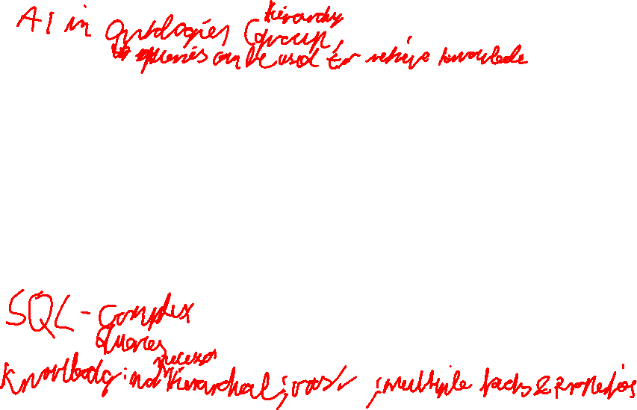
Knowledge representation Techniques
Semantic Network Representation (graphical networks, nodes:objects, arcs:relationship)
IS-A relation (Inheritance)
Kind-of-relation
And rules!
is-a
cat
mammal
smart
is-a
is-a
Ichiro
is-a
is-colored
animal
is-owned-by
ginger
Marcus
Notes:
coloTiget

Slide 6

Breadth First
S
Depth First
S
A
B
A
B
C
D
J
H
C
D
J
H
E
F
I
E
F
I
G
G

Slide 7
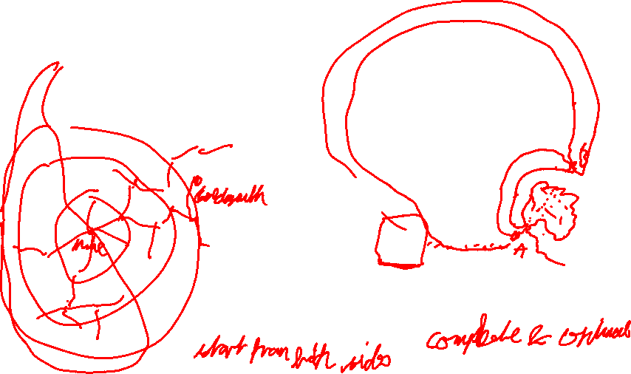
Informed or Heuristic Search
Domain knowledge, e.g., estimated distance
Not guaranteed for best solution but solution in reasonable time
A* Search Algorithm
minimizing the total estimated solution cost
f(n) = g(n)+h(n)
Estimated cost of the cheapest solution through node n
Estimated cost to get from node n to goal node
Cost to reach node n

Slide 8
Compare them – please discuss!
BFS | DFS
Will provide a solution if any. | No guarantee that will find a solution.
If there are more than one solutions for a given problem, it will provide the optimal solution with the least number of steps. | Might get trapped in an infinite loop.
Requires lots of memory since each level of the tree must be saved into memory to expand the next level. | Requires very less memory as it only needs to store a stack of the nodes on the path from root node to the current node.
Needs lots of time if the solution is far away from the root node. | Needs less time to reach the goal node, if it traverses the right path.
Needs less time to reach the goal node, if the goal is close | Could miss the goal and then need a lot of time; then might end up in a long path
Bonus: when will DFS not find a solution?
What about A*
Notes:
Breadth-first Search
Advantages:
BFS will provide a solution if any solution exists.
If there are more than one solutions for a given problem, then BFS will provide the minimal solution which requires the least number of steps.
Disadvantages:
It requires lots of memory since each level of the tree must be saved into memory to expand the next level.
BFS needs lots of time if the solution is far away from the root node.
Depth first search
Advantage:
DFS requires very less memory as it only needs to store a stack of the nodes on the path from root node to the current node.
It takes less time to reach to the goal node than BFS algorithm (if it traverses in the right path).
Disadvantage:
There is the possibility that many states keep re-occurring, and there is no guarantee of finding the solution.
DFS algorithm goes for deep down searching and sometime it may go to the infinite loop.

Slide 9



Minimax – AlphaBeta pruning
$α=−∞$ : max
$β=\text{+}∞$ : min
5
A
5
A
Max
5
B
0
C
5
B
2
C
Min
5
D
9
E
2
F
0
G
5
D
6
E
2
F
G
Max
3
5
6
9
1
2
0
-4
3
5
6
9
1
2
0
-4
Notes:
6

Slide 10
CSP Example
Graph representation
B
C
X = A, B, C, D, E, F
D = red, green, blue
C = neighboring squares should have different color
Bonus question: are three colors always enough?
A
D
E
F
A | B | C
 | D |  | E
 |  |  | F
A | B | C
 | D |  | E
 |  |  | F

