Slide 1
Artificial Intelligence and Pattern Recognition - D7062E
Marcus Liwicki, Christoforos Kanellakis, György Kovács, Rajkumar Saini, and Homam Mokayed. (Teachers)
Gustav Grund Pihlgren (TA)
Hamam.Mokayed@ltu.se

Slide 2

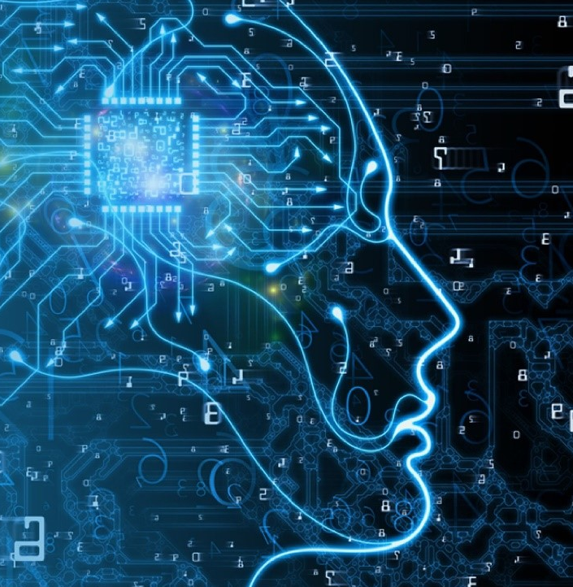

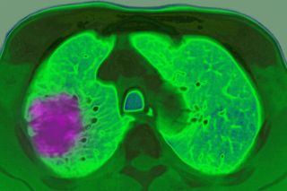

Slide 3
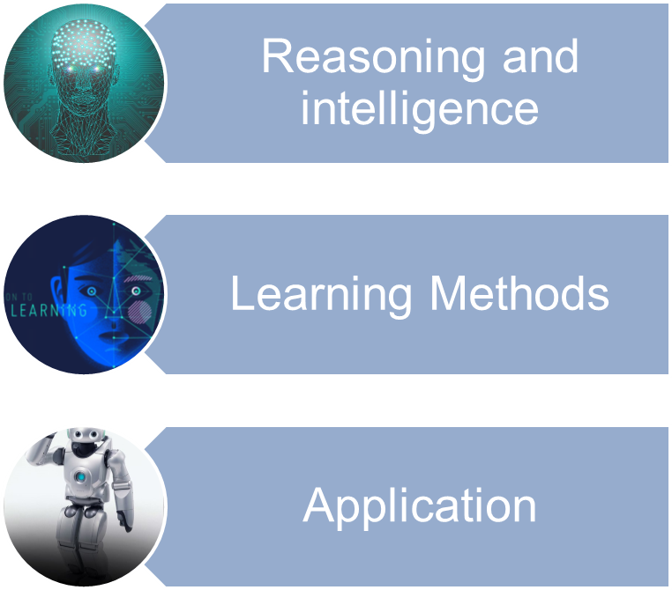
Our Journey

Slide 4
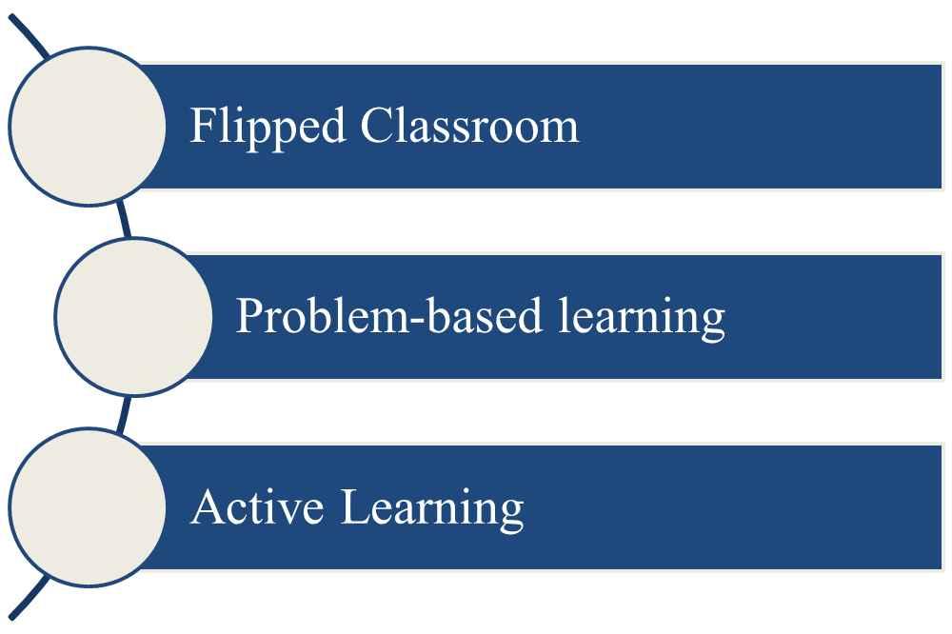
Teaching
Approach

Slide 5
Learning gives best results when it is more independent and discovery oriented, therefor, we implement the following pedagogical concepts while designing the course:
Flipped classroom
Short offline videos
Preparing questions before the Q/A session
Problem-based learning approach
Designing problems to be solved in Lab’s session with different level of difficulties
Active Learning
Weekly summary reports
Peer reviews
Knowledge reflection for every week
Teaching
Approach

Slide 6
1. Week 35 - What is AI?
2. Week 36 - Reasoning and Retrieval
3. Week 37 - Instance-based Learning
4. Week 38 - Clustering
5. Week 39 - Training-based Classifier
6. Week 40 - Ensemble Methods
7. Week 41 - Robotics
8. Week 42 - Ethics and AI.
AIPR
Syllabus
 | Reflective Session
 | Live Session

Slide 7
Week 38 - Project introduction.
Week 39 - Sunday: Project Task 1 deadline
Week 40 - Sunday: Project Task 2 deadline
Week 41 - Sunday: Project Task 3 deadline
Week 42 – Project Presentation.
Week 43 – Exams Oral exam
Important Dates

Slide 8
Videos, Discussion forums, Quizzes, and other material on the course page.
In-person/live Lectures and Lab sessions.
A project, done in pairs, where you will solve a technical problem split into three subtasks.
One out of three books
A final oral exam
Main Components

Slide 9
The 7.5 credits of the course are split between 4.5 credits from the oral exam and 3.0 credits from the quizzes and group project.
Pass all quizzes and all parts of the group project
(pass or fail)
Pass Oral Exam
"U" for failed or "3", "4", and "5" as increasing
levels of passing grades.
Passing Criteria

Slide 10
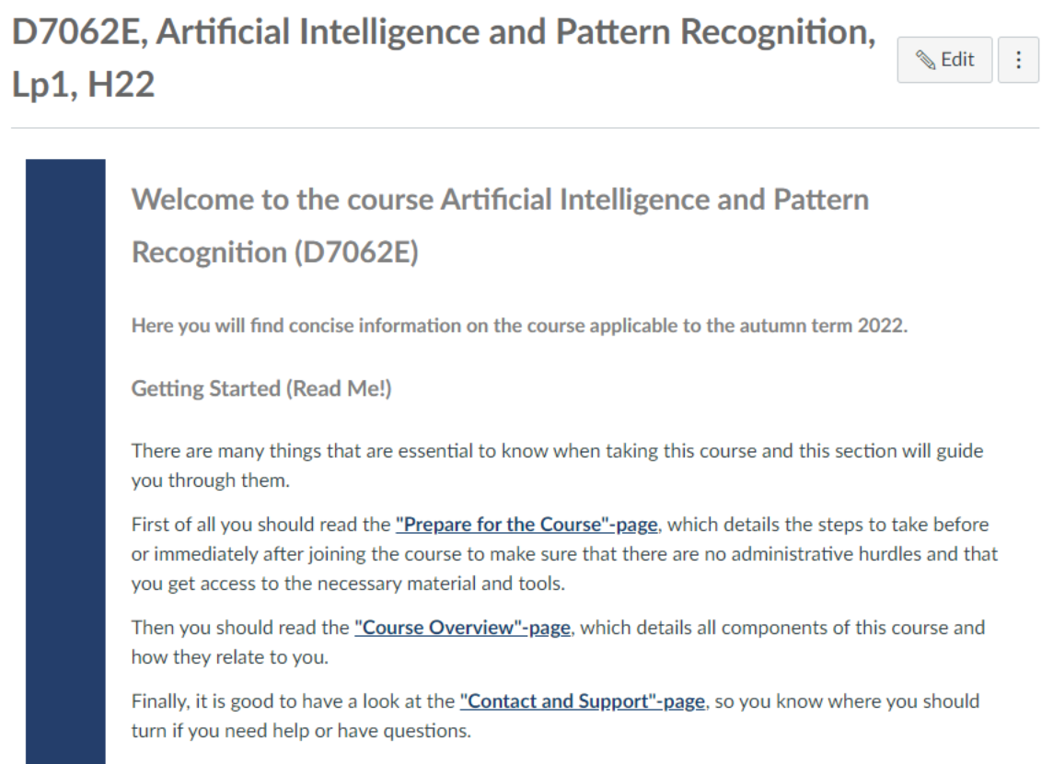
AIPR Canvas Page

