Slide 1
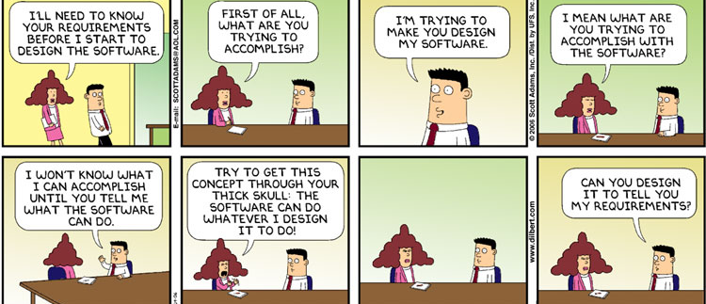
Software Engineering
Lecture 6 – Quality Attributes

Slide 2
Redesign (q4)
Coding best practices (metrics) (1p):
Classification of functionality / classes (comprehensibility) (2p):
Quality attributes (reasoning) (2p):
Design patterns (reasoning - if applicable) (1p):

Slide 3
Re-engineering (q5)
Customising game mechanics and phases of the game (3p):
Develop and understand code based on quick glance (1p):
Coding best practices (structure, standards, naming, etc.) (1p):
Quality attributes / metrics (implementation) (2p):
Design patterns (implementation - if applicable) (1p):
Error handling / error reporting (1p):
Documentation (1p):
Unit testing (2p):
True to the design documents (1p):

Slide 4
Security

Slide 5
Chapter Outline
What is Security?
Security General Scenario
Tactics for Security
A Design Checklist for Security
Summary

Slide 6
What is Security?
Protect data and information from unauthorized access
User access control
Attacks:
Unauthorized access (read/modify)
Harm the system and the availability of data
Manipulate data records

Slide 7
What is Security?
Security has three main characteristics, called CIA:
Confidentiality
protected from unauthorized access.
Integrity
not subject to unauthorized manipulation.
Availability
available for legitimate use.

Slide 8
Other characteristics
Other characteristics that support CIA are
Authentication
Nonrepudiation
guarantees that the sender of a message cannot later deny having sent the message and that the recipient cannot deny having received the message.
For example, you cannot deny ordering something from the Internet, or the merchant cannot disclaim getting your order.
Authorization
grants a user the privileges to perform a task.

Slide 9
Exercise
Consider Security for Google mail
What should be done to monitor security and when an attack is detected? (response)
How do we measure if a system is secure? (response measure / metrics)

Slide 10
Security General Scenario
Portion of Scenario | Possible Values
Source | Human or another system which may have been previously identified (either correctly or incorrectly) or may be currently unknown. A human attacker may be from outside the organization or from inside the organization.
Stimulus | Unauthorized attempt is made to display data, change or delete data, access system services, change the system’s behavior, or reduce availability.
Environment | The system is either online or offline, connected to or disconnected from a network, behind a firewall or open to a network, fully operational, partially operational, or not operational
Response | Transactions are carried out in a fashion such that data or services are protected from unauthorized access; data or services are not being manipulated without authorization; parties to a transaction are identified with assurance; the parties to the transaction cannot repudiate their involvements; the data, resources, and system services will be available for legitimate use. The system tracks activities within it by recording access or modification, recording attempts to access data, resources or services, notifying appropriate entities (people or systems) when an apparent attack is occurring.
Response Measure | One or more of the following how much of a system is compromised when a particular component or data value is compromised, how much time passed before an attack was detected, how many attacks were resisted, how long does it take to recover from a successful attack, how much data is vulnerable to a particular attack

Slide 11
Sample Concrete Security Scenario
A disgruntled employee from a remote location attempts to modify the pay rate table during normal operations. The system maintains an audit trail and the correct data is restored within a day.

Slide 12
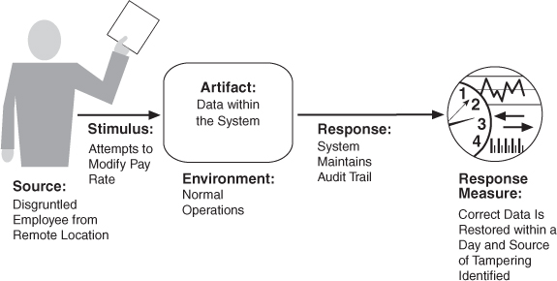
Concrete scenario

Slide 13
Goal of Security Tactics
One method for thinking about system security is to think about physical security.
Secure installations have limited access to them (e.g., by using security checkpoints), have means of detecting intruders (e.g., by requiring legitimate visitors to wear badges), have deterrence mechanisms such as armed guards, have reaction mechanisms such as automatic locking of doors and have recovery mechanisms such as off-site back up.
This leads to our four categories of tactics: detect, resist, react, and recover.

Slide 14
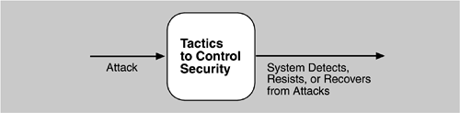
Goal of Security Tactics

Slide 15
Question
How do we design for security?

Slide 16
Security Tactics

Slide 17
Detect Attacks
Detect Intrusion: compare network traffic or service request patterns within a system to a set of signatures or known patterns of malicious behavior stored in a database.
Detect Service Denial: comparison of the pattern or signature of network traffic coming into a system to historic profiles of known Denial of Service (DoS) attacks.
Verify Message Integrity: use techniques such as checksums or hash values to verify the integrity of messages, resource files, deployment files, and configuration files.
Detect Message Delay: checking the time that it takes to deliver a message, it is possible to detect suspicious timing behavior.

Slide 18
Resist Attacks
Identify Actors: identify the source of any external input to the system.
Authenticate Actors: ensure that an actor (user or a remote computer) is actually who or what it purports to be.
Authorize Actors: ensuring that an authenticated actor has the rights to access and modify either data or services.
Limit Access: limiting access to resources such as memory, network connections, or access points.

Slide 19
Resist Attacks
Limit Exposure: minimize the attack surface of a system by having the fewest possible number of access points.
Encrypt Data: apply some form of encryption to data and to communication.
Separate Entities: can be done through physical separation on different servers attached to different networks, the use of virtual machines, or an “air gap”.
Change Default Settings: Force the user to change settings assigned by default.

Slide 20
React to Attacks
Revoke Access: limit access to sensitive resources, even for normally legitimate users and uses, if an attack is suspected.
Lock Computer: limit access to a resource if there are repeated failed attempts to access it.
Inform Actors: notify operators, other personnel, or cooperating systems when an attack is suspected or detected.

Slide 21
Recover From Attacks
In addition to the Availability tactics for recovery of failed resources there is Audit.
Audit: keep a record of user and system actions and their effects, to help trace the actions of, and to identify, an attacker.

Slide 22
Checklist
Allocation of responsibilities
Coordination model
Data model
Mapping among architectural elements
Management of resources
Binding time decisions
Choice of technology

Slide 23
Allocation of responsibilities
Who…? What…?
Authentication, grant, deny, etc.
Logs, records, undo
Encryption
Notifications
Recovery
Validation (checksums, hash-values, etc.)

Slide 24
Design Checklist for Security
Allocation of Responsibilities | Determine which system responsibilities need to be secure. For each of these responsibilities ensure that additional responsibilities have been allocated to: identify the actor authenticate the actor authorize actors grant or deny access to data or services record attempts to access or modify data or services encrypt data recognize reduced availability for resources or services and inform appropriate personnel and restrict access recover from an attack verify checksums and hash values

Slide 25
Coordination model
Secure connections / transmissions – encrypted
Recognize abnormal behavior (high network demand, etc.)
Limit / restrict / deny for connections

Slide 26
Design Checklist for Security
Coordination Model | Determine mechanisms required to communicate and coordinate with other systems or individuals. For these communications, ensure that mechanisms for authenticating and authorizing the actor or system, and encrypting data for transmission across the connection are in place. Ensure also that mechanisms exist for monitoring and recognizing unexpectedly high demands for resources or services as well as mechanisms for restricting or terminating the connection.

Slide 27
Data model
How sensitive is the data?
Is sensitive data separated from non-sensitive?
Different access right?
Is access logged?
Is data encrypted?
Can data be restored?

Slide 28
Design Checklist for Security
Data Model | Determine the sensitivity of different data fields. For each data abstraction Ensure that data of different sensitivity is separated. Ensure that data of different sensitivity has different access rights and that access rights are checked prior to access. Ensure that access to sensitive data is logged and that the log file is suitably protected. Ensure that data is suitably encrypted and that keys are separated from the encrypted data. Ensure that data can be restored if it is inappropriately modified.

Slide 29
Mapping among architectural elements
Alternative mappings based on:
Access rights
System under attack
Suspected behavior
Etc.
Alternative mappings to safeguard sensitive information…
Read / Write / Modify, etc.

Slide 30
Design Checklist for Security
Mapping Among Architectural Elements | Determine how alternative mappings of architectural elements may change how an individual or system may read, write, or modify data, access system services or resources, or reduce their availability. Determine how alternative mappings may affect the recording of access to data, services or resources and the recognition of high demands for resources. For each such mapping, ensure that there are responsibilities to identify an actor authenticate an actor authorize actors grant or deny access to data or services record attempts to access or modify data or services encrypt data recognize reduced availability for resources or services, inform appropriate personnel, and restrict access recover from an attack

Slide 31
Resource management
Which are the critical resources?
These are the likely candidates to be attacked
How do we safeguard these?
How do we limit access if attacked?
How do we provide continuous service (availability)?

Slide 32
Design Checklist for Security
Resource Management | Determine the system resources required to identify and monitor a system or an individual who is internal or external, authorized or not authorized, with access to specific resources or all resources. Determine the resources required to authenticate the actor, grant or deny access to data or resources, notify appropriate entities, record attempts to access data or resources, encrypt data, recognize high demand for resources, inform users or systems, and restrict access. For these resources consider whether an external entity can access or exhaust a critical resource; how to monitor the resource; how to manage resource utilization; how to log resource utilization and ensure that there are sufficient resources to perform necessary security operations. Ensure that a contaminated element can be prevented from contaminating other elements. Ensure that shared resources are not used for passing sensitive data from an actor with access rights to that data to an actor without access rights.

Slide 33
Binding time
Can late binding result in loss of security?
Is the late-bound resource trusted?
How to prevent man-in-the-middle or spoofing?

Slide 34
Design Checklist for Security
Binding Time | Determine cases where an instance of a late bound component may be untrusted. For such cases ensure that late bound components can be qualified, that is, if ownership certificates for late bound components are required, there are appropriate mechanisms to manage and validate them; that access to late bound data and services can be managed; that access by late bound components to data and services can be blocked; that mechanisms to record the access, modification, and attempts to access data or services by late bound components are in place; and that system data is encrypted where the keys are intentionally withheld for late bound components

Slide 35
Choice of technology
Does your choice of technology support the tactics that you decide to use?

Slide 36
Design Checklist for Security
Choice of Technology | Determine what technologies are available to help user authentication, data access rights, resource protection, data encryption. Ensure that your chosen technologies support the tactics relevant for your security needs.

Slide 37
Summary
Attacks against a system can be characterized as attacks against the confidentiality, integrity, or availability of a system or its data.
This leads to many of the tactics used to achieve security. Identifying, authenticating, and authorizing actors are tactics intended to determine which users or systems are entitled to what kind of access to a system.
No security tactic is foolproof and systems will be compromised. Hence, tactics exist to detect an attack, limit the spread of any attack, and to react and recover from an attack.

Slide 38
Testability
Qualitative attribute

Slide 39
Chapter Outline
What is Testability?
Testability General Scenario
Tactics for Testability
A Design Checklist for Testability
Summary

Slide 40
What is Testability?
Software testability refers to the ease with which software can be made to demonstrate its faults through (typically execution-based) testing.

Slide 41
What is Testability?
For a system to be properly testable, it must be possible to control each component’s inputs (and possibly manipulate its internal state) and then to observe its outputs (and possibly its internal state).

Slide 42
Exercise
What is the difference between software testing and testability?
What tactics can we use to make something testable? (not talking about specific tests, but rather how to make it possible or simplifying it)
How do we measure if something is testable? (response measure / metrics)

Slide 43
Testability General Scenario
Portion of Scenario | Possible Values
Source | Unit testers, integration testers, system testers, acceptance testers, end users, either running tests manually or using automated testing tools
Stimulus | A set of tests are executed due to the completion of a coding increment such as a class, layer or service; the completed integration of a subsystem; the complete implementation of the system; or the delivery of the system to the customer.
Environment | Design time, development time, compile time, integration time, deployment time, run time
Response | One or more of the following: execute test suite and capture results; capture activity that resulted in the fault; control and monitor the state of the system
Response Measure | One or more of the following: effort to find a fault or class of faults, effort to achieve a given percentage of state space coverage; probability of fault being revealed by the next test; time to perform tests; effort to detect faults; length of longest dependency chain in test; length of time to prepare test environment; reduction in risk exposure (size(loss) * prob(loss))

Slide 44
Sample Concrete Testability Scenario
The unit tester completes a code unit during development and performs a test sequence whose results are captured and that gives 85% path coverage within 3 hours of testing.

Slide 45
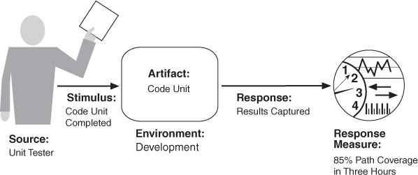
Concrete scenario

Slide 46
Goal of Testability Tactics
The goal of tactics for testability is to allow for easier testing when an increment of software development has completed.
Anything the architect can do to reduce the high cost of testing will yield a significant benefit.
There are two categories of tactics for testability:
The first category deals with adding controllability and observability to the system.
The second deals with limiting complexity in the system’s design.

Slide 47
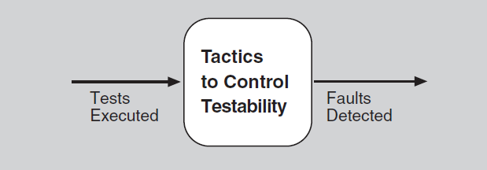
Goal of Testability Tactics

Slide 48
Question
How do we design for testability?

Slide 49
Testability Tactics
x=1;
assert (x>0);

Slide 50
Control and Observe System State
Specialized Interfaces: to control or capture variable values for a component either through a test harness or through normal execution.
Record/Playback: capturing information crossing an interface and using it as input for further testing.
Localize State Storage: To start a system, subsystem, or module in an arbitrary state for a test, it is most convenient if that state is stored in a single place.

Slide 51
Control and Observe System State
Abstract Data Sources: Abstracting the interfaces lets you substitute test data more easily.
Sandbox: isolate the system from the real world to enable experimentation that is unconstrained by the worry about having to undo the consequences of the experiment.
Executable Assertions: assertions are (usually) hand coded and placed at desired locations to indicate when and where a program is in a faulty state.

Slide 52
Limit Complexity
Limit Structural Complexity: avoiding or resolving cyclic dependencies between components, isolating and encapsulating dependencies on the external environment, and reducing dependencies between components in general.
Limit Non-determinism / Limit behavioral complexity: finding all the sources of non-determinism, such as unconstrained parallelism, and weeding them out as far as possible.
Notes:
Non-determinism – same input may yield different results… bad for unit-testing

Slide 53
Checklist
Allocation of responsibilities
Coordination model
Data model
Mapping among architectural elements
Management of resources
Binding time decisions
Choice of technology

Slide 54
Allocation of responsibilities
Determine which responsibilities are critical
Execute test-suite and capture results
Log events leading up to a fault

Slide 55
Design Checklist for Testability
Allocation of Responsibilities | Determine which system responsibilities are most critical and hence need to be most thoroughly tested. Ensure that additional system responsibilities have been allocated to do the following: execute test suite and capture results (external test or self-test) capture (log) the activity that resulted in a fault or that resulted in unexpected (perhaps emergent) behavior that was not necessarily a fault control and observe relevant system state for testing Make sure the allocation of functionality provides high cohesion, low coupling, strong separation of concerns, and low structural complexity.

Slide 56
Coordination model
Support injection of a state into communications for use in testing
Don’t introduce unnecessary dependencies
Don’t introduce needless runtime choices (non-determinism)

Slide 57
Design Checklist for Testability
Coordination Model | Ensure the system’s coordination and communication mechanisms: support the execution of a test suite and capture of the results within a system or between systems support capturing activity that resulted in a fault within a system or between systems support injection and monitoring of state into the communication channels for use in testing, within a system or between systems do not introduce needless non-determinism or unnecessary dependencies
Notes:
Non-determinism: Unlike an if-then statement, the method of choice between these alternatives is not directly specified by the programmer; the program must decide at run time between the alternatives, via some general method applied to all choice points.

Slide 58
Data model
Make sure you can capture values of important data instances
Useful for automated testing (unit-tests)
Make sure a state can be injected to test the values of important data instances

Slide 59
Design Checklist for Testability
Data Model | Determine the major data abstractions that must be tested to ensure the correct operation of the system. Ensure that it is possible to capture the values of instances of these data abstractions. Ensure that the values of instances of these data abstractions can be set when state is injected into the system, so that system state leading to a fault may be re-created. Ensure that the creation, initialization, persistence, manipulation, translation, and destruction of instances of these data abstractions can be exercised and captured

Slide 60
Mapping among architectural elements
Design the architecture with ways to test
Mappings
Elements
Threads
Processes
etc.

Slide 61
Design Checklist for Testability
Mapping Among Architectural Elements | Determine how to test the possible mappings of architectural elements (especially mappings of processes to processors, threads to processes, modules to components) so that the desired test response is achieved and potential race conditions identified. In addition, determine whether it is possible to test for illegal mappings of architectural elements.

Slide 62
Resource management
Test resource limits
Log resource use for analysis in event of failure
Inject new resource limits for testing
Simulate resources for testing

Slide 63
Design Checklist for Testability
Resource Management | Ensure there are sufficient resources available to execute a test suite and capture the results. Ensure that your test environment is representative of (or better yet, identical to) the environment in which the system will run. Ensure that the system provides the means to: test resource limits capture detailed resource usage for analysis in the event of a failure inject new resources limits into the system for the purposes of testing provide virtualized resources for testing

Slide 64
Binding time
Make sure late-bound components can be tested
Test all bindings

Slide 65
Design Checklist for Testability
Binding Time | Ensure that components that are bound later than compile time can be tested in the late bound context. Ensure that late bindings can be captured in the event of a failure, so that you can re-create the system’s state leading to the failure. Ensure that the full range of binding possibilities can be tested.

Slide 66
Choice of technology
Can the choice of technology help with
Regression testing
Fault injection
Record and playback
Etc.

Slide 67
Design Checklist for Testability
Choice of Technology | Determine what technologies are available to help achieve the testability scenarios that apply to your architecture. Are technologies available to help with regression testing, fault injection, recording and playback, and so on? Determine how testable the technologies are that you have chosen (or are considering choosing in the future) and ensure that your chosen technologies support the level of testing appropriate for your system. For example, if your chosen technologies do not make it possible to inject state, it may be difficult to re-create fault scenarios.

Slide 68
Summary
Ensuring that a system is easily testable has payoffs both in terms of the cost of testing and the reliability of the system.
Controlling and observing the system state are a major class of testability tactics.
Complex systems are difficult to test because of the large state space in which their computations take place, and because of the larger number of interconnections among the elements of the system. Consequently, keeping the system simple is another class of tactics that supports testability.

