Slide 1
D7032E Software Engineering
Software Lifecycle
Josef Hallberg

Slide 2
Workshop 3
.~))>>
.~)>>
.~))))>>>
.~))>> ___
.~))>>)))>> .-~))>>
.~)))))>> .-~))>>)>
.~)))>>))))>> .-~)>>)>
) .~))>>))))>> .-~)))))>>)>
( )@@*) //)>)))))) .-~))))>>)>
).@(@@ //))>>))) .-~))>>)))))>>)>
(( @.@). //))))) .-~)>>)))))>>)>
)) )@@*.@@ ) //)>))) //))))))>>))))>>)>
(( ((@@@.@@ |/))))) //)))))>>)))>>)>
)) @@*. )@@ ) (\_(\-\b |))>)) //)))>>)))))))>>)>
(( @@@(.@(@ . _/`-` ~|b |>))) //)>>)))))))>>)>
)* @@@ )@* (@) (@) /\b|))) //))))))>>))))>>
(( @. )@( @ . _/ / / \b)) //))>>)))))>>>_._
)@@ (@@*)@@. (6///6)- / ^ \b)//))))))>>)))>> ~~-.
( @jgs@@. @@@.*@_ VvvvvV// ^ \b/)>>))))>> _. `bb
((@@ @@@*.(@@ . - | o |' \ ( ^ \b)))>> .' b`,
((@@).*@@ )@ ) \^^^/ (( ^ ~)_ \ / b `,
(@@. (@@ ). `-' ((( ^ `\ \ \ \ \| b `.
(*.@* / (((( \| | | \ . b `.
/ / ((((( \ \ / _.-~\ Y, b ;
/ / / (((((( \ \.-~ _.`" _.-~`, b ;
/ / `(((((() ) (((((~ `, b ;
_/ _/ `"""/ /' ; b ;
_.-~_.-~ / /' _.'~bb _.'
((((~~ / /' _.'~bb.--~
(((( __.-~bb.-~
.' b .~~
:bb ,'
~~~~
Refactor the code

Slide 3
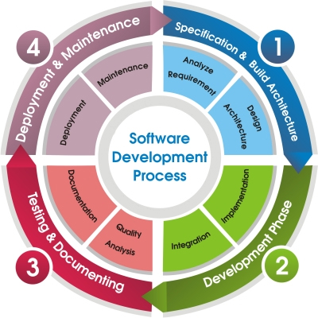
Software Development Process
Documenting Architecture
Implementing
Coding Standards and Documentation
(Testing) and Debugging
Deployment and Mobility
Maintenance
Configuration management
Notes:
https://www.youtube.com/watch?v=BKorP55Aqvg

Slide 4
The Mapping Problem
Architecture-based development provides a unique twist on the classic problem
It becomes, in large measure, a mapping activity
Maintaining mapping means ensuring that our architectural intent is reflected in our constructed systems
Design Decisions
Implementation Artifacts

Slide 5
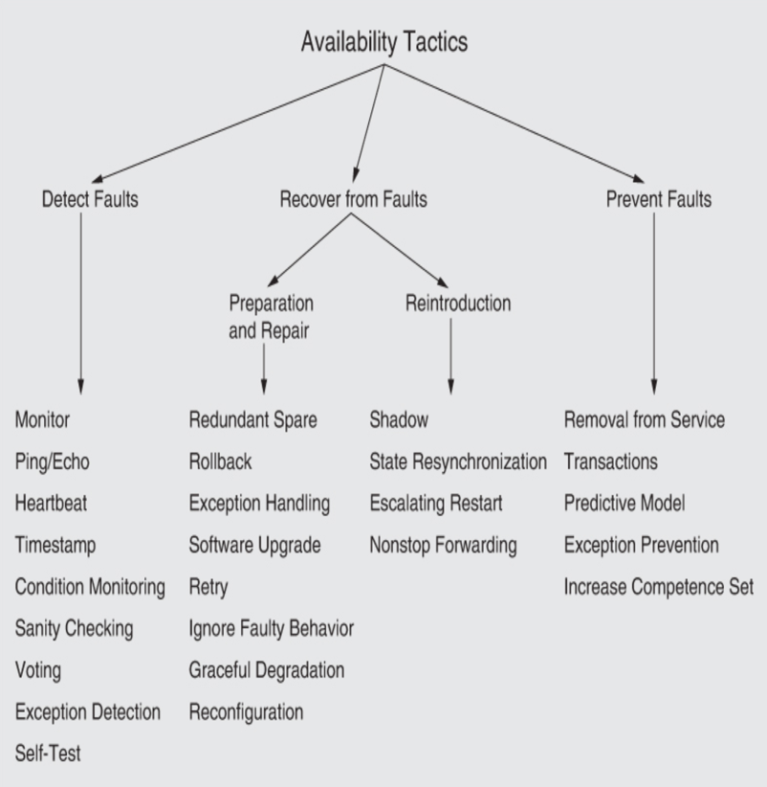
Reflections from workshop 2
Quality attributes as concepts are easy
But difficult to implement in reality
Availability
Who need the system to be available? Why?
What are the critical functionalities that must work?
What response is expected if the system is down?
Source: Len Bass, Paul Clements, Rich Kazman, ”Software Architecture in Practice (4th ed.), 2021, Addison-Wesley Professional, ISBN-13:978-0136886099

Slide 6
To consider for the exam
… and to prepare for the oral exam

Slide 7
Modifiability
Modifiability Tactics
What might change?
What design-choice best supports such change?
Appropriate balance
Overdoing it might hurt the design
Other quality attributes
What is an appropriate balance?
Increase Cohesion
Split Module
Rediistribute Responsibilities
Reduce Coupling
Encapsulate
Use an Intermediary
Abstract Common Services
Restrict Dependencies
Defer Binding
Component Replacement
Couple-Time Parametrization
Aspects
Configuration-Time Binding
Resource Files
Discovery
Interpret Parameters
Shared Repositories
Polymorphism
Source: Len Bass, Paul Clements, Rich Kazman, ”Software Architecture in Practice (4th ed.), 2021, Addison-Wesley Professional, ISBN-13:978-0136886099

Slide 8
Testability
Testability Tactics
What is extra important to test?
Functional (User) requirements
(Non-functional requirements)
Bugs from previous iterations
Known problems
Is it worth developing a test harness?
Dependent on
the size of the project
the longevity of the project
the number of developers
etc.
Complexity
Balance complexity of supporting testability with other quality attributes
Control and Observe System State
Specialized Interfaces
Record/Playback
Localize State Storage
Abstract Data Sources
Sandbox
Executable Assertions
Limit Complexity
Limit Structural Complexity
Limit Nondeterminism
Source: Len Bass, Paul Clements, Rich Kazman, ”Software Architecture in Practice (4th ed.), 2021, Addison-Wesley Professional, ISBN-13:978-0136886099

Slide 9
Extensibility
Extension strategy: How are extensions packaged and integrated?
Testing strategy: How are extensions tested, both individually and in combinations?
Lifecycle management: When are extensions included in a system, and when are they invoked/bound/activated?
Deployment strategy: How are extensions checked, approved, signed, and potentially incorporated?
Dependency management: Is there support for extension orchestration, including ordering, composition, compatibility checking, and management of shared resources?

Slide 10
Extensibility
Extensibility builds upon
Modifiability
Integrability
Testability
More information available in Canvas
Canvas→Files→Slides from 2023→Extensibility.pdf
Source: Rich Kazman, Sebastián Acheverria, James Ivers, ”Extensibility”, 2022, URL: https://insights.sei.cmu.edu/documents/1297/2022_005_001_876979.pdf

Slide 11
Extensibility
Extensibility Tactics
What might be added?
Can it be added without changing the existing design?
Design patterns
Those that support late binding
Layered structures
Modularity, etc.
Complexity
Balance complexity of supporting extensibility with other quality attributes
Manage Dependencies
Encapsulate
Use an Intermediary
Restrict Communication Paths
Abstract Common Services
Defer Binding
Discover Service (static)
Discover Service (dynamic)
Manage System State
Specialized Interfaces
Record/Playback
Localize State Storage
Manage Deployments
Orchestrate
Manage Resources
Segment Deployments
Source: Rich Kazman, Sebastián Acheverria, James Ivers, ”Extensibility”, 2022, URL: https://insights.sei.cmu.edu/documents/1297/2022_005_001_876979.pdf

Slide 12
So what are all the UML diagrams for?

Slide 13
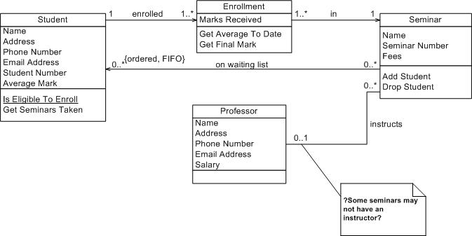
How do you implement a class diagram?
Notes:
Straight forward, but doesn’t say anything about persistent storage for example… So, not complete…

Slide 14
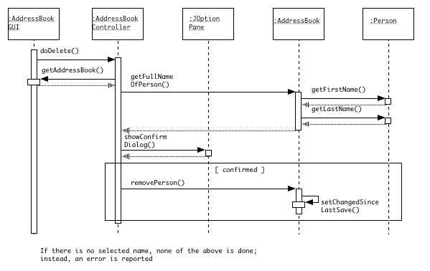
How do you implement a sequence diagram?
Notes:
Gives hints about relations and behavior, as well as communication, function calls, and API

Slide 15
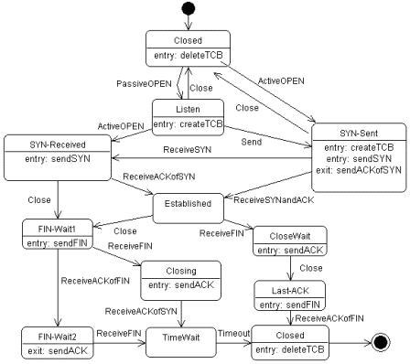
How do you implement a statechart?
Notes:
Doesn’t really help with the implementation… Better for documenting an implementation

Slide 16
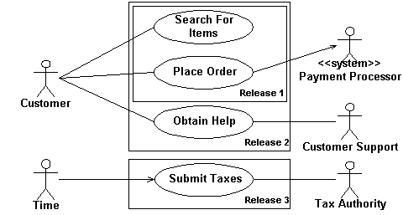
How do you implement a use-case diagram?
Notes:
Doesn’t help with the implementation, but described what functionality should be included in the product. Same goes for Activity diagrams etc.

Slide 17
Coding Standards and documentation

Slide 18
Names 1
Use concatenated words
e.g., cylinderLength (has a camelHump L)
Vs. cylinder_length ?
Begin class names with capitals
Variable names begin lower case
Constants with capitals
as in MAX_NAME_LENGTH
use static final
-- but consider method instead
Adapted from Software Engineering: An Object-Oriented Perspective by Eric J. Braude (Wiley 2001), with permission.

Slide 19
Names 2
Data members of classes with an underscore
as in _timeOfDay
or equivalent to distinguish them from other variables
since they are global to their object
Use get…, set…., and is… for accessor method
as in getName(), setName(), isBox()
latter returns boolean
additional getters and setters of collections
e.g., insertIntoName(), removeFromName().
Adapted from Software Engineering: An Object-Oriented Perspective by Eric J. Braude (Wiley 2001), with permission.

Slide 20
Names, ctd.
Consider preceding with standard letters or combinations of letters
e.g., C….. for classes
as in CCustomer etc.
useful when the importance of knowing the types of names exceeds the awkwardness of strange-looking names.
or place these type descriptors at the end
And/or distinguish between instance variables, local variables and parameters
_length, length and aLength
Adapted from Software Engineering: An Object-Oriented Perspective by Eric J. Braude (Wiley 2001), with permission.

Slide 21
Use of variables
int i… as a global variable?
for(int i=0; i<array.length; i++){ //blockvar
for(int j=0; j<array2.length; j++) { //inner blockvar

Slide 22
Documenting Methods 1
what the method does
why it does so
what parameters it must be passed (use @param tag)
exceptions it throws (use @exception tag)
reason for choice of visibility
known bugs
Adapted from Software Engineering: An Object-Oriented Perspective by Eric J. Braude (Wiley 2001), with permission.

Slide 23
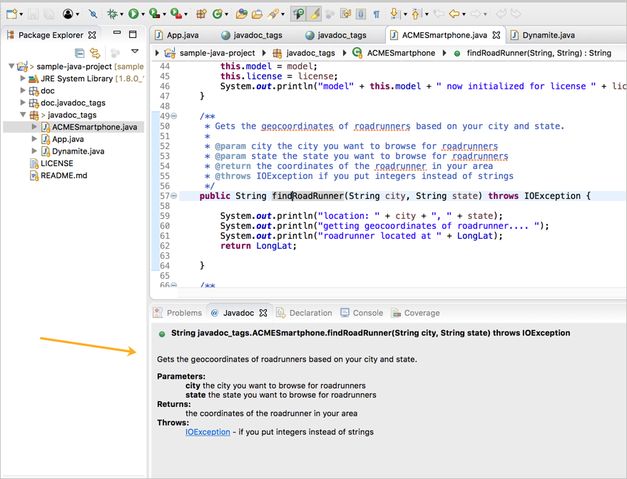

Slide 24
Documenting Methods 2
test description, describing whether the method has been tested, and the location of its test script
history of changes if you are not using a version management system
example of how the method works
pre- and post-conditions
special documentation on threaded and synchronized methods
Adapted from Software Engineering: An Object-Oriented Perspective by Eric J. Braude (Wiley 2001), with permission.

Slide 25
Things to link
A class can address a specific requirement
UserSleep : #1002, #1003
A function can link to requirements and tests
Version 1.3.2.1 test #132
FunctionalRequirement: #1004

Slide 26
Documenting Methods 3
May even be useful to refer to requirements specification

Slide 27
Attributes
Description -- what it's used for
All applicable invariants
quantitative facts about the attribute,
such as "1 < _age < 130"
or " 36 < _length * _width < 193".
See www.ambysoft.com

Slide 28
Initializing Attributes
Attributes should be always be initialized, think of
private float _balance = 0;
Attribute may be an object of another class, as in
private Customer _customer;
Traditionally done using the constructor, as in
private Customer _customer = new Customer( "Edward", "Jones" );
Adapted from Software Engineering: An Object-Oriented Perspective by Eric J. Braude (Wiley 2001), with permission.

Slide 29
One Solution to Object Initialization
Use initialization when the value is first accessed.
Supply MyClass with static getDefaultMyClass().
Attributes are declared without initialization, then assigned values when they are accessed.
In class Customer:
….
public static Customer getDefaultCustomer()
// … reasons these values are chosen for the default
{ return new Customer
( "John", "Doe", 0, 1000, -2000 );
}
Account
Customer
Notes:
Does not defer the knowledge of the best initialization parameters to the Account, but keeps the knowledge of best parameters inside of Customer.

Slide 30
(Testing) and Debugging

Slide 31
Debugging
Is an art
attempts to match symptom with cause
difference between expected and actual performance

Slide 32
Why is Debugging so Difficult?
The symptom and the cause may be geographically remote
The symptom may disappear (temporarily) when another error is corrected
The symptom may actually be caused by nonerrors (e.g., round-off accuracies)
The symptom may be caused by human error that is not easily traced
(continued on next slide)

Slide 33
Why is Debugging so Difficult? (continued)
The symptom may be a result of timing problems, rather than processing problems
It may be difficult to accurately reproduce input conditions, such as asynchronous real-time information
The symptom may be intermittent such as in embedded systems involving both hardware and software
The symptom may be due to causes that are distributed across a number of tasks running on different processes

Slide 34
Question
How do you debug software?
What are your favorite tools/methods?

Slide 35
Debugging Strategies
Debugging methods and tools are not a substitute for careful evaluation based on a complete design model and clear source code
There are three main debugging strategies
Brute force
Backtracking
Cause elimination

Slide 36
Strategy #1: Brute Force
Most commonly used (but not necessarily the best)
Used when all else fails
Involves the use of memory dumps, run-time traces, and output statements
Helped by debugging tools
Breakpoints
Step-by-step tracing
Variable values / condition checking
Watches

Slide 37
Strategy #2: Backtracking
Can be used successfully in small programs
The method starts at the location where a symptom has been uncovered
The source code is then traced backward (manually) until the location of the cause is found
In large programs, the number of potential backward paths may become unmanageably large

Slide 38
Strategy #3: Cause Elimination
Involves the use of induction or deduction
Induction (specific to general): Device a hypothesis, Prove the hypothesis
Deduction (general to specific): Enumerate the possible causes or hypotheses, Use the data to eliminate possible causes
Rubberducking
Force yourself to explain something, line-by-line, to a rubber duck…
Notes:
Induction: why did I get BSOD on my old computer? (turned out to be my PSU… who would have guessed?)
Deduction:

Slide 39
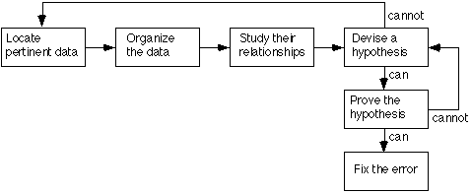

Debugging - Induction
Locate, Organize, Device a hypothesis, Prove the hypothesis
Notes:
When you organize the data you might find out a common relationship, such as: The error only occurs when the pilot is turning left…

Slide 40
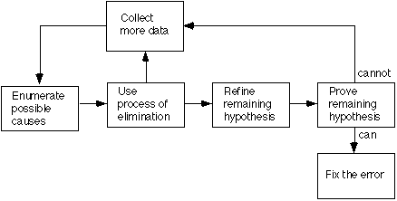
Debugging - Deduction
Enumerate the possible causes or hypotheses, Use the data to eliminate possible causes, Refine, Prove…
Notes:
Enumerate causes: example – did we send a pointer to that object, or did we make a copy? Which variable was actually updated, and which one do we have here?
Or, perhaps we have a block variable when we thought it was a class variable, etc.

Slide 41
Three Questions to ask Before Correcting the Error
Is the cause of the bug reproduced in another part of the program?
Similar errors may be occurring in other parts of the program
What next bug might be introduced by the fix that I’m about to make?
Assess the coupling of logic and data structures related to the fix
What could we have done to prevent this bug in the first place?
☺

Slide 42
Deployment
Release Management

Slide 43
Common Release Problems
Take too long – impacts revenue
Unpredictable – impacts dependent plans
Poor quality – impacts support
Not useful – impacts revenue
Contents unplanned – impacts integrity
Contents uncontrolled – impacts reliability
Overlooked distribution/installation – impacts support
Cowham, Robert. “Release Management – Making it Lean and Agile” CM Crossroads, Aug 16, 2004 http://www.cmcrossroads.com/ubbthreads/showflat.php?Cat=&Number=31243

Slide 44
The Challenge
Time to Market vs Features vs Quality
Only one top priority
Balance – don’t ignore the other two
Release criteria reflect priorities
Time to Market
Features
Quality

Slide 45
Types of Releases
Major = significant new features, product launch, planned, pull, annual
Minor = small new features, backwards compatible, planned, pull, semi-annual
Patch = collection of bug fixes, planned, pull, quarterly
Emergency = Urgent bug fix, harmful if not fixed, unplanned, push, as needed

Slide 46
Release Process
Define Content
Assign Version
Plan Release
Build
Package
Deploy
Test
Control Change
Assess Readiness
Release
Iterate

Slide 47
1. Define Content
Golden Build (software)
Documentation
Training materials
Marketing collateral
Internal documents
Customer Notification
Release Notes

Slide 48
1. Define Content: Must and Nice
Disp | ID | Severity | Pri | Description
Nice | 41928 | enhancement | P3 | Performance - Publish: loadSiteLite() to replace loadSite()
Nice | 59439 | trivial | P4 | Misalignment of Editable site and Proof site sections on Manage site screen once the actor checks Lock-site checkbox.
Nice | 59929 | minor | P5 | Error message:Get A Quote form:The listed items in error message may need some order; by logical or by alphabetic
Nice | 57954 | major | P2 | Only Ford Make is displayed in 'Quick Quote Form' : GM Design
Nice | 59368 | minor | P2 | Masthead descenders are being chopped off in Klamath_B_Dst design
Nice | 57019 | minor | P3 | Can't tell mouse over selection from current page selection in nav
Nice | 59726 | minor | P3 | Design Celandine: Titles (Header) for static pages are not bold as those for dynamic pages
Nice | 60108 | major | P3 | Misalignment of footer in Hours and directions page-Celandine designs
Must | 64793 | enhancement | P3 | create new Saab luxury design and homepage
Must | 64796 | enhancement | P3 | create new Land Rover luxury design and homepage

Slide 49
2. Assign version
Version is a unique identifier for the product state as of a certain point in time. Not all versions are released. Versions are sequential.
Versioning Schemes relate to release types, product management, and configuration management:
Major.Minor.Patch.Fix, e.g. 1.0, 1.1, 1.1.2, 1.1.2.1
Major.Feature.Patch, e.g. 1.0, 1.1, 1.1.2
Major.Feature.Patch.Build, e.g. 1.0.0.301

Slide 50
3. Plan Release
Dependencies
Customer commitments
Revenue recognition
Resource availability: people, environments
Introducing too much change at once
Stabilizing between releases
Organizational capability

Slide 51
3. Plan Release: Milestones
Scope Freeze | 9/7 | COMPLETE
Functional Freeze | 9/17 | COMPLETE
Functional Test Complete | 9/30 | COMPLETE
Code Freeze | 10/1 | COMPLETE
Regression Test Complete | 10/13 | COMPLETE
Golden Build | 10/8 | COMPLETE
Performance Test Complete | 10/13 | COMPLETE
Mock Deployment | 10/12 | FAILED
Mock Deployment | 10/14 | COMPLETE
Deployment Plan Review | 10/15 | COMPLETE
Go/No-Go | 10/15 | COMPLETE – GO
Executive Approval | 10/15 | COMPLETE-APPROVED
RELEASE | 10/15 | COMPLETE

Slide 52
4. Build
Build (What) | Visibility (Who) | Frequency (When) | Purpose (Why)
Private System Build | Individual Developer | One or more times per change task | Provide feedback to the developer of the changes just implemented in the private workspace.
Integration Build | Whole Development Team | After each change task and/or one or more times per day (e.g. Nightly) | Integrates the latest changes in the repository and runs automated tests against the release providing feedback to the development team.
Release Build | Independent Test (QA or V&V) Team and Customers | At the end of each iteration/release | Packages release for distribution to the development team’s customer.
Appleton, Brad. “Agile Build Promotion: Navigating the Ocean of Promotion Notions”, CM Crossroads, September 2004. http://www.cmcrossroads.com/ubbthreads/showflat.php?Cat=&Number=32900

Slide 53
5. Package
Create the release package containing all release deliverables
File: tar, .zip, .exe, .msi
Medium: CD-ROM, Web, App-store, etc.
Bill of Materials lists what’s in the package
Final release package is “golden build”

Slide 54
6. Deploy
Deployment Plan
Install Team
Deployment Plan Review
Contact List

Slide 55
7. Test
Plan ahead for test environments
Execute Test Plan
Functional test: does it function as required?
Regression test: did old bugs reappear?
Performance test: does it perform within acceptable limits?
Reliability test: does it function consistently over time?
Stress test: does it function consistently under volume?

Slide 56
8. Control Change
Baseline scope, requirements, design
Accommodate controlled change
Allow change, it’s reality
Change requests
Change request decision (approve, reject, defer)
Change Control Board (CCB)
Cross-functional representation
Impact analysis
Business drivers

Slide 57
9. Assess Readiness
Release Criteria define “done”
Defined Deliverables
Features: Must Have vs Nice to Have
Quality: test results, metrics
Schedule: time-to-market criteria
Objective, quantifiable criteria preferred
Organizational Readiness
Support, Training, Marketing, Sales
Acceptable Risk

Slide 58
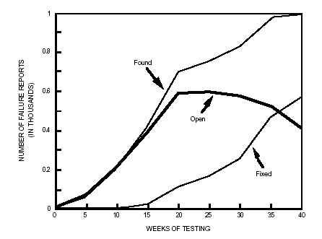
Assess Readiness: Metrics
Common metrics: fix rate, find rate, defect density, rate of change
Example: find rate vs fix rate
Stability reached at week 35 of testing, when defects fixed exceeds defects opened.

Slide 59
9. Assess Readiness: Go/No-Go
Release Readiness Assessment
Are all release criteria equal?
Can any criteria be waived?
Go/No-Go
Formal sign-off by stakeholders
Meeting, email vote
Recommendation by Release Manager
Executive Approval

Slide 60
10. Release
Formal release by Configuration Mgmt
Deploy to Production or Distribute to Customer

Slide 61
What’s in the release?
Getting your program ready for market
Help documents
Executable file
Icon library
License Agreement
Code Obfuscation
Trial Version
Install Wizard
Uninstall Program

Slide 62
Maintenance

Slide 63
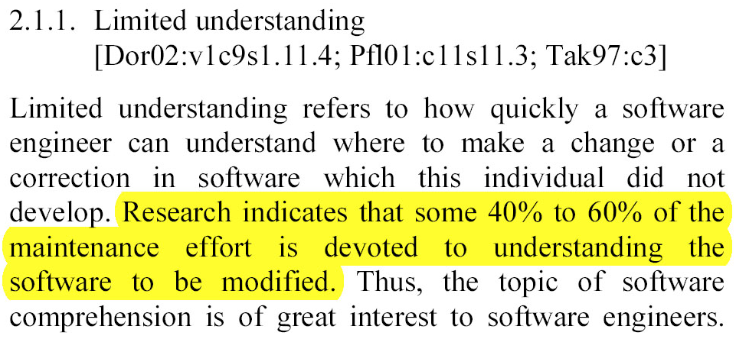
What maintainers do
Alain Abran and James W. Moore, Executive Editors. Guide to the Software Engineering Body of Knowledge - SWEBOK®. IEEE Computer Society, 2004. ISBN 0-7695-2330-7.

Slide 64
Types of Maintenance
Corrective Maintenance
Adaptive Maintenance
Perfective Maintenance
(Preventative Maintenance)

Slide 65
Corrective Maintenance
Focuses on fixing defects, ie, fault repair
It is a reactive process
i.e. defects generally need to be corrected either immediately or in the near future
Defects
refer to the system not performing as originally intended or as specified in the requirements
17% of maintenance is correcting faults

Slide 66
Adaptive Maintenance
It includes all changes to meet the evolving needs of the user and the environment
i.e. modifications to a system to cope with a changing environment, eg changed hardware, operating system
18% of maintenance is change to adapt to a new environment
It includes work to enhance a system’s functionality
i.e. relates to changing a system when requirements change due to organisational or business changes
The scale of this maintenance is often greater than for other types of maintenance
65% of maintenance is new requirements

Slide 67
Perfective Maintenance
It includes all efforts to improve the quality of the software
It includes restructuring code, creating and updating documentation, improving reliability or efficiency, improving performance
Maintenance work in the above categories is often performed concurrently

Slide 68
What maintenance is
Re-engineering
Refactoring
Bug-fixing
Adding features
Porting to new environments
Improving quality attributes
Etc.

Slide 69
Summary
Larger systems require more control
Without control we end up wasting time
We need to be able to track and control changes
Release management
What should be included in the release?
Maintenance
Less work if we did it right from the start
Documentation, versioning, architecture design, plan ahead, etc.

Slide 70
Configuration management
Software Management

Slide 71
Software Configuration Management (SCM)
Changes to requirements drive the design
Design changes affect the code

Slide 72
Motivation
What if a fully tested program doesn’t work?
What if a difficult bug that was fixed reappears?

Slide 73
Without control
Simultaneous updates
Shared code
Common code
Versions
Problems
Leads to wasting an enormous amount of time

Slide 74
Control the system
To answer the questions
What is my current software configuration?
What is its status?
How do I control changes to my configuration?
What changes have been made to the software?
Do anyone else’s changes affect my software?
What tests go together with this version?

Slide 75
Configuration Management Overview
Initial development
Requirements / Design / Use
Establish / Update Baseline
Approve change
Validate Baseline
Authorize change
Implement change
Validate change
Baseline
Changes

Slide 76
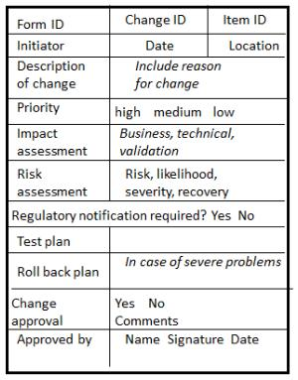
Change Request Form

Slide 77
Configuration Control
Only one official copy of the code
Baseline
Not the same as version management
Changes to the baseline must be approved

Slide 78
The version confusion
“The user-interface crashes when I press this button”
“But you told me you added this feature… I don’t see it”
“There is an interface mismatch between these components”

Slide 79
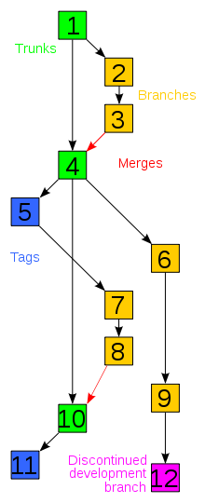
Versioning
Revisions
saved changes
Branches
the main projects is branched to enable simultaneous development
Merge
a point where branches are merged to form a new baseline
Trunk (subversion) = Master (Git)
The main branch of the project
Baseline = Labels = Tags
An approved version for all to work on
Notes:
Checkout, Commit, Conflict - Resolve, Delta compression (only retain the differences between successive versions of files), Repository where the current historical data is stored, working copy (local copy)

Slide 80
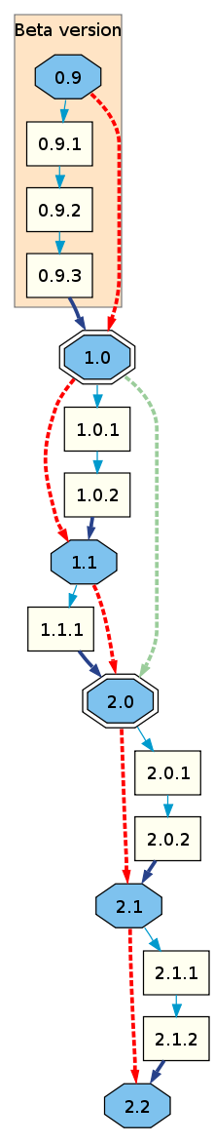
Versioning
In some cases:
Odd-numbered versions for development releases
Version 1.0 as a milestone
major.minor[.build[.revision]]
Or major.minor[.maintenance[.build]]

Slide 81
Tools
Versioning / Change management tools
CVS
Subversion
Git
Bug tracking
Bugzilla
Mantis
Redmine

Slide 82
Summary

Slide 83
Questions?

