Slide 1
Discussion 1
SOLID Principles and Booch’s metrics

Slide 2
SOLID Principles

Slide 3
Single Responsibility Principle
Application in Reality
Avoiding code smell by keeping classes and functions focused
Consequences
With: Easier maintenance, simpler unit testing
Without: Code changes reipple through unreleated functionalities, harder debugging

Slide 4
Open/Close Principle
Application in Reality
Using interfaces and abstract classes for expansion
Consequences
With: Code remains closed for modifcation but open for extension
Without: Frequent code changes, risk of breaking existing functionality

Slide 5
Liskov Substitution Principle
Application in Reality
Sbutypes must be replacable for their base types
Consequences
With: Polymorphic code is more reliable
Without: Unexpected behaviour when using derived classes

Slide 6
Interface Segregation Principle
Application in Reality
Splitting interfaces to ensure relevant methods for implementing classes
Consequences
With: More granular interfaces, less dummy implementation
Without: Classes forced to implement methods they don’t need

Slide 7
Dependency Inversion Principle
Application in Reality
High-level modules should not depend on low-level ones
Consequences
With: Easier code refactoring, better modularity
Without: Code becomes tightly coupled and less modular

Slide 8
Booch’s metrics

Slide 9
Coupling
Application in Reality
Keeping system componenets loosely connected
Consequences
With weak coupling: Enhanced modularity, simpler changes
With strong coupling: Difficult maintenance, ripple effects of changes

Slide 10
Cohesion
Application in Reality
Ensuring a class has a single, well-defined responsibility
Consequences
With high cohesion: improved maintainability and reliability
With low cohesion: difficult to understand and change the class

Slide 11
Sufficiency, Completeness, and Primitiveness
Application in Reality
Ensuring classes provide adequate functionality, cover required responsibilities, and are not over-specified
Consequences
With these metrics: Balanced design, neither under-specified or bloated
Without these metrics: Classes may lack necessary methods or become overly complex

Slide 12
Mini-workshop

Slide 13
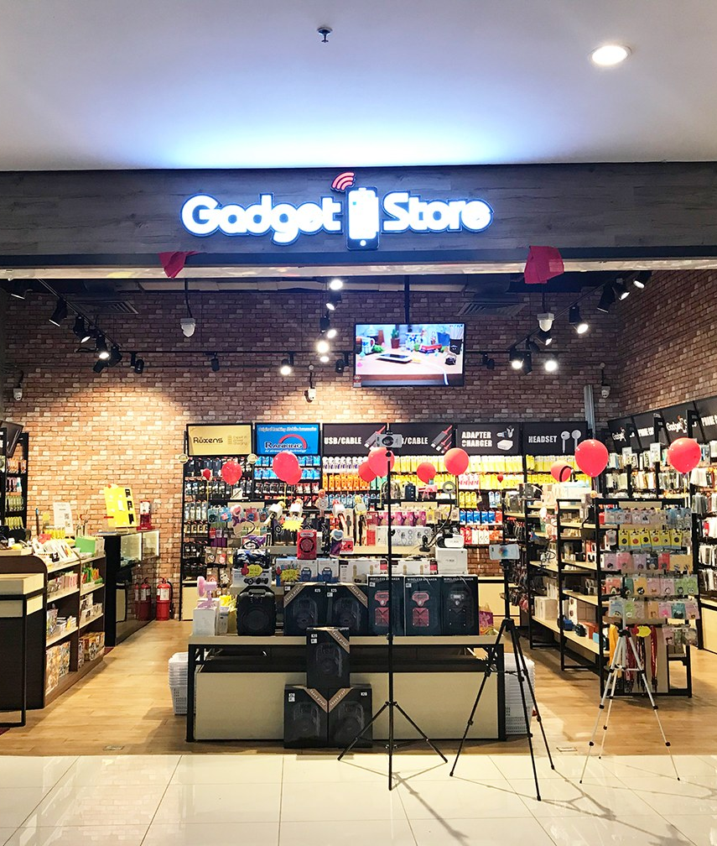
Online Gadget Store
Work in small groups (~ 3 people)
Step 1 (~20 minutes):
Analyse the provided code
Identify broken SOLID principles
Consider Booch’s metrics
Report your findings
Step 2 (15 minutes):
Propose a new design following best practices
(Pseudo code, UML diagrams, or mix)
Report on changes you did

Slide 14
Step 1 – Broken SOLID Principles
Single Responsibility Principle (SRP):
The User class is handling multiple responsibilities: registration, login, and user type management. It also has an embedded shopping cart for customers (using Composition rather than Aggregation).
The ShoppingCart class handles both the cart management (adding products) and the payment process, mixing these responsibilities.
Open-Closed Principle (OCP):
If we wanted to add another user type (e.g., Admin), we'd need to make significant changes in the User class and wherever user types are checked.
Similarly, adding a new payment method would require altering the ShoppingCart class.
Liskov Substitution Principle (LSP):
The User class cannot be easily extended to cater to specific behaviors of Owner or Customer without further complicating the code.
Interface Segregation Principle (ISP):
There are no interfaces, so all classes are tightly bound to specific implementations. For instance, separating login and registration functionality using interfaces would allow more flexibility.
Dependency Inversion Principle (DIP):
The ShoppingCart is directly dependent on a specific payment processing mechanism (credit card, PayPal) rather than an abstract payment process.

Slide 15
Step 1 – Poor Booch’s metrics in the code
Cohesion:
The User class is not very cohesive. It deals with registration, login, and contains shopping cart logic (via the embedded cart) which makes it multi-responsible.
ShoppingCart mixes cart management with payment processing, reducing its cohesion.
Coupling:
Concept: Strong coupling between user types and the main application logic. Checking user types (Customer, Owner) directly in the main method leads to tight coupling (risk for errors…)
The ShoppingCart has a direct dependency on specific payment methods, indicating strong coupling.
Primitiveness:
Some methods are not primitive. For instance, the checkout method in ShoppingCart performs both the calculation of the total amount and payment processing.
Sufficiency & Completeness:
The User class is neither sufficient nor complete. For example, a user's role determines functionalities, but this is not clearly reflected in the class design. It's unclear what methods are applicable for different user types.

Slide 16
Step 2 – Addressing SOLID Principles
Single Responsibility Principle (SRP):
Split the User class into separate Customer and Owner classes. Each class now has its own responsibility and does not have mixed duties.
Introduced PaymentProcessor to solely handle payment processing, separating it from the ShoppingCart.
Open-Closed Principle (OCP):
Created interfaces (Authenticatable, Registerable, PaymentProcessor). Using interfaces allows us to extend functionalities without altering existing behavior.
Liskov Substitution Principle (LSP):
Customer and Owner both extend the User class and implement the Authenticatable and Registerable interfaces. This ensures that both can replace the User type without unintended consequences.
Interface Segregation Principle (ISP):
Instead of a monolithic User interface, we broke it down to more specific interfaces like Authenticatable and Registerable. Thus, our classes implement only the interfaces they need.
Dependency Inversion Principle (DIP):
Introduced the PaymentProcessor interface and injected a concrete implementation (BasicPaymentProcessor) into the ShoppingCart. This way, ShoppingCart depends on the abstraction (interface) rather than the concrete class.

Slide 17
Step 2 – Designing with Booch’s metrics in mind
Cohesion:
User responsibilities were split among Customer and Owner, thus each class is more focused and cohesive.
Payment processing methods were segregated into PaymentProcessor.
Coupling:
Use of interfaces (Authenticatable, Registerable, PaymentProcessor) ensures loose coupling as the classes depend on abstractions and not on other concrete classes.
Primitiveness:
By splitting functionality into Customer and Owner, and by abstracting payment processes, we ensured that each class and method is primitive in nature, having a single, clear functionality.
Sufficiency:
The classes capture enough characteristics to function properly (well, for this Mockup). For instance, Customer has shopping cart related functionalities sufficient for its role.
Completeness:
The classes also capture all the meaningful characteristics for their roles (well, for this Mockup). The interfaces ensure that all essential methods are implemented.

