Slide 1
introduktion till Artificiell Intelligens
History – before Deep Learning

Slide 2
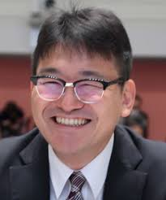
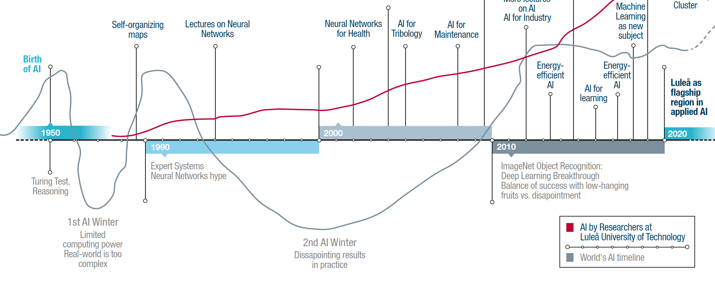
A rough timeline – two AI winters are over
Seiichi Uchida
Before Deep learning (BD) … After Deep (AD)

Slide 3
Timeline
Gestation of AI (1943-1955): NN computer in 1950, SNARC
Birth hour of AI (1956): Darthmouth
Early enthusiasm (1952-1969): LISP, SHRDLU
First AI winter (1966-1973): things took more time;
Knowledge-based systems (1969-1979): new hope, DENDRAL
Neural Networks (1986-1990s): back-propagation; industrial app
Second AI winter (1990-2010): not yet enough data, little progress
Big data and big networks (2001-present): slowly increasing

Slide 4
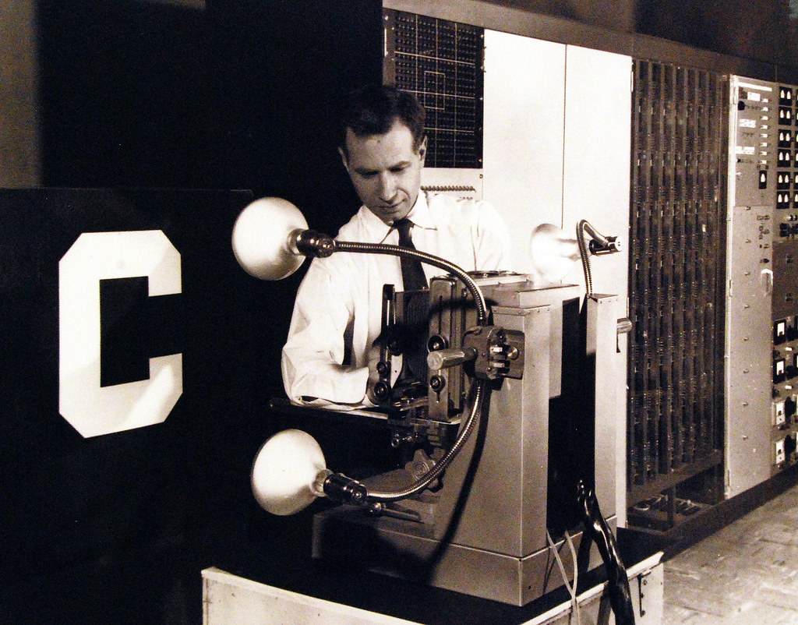

First Neural Computers
1951 – SNARC; Stochastic Neural Analog Reinforcement Calculator
Calculating simple math; but with self-learnable machines
Experiments similarly discussed as quantum computing now
Perceptron and other simple neural network
This photo shows the Mark I Perceptron, an experimental machine which can be trained to automatically identify objects or patterns, such as letters of the alphabet (1960).
https://www.flickr.com/photos/127906254@N06/20897323365

Slide 5
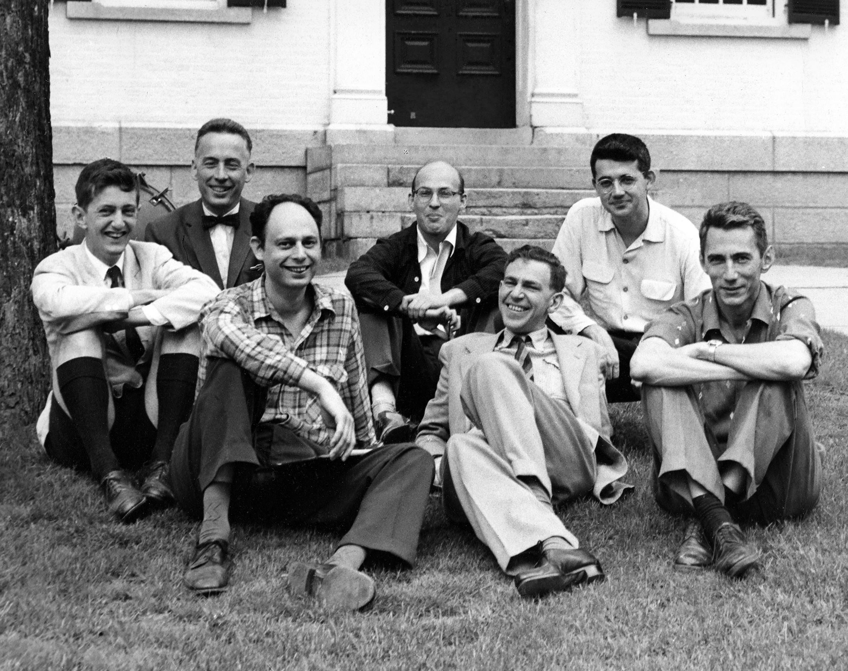
Birth hour of AI
Workshop in Dartmouth, 1956
McCarthy, Minsky, Shannon, Rochester, More, Samuel, Solomonoff, Selfridge, Newell and Simon
No real break-through, but VIP met and coined AI
AI as a separate research field
Concept of imitating human behavior
Uses methods of mathematics, computer science, control-theory and cybernetics
Tries to create machines that work autonomous in complex, changing environments
Photo: Margaret Minsky
https://medium.com/cantors-paradise/the-birthplace-of-ai-9ab7d4e5fb00
Notes:
Math: John McCarthy
Marvin Minsky
Math: Claude Shannon
Nathaniel Rochester
Herbert A. Simon - 1978 Nobel Memorial Prize in Economics for the work, and more broadly for “his pioneering research into the decision-making process within economic organizations”
Allen Newell: List programming introduced by him
Oliver Selfridge – early work on pattern recognition and neural networks
Julian Bigelow –worked together with John von Neumann to build one of the first computers
Ray Solomonoff, Trenchard More, Nat Rochester, W. Ross Ashby, W.S. McCulloch, Abraham Robinson, David Sayre, Arthur Samuel and Kenneth R. Shoulders.

Slide 6
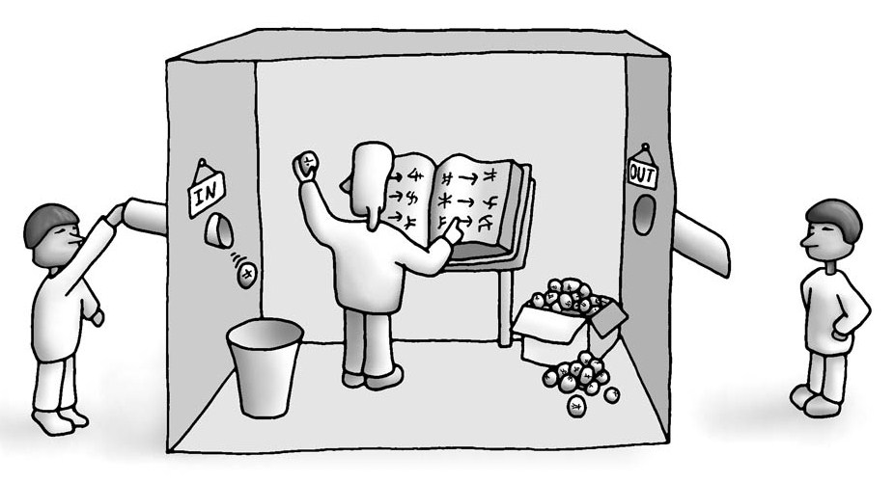
Chinese Room Experiment (Searle 1980)
Famous though experiment; besides the Turing test to understand AI
Imagine yourself in a room
You know no Chinese
You receive snippets with symbols
You have a book of rules
You throw out symbols according to rules
The people outside will think that you are perfect in Chinese
➔ Question behind: how can we observe and test AI?

Slide 7
Early simple logic programming
https://www.cleverbot.com/
State of the art
ELIZA – simple chatbot program
LISP (List Processor) as an early programming language
ELIZA: Please tell me what's been bothering you.
YOU: I have stress with my parents
ELIZA: Is it important to you that you have your parents ?
YOU: Of course! I love them
ELIZA: Can you elaborate on that ?
Where do you live?
In my house.
Where is your house?
I won't tell you.
Why?
Because you can be a killer.
Try it out (homework):
https://www.masswerk.at/elizabot/

Slide 8
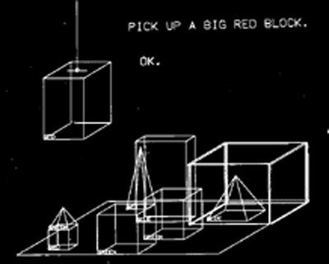

General Problem Solver
We will hear more about logic in 2 weeks
Newell and Simon
Tries to imitate human behavior in problem solving
Solves logical equations like:
Many similar systems followed
Program to move blocks on a table
SHRDLU written in lisp
Principle is to divide tasks into sub-tasks
We will see that next week again!
$$R∧(¬P⇒ \text{Q}) \text{to} (Q∨P)∧\text{R}$$
CC-BY-SA

Slide 9

Knowledge-based systems
Analysis of molecular structures
DENDRAL (Dendritic Algorithm)
Knowledge based system
Diagnosis of infections
MYCIN (name derived from antibiotics)
Knowledge based system with fuzzy logic
In 1991 diagnosis programs reached level of doctors
Lymph-node pathology, expert scoffs at the system's response
Program explained reasons / doc finally agreed and admits his error
1000
rules
LISP
Computer program
(facts & rules)
➔ New facts & answers

Slide 10
The two AI winters
Remember: Research & Applications always progressed
There was just general disappointment in slow speed
We will observe that again in the next decade
AI Winter is typically observable by less funding after enthusiasm
There were two major winters in 1974–1980 and 1987–1993[6]
1966: failure of machine translation
1970: abandonment of connectionism
1971–75: DARPA's frustration with Speech Understanding programs
1973: large decrease in AI research in the UK
1973–74: DARPA's cutbacks to academic AI research in general
1987: collapse of the LISP machine market
1988: cancellation of new spending on AI in US, Germany & others
1993: resistance to new expert systems deployment and maintenance
https://en.wikipedia.org/wiki/AI_winter

