Slide 1
Q/A Clustering
Homam Mokayed
Hamam.Mokayed@ltu.se

Slide 2
Let us discuss
What is clustering?

Slide 3

How many clusters?

Slide 4
Recap
K-mean

Slide 5
K-mean example
A1(2,10)
A2(2,5)
A3(8,4)
A4(5,8)
A5(7,5)
A6(6,4)
A7(1,2)
A8(4,9)

Slide 6
Let us discuss
How can the optimal value of K be chosen in Kmeans?

Slide 7
Recap
DBScan

Slide 8
DBscan example
A1(2,10)
A2(2,5)
A3(8,4)
A4(5,8)
A5(7,5)
A6(6,4)
A7(1,2)
A8(4,9)

Slide 9
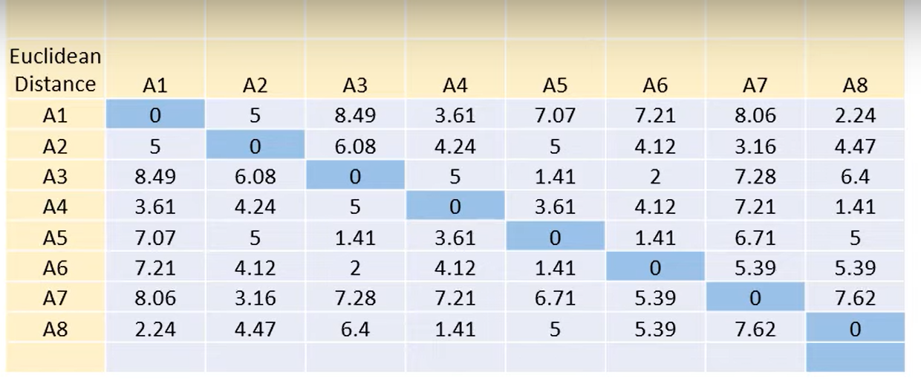
DBScan
Min point = 2
Epsilon = 2

Slide 10
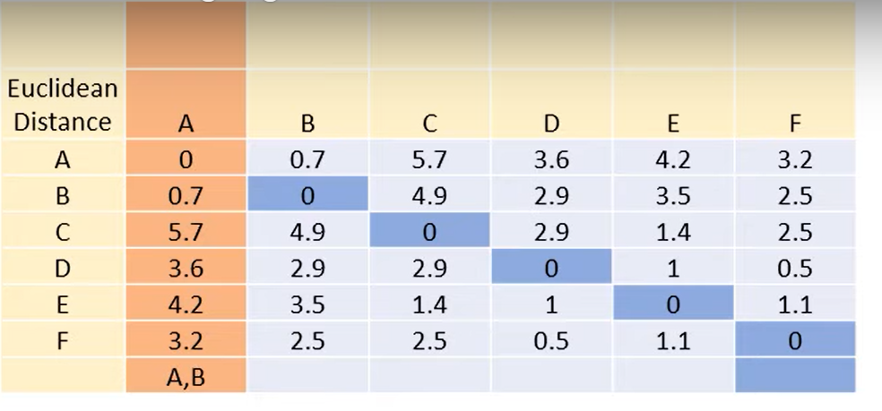
Apply DBScan?
Min point = 3
Epsilon = 2

Slide 11
Let us discuss
What are the effects of increasing/decreasing values of minPT and eps in DBScan
Notes:
Elbow Method

